Slide 1


Workshop 5
Introduction to Injection

Slide 2
Why?
Injection is a broad topic in information security
Consistently rated as one of the top web application security risks
(OWASP top 10)
A good topic to begin building intuition in information security

Slide 3
Today
Command Injection
SQL injection
Cross Site Scripting
A few other examples to get you thinking

Slide 4
Direct command injection

Slide 5
Command Injection
User input is passed as a parameter to a command executed on the host
Classic example: a ping service

Slide 6
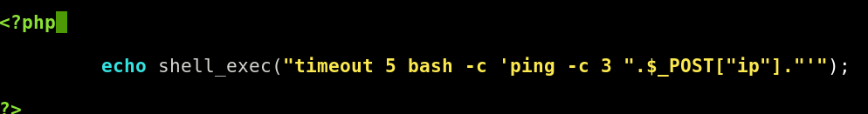

Slide 7
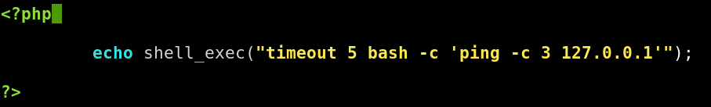

Slide 8
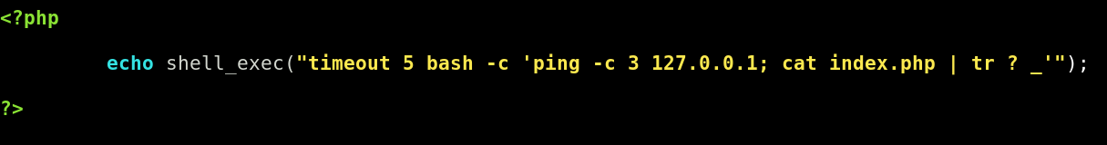

Slide 9
See: http://pentestmonkey.net/cheat-sheet/shells/reverse-shell-cheat-sheet

Slide 10
recap
Theme: certain characters allow users to break out of the framework that parses their input
This allows them to perform actions we didn’t intend
Here: arbitrary commands are run on the host
This idea pervades all forms of injection

Slide 11
SQL Injection
SQL: Broadly, a language used to query relational databases.
Example: user input is used to construct a query , which is then sent to a database

Slide 12
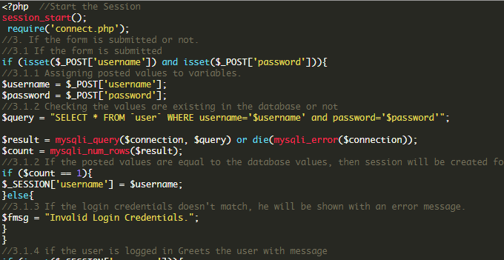

Slide 13
Login:admin’ or 1=1 -- -
Password: <anything>
SELECT * FROM user WHERE username = admin’ or 1=1 -- -
Returns: all rows of the username table

Slide 14
Login:admin’ --
Password: <anything>
SELECT * FROM user WHERE username = admin’
Returns: the admin row
Login

Slide 15
SQLi is an enormously deep topic
Some subtopics:
Enumeration techniques
Union injection (Dump arbitrary data from a database)
Blind injection techniques (when we aren’t returned output)

Slide 16
Others to look out for
Cross Site Scripting (will have a workshop on this)
Inject code displayed in the users browser
XXE (XML external entities)
If a server constructs and parses XML input, inject XML entity to read files and (sometimes, rarely) execute code
LDAP injection
LaTex Injection
If an app parses latex to construct PDFs for example, commands can be execute in the LaTex parser

Slide 17
Things to think about
I think I can execute code, but nothing is printed to screen, what do I do?
Interact with yourself!
Ping yourself – very reliable in secure environments since ICMP will rarely be filtered
Query yourself – command line tools such as wget can be used to send http requests; attach the output of your command to an http request and send the query to yourself
This generalises to other application layer protocols that send text queries, eg DNS

Slide 18
DNS example

