Slide 1
Cryptography & Encryption
University of Melbourne Information Security Club

Slide 2
Why we need cryptography
Confidentiality
CIA triad
Integrity
Availability

Slide 3
Cryptography
Plaintext
Encryption algorithm
Ciphertext
Decryption algorithm
Plaintext
https://www.youtube.com/watch?time_continue=4&v=Kf9KjCKmDcU

Slide 4
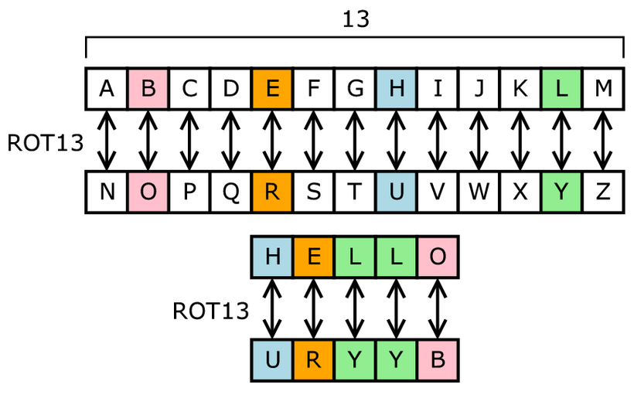
Ancient cryptography
Monoalphabetic Cipher uses fixed substitution over the entire message
E.g.
Credit : Matt Crypto

Slide 5
Ancient cryptography
Polyalphabetic Cipher uses a number of substitutions at different positions in the message

Slide 6
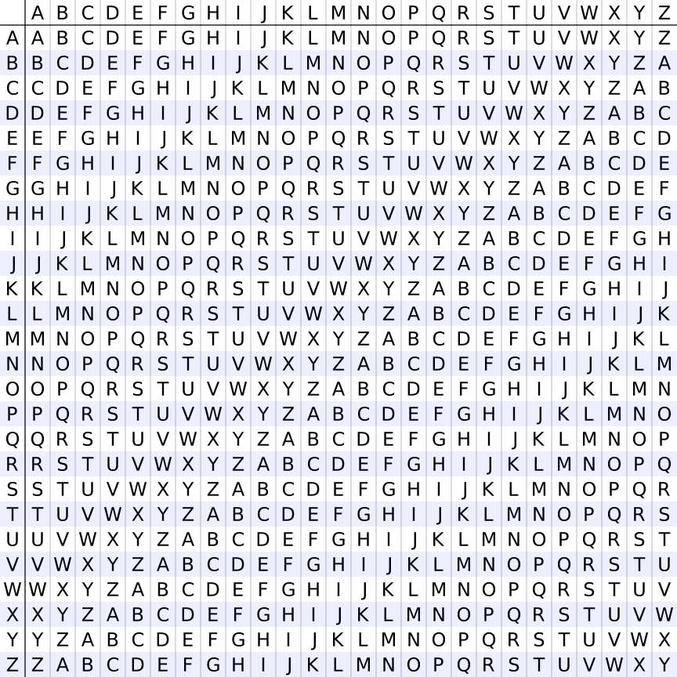
Vigenere cipher
E,g.
Plaintext：attackatdawn
Key ：lemonlemonle
Ciphertext: lxforpvefrnhr

Slide 7
Modern cryptography
Symmetric Cryptography
Asymmetric Cryptography
Hash Function
Digital Signature

Slide 8
Symmetric cryptography
Use the same cryptographic keys for both encryption of plaintext and decryption of ciphertext.
Block Cipher
Stream Cipher

Slide 9
Asymmetric Cryptography
Asymmetric Cryptography

Slide 10
Modern cryptography
Hash Function
Hash VS cryptography

Slide 11
Modern cryptography
Digital Signature

Slide 12
Task 1
Password Cracking using Hashcat

Slide 13
Task 2
krypton challenges
http://overthewire.org/wargames/krypton/

Slide 14
Resources
List of commands
Tools
Notes:
github

