Slide 1



CROSS-SITE SCRIPTING (XSS)
UoM Information security club

Slide 2
What is XSS?
Code Injection Attack
JavaScript is injected into an other user’s browser

Slide 3
JavaScript? Malicious?
JS has access to sensitive information such as cookies
JS can make arbitrary HTTP requests
JS can be used to make arbitrary modifications to the HTML of the current page

Slide 4


How JavaScript Is Injected?

Slide 5
Consequences of XSS:
Cookie theft
Keylogging
Phishing
access the victim's cookies
extract sensitive information like session IDs.
register a keyboard event listener
Recording sensitive information such as passwords and credit card numbers.
insert a fake login form
trick the user into submitting sensitive information.

Slide 6
Types of XSS
Persistent XSS : malicious string originates from the website's database.
Reflected XSS : malicious string originates from the victim's request.
DOM-based XSS : vulnerability exists in the client-side code rather than the server-side.

Slide 7
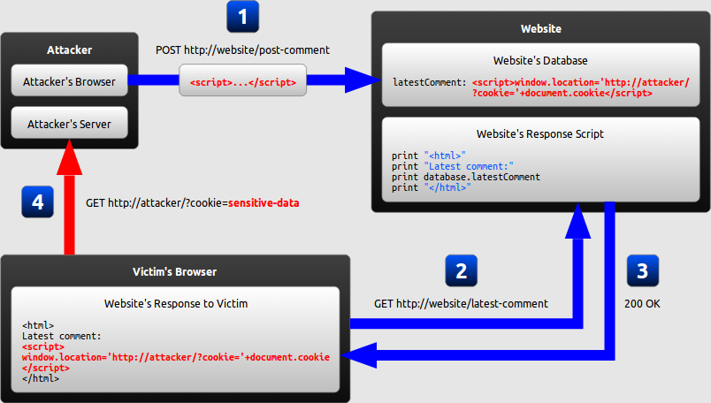
Example of Persistent XSS

Slide 8
Step-by-Step Analysis
The attacker uses one of the website's forms to insert a malicious string into the website's database.
The victim requests a page from the website.
The website includes the malicious string from the database in the response sent to the victim
The victim's browser executes the malicious script inside the response, sending the victim's cookies to the attacker's server.

Slide 9
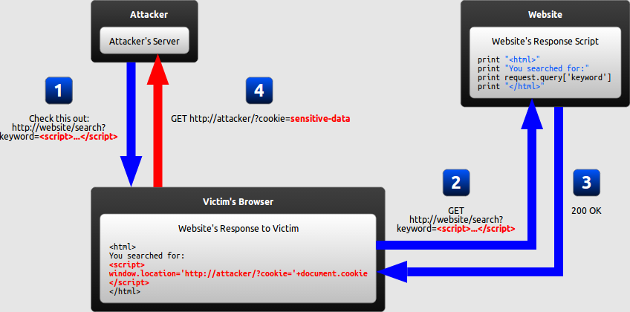
Closer Look at Reflected XSS Attacks

Slide 10
Step-by-Step Analysis
The attacker crafts a URL containing a malicious string and sends it to the victim.
The victim is tricked by the attacker into requesting the URL from the website.
The website includes the malicious string from the URL in the response.
The victim's browser executes the malicious script inside the response, sending the victim's cookies to the attacker's server.

Slide 11
DOM Based XSS (Invisible to the server)
Website receives request and responds
Victim’s browsers parses the response, causing the malicious script to be inserted into the page
Attacker initiates attack usually through social engineering
Browser executes the malicious script, sending the victim’s cookies to the attacker’s server

Slide 12
Preventing XSS
Encoding : escape user input so that the browser interprets it only as data, not as code.
Validation : filters user input so that the browser interprets the code without the malicious commands.

Slide 13
Time To Hack!
XSS Challenge: https://xss-game.appspot.com/
Helpful starting XSS & JavaScript starter guide: http://securityidiots.com/Web-Pentest/XSS/xss.series-by-securityidiots.html
Workshop slides and more resources: https://github.com/umisc/workshops/tree/master/XSS

