Slide 1
Aviation Safety
C.J. Argue, Jake Caldwell, Inkee Jung, Jinting Liu
Include pictures, positions seeking

Slide 2
Problem Definition
Motivation
Increasing air travel demands call for ongoing improvements in aviation safety
Data-driven insights can support lawmakers and airlines in shaping preventive policies and risk mitigation strategies
Key Questions
What are the most influential factors that lead to “severe” accident outcomes?
Can we predict whether a given accident will result in serious aircraft damage or casualties?
What trends can be observed in the number of accidents over time?

Slide 3
plot damage vs time(1.1.2000 – 2021.12.31)
Proportions in damage category over time
Illustrative images.

Slide 4
National Travel Safety Board (NTSB) investigation database
Dataset of investigations into airplane accidents, typically performed within 1-2 years of incident
Fact gathering includes flight logs, maintenance records
Includes information on on-flight injuries, their severity, and aircraft damage.

Slide 5
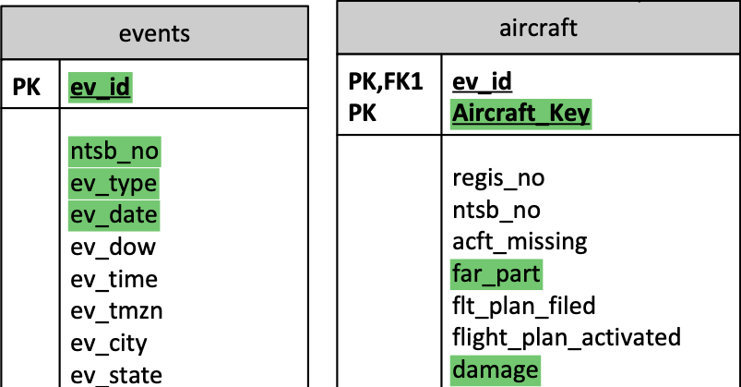
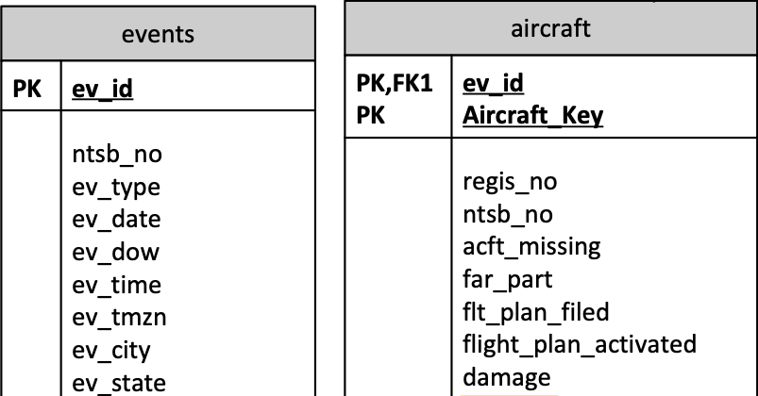
National Travel Safety Board (NTSB) investigation database
~30000 aviation investigations since 2008
~250 variables
.mdb file parsed using ‘mdb-tools’
Extracted data
Selected ~50 variables
Merged columns split across files

