Slide 1

Predicting Aviation Accident Severity
C.J. Argue, Jake Caldwell, Inkee Jung, Jinting Liu

Slide 2
Problem
Given that accident occurred, what features predict its severity?
Severity: Injuries, damage to aircraft
Universe: accidents in the USA
All aircraft types (planes, helicopters, gliders, etc.)
Stakeholders
Regulators, lawmakers, airlines

Slide 3
KPIs & Target Variables
KPI: Level of accident severity
Level of Aircraft Damage
Destroyed, substantial, minor, none
Proportion of injuries
Fatal, serious, minor, none
(Number of accidents in given month)

Slide 4
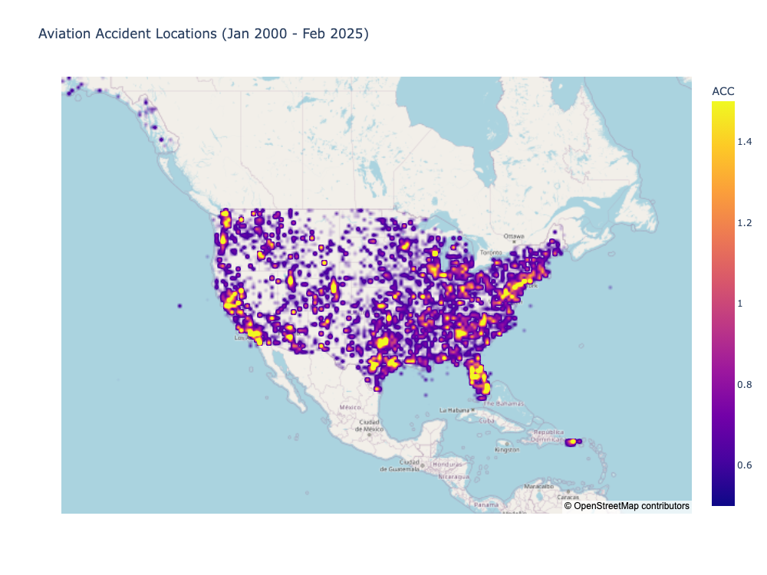

Slide 5
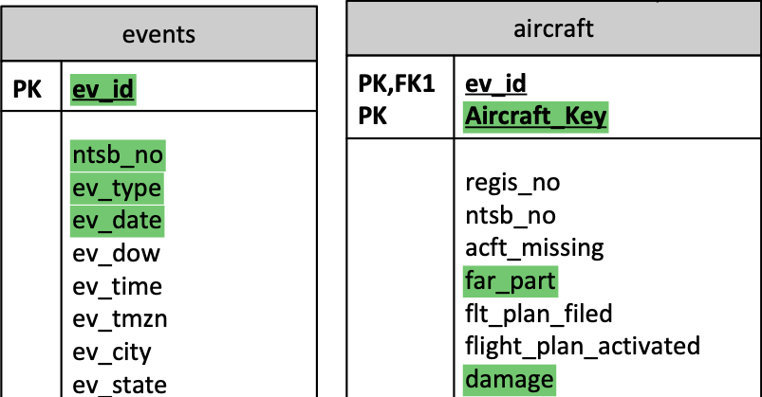
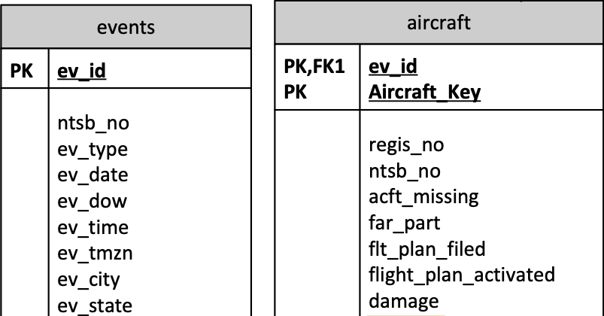
National Travel Safety Board (NTSB) investigation database
~30000 aviation investigations since 2008
~250 variables
.mdb file parsed using ‘pyodbc’
Extracted data
Selected ~50 variables
Merged columns split across files

Slide 6
Merged datasets to get aircraft-level data
Event-level
Aircraft-level
Sub-aircraft level
Light condition | Make | Fatalities
Light | Cessna | Crew: 0
 |  | Pass: 0
Dark | Boeing | Crew: 1
 |  | Pass: 4
Dark | Cessna | Crew: 2
 |  | Pass: 0
 | Piper | Crew: 0
 |  | Pass: 0
Light condition | Make | Fatalities
Light | Cessna | 0
Dark | Boeing | 5
Dark | Cessna | 2
Dark | Piper | 0
Propagated to aircraft
Aggregated by aircraft

Slide 7
Removed rows, reduced categories, and imputed to get complete data with manageable feature set
ev_type | country | phase | acft_make | num_eng | rwy_len
ACC | USA | Maneuvering | Bell | 1
ACC | USA | Takeoff | Cessna | 1 | 1717
ACC | USA | Initial Climb | Piper | 1
ACC | USA | Takeoff | RANS | 1
ACC | USA | Enroute
ACC | USA | Landing | Cessna | 1 | 6000
ACC | USA | Landing | Cessna | 1 | 2221
ACC | USA | Takeoff | CESSNA | 2 | 6505
ACC | USA | Enroute | PIPER | 1
ACC | USA | Approach | Cessna | 1 | 3499
ACC | USA | Approach | CESSNA | 1
ACC | USA | Approach | HARMS R. | 1
ACC | USA | Maneuvering | Van Heeswyk
INC | USA |  | AEROSPATIAL | 2
INC | USA
ACC | GE
ACC | PE
ev_type | country | phase | acft_make | num_eng | rwy_len
ACC | USA | Maneuvering | Bell | 1
ACC | USA | Takeoff | Cessna | 1 | 1717
ACC | USA | Initial Climb | Piper | 1
ACC | USA | Takeoff | RANS | 1
ACC | USA | Enroute
ACC | USA | Landing | Cessna | 1 | 6000
ACC | USA | Landing | Cessna | 1 | 2221
ACC | USA | Takeoff | CESSNA | 2 | 6505
ACC | USA | Enroute | PIPER | 1
ACC | USA | Approach | Cessna | 1 | 3499
ACC | USA | Approach | CESSNA | 1
ACC | USA | Approach | HARMS R. | 1
ACC | USA | Maneuvering | Van Heeswyk
INC | USA |  | AEROSPATIAL | 2
INC | USA
ACC | GE
ACC | PE
ev_type | country | phase | acft_make | num_eng
ACC | USA | Enroute | Bell | 1
ACC | USA | Takeoff | Cessna | 1
ACC | USA | Takeoff | Piper | 1
ACC | USA | Takeoff | RANS | 1
ACC | USA | Enroute
ACC | USA | Landing | Cessna | 1
ACC | USA | Landing | Cessna | 1
ACC | USA | Takeoff | CESSNA | 2
ACC | USA | Enroute | PIPER | 1
ACC | USA | Landing | Cessna | 1
ACC | USA | Landing | CESSNA | 1
ACC | USA | Landing | HARMS R. | 1
ACC | USA | Enroute | Van Heeswyk
ev_type | country | phase | acft_make | num_eng
ACC | USA | Maneuvering | Bell | 1
ACC | USA | Takeoff | Cessna | 1
ACC | USA | Initial Climb | Piper | 1
ACC | USA | Takeoff | RANS | 1
ACC | USA | Enroute
ACC | USA | Landing | Cessna | 1
ACC | USA | Landing | Cessna | 1
ACC | USA | Takeoff | CESSNA | 2
ACC | USA | Enroute | PIPER | 1
ACC | USA | Approach | Cessna | 1
ACC | USA | Approach | CESSNA | 1
ACC | USA | Approach | HARMS R. | 1
ACC | USA | Maneuvering | Van Heeswyk
ev_type | country | phase | acft_make | num_eng
ACC | USA | Enroute | bell | 1
ACC | USA | Takeoff | cessna | 1
ACC | USA | Takeoff | piper | 1
ACC | USA | Takeoff | other/unknown | 1
ACC | USA | Enroute | other/unknown
ACC | USA | Landing | cessna | 1
ACC | USA | Landing | cessna | 1
ACC | USA | Takeoff | cessna | 2
ACC | USA | Enroute | piper | 1
ACC | USA | Landing | cessna | 1
ACC | USA | Landing | cessna | 1
ACC | USA | Landing | other/unknown | 1
ACC | USA | Enroute | other/unknown
ev_type | country | phase | acft_make | num_eng | rwy_len
ACC | USA | Maneuvering | Bell | 1
ACC | USA | Takeoff | Cessna | 1 | 1717
ACC | USA | Initial Climb | Piper | 1
ACC | USA | Takeoff | RANS | 1
ACC | USA | Enroute
ACC | USA | Landing | Cessna | 1 | 6000
ACC | USA | Landing | Cessna | 1 | 2221
ACC | USA | Takeoff | CESSNA | 2 | 6505
ACC | USA | Enroute | PIPER | 1
ACC | USA | Approach | Cessna | 1 | 3499
ACC | USA | Approach | CESSNA | 1
ACC | USA | Approach | HARMS R. | 1
ACC | USA | Maneuvering | Van Heeswyk
INC | USA |  | AEROSPATIAL | 2
INC | USA
ACC | GE
ACC | PE
ev_type | country | phase | acft_make | num_eng
ACC | USA | Enroute | bell | 1
ACC | USA | Takeoff | cessna | 1
ACC | USA | Takeoff | piper | 1
ACC | USA | Takeoff | other/unknown | 1
ACC | USA | Enroute | other/unknown | 1
ACC | USA | Landing | cessna | 1
ACC | USA | Landing | cessna | 1
ACC | USA | Takeoff | cessna | 2
ACC | USA | Enroute | piper | 1
ACC | USA | Landing | cessna | 1
ACC | USA | Landing | cessna | 1
ACC | USA | Landing | other/unknown | 1
ACC | USA | Enroute | other/unknown | 2
Notes:
Created dummy variables for categories with frequency > 1%
Imputed missing numerical values
Dropped columns with > 20% missing values, only one frequent category

Slide 8
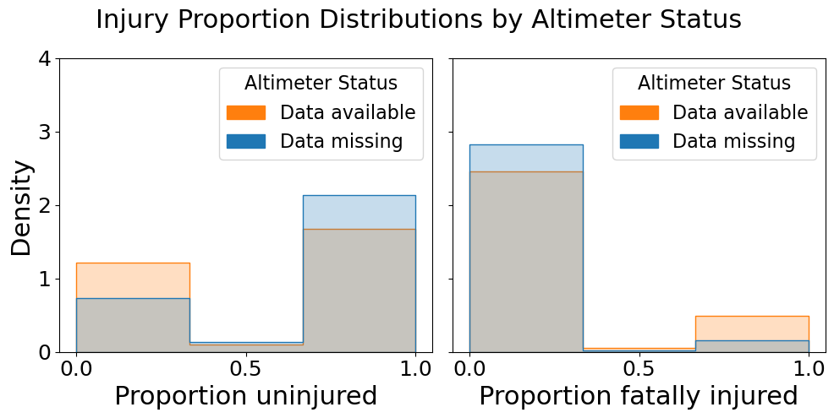
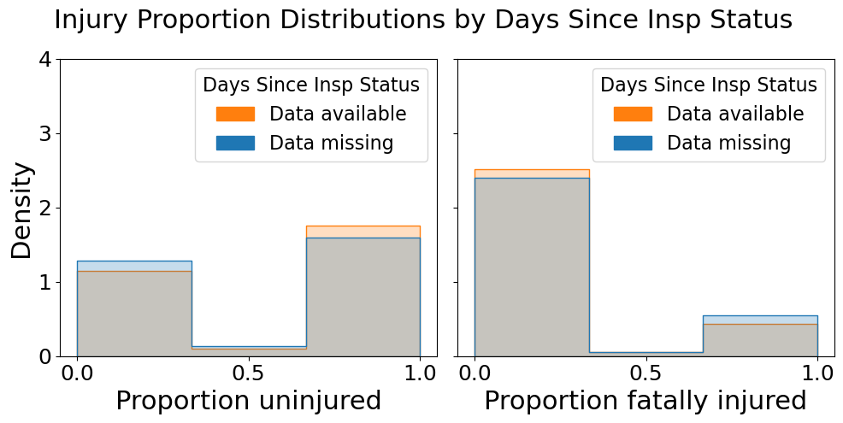
Analyzed missingness to avoid data leakage
Status strongly predictive of fatality
Drop feature
Status weakly predictive
Keep feature

Slide 9
Modeling approach
Series of Learners
Random Forest (Classifier/Regressor)
Extra Trees (Classifier/Regressor)
Histogram Gradient Boost (Classifier/Regressor)
XGBoost (Classifier/Regressor)
Bagging (Classifier/Regressor)
Hyperparameter tuning for each target
5-fold cross-validation

Slide 10
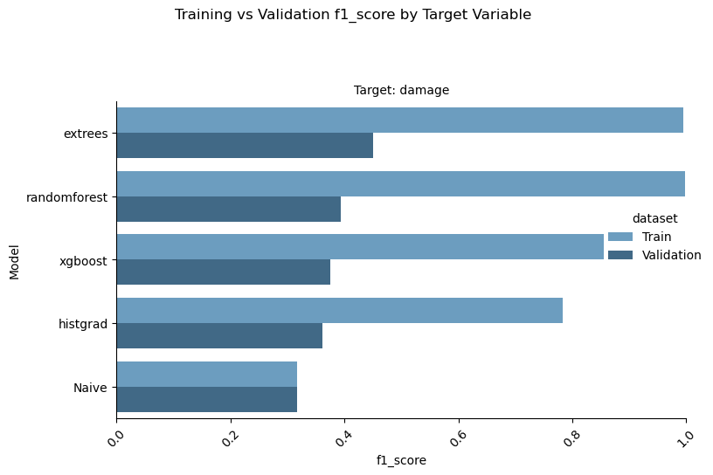
Classification Model Performances: Training and Validation Sets
For each, Extra Trees Classifier has highest validation F1(macro) score.
Slight edge over “Naïve” estimator
For all, every model overfits training data

Slide 11
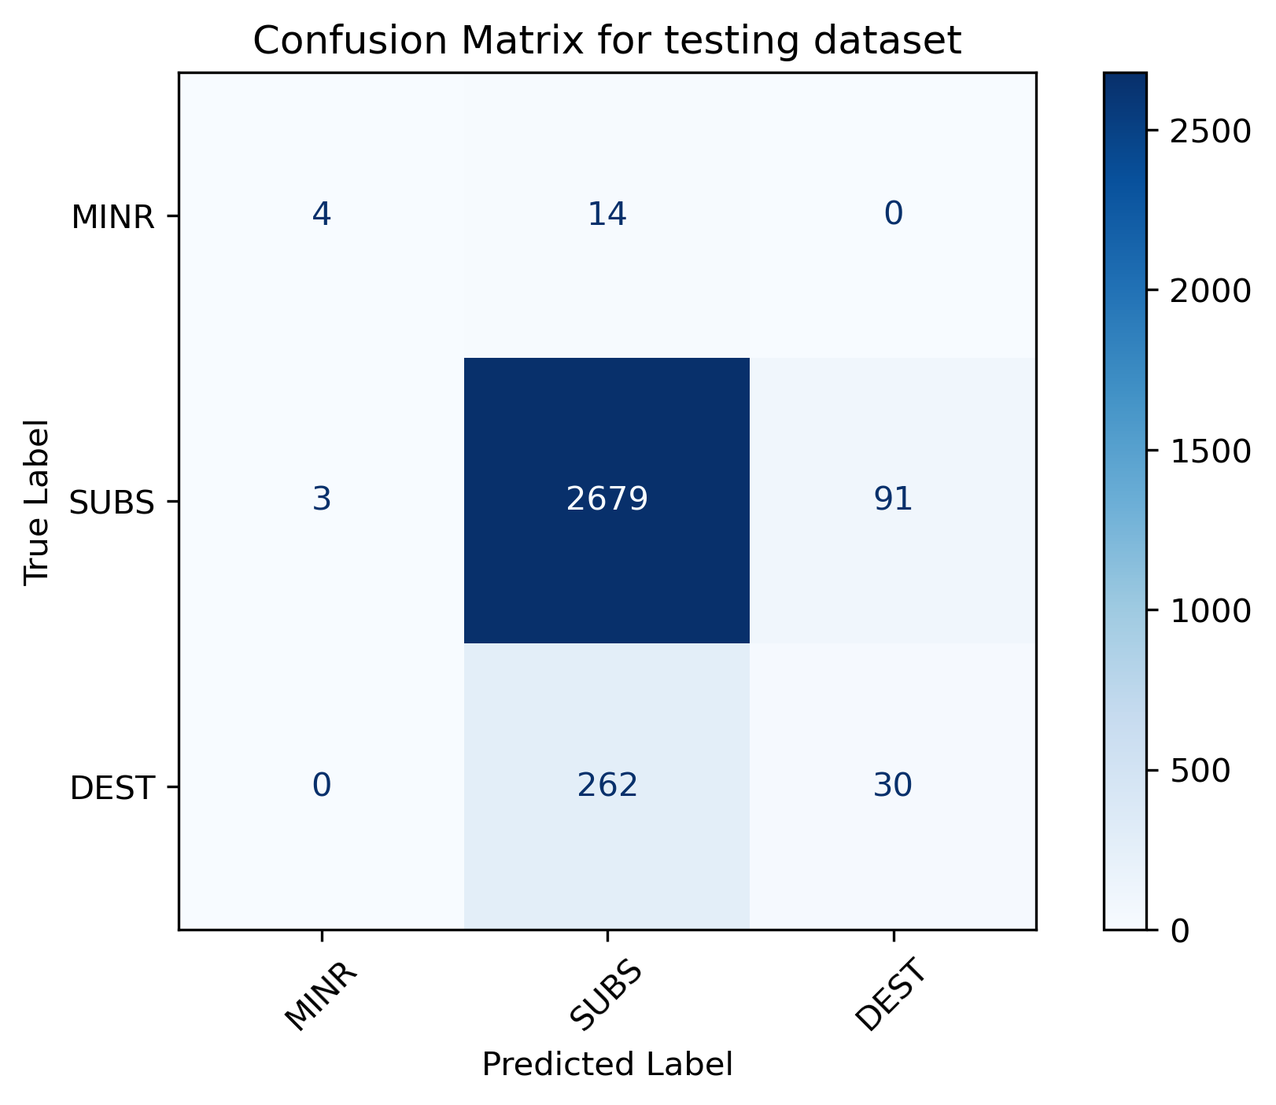
Classification Models: Results
Target: Damage
Model | F1 score (Macro average)
Extra Trees Classifier | 0.459
Naïve predictor (Baseline) | 0.316

Slide 12
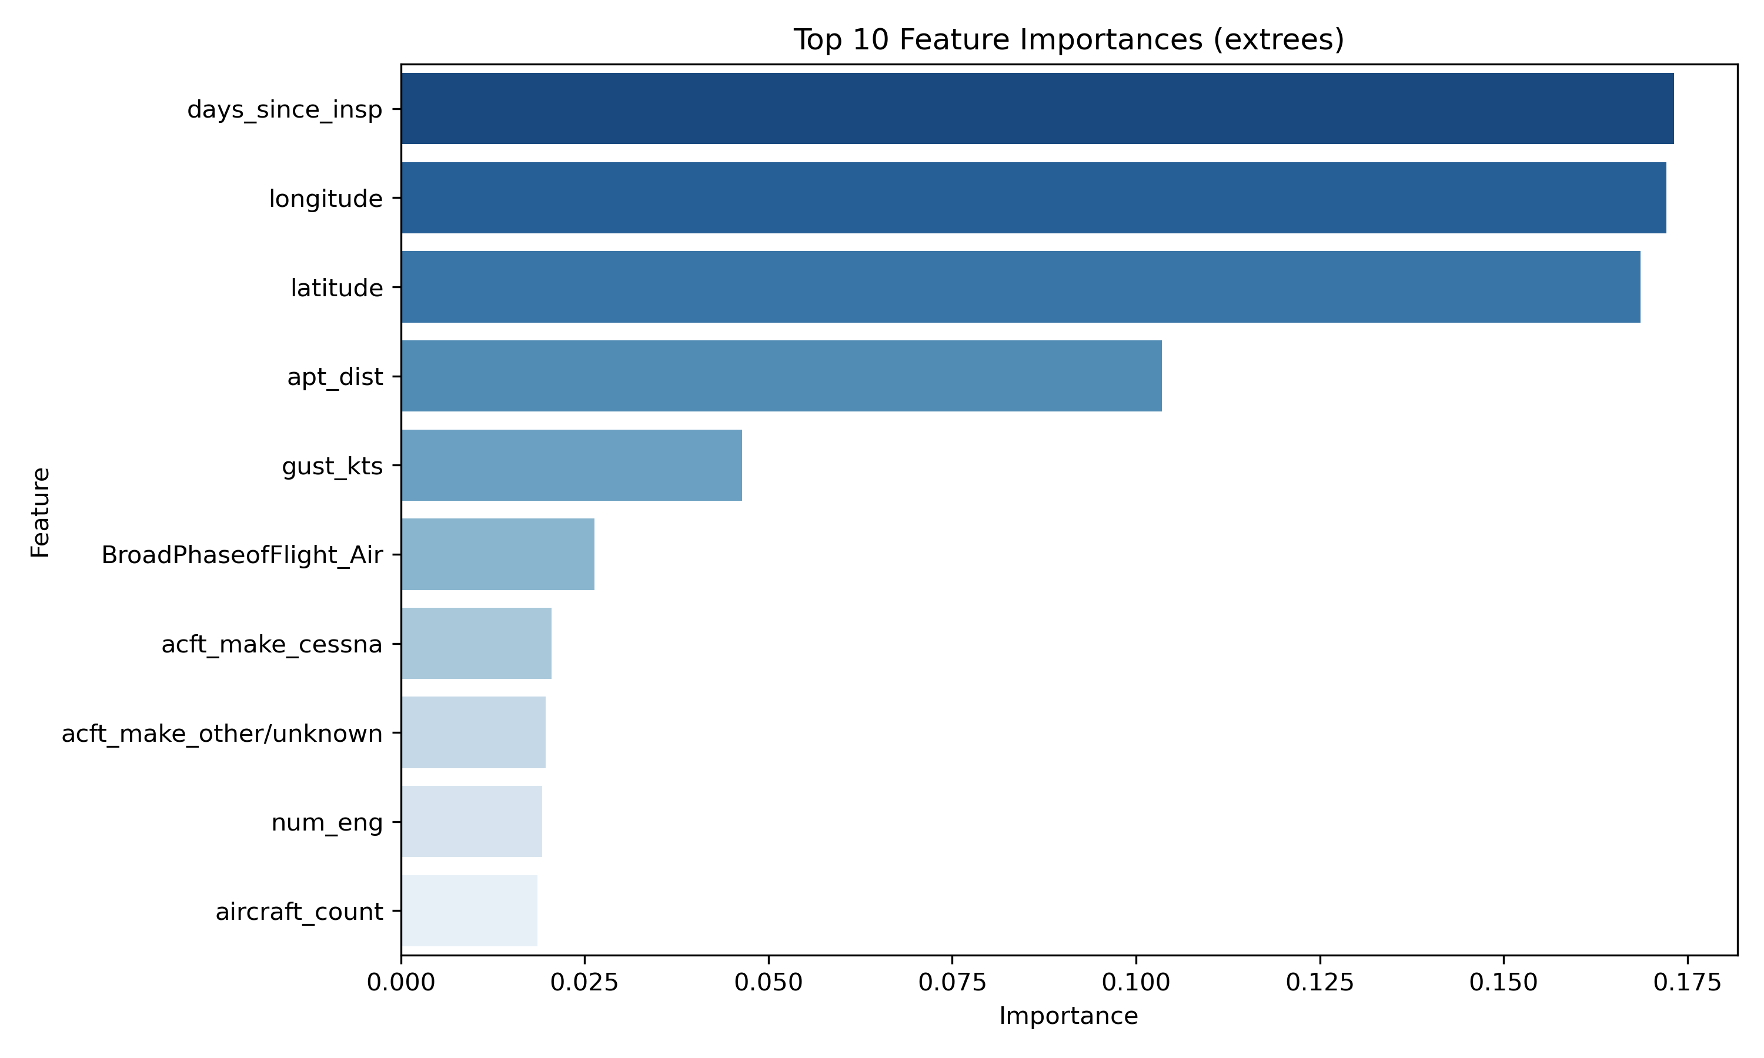
Damage classification: Extra Trees Feature Importances

Slide 13
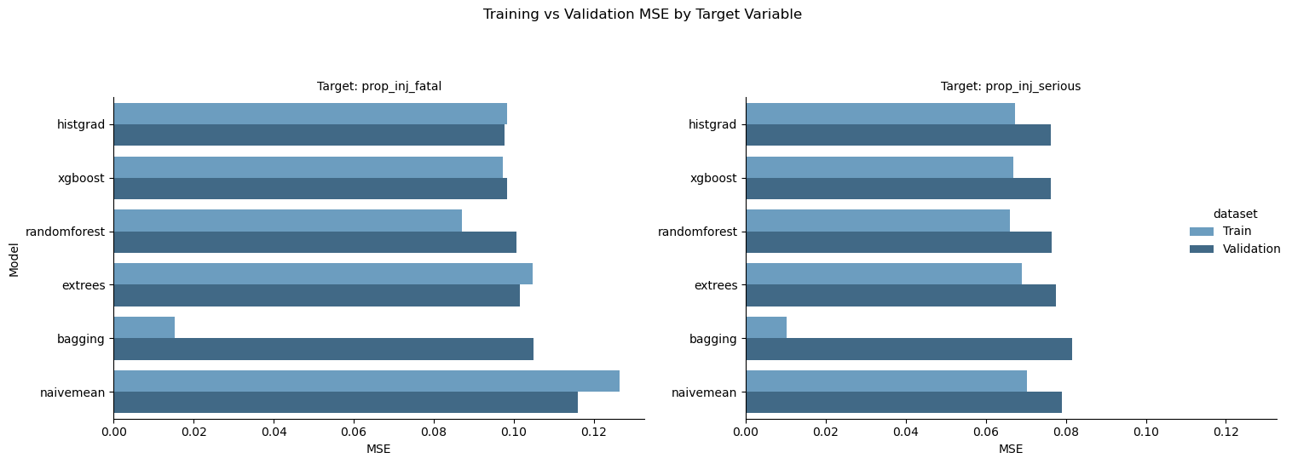
Regression Model Performances: Training and Validation Sets
For each, Histogram Gradient Boosting Regressor has lowest validation MSE.
Slight edge over “Naïve Mean” estimator

Slide 14
Regression Models: Results
Target: Proportion of Fatal Injuries
Model | MSE | MAE
Histogram Gradient Boost | 0.114 | 0.232
Naïve Mean (Baseline) | 0.133 | 0.267
Target: Proportion of Serious Injuries
Model | MSE | MAE
Histogram Gradient Boost | 0.075 | 0.163
Naïve Mean (Baseline) | 0.077 | 0.166

Slide 15
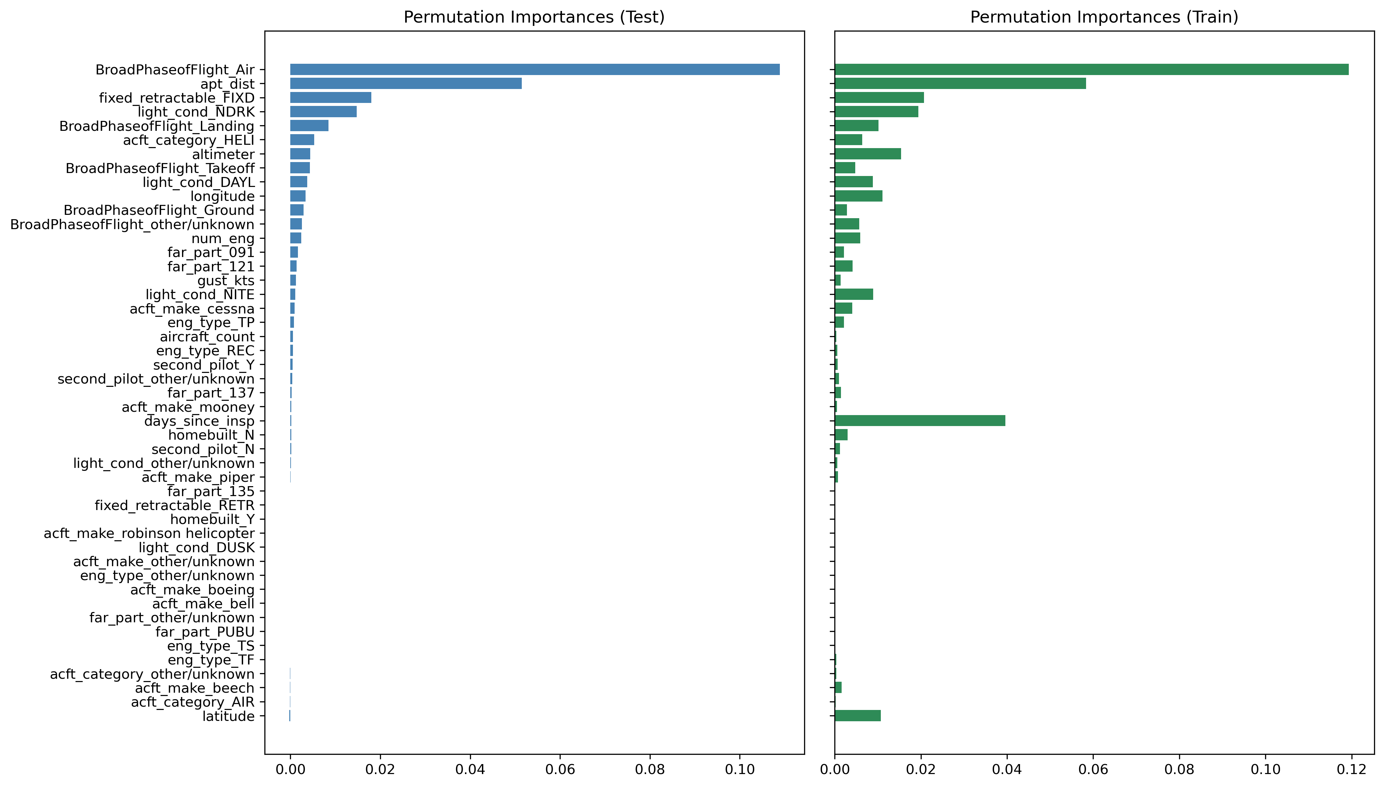
Fatal Injury Proportions: Permutation Importances

Slide 16
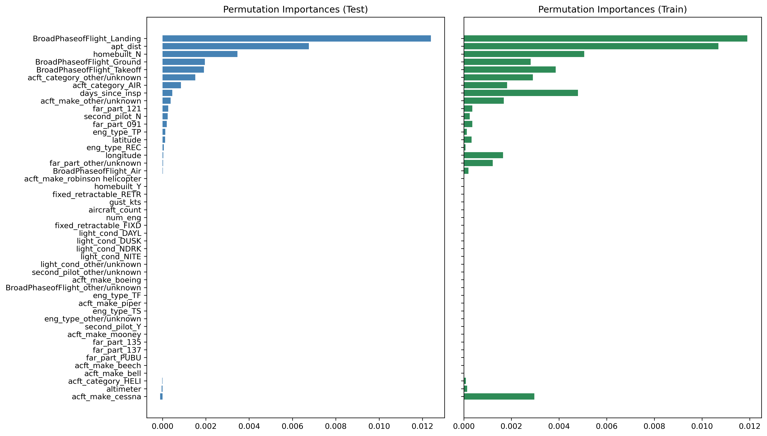
Serious Injury Proportions: Permutation Importances

Slide 17
Results
Predicting damage:
Decent (45%) improvement over baseline
Indicates location and inspections important
Proportion of injuries:
Modest (14%) improvement for predicting fatal injuries
No (2.5%) improvement for predicting serious injuries

Slide 18
Insights
Across all our models, features from the various NTSB datasets show limited predictive power
They offer only marginal improvement over naive baseline predictors
Given these limitations, we shift focus to a different task:
Using time series models to predict the number of aircraft accidents per month

Slide 19
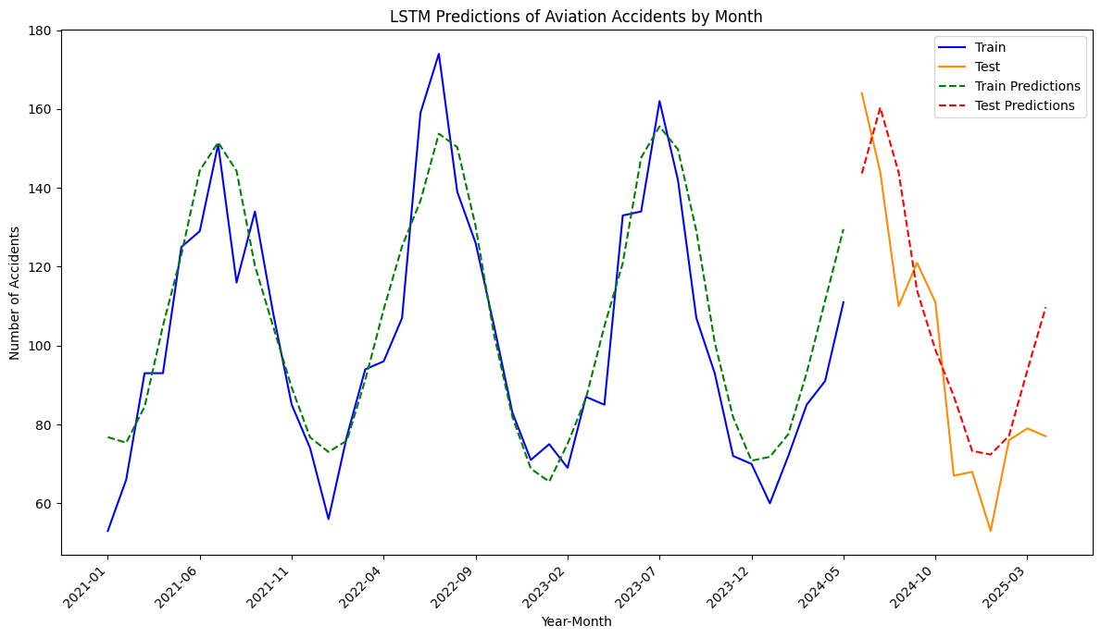
Time Series Prediction on Monthly Accidents

Slide 20
Conclusion & Future Work
Accident severity may be linked to the time since last inspection.
Regulators should assess if more frequent inspections would reduce severity.
Use more advanced techniques to uncover complex patterns in the data.
Build a web-based tool to visualize trends and explore "what-if" scenarios.

Slide 21
Thank you!

