Slide 1
Aviation Safety
C.J. Argue, Jake Caldwell, Inkee Jung, Jinting Liu

Slide 2
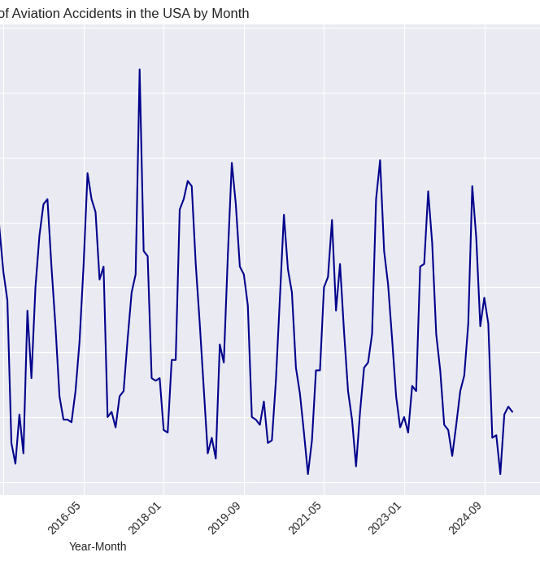
Problem Definition
Motivation
Increasing air travel demands call for ongoing improvements in aviation safety
Data-driven insights can support lawmakers and airlines in shaping preventive policies and risk mitigation strategies
Key Questions
What are the most influential factors that lead to “severe” accident outcomes?
Can we predict whether a given accident will result in serious aircraft damage or casualties?
What trends can be observed in the number of accidents over time?

Slide 3
National Travel Safety Board (NTSB) investigation database
Dataset of investigations into airplane accidents
Fact gathering includes flight logs, maintenance records
On-flight injuries Severity Aircraft damage.

Slide 4
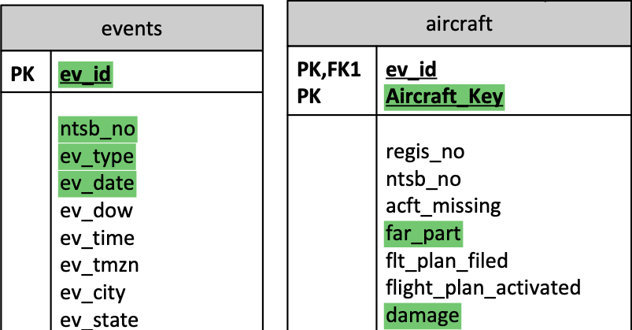
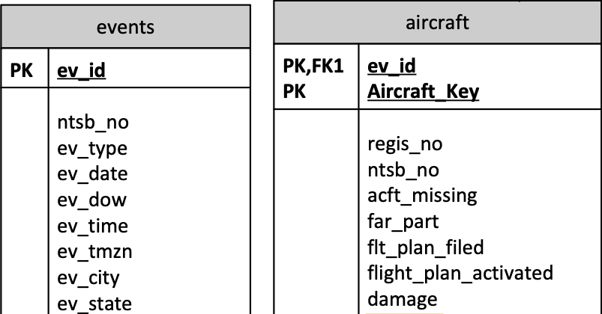
National Travel Safety Board (NTSB) investigation database
~30000 aviation investigations since 2008
~250 variables
.mdb file parsed using ‘mdb-tools’
Extracted data
Selected ~50 variables
Merged columns split across files

