Slide 1

Predicting Aviation Accident Severity
C.J. Argue, Jake Caldwell, Inkee Jung, Jinting Liu

Slide 2
Problem
Given that accident occurred, what features predict its severity?
Severity: Injuries, damage to aircraft
Universe: accidents in the USA
All aircraft types (planes, helicopters, gliders, etc.)
Stakeholders
Regulators, lawmakers, airlines

Slide 3
KPIs & Target Variables
KPI: Level of accident severity
Level of Aircraft Damage
Destroyed, substantial, minor, none
Proportion of injuries
Fatal, serious, minor, none
(Number of accidents in given month)

Slide 4
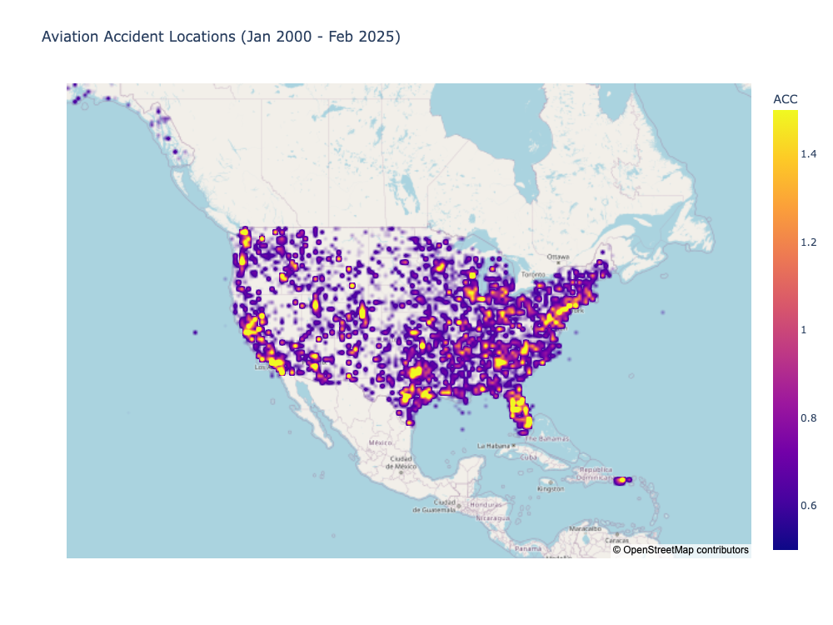

Slide 5
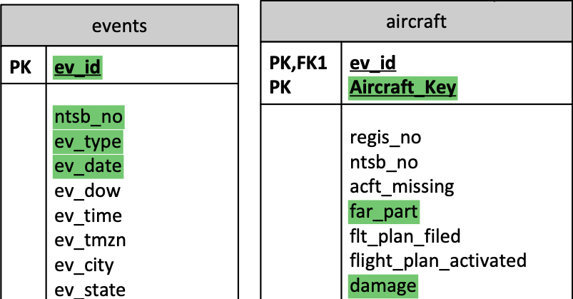
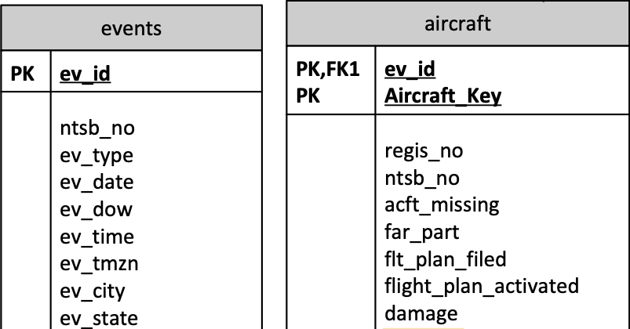
National Travel Safety Board (NTSB) investigation database
~30000 aviation investigations since 2008
~250 variables
.mdb file parsed using ‘pyodbc’
Extracted data
Selected ~50 variables
Merged columns split across files

Slide 6
Merged datasets to get aircraft-level data
Event-level
Aircraft-level
Sub-aircraft level
Light condition | Make | Fatalities
Light | Cessna | Crew: 0
 |  | Pass: 0
Dark | Boeing | Crew: 1
 |  | Pass: 4
Dark | Cessna | Crew: 2
 |  | Pass: 0
 | Piper | Crew: 0
 |  | Pass: 0
Light condition | Make | Fatalities
Light | Cessna | 0
Dark | Boeing | 5
Dark | Cessna | 2
Dark | Piper | 0
Propagated to aircraft
Aggregated by aircraft

Slide 7
Removed rows, reduced categories, and imputed to get complete data with manageable feature set
ev_type | country | phase | acft_make | num_eng | rwy_len
ACC | USA | Maneuvering | Bell | 1
ACC | USA | Takeoff | Cessna | 1 | 1717
ACC | USA | Initial Climb | Piper | 1
ACC | USA | Takeoff | RANS | 1
ACC | USA | Enroute
ACC | USA | Landing | Cessna | 1 | 6000
ACC | USA | Landing | Cessna | 1 | 2221
ACC | USA | Takeoff | CESSNA | 2 | 6505
ACC | USA | Enroute | PIPER | 1
ACC | USA | Approach | Cessna | 1 | 3499
ACC | USA | Approach | CESSNA | 1
ACC | USA | Approach | HARMS R. | 1
ACC | USA | Maneuvering | Van Heeswyk
INC | USA |  | AEROSPATIAL | 2
INC | USA
ACC | GE
ACC | PE
ev_type | country | phase | acft_make | num_eng | rwy_len
ACC | USA | Maneuvering | Bell | 1
ACC | USA | Takeoff | Cessna | 1 | 1717
ACC | USA | Initial Climb | Piper | 1
ACC | USA | Takeoff | RANS | 1
ACC | USA | Enroute
ACC | USA | Landing | Cessna | 1 | 6000
ACC | USA | Landing | Cessna | 1 | 2221
ACC | USA | Takeoff | CESSNA | 2 | 6505
ACC | USA | Enroute | PIPER | 1
ACC | USA | Approach | Cessna | 1 | 3499
ACC | USA | Approach | CESSNA | 1
ACC | USA | Approach | HARMS R. | 1
ACC | USA | Maneuvering | Van Heeswyk
INC | USA |  | AEROSPATIAL | 2
INC | USA
ACC | GE
ACC | PE
ev_type | country | phase | acft_make | num_eng
ACC | USA | Enroute | Bell | 1
ACC | USA | Takeoff | Cessna | 1
ACC | USA | Takeoff | Piper | 1
ACC | USA | Takeoff | RANS | 1
ACC | USA | Enroute
ACC | USA | Landing | Cessna | 1
ACC | USA | Landing | Cessna | 1
ACC | USA | Takeoff | CESSNA | 2
ACC | USA | Enroute | PIPER | 1
ACC | USA | Landing | Cessna | 1
ACC | USA | Landing | CESSNA | 1
ACC | USA | Landing | HARMS R. | 1
ACC | USA | Enroute | Van Heeswyk
ev_type | country | phase | acft_make | num_eng
ACC | USA | Maneuvering | Bell | 1
ACC | USA | Takeoff | Cessna | 1
ACC | USA | Initial Climb | Piper | 1
ACC | USA | Takeoff | RANS | 1
ACC | USA | Enroute
ACC | USA | Landing | Cessna | 1
ACC | USA | Landing | Cessna | 1
ACC | USA | Takeoff | CESSNA | 2
ACC | USA | Enroute | PIPER | 1
ACC | USA | Approach | Cessna | 1
ACC | USA | Approach | CESSNA | 1
ACC | USA | Approach | HARMS R. | 1
ACC | USA | Maneuvering | Van Heeswyk
ev_type | country | phase | acft_make | num_eng
ACC | USA | Enroute | bell | 1
ACC | USA | Takeoff | cessna | 1
ACC | USA | Takeoff | piper | 1
ACC | USA | Takeoff | other/unknown | 1
ACC | USA | Enroute | other/unknown
ACC | USA | Landing | cessna | 1
ACC | USA | Landing | cessna | 1
ACC | USA | Takeoff | cessna | 2
ACC | USA | Enroute | piper | 1
ACC | USA | Landing | cessna | 1
ACC | USA | Landing | cessna | 1
ACC | USA | Landing | other/unknown | 1
ACC | USA | Enroute | other/unknown
ev_type | country | phase | acft_make | num_eng | rwy_len
ACC | USA | Maneuvering | Bell | 1
ACC | USA | Takeoff | Cessna | 1 | 1717
ACC | USA | Initial Climb | Piper | 1
ACC | USA | Takeoff | RANS | 1
ACC | USA | Enroute
ACC | USA | Landing | Cessna | 1 | 6000
ACC | USA | Landing | Cessna | 1 | 2221
ACC | USA | Takeoff | CESSNA | 2 | 6505
ACC | USA | Enroute | PIPER | 1
ACC | USA | Approach | Cessna | 1 | 3499
ACC | USA | Approach | CESSNA | 1
ACC | USA | Approach | HARMS R. | 1
ACC | USA | Maneuvering | Van Heeswyk
INC | USA |  | AEROSPATIAL | 2
INC | USA
ACC | GE
ACC | PE
ev_type | country | phase | acft_make | num_eng
ACC | USA | Enroute | bell | 1
ACC | USA | Takeoff | cessna | 1
ACC | USA | Takeoff | piper | 1
ACC | USA | Takeoff | other/unknown | 1
ACC | USA | Enroute | other/unknown | 1
ACC | USA | Landing | cessna | 1
ACC | USA | Landing | cessna | 1
ACC | USA | Takeoff | cessna | 2
ACC | USA | Enroute | piper | 1
ACC | USA | Landing | cessna | 1
ACC | USA | Landing | cessna | 1
ACC | USA | Landing | other/unknown | 1
ACC | USA | Enroute | other/unknown | 2
Notes:
Created dummy variables for categories with frequency > 1%
Imputed missing numerical values
Dropped columns with > 20% missing values, only one frequent category

Slide 8
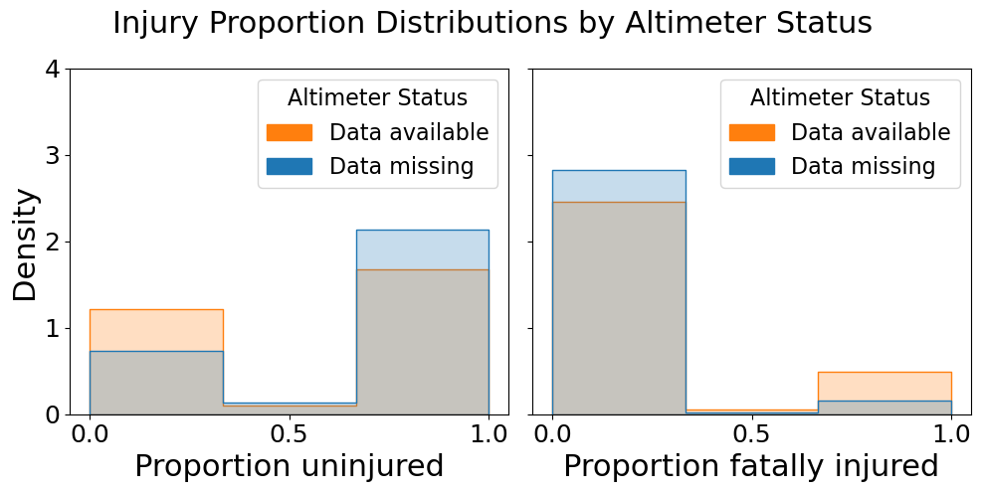
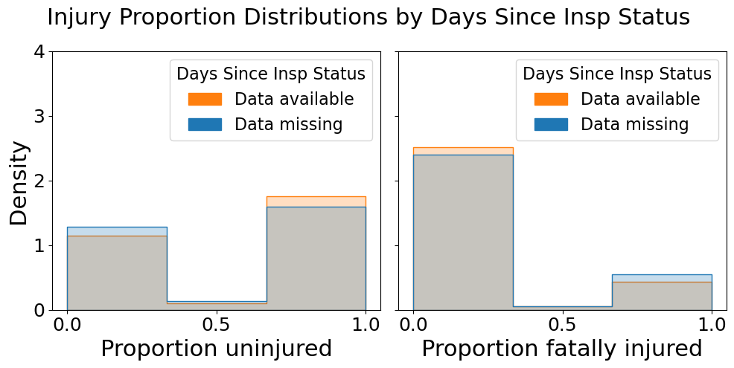
Analyzed missingness to avoid data leakage
Status strongly predictive of fatality
Drop feature
Status weakly predictive
Keep feature

Slide 9
Modeling approach
Series of Learners
Random Forest (Classifier/Regressor)
Extra Trees (Classifier/Regressor)
Histogram Gradient Boost (Classifier/Regressor)
XGBoost (Classifier/Regressor)
Bagging (Classifier/Regressor)
Hyperparameter tuning for each target
5-fold cross-validation

Slide 10
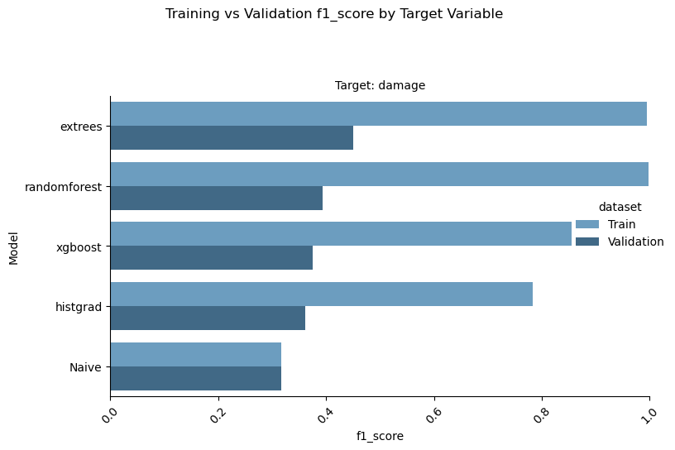
Classification Model Performances: Training and Validation Sets
For each, Extra Trees Classifier has highest validation F1(macro) score.
Slight edge over “Naïve” estimator
For all, every model overfits training data

Slide 11
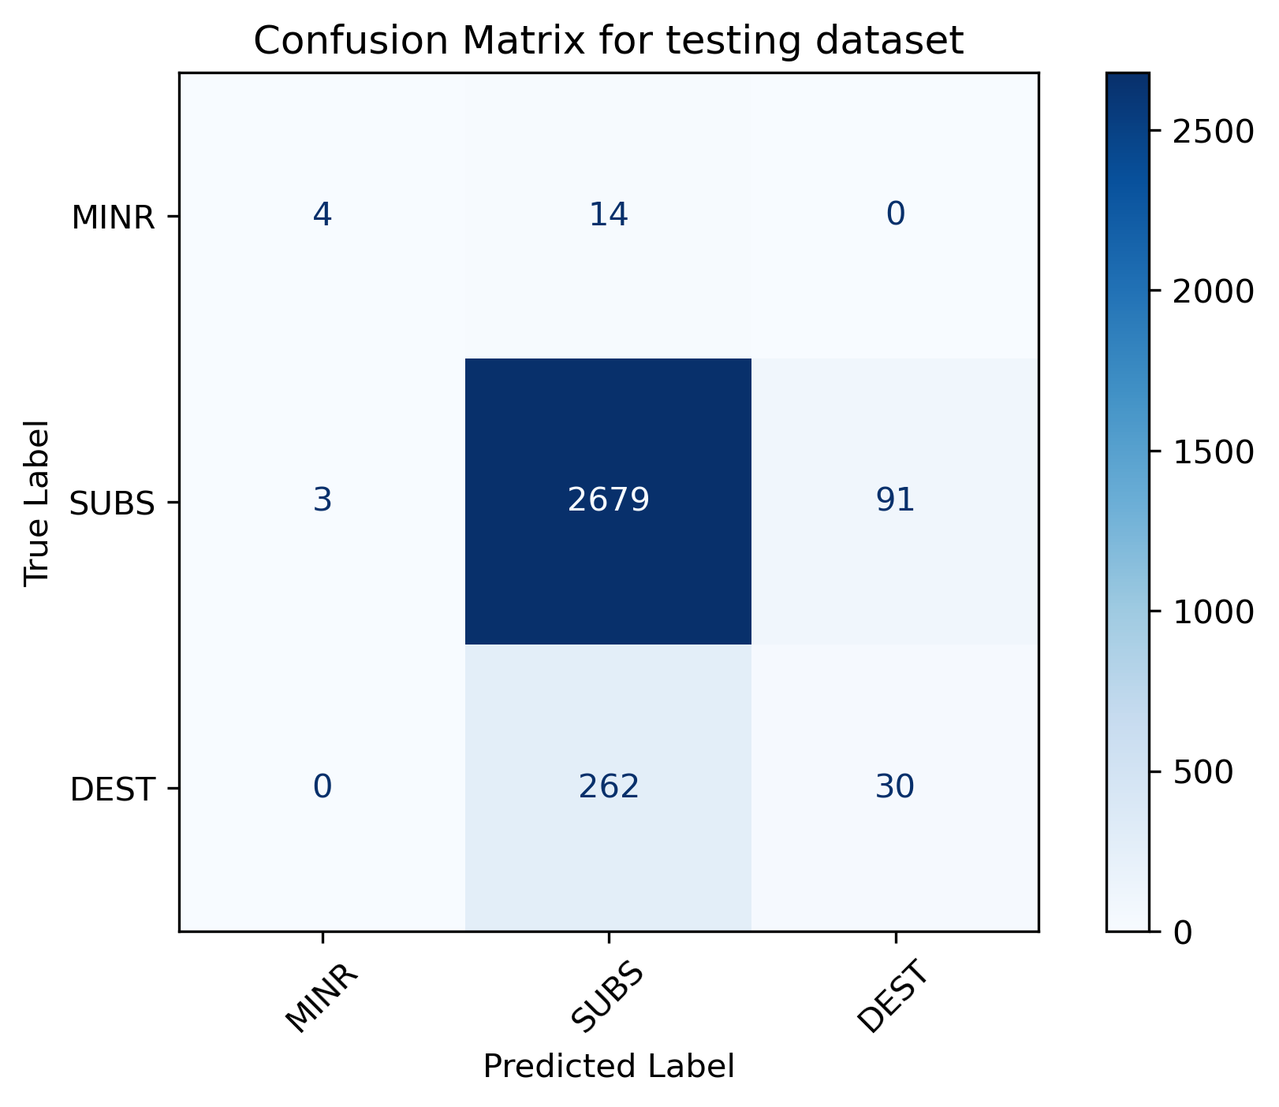
Classification Models: Results
Target: Damage
Model | F1 score (Macro average)
Extra Trees Classifier | 0.459
Naïve predictor (Baseline) | 0.316

Slide 12
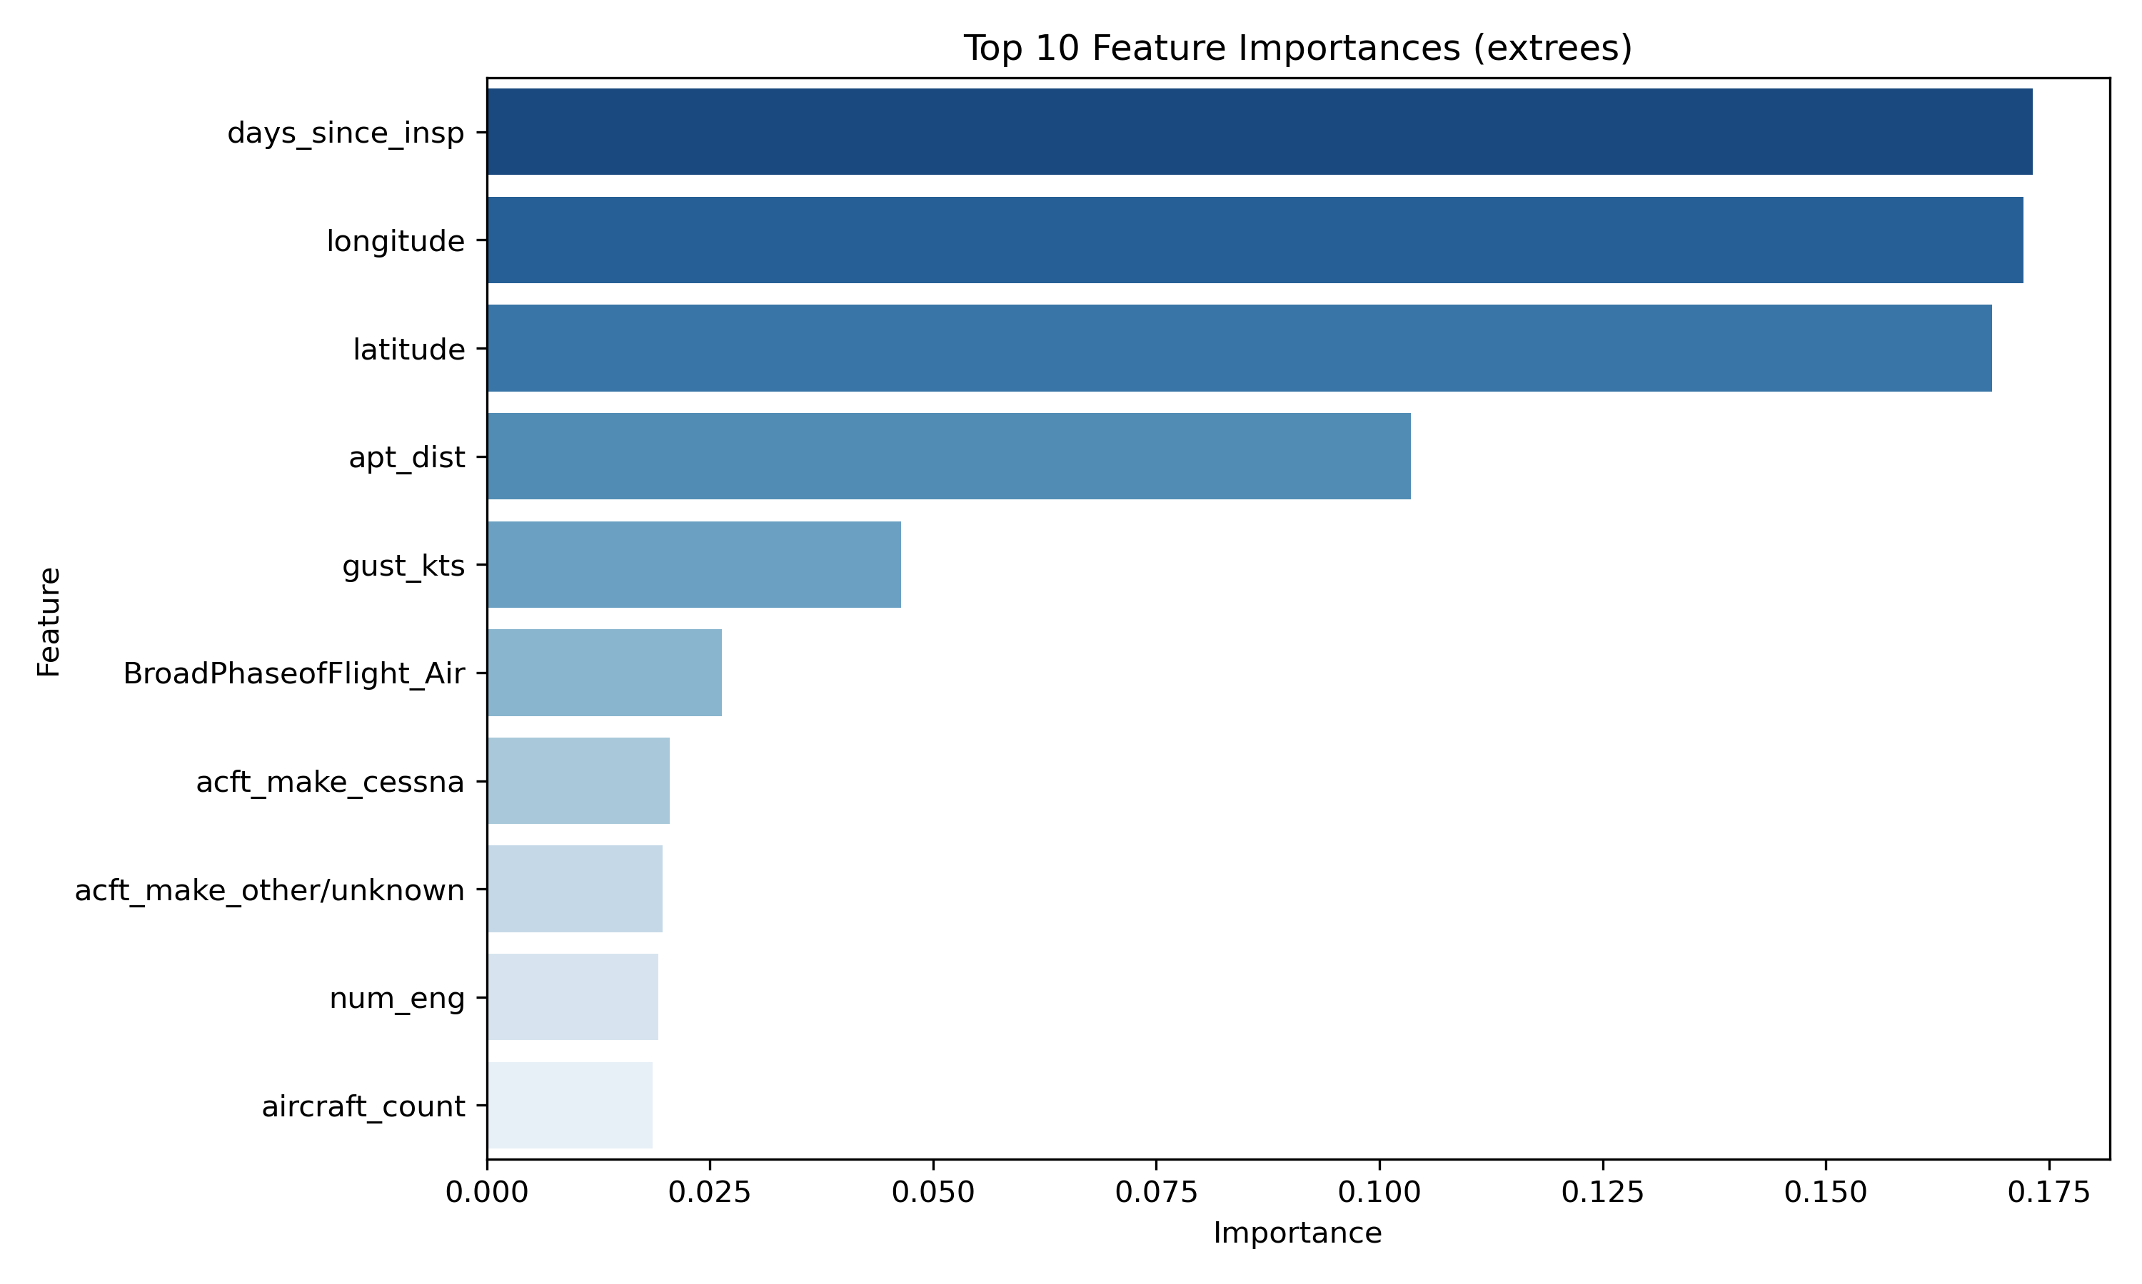
Damage classification: Extra Trees Feature Importances

Slide 13
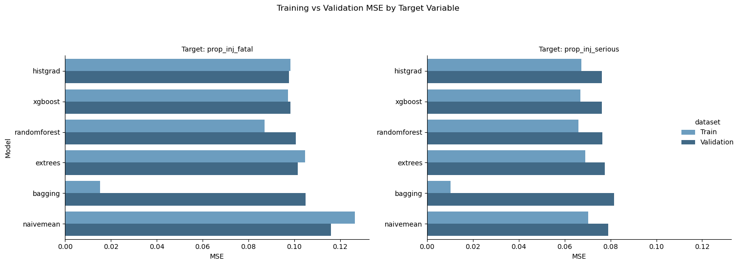
Regression Model Performances: Training and Validation Sets
For each, Histogram Gradient Boosting Regressor has lowest validation MSE.
Slight edge over “Naïve Mean” estimator

Slide 14
Regression Models: Results
Target: Proportion of Fatal Injuries
Model | MSE | MAE
Histogram Gradient Boost | 0.114 | 0.232
Naïve Mean (Baseline) | 0.133 | 0.267
Target: Proportion of Serious Injuries
Model | MSE | MAE
Histogram Gradient Boost | 0.075 | 0.163
Naïve Mean (Baseline) | 0.077 | 0.166

Slide 15
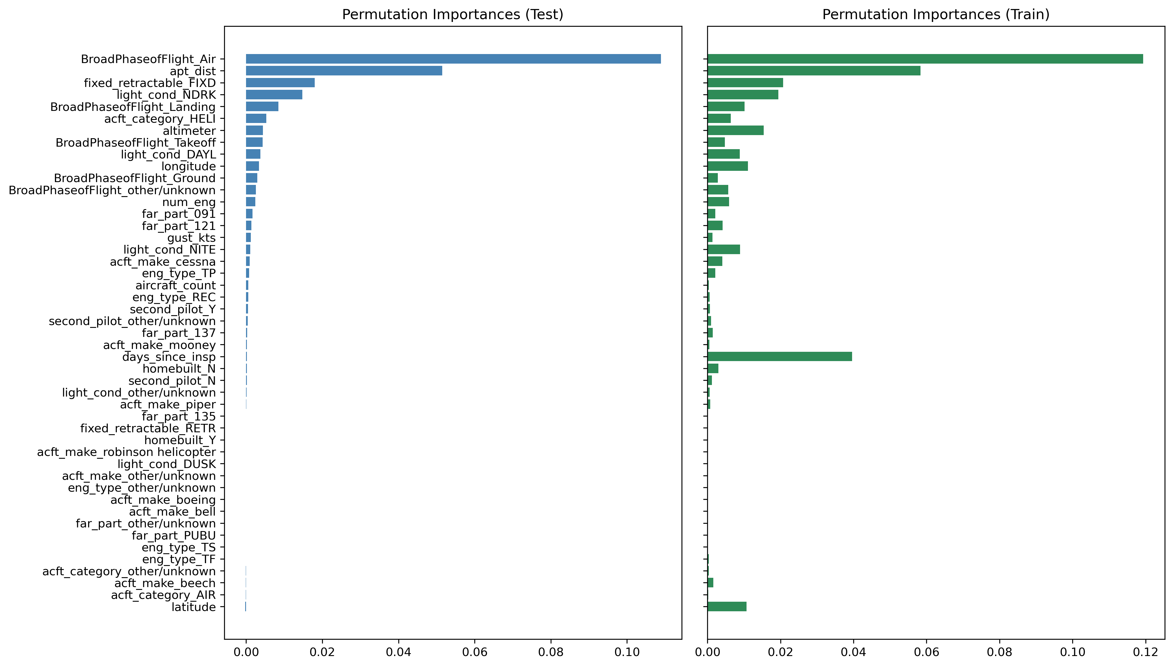
Fatal Injury Proportions: Permutation Importances

Slide 16
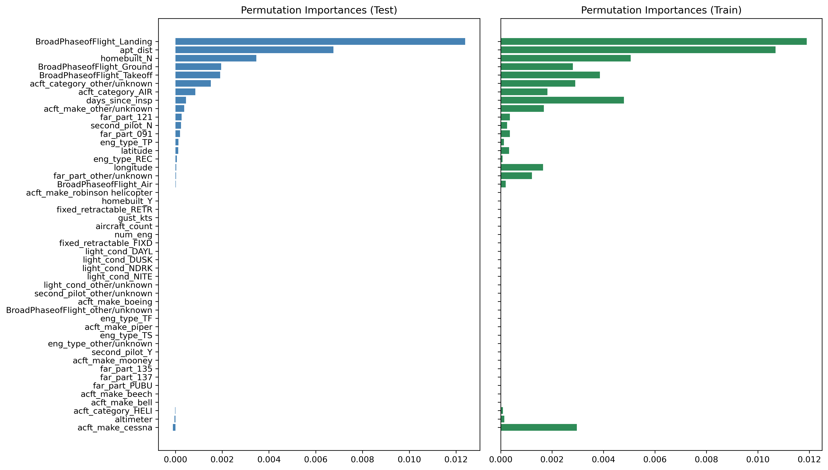
Serious Injury Proportions: Permutation Importances

Slide 17
Results
Predicting damage:
Decent (45%) improvement over baseline
Indicates location and inspections important
Proportion of injuries:
Modest (14%) improvement for predicting fatal injuries
No (2.5%) improvement for predicting serious injuries

Slide 18
Conclusions

