Slide 1
Aviation Safety
C.J. Argue, Jake Caldwell, Inkee Jung, Jinting Liu
Include pictures, positions seeking

Slide 2
Problem Definition
Motivation
Increasing air travel demands call for ongoing improvements in aviation safety
Data-driven insights can support lawmakers and airlines in shaping preventive policies and risk mitigation strategies
Key Questions
What are the most influential factors that lead to “severe” accident outcomes?
How have accident patterns evolved over time?
Can we predict whether a given accident will result in serious aircraft damage or casualties?

Slide 3
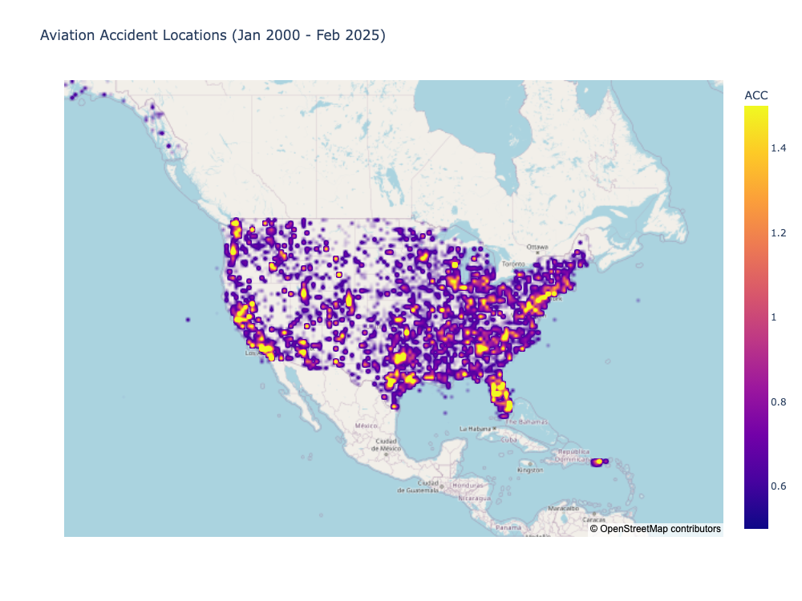

Slide 4
Data Sources
Dataset | Provider | Description
NTSB Aviation Investigation Database
T-100

Slide 5
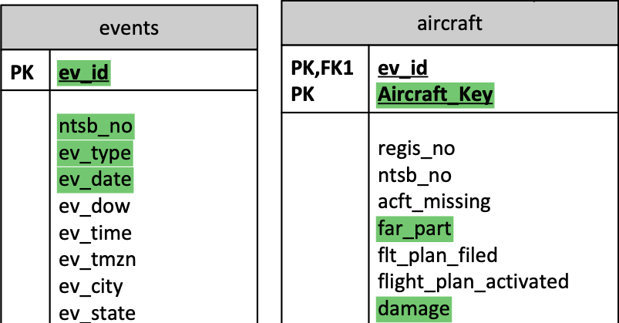
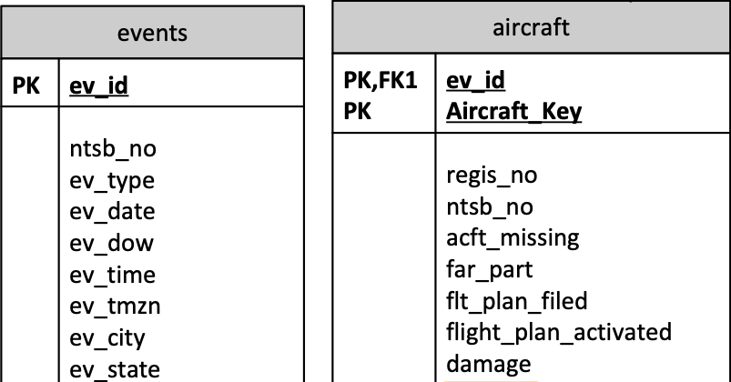
National Travel Safety Board (NTSB) investigation database
~30000 aviation investigations since 2008
~250 variables
.mdb file parsed using ‘pyodbc’
Extracted data
Selected ~50 variables
Merged columns split across files

Slide 6
Problem Definition revisited
Objective
To create a comprehensive overview of aviation accident in US territory during 2008 – 2022
To analyze key contributing factors associated with aircraft damage and casualties
To develop predictive insights and recommendations for enhancing aviation safety

Slide 7
KPIs & Target Variables
KPI: Level of accident severity
Level of Aircraft Damage
Destroyed, substantial, minor, none
Proportion of injuries
Fatal, serious, minor, none
(Number of accidents in given month)

