Slide 1
Laundry
Management
System
Contributors:
1. Eshan Dhok
2. Ojas Dighe
3. Mohan Tare

Slide 2
Contents
Problem Statement and Possible Solution
Project Description
Detailed Explanation of Project Components
Advantages
Future Scope
Conclusion

Slide 3
Problems Faced
Traditional laundry management systems suffer from problems like the following:
Higher workload on workers
Possible mismanagement due to the same
Lack of insight into the business trends
Planning becomes a tedious task

Slide 4

Possible Solution
A data analysis-driven management system that allows the owner to keep track of their business easily and facilitates simpler management and future planning. This system should be able to resolve all the issues mentioned in the previous section while being easy to use and simple to understand.

Slide 5
Project Description: Laundry Management System
Laundry Management System (LMS) is a user-friendly, easy-to-use software that helps the owners to monitor the current status of their business via constant analysis of their business database - including user management, revenue monitoring and planning future steps.
Being able to visualize data like the users' list, current laundry orders, etc. as well as features like inventory management makes management easier while minimizing the human resources requirements for the business.

Slide 6

Technologies Implemented
Back-End:
Node.js
Express
MongoDB
Front-End:
React
CSS
JavaScript
MaterialUI
Axios
Recharts

Slide 7
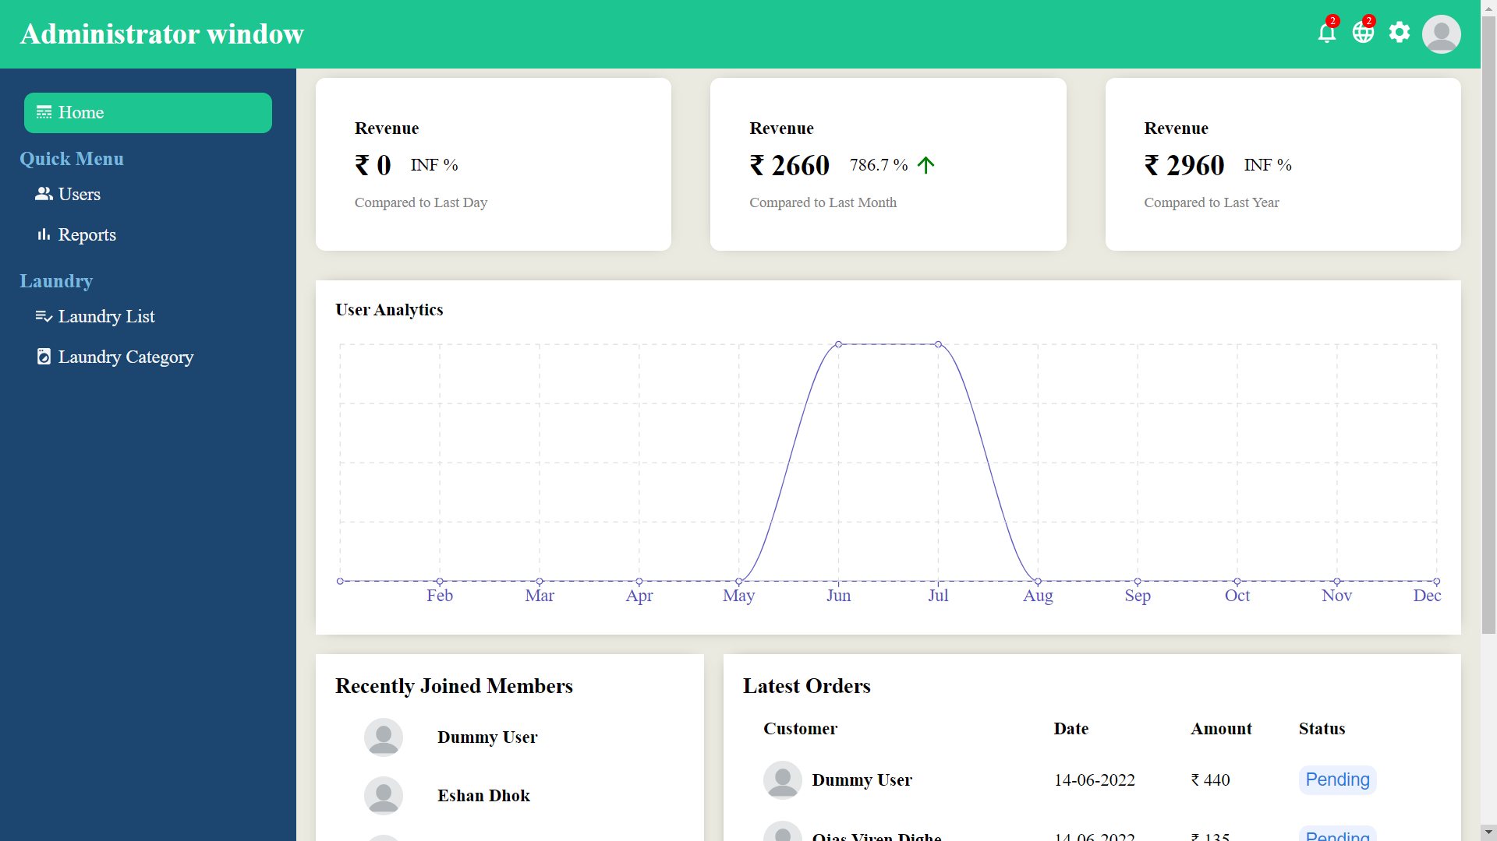
Project Components
Home: Provides a quick summary of changes in revenue, users, etc. and shows latest transactions.

Slide 8
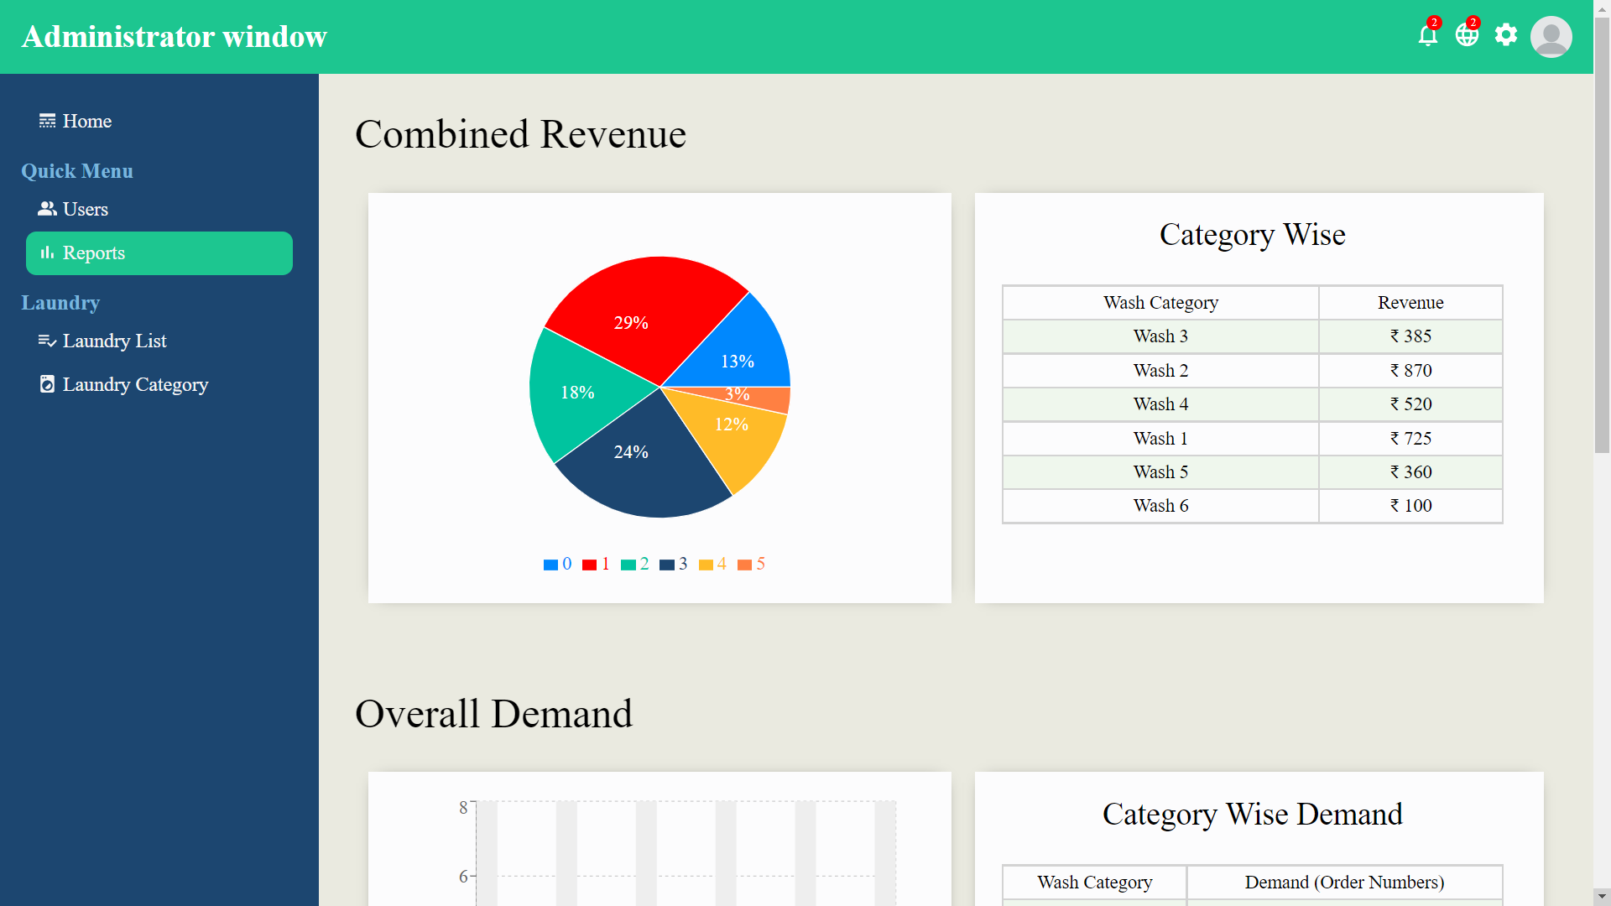
Reports: Shows analysis of various aspects of the business in a visual format.

Slide 9
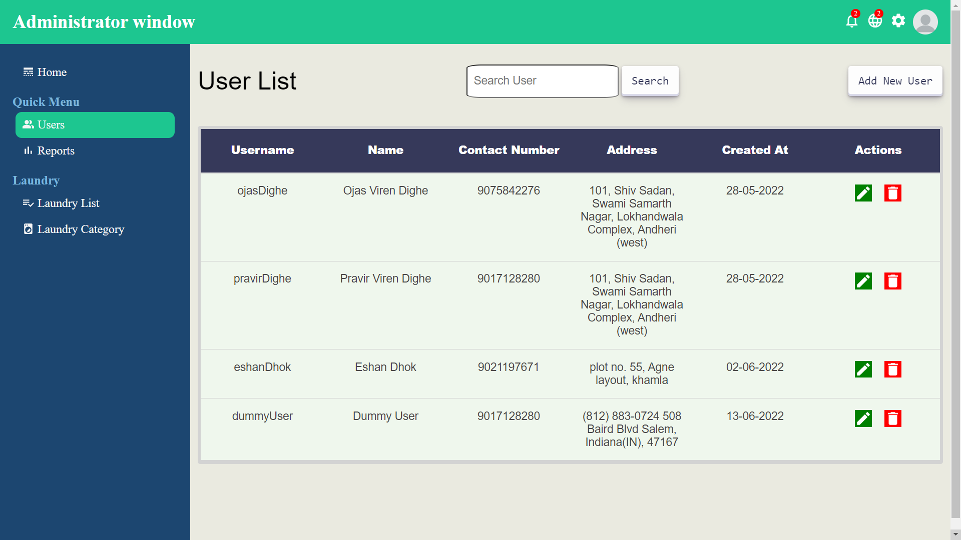
Users: Contains a list of users and their information.

Slide 10
Reports: Displays the demand-supply situation, order status and various other statistics.

Slide 11
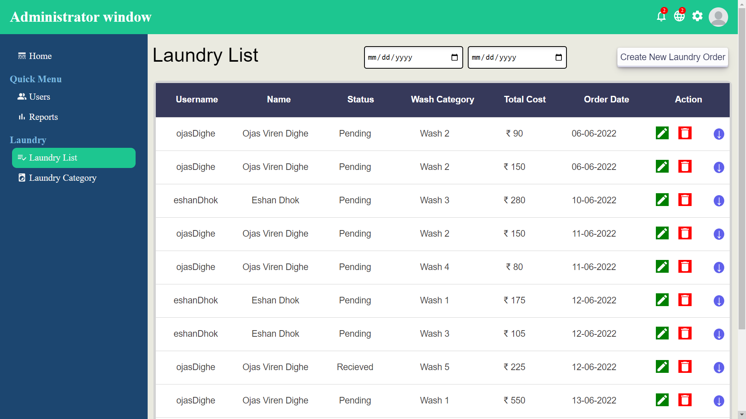
Laundry List: List of current orders under process, with customer and order details.

Slide 12
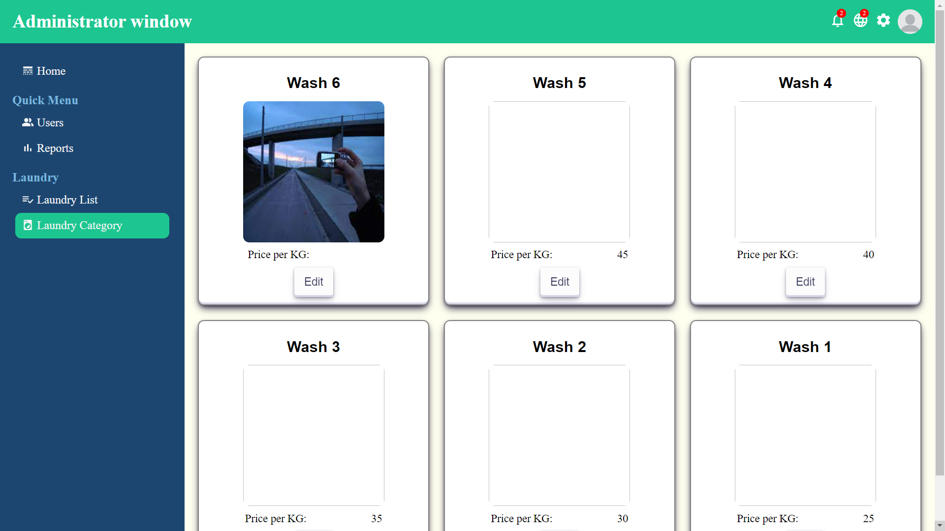
Laundry Category: Displays various categories of laundry with respective prices.

Slide 13
Advantages of This System
Easy-to-use and user friendly
Centralized system model
Reduced operational complexity
Visual representation of analyzed data
Online feedback facility

Slide 14
Future Scope
Creating user dashboard/ User side app.
An online payment system
Encouraging the usage of the system over traditional ones by customers, with discounts and special offers
A notification system to alert customers
An application for more platforms like mobile and desktop

Slide 15

Conclusion
This Laundry Management System acts as a means to aid laundry owners in managing their business. Not only does it provide an edge over the competition but also promotes E-commerce in this sector. This low-investment system can provide similar major benefits in the long run, with next to no negative consequences.

