Slide 1


Facility Sense
CptS 322
Team Members:
Luke Clancy
Chanse Cramer
Joe Guerrero
Best Team

Slide 2
Goal
Create a website that
  Provides useful student opinions and information about available facility services
  Provides useful data to the campus’ facility personnel.
To do this we needed to
  Create a user authentication method
  Create map and comment functionality
  Implement a simple, functional interface.
Notes:
12/3/17
Template H-crimson vert bars

Slide 3
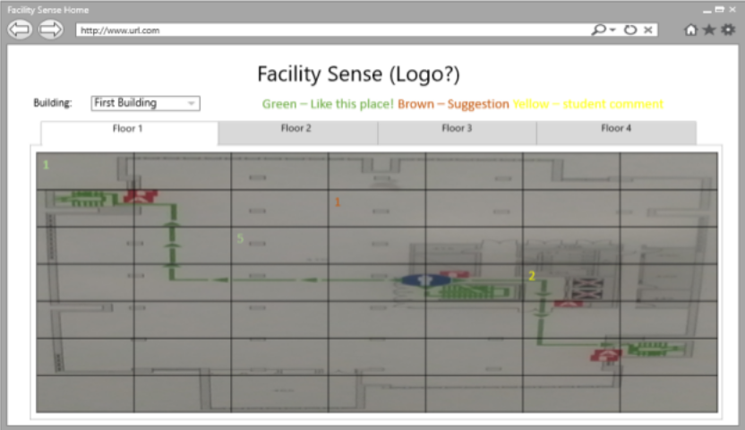
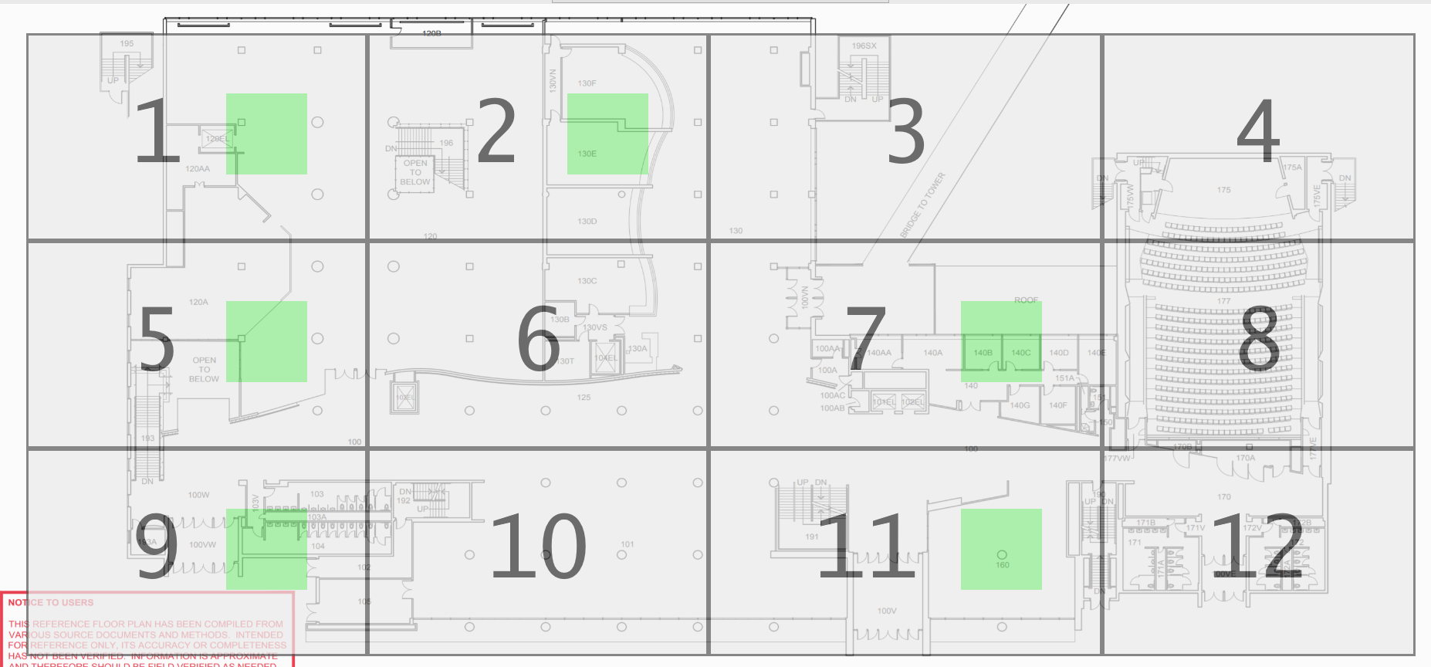
From Requirements Document
Notes:
12/3/17
Template H-crimson vert bars

Slide 4
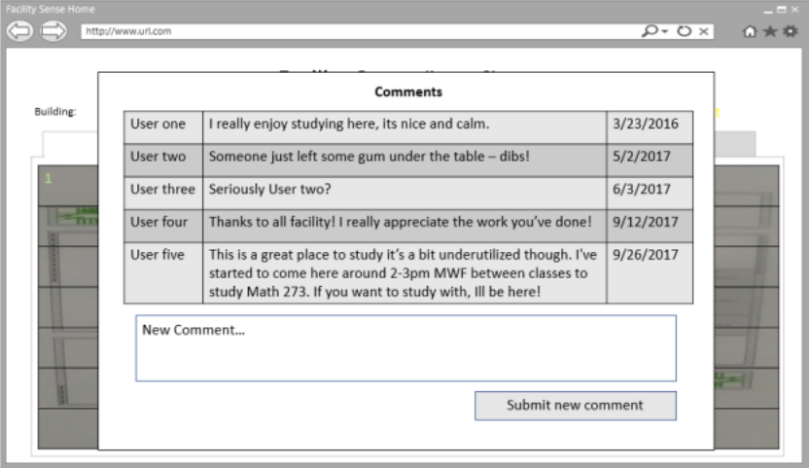
Notes:
12/3/17
Template H-crimson vert bars

Slide 5
Demonstration Time!
Notes:
12/3/17
Template H-crimson vert bars

Slide 6
Issues we faced
Worked on log on functionality first.
  We should of completed the main task of facility commenting, and then implemented log on functionality.
At times focused on additional functionality before work on main requirements.
  Pervasive serialization
  Email verification
  ‘Premature optimization is the root of all evil’
Notes:
12/3/17
Template H-crimson vert bars

Slide 7
We learned
Gained more in depth knowledge in Python, javascript, HTTP, CSS, and flask
Gained valuable information on how git works in the field.
Learned the value of organization and documentation in projects.
Learned the benefits of clearly separating the front and back end of web applications.
  frontenddev backenddev branches
Notes:
12/3/17
Template H-crimson vert bars

Slide 8
Questions?
Notes:
12/3/17
Template H-crimson vert bars

