Slide 1


CptS 322
Facility Sense
Team Members:
Luke Clancy
Chanse Cramer
Joe Guerrero
Best Team
Notes:
12/3/17
Template H-crimson vert bars
<number>

Slide 2
Goal
Create a website that
Provides useful information to students about available facility services
Provides useful data to that facility's workers
To do this we needed to
Create a user authentication method
Create map and comment functionality
Notes:
12/3/17
Template H-crimson vert bars
<number>

Slide 3
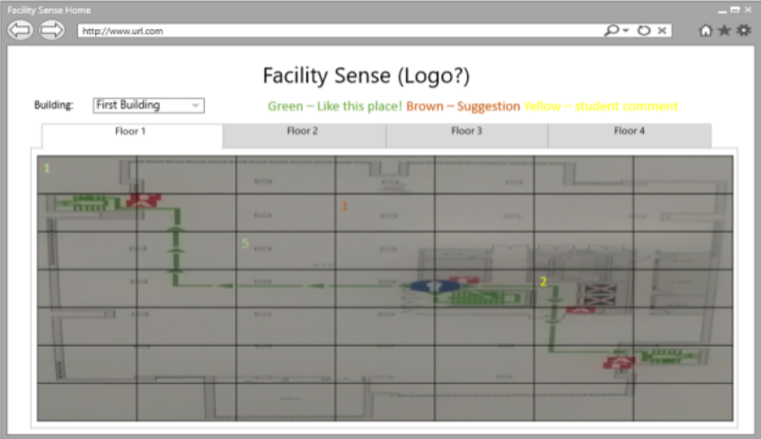
From Requirements Document
Notes:
12/3/17
Template H-crimson vert bars
<number>

Slide 4
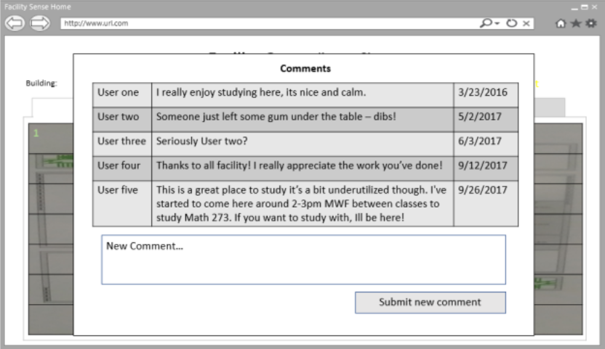
Notes:
12/3/17
Template H-crimson vert bars
<number>

Slide 5
Demonstration Time!
Notes:
12/3/17
Template H-crimson vert bars
<number>

Slide 6
Issues we faced
Worked on log on functionality first.
We should of completed the main task of facility commenting, and then implemented log on functionality.
At times focused on additional functionality before work on main requirements
Pervasive serialization
Email verification
‘Premature optimization is the root of all evil’
Notes:
12/3/17
Template H-crimson vert bars
<number>

Slide 7
We learned
Gained more in depth knowledge in python, javascript, HTTP, CSS, and flask
Gained valuable information on how git works in the field.
Learned the benefits of clearly separating the front and back end of web applications.
frontenddev backenddev branches
Notes:
12/3/17
Template H-crimson vert bars
<number>

Slide 8
Questions?
Notes:
12/3/17
Template H-crimson vert bars
<number>

