Slide 1

Improving Sentiment Analysis with Multi-task Learning of Negation
TEam Members
Akshaya nagarajan
Pooja patil
Sivaranjani kumar
Vigneshkumar thangarajan

Slide 2
Introduction
Sentiment Analysis = Mining Opinion from a piece of text.
However, it is directly affected by compositional phenomena in language that act on the prior polarity of the words and phrases in the text.
Negation is the most prevalent of these phenomena and a classifier should be able to identify negation and disentangle the effects that its scope has on final polarity of text.

Slide 3
Negation Cue and Negation Scope
Negation Cue – Words in a piece of text which change the polarity of the sentence and make them negative.
Negation Scope - Part of the sentence which gets affected by the Negation Cue is called the scope of that cue.
Example – I don't like this movie, here "don't'" is the Negation Cue.

Slide 4
Approach
We use a cascading and hierarchical Multi-task learning approach where we explicitly train the negation as an Auxiliary task, which in turn helps to improve our main task of Sentiment Analysis.
Incorporating information from data sets explicitly annotated for negation in order to improve the performance of sentiment classifiers.
Model – is a cascading and hierarchical neural architecture with selective sharing of LSTM layer.

Slide 5
Challenges
Identifying words indicating Negation (Negation cues) is not enough.
The reason behind this is, the Negation Scope, which is equally important in analyzing the Sentiment.
It’s not so much a work of entertainment as it is a unique, well-crafted psychological study of grief.

Slide 6
Datasets
We used two different Datasets specific to Negation and Sentiment Analysis tasks
Conan Doyle-Neg (CD)
Standford Sentiment Treebank (SST)

Slide 7
ConanDoyle-Neg (CD)
Contains Conan Doyle's stories, annotated for negation cues, scopes and events.
This was employed in the 2012 SEM shared task on Negation detection.
The annotation scheme was also employed based on the biomedical BioScope corpus but with modifications.
This dataset has wide range of annotated cue types which are sub-token, word-based and multi-word negation cues.

Slide 8
Standford Sentiment Treebank (SST)
This dataset contains 11,855 sentences taken from movie reviews.
Two versions:
Fine Grained Labels – Strong Positive, Strong Negative, Neutral, Positive and Negative.
Binary - Positive/ Negative

Slide 9
Model
We model both Sentiment classification and Negation Detection in Multi-task Learning fashion.
Main Task - Sentence level classification of Sentiments.
Auxillary Task - Sequence labeling of negation cues and scopes.
We employed a cascading architecture where the lower layers are used to perform the auxiliary task and higher layers performs main task.

Slide 10
Negation Model
Detects Negation Cues and Scopes using a BiLSTM in one task
It models the sequence of tokens in an embedding layer and using BiLSTM, creates a contextualized represenation of each token.
This represenation is then used as feautures in Conditional Random Field (CRF) along with Vertibi Decoding to find the most probablistic assignment of labels.

Slide 11
Sentiment Analysis Model
This model uses the same embedding (as Negation model) and first layer of BiLSTM to create a contextualized representations of input tokens.
We use skip connections to concatenate the original embeddings to the contextualized representation.
This in turn is given as input to the second sentiment analysis specific BiLSTM layer and Maxpool operation is performed on the output.
Class probabilities are computed using SoftMax using the max pooled representations.

Slide 12
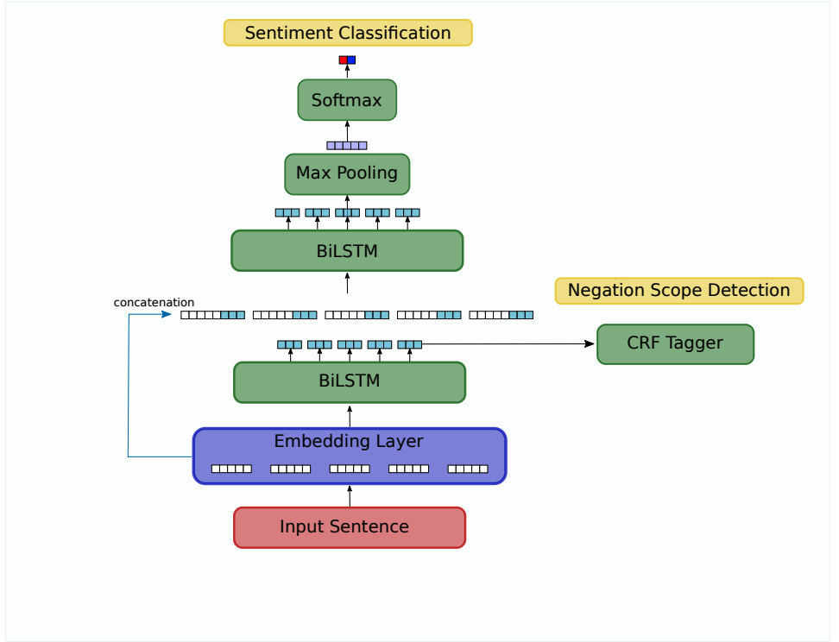
Architecture Diagram
Source: https://arxiv.org/pdf/1906.07610.pdf

Slide 13

Demo

Slide 14
References
[1] Bingel, J. and Søgaard, A. (2017). Identifying beneficial task relations for multi-task learning in deep neural networks. In Proceedings of the 15th Conference of the European Chapter of the Association for Computational Linguistics, pages 164–169, Valencia, Spain.
[2] Improving Sentiment Analysis with Multi-task Learning of Negation J E R EM Y B A R N E S , E R I K V E L L D A L , and L I L J A Ø V R E L I D Language Technology Group, University of Oslo email: {jeremycb,erikve,liljao}@ifi.uio.no

Slide 15

Questions ?

Slide 16

Thank you

