Slide 1
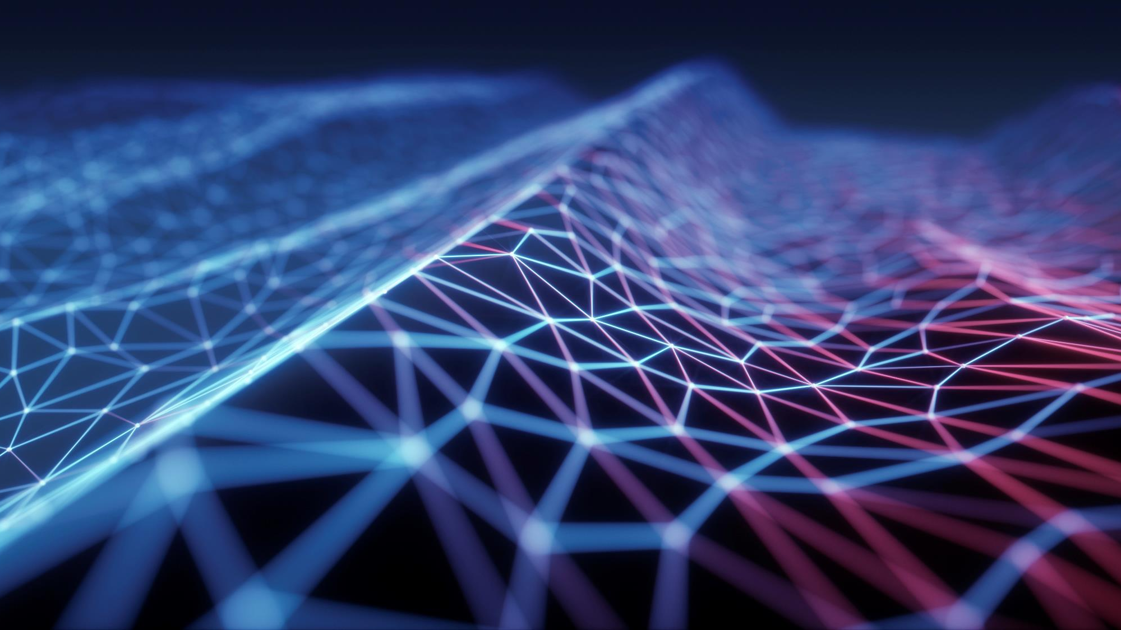
Senior Design Project: Color Filter
By Ezequiel Villanueva & Logan Doizaki
Notes:
Introduce yourselves/

Slide 2
Presentation Outline
Project Description 3
Architecture 5
Development 10
Budget 15
Schedule 16
Q&A 17

Slide 3
Project Description

Slide 4
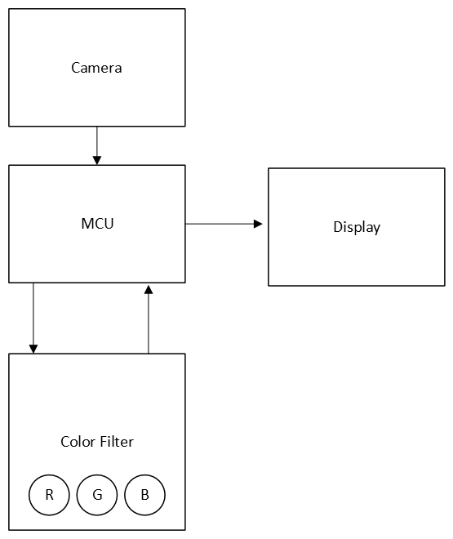
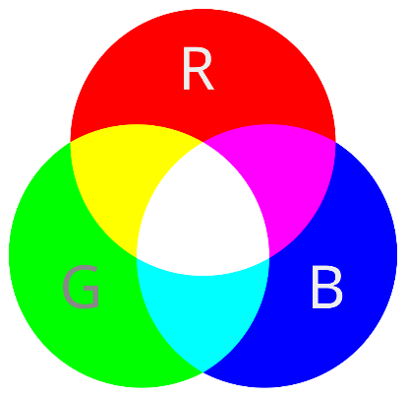
Overview
The purpose of this project is to develop a device which processes an image and applies RGB manipulation through user-based input.
This project introduces students to digital image processing and file management.
Notes:
Clarify go more in depth in next slide. This is just the quick idea explanation.

Slide 5
Architecture

Slide 6
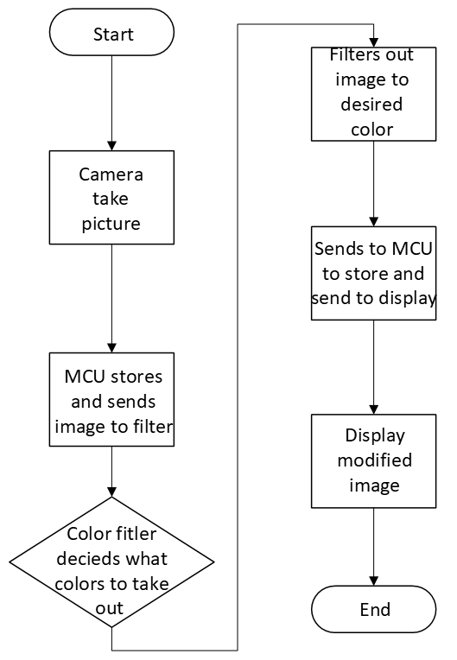
Workflow
The device is connected to a microcontroller (MCU) with the ability to take, store, and display images.
The MCU captures a picture (storing it on the MCU) using the camera attached and displays the unedited image on the display the MCU is attached to.
Using the MCU, the whole image file is sent to the Color Device filter where it will be stored temporarily.
On the device, when the image is received, the user can select between 3 buttons. The 3 buttons control the red, green, and blue filters. The buttons, when enabled, take out 100% of the selected color.
After the user selects their modifiers, the color filter works by utilizing multiplexers, multipliers, adders, and shifters to apply the change to the image stored locally.
After digitally altering the image, the processed image is stored on the device.
The image is then sent back to the MCU.
The MCU is used to display modified images on the display.

Slide 7
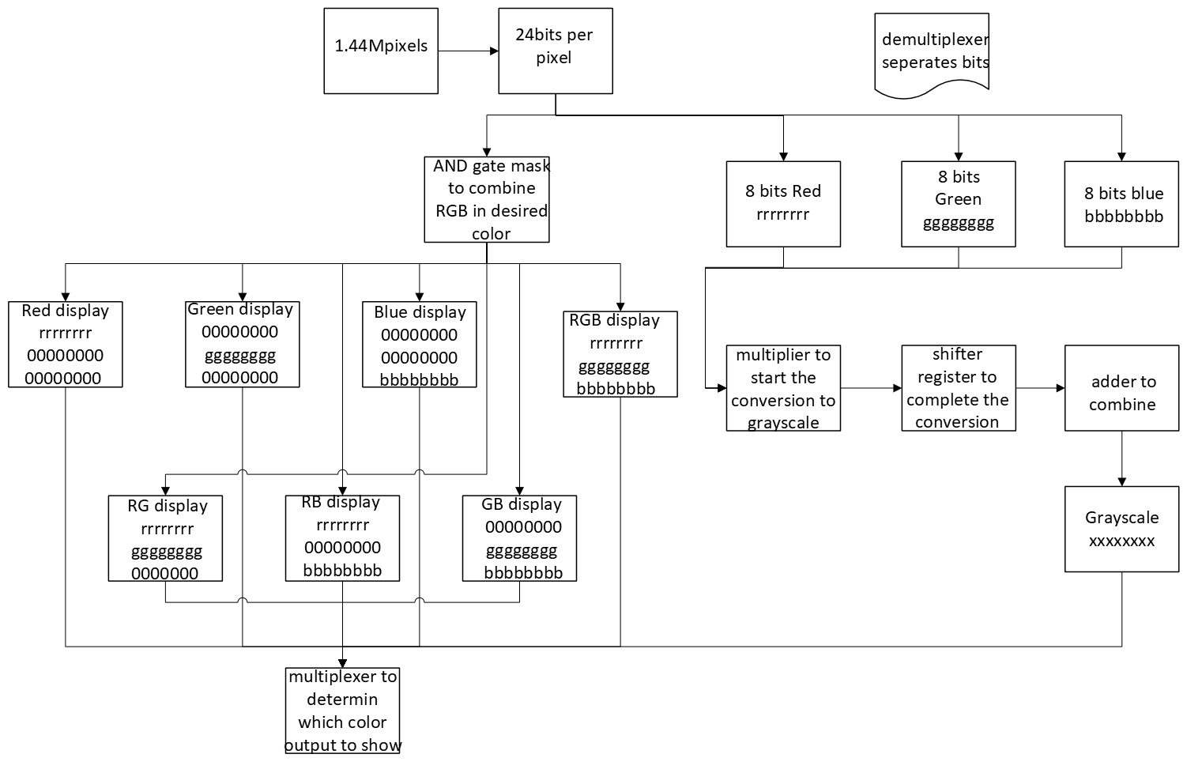
Memory System
MCU takes a JPEG file and converts to Bitmap file.
Memory system works by sending the image segments at a time that are processed within the filter.

Slide 8
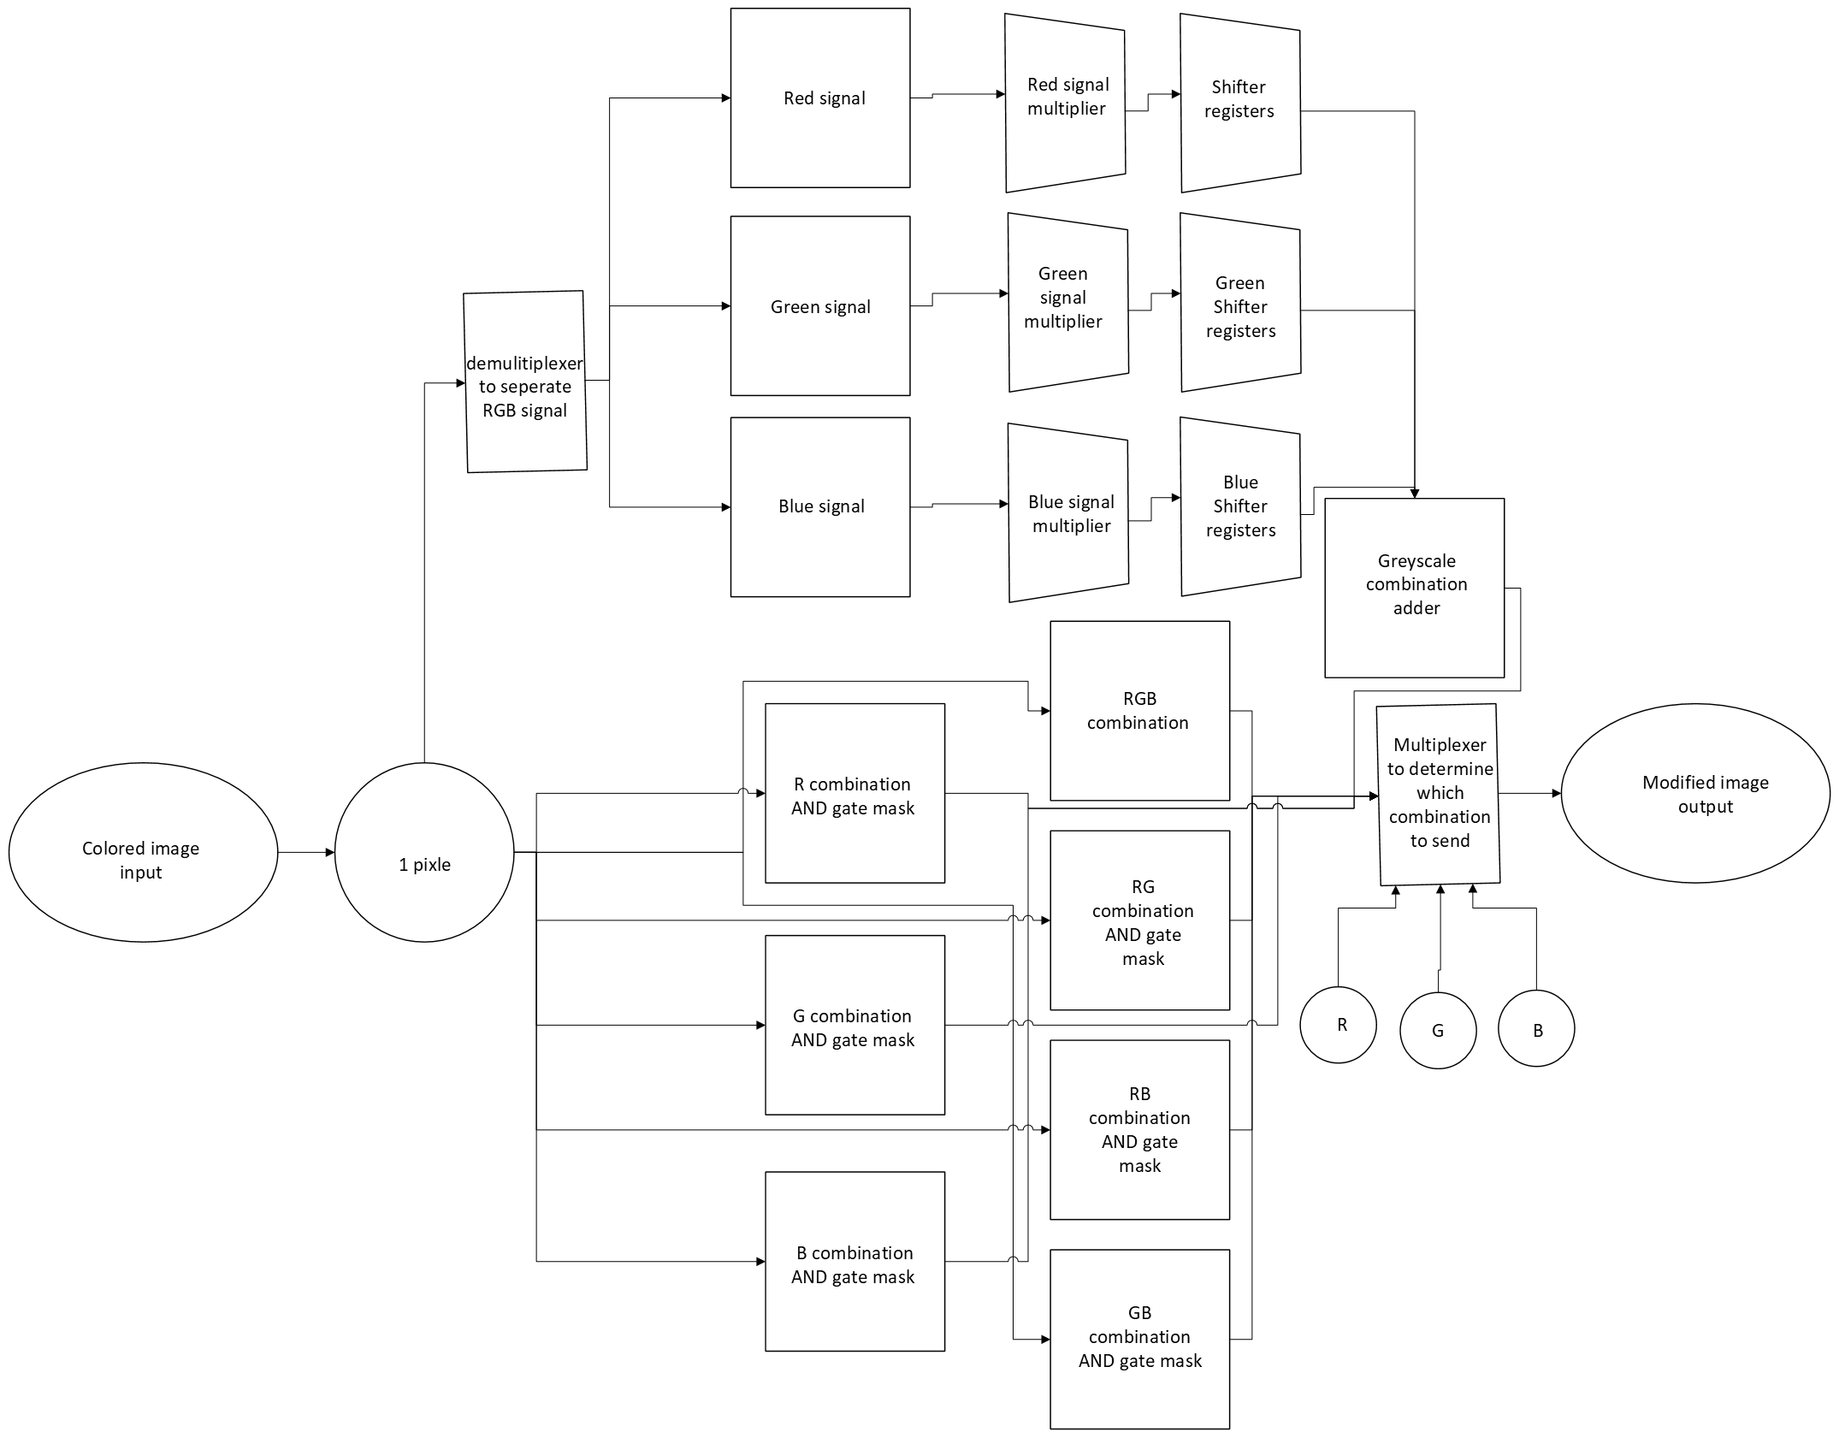
Color Filter
The Color Filter is composed of:
De/Multiplexors:
Multipliers:
Adders:
Shifter registers:
AND gates:
Notes:
Multipliers: These will be used to do part of the conversion from full color to greyscale. Staying in binary to be able to multiply a fraction a multiplier is needed. These will manipulate the values of red, green, and blue. With the help of a shift register it will make the picture into grayscale
Adders: These will be used to combine the red, green, and blue signal. After doing the conversion to greyscale you need to combine the numbers back together to produce the greyscale color.
Shift Register: These will be used to do part of the conversion from full color to greyscale. With staying in binary to be able to multiply a fraction a shift register is need. This will complete the conversion from color to grayscale by shifting the multiplier output. The shift registers and multipliers together complete the full conversion.
AND gates: These will be used as filters. Taking a mask and putting the red, green, and blue signals through the AND gate with the mask will filter out the colors that are not wanted.

Slide 9
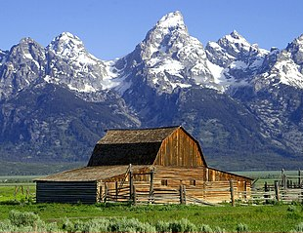
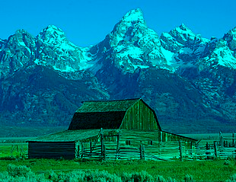
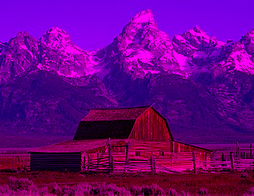
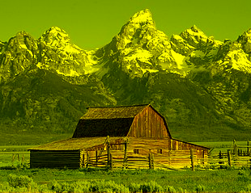
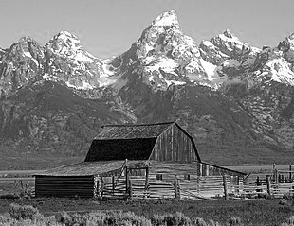
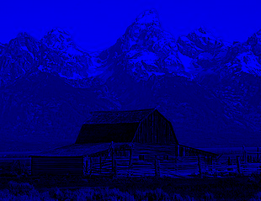
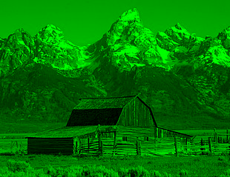
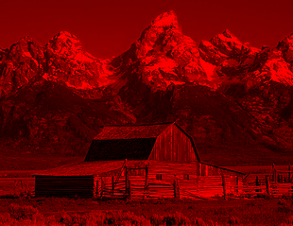
Examples
Notes:
Examples of the filter in action. Shortcuts indicate REMOVED COLOR
OG | R | G | B GREY | RG | RB | GR

Slide 10
Development

Slide 11
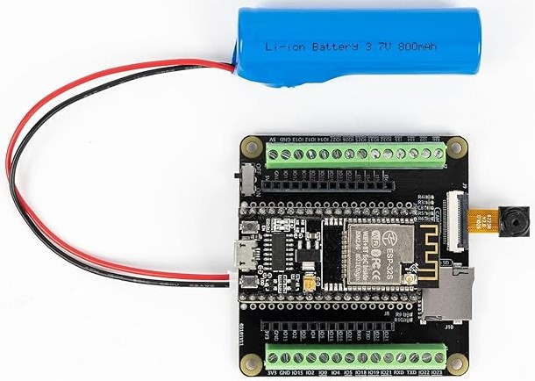
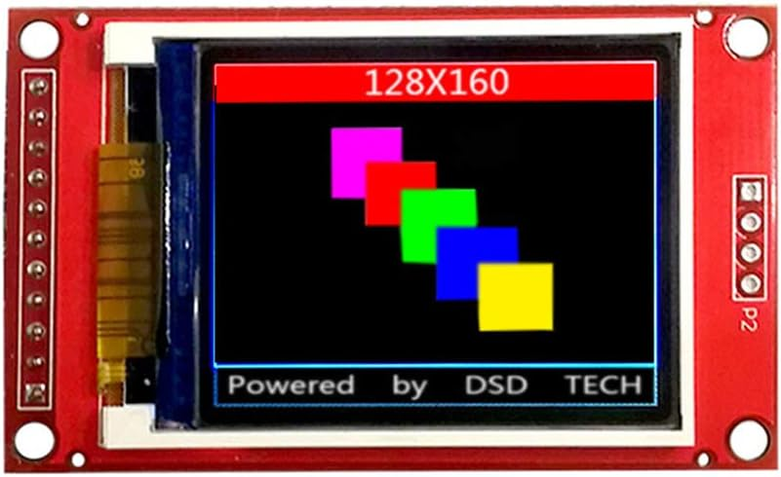
The microcontroller implementation
Focus on setting up the microcontroller.
ESP32
The Arduino IDE using Python and C will be used.
The microcontroller attaches to an external camera, store images locally (on board memory/external memory), and display the image on an external display.
A simple interface would be created for the MCU for users to use.

Slide 12
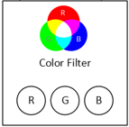
The Color Filter Device
When starting out, only one-color filter will be developed.
Simultaneously, a memory management system will be created to allow the image file received from the MCU to be accessed, modified, and transferable.
A simple button interface will be created on the device itself to allow the user to toggle the filters developed and send the image to the MCU.

Slide 13
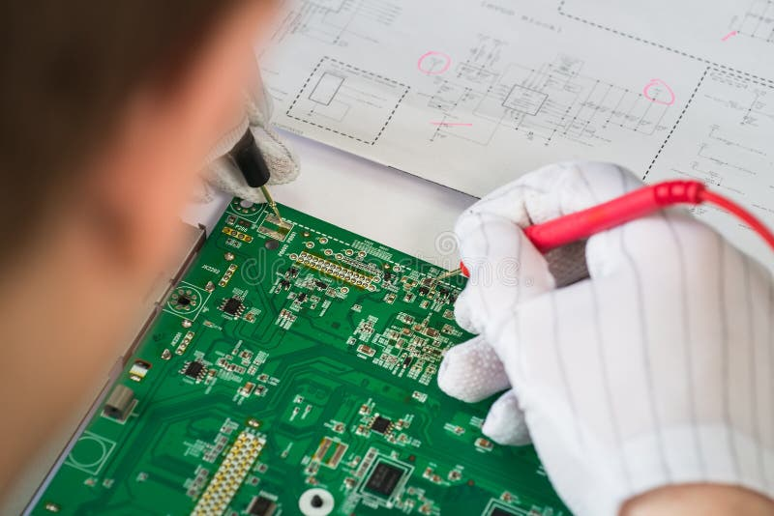
Testing
Testing will be done concurrently with the process of step 1 and 2.
Extensive testing will be done once both steps are completed.
After developing the Microcontroller and the Color filter device, both will be connected to each other. Some tests are:
Expecting interfaces to work correctly
Files being transferred without corruption.
RGB Filter creating expected results

Slide 14

Optimization
After completing the previous steps, optimization can begin. Optimization could include:
Pricing, where we choose better or cheaper components.
Better processing, Using simpler components, advanced components, redesigning the code/hardware and more.
Future Project Ideas:
Advancing the User Interface: Adding more controllability using knobs
Live Feed Capability

Slide 15
Budget
Part | Cost
ESP32 w/ Camera Module | 27
DSD TECH 1.8 Inch TFT LCD Display Module | 9.99
Switches/Buttons | 7.99
MicroSD | 6.79
De/Multiplexers | 2(2.95) = 5.9
Multipliers | 3(.94)=2.82
Adders | 4(5.12) =20.48
Shifters | 3(1.05) =3.15
AND | 36(0.42)=15.12
Resistor Variety | 9.99
Breadboard | 8.99
PCB | Refer To Above Description??? (20-50)
Total | 118.22
Price of parts as of writing 12/5/2024
Notes:
It should be noted, the total price will vary as the components used in the color filter device changes. In this chart, we are assuming these will be the parts list in the color filters device. The cost changes as development progresses.
- Cost for a single device is $125.26 not including the PCB and tax/shipping. With the PCB the cost could increase to approximately $160.
- Mention, two of these devices would be created to allow efficient collaboration. By having two devices, this would allow work to be done simultaneously. The cost would double to $320.
- PCB can be commissioned.

Slide 16
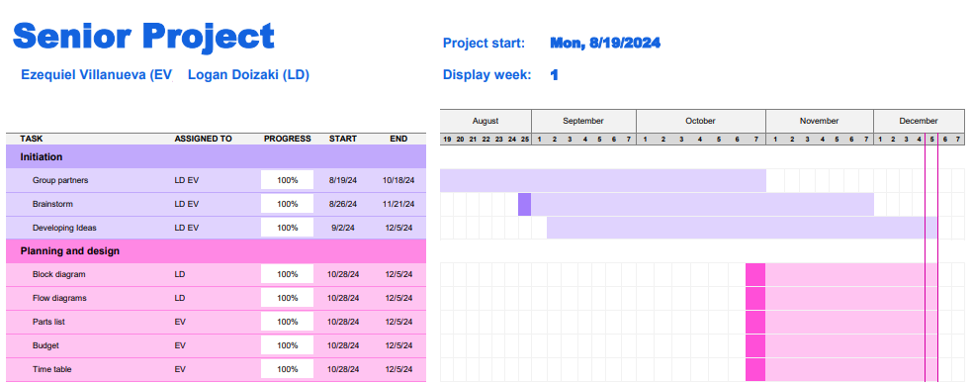
Schedule

Slide 17

Q&A
Got Any Questions?

Slide 18
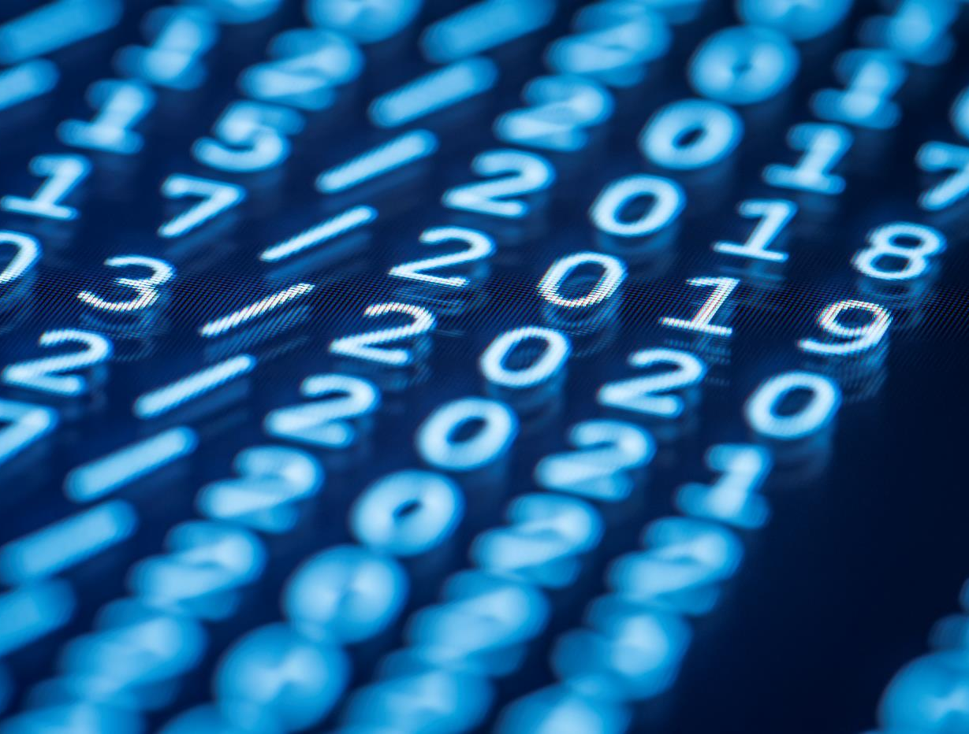
Thank You
Email us: evillan5@msudenver.edu
ldoizak1@msudenver.edu

