Slide 1
Independent Re-analysis of the MAL2 Malaysian Cohort
Ezra Seckin
BIOMI 4300
Testing a Global CRC Microbial Consortium:

Slide 2
01
Introduction

Slide 3
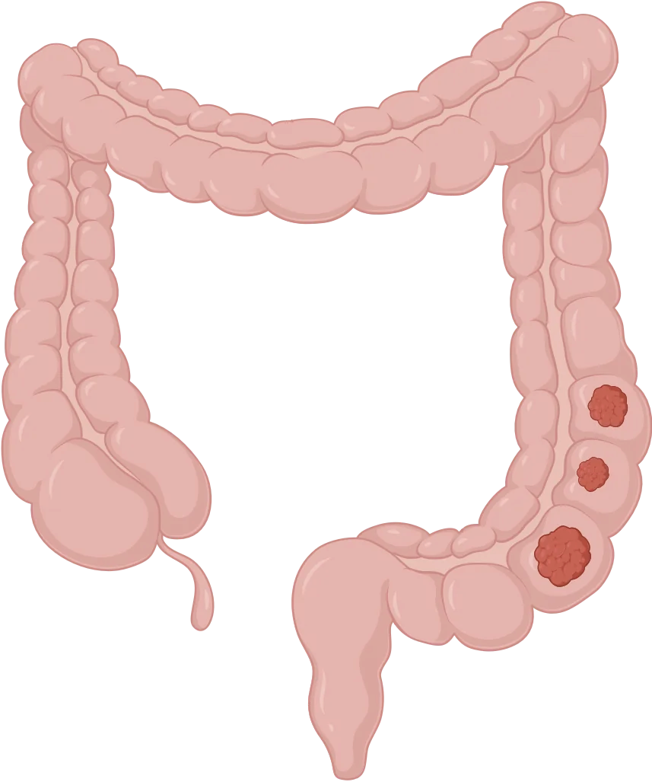
"CRC Is the 3rd Most Common Cancer Globally, Yet Non-Genetic Risk Factors Remain Poorly Characterized"
~1.93 million new CRC cases globally in 2022; 9.6% of all cancers; 2nd leading cause of cancer death
Only ~5–10% of CRC is attributable to hereditary syndromes (APC mutations → Familial Adenomatous Polyposis; Lynch syndrome → MLH1/MSH2)
The remaining ~90% of sporadic cases implicate environmental/microbial drivers, including the gut microbiome as a potential contributing factor
https://static.igem.wiki/teams/5758/description/colorectal-cancer.webp

Slide 4
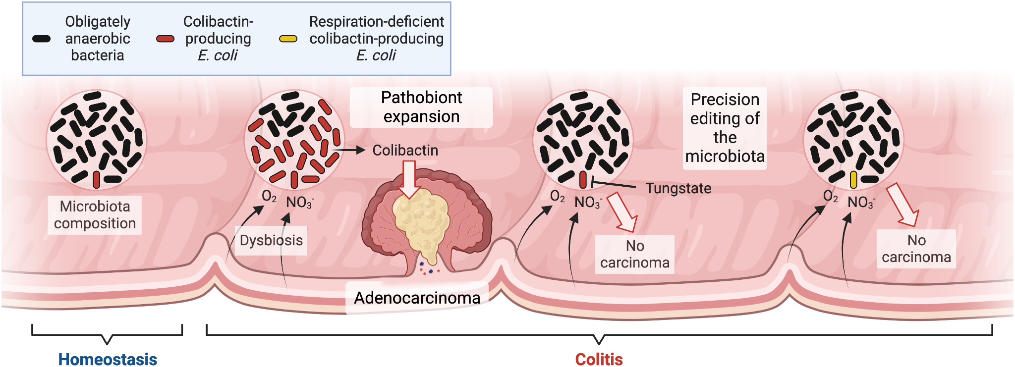
"Multiple Studies Confirm That CRC Tissue Is Consistently Enriched for Oral Pathogens and Depleted of Protective Commensals"
Over a dozen studies using stool and tumor tissue sequencing have associated CRC with microbial dysbiosis in taxonomic composition and/or mucosal structural organization
Consistently enriched in CRC tissue:
Fusobacterium nucleatum (oral pathogen; promotes tumorigenesis via FadA/Fap2 adhesins)
Bacteroides fragilis (ETBF strain) (encodes the BFT metalloprotease toxin)
Parvimonas micra, Peptostreptococcus stomatis, Gemella morbillorum (oral anaerobes)
Consistently depleted in CRC tissue:
Faecalibacterium prausnitzii (anti-inflammatory butyrate producer)
Bacteroides vulgatus, B. dorei, B. stercoris (protective commensals)
https://www.pnas.org/doi/10.1073/pnas.2316579120

Slide 5
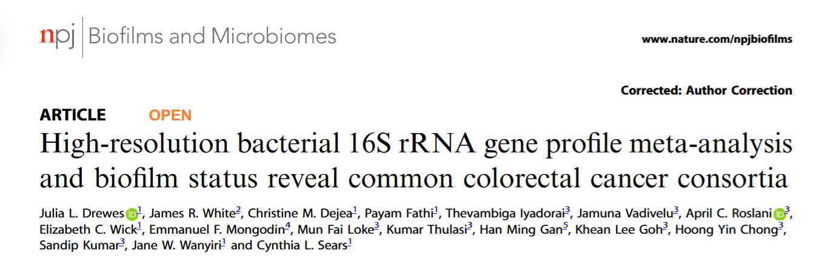

Slide 6
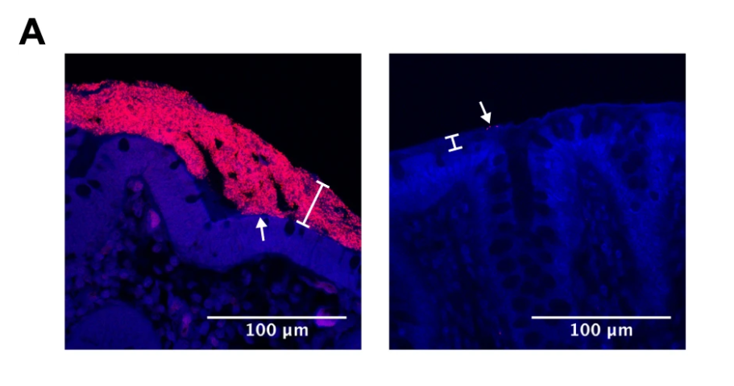
"Polymicrobial Biofilms Cover ~100% of Right-Sided CRC Tumors and Their Paired Normal Tissue Suggesting They Precede Tumorigenesis"
Biofilms = dense polymicrobial aggregates invading the inner mucus layer; visualized by FISH (Eub338 probe)
Right-sided tumors: 100% biofilm-positive across all three cohorts (USA, MAL1, MAL2)
Left-sided tumors: Only 37.5% biofilm-positive in MAL2 (Fisher's exact p = 0.008)
Biofilm status of paired normal tissue matches the tumor in 20/23 MAL2 patients → biofilm precedes cancer
a Microbial biofilms in Carnoy’s-fixed tissue were detected by FISH with the universal 16S rRNA gene probe Eub338 (stained in red) and the nucleic acid stain DAPI (blue).

Slide 7
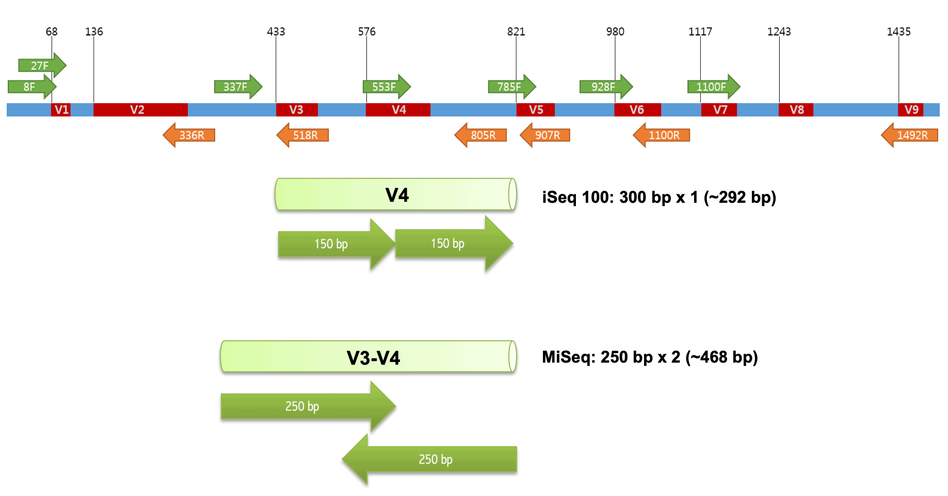
"Genus-Level Resolution and Cross-Lab Heterogeneity Masked Species-Specific CRC Signals Across 11+ Prior Datasets"
Different primers (V1-V2, V3-V4, V3-V5), platforms (454, MiSeq), and extraction methods → contradictory findings
OTU-level clustering conflates pathogenic and commensal species within the same genus
Canonical example: F. nucleatum (CRC-enriched) vs. F. mortiferum/varium (not enriched) are invisible at genus level — their signals cancel
F. prausnitzii* (commensal, CRC-depleted) was historically misclassified as Fusobacterium — reversing the signal entirely
Solution: Drewes et al. applied Resphera Insight (species-level 16S classifier) uniformly to all 12 datasets*
https://help.ezbiocloud.net/wp-content/uploads/2019/02/iseq-100-V4-region.png

Slide 8
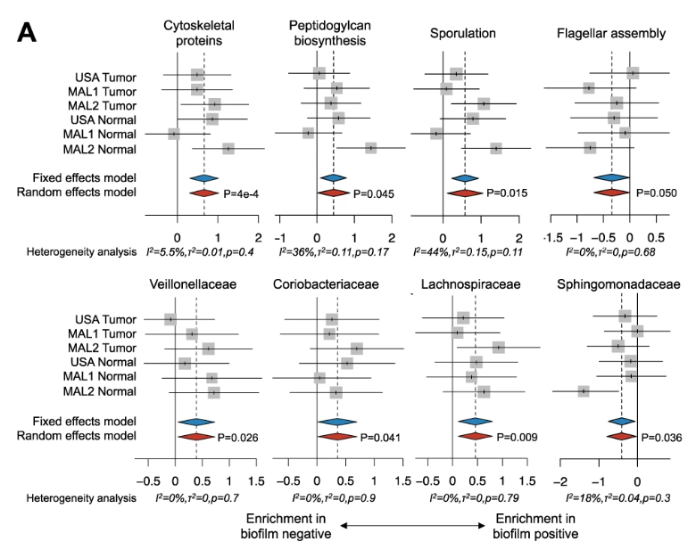
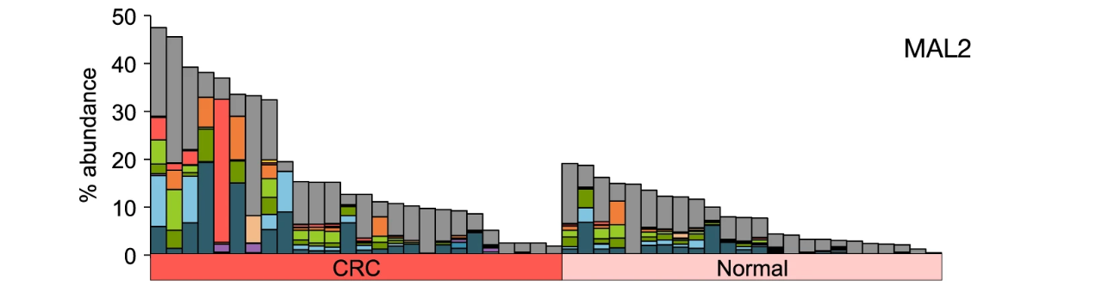
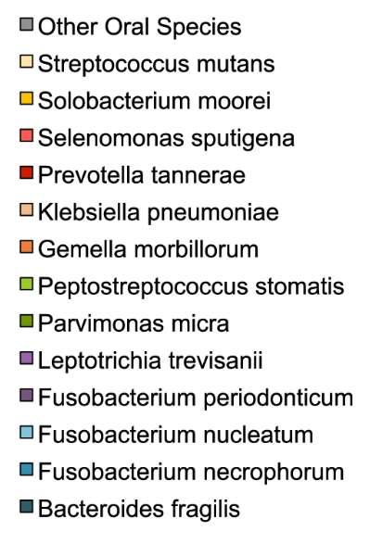
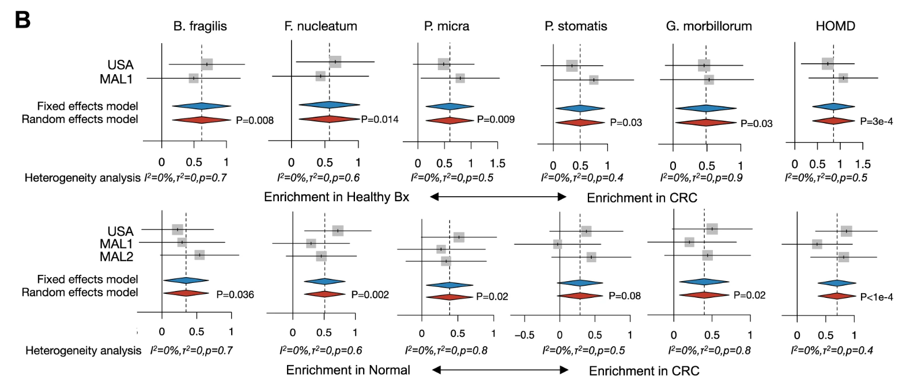
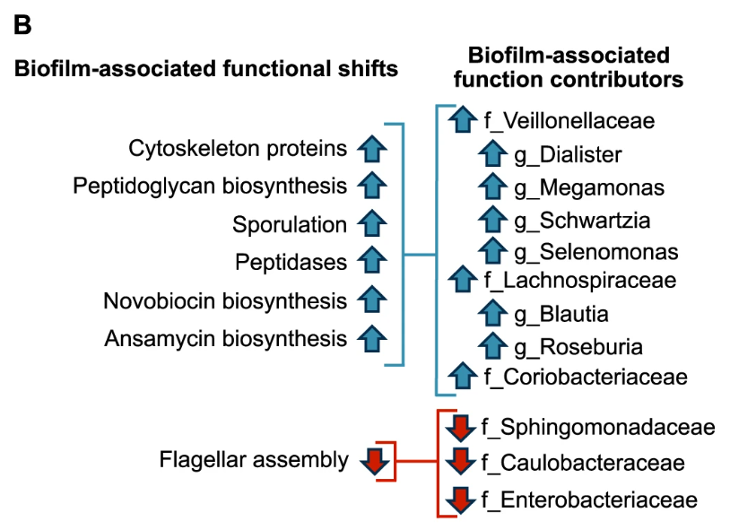
Associations of B. fragilis and human oral microbiota with CRC status for USA, MAL1, and MAL2 cohorts. Microbiome profiling with 16S rRNA gene sequencing was applied to tumor (CRC) and paired normal tissues (Normal) from CRC patients for all three cohorts, as well as healthy biopsies (Healthy Bx) for USA and MAL1

Slide 9
So…why do we care?
…And what did I do?

Slide 10
Goals:
Build original analyses of the MAL2 Cohort
2) Try to recreate analyses built by the authors

Slide 11
02
Ezra’s 16S Amplicon Pipeline

Slide 12
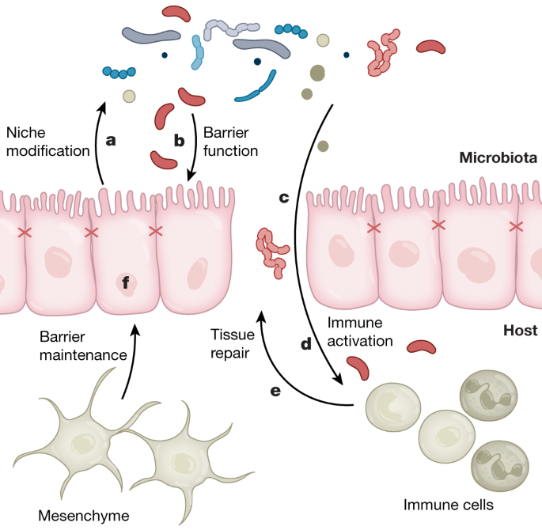
Hypothesis Formation
Scientific question: Does gut microbial community composition and diversity differ between patients with colorectal cancer (CRC) and healthy individuals with normal colon tissue, and if so, which specific taxa drive these differences?
Null hypothesis (H₀): Gut microbial alpha diversity, beta diversity, and taxonomic composition do not differ between CRC and Normal colon tissue samples — any observed differences are attributable to inter-individual variation rather than disease status
Alternative hypothesis (H₁): Gut microbial diversity is reduced and community composition is significantly altered in CRC samples relative to Normal samples, characterized by the enrichment of oncogenic pathobionts (e.g., Fusobacterium nucleatum, Peptostreptococcus stomatis) and the depletion of protective commensals (e.g., Faecalibacterium prausnitzii), consistent with disease-associated dysbiosis in the tumor microenvironment
https://media.springernature.com/m685/springer-static/image/art%3A10.1038%2Fs41586-020-2729-3/MediaObjects/41586_2020_2729_Fig1_HTML.png

Slide 13
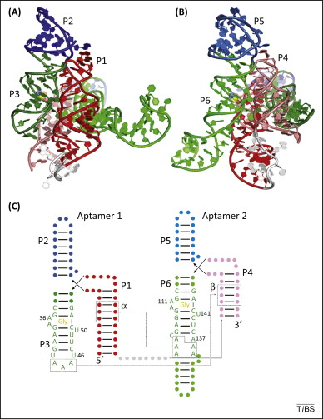
Dataset & Sequencing Strategy
Source: MAL2 cohort (Drewes et al., 2017; BioProject PRJNA325650) — surgical biopsy tissue samples collected from CRC tumor tissue and paired normal tissue taken from a non-cancerous region of the resected colorectal sample as far as possible from the tumor — 23 CRC patients yielding paired tumor + normal biopsies; 41 samples retained after QC in our analysis (20 CRC, 21 Normal)
Sequencing platform: Illumina MiSeq, paired-end 2×250 bp; targeting the V3-V4 hypervariable region of the 16S rRNA gene using primers 515F (GTGYCAGCMGCCGCGGTAA) and 806R (GGACTACNVGGGTWTCTAAT)
Bioinformatic pipeline: Primers removed with Cutadapt; quality filtering, denoising, and ASV inference with DADA2; taxonomy assigned against the SILVA v138 reference database; downstream analyses in R using phyloseq, vegan, and iNEXT
https://www.sciencedirect.com/science/article/pii/S0968000415000262

Slide 14
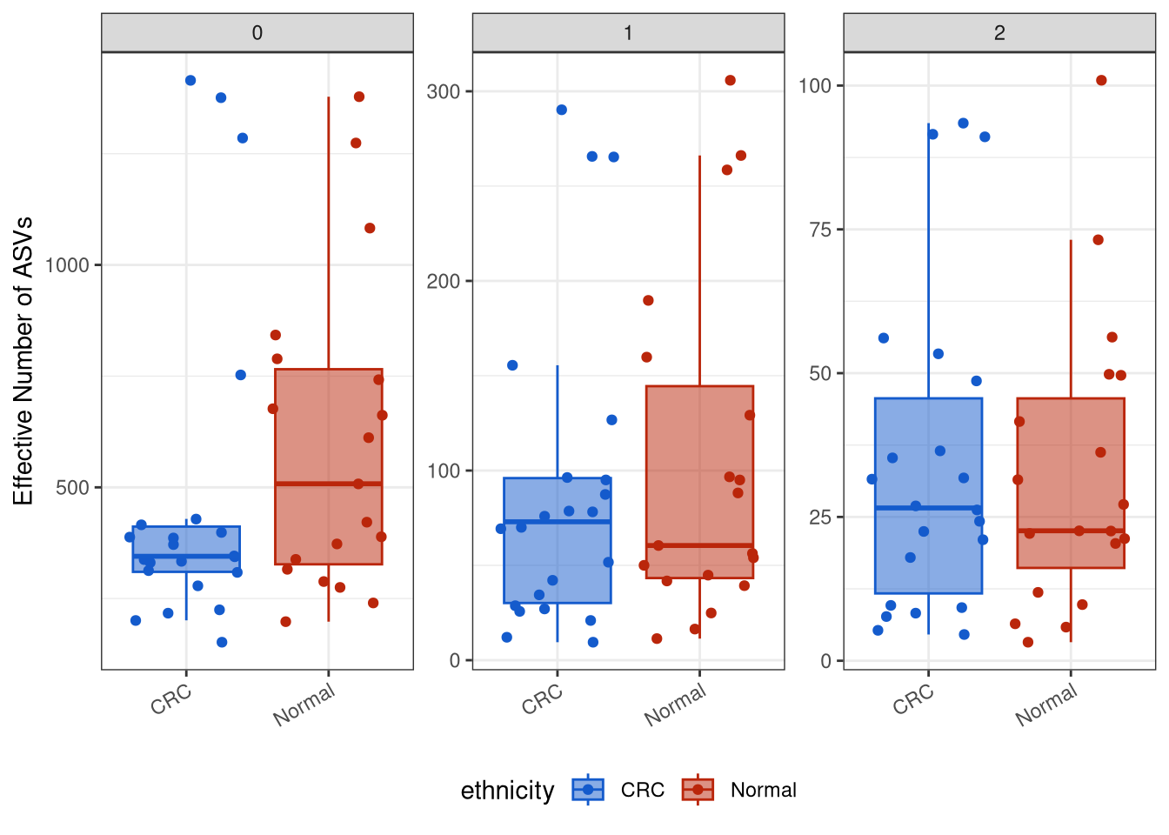
“Abundance Unweighted Counts is Significantly Lower in CRC Samples”
Richness Shannon Simpson

Slide 15
“Abundance Unweighted Counts is Significantly Lower in CRC Samples”
q = 0 (Richness): Normal samples show substantially higher richness than CRC, consistent with the loss of rare commensal taxa during gut dysbiosis.
q = 2 (Simpson): Dominant taxa are similarly structured between groups, suggesting CRC selects against rare taxa while preserving — or even enriching — overdominant ones.
Biological relevance: This pattern challenges the idea that immunoprivileged tumor microenvironments allow for increased microbial density and the rise of opportunistic taxa that would otherwise be kept in check by host immunity.

Slide 16
Do we expect community-wide shifts in the composition of our microbiome samples?

Slide 17
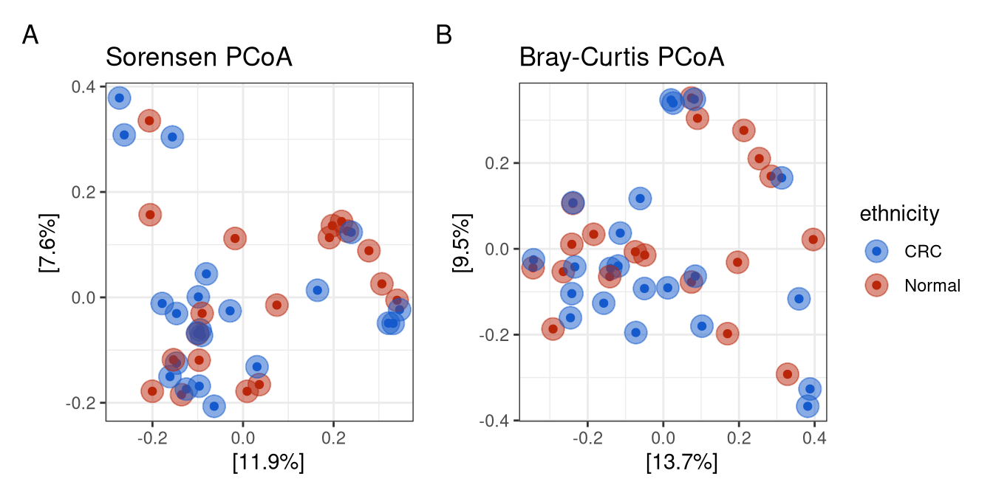
PCoA Analysis: Sorensen vs. Bray-Curtis
R²=0.01696
F = 0.6727
R²=0.01659
F = 0.98341

Slide 18
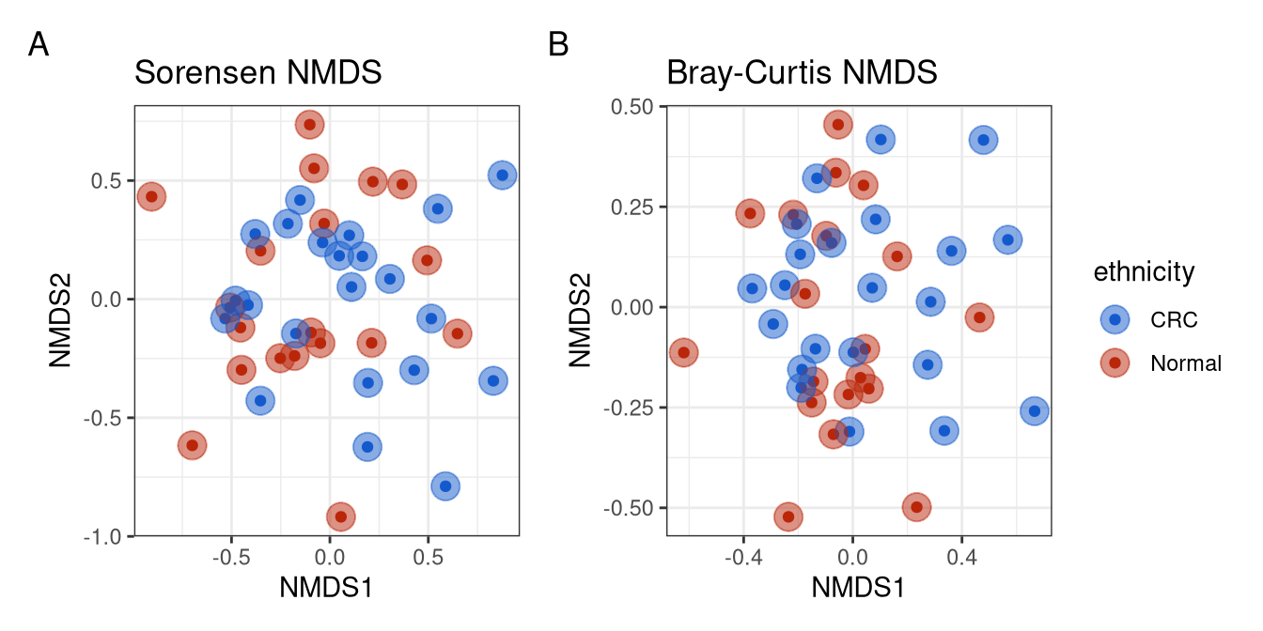
NMDS Analysis: Sorensen vs. Bray-Curtis

Slide 19
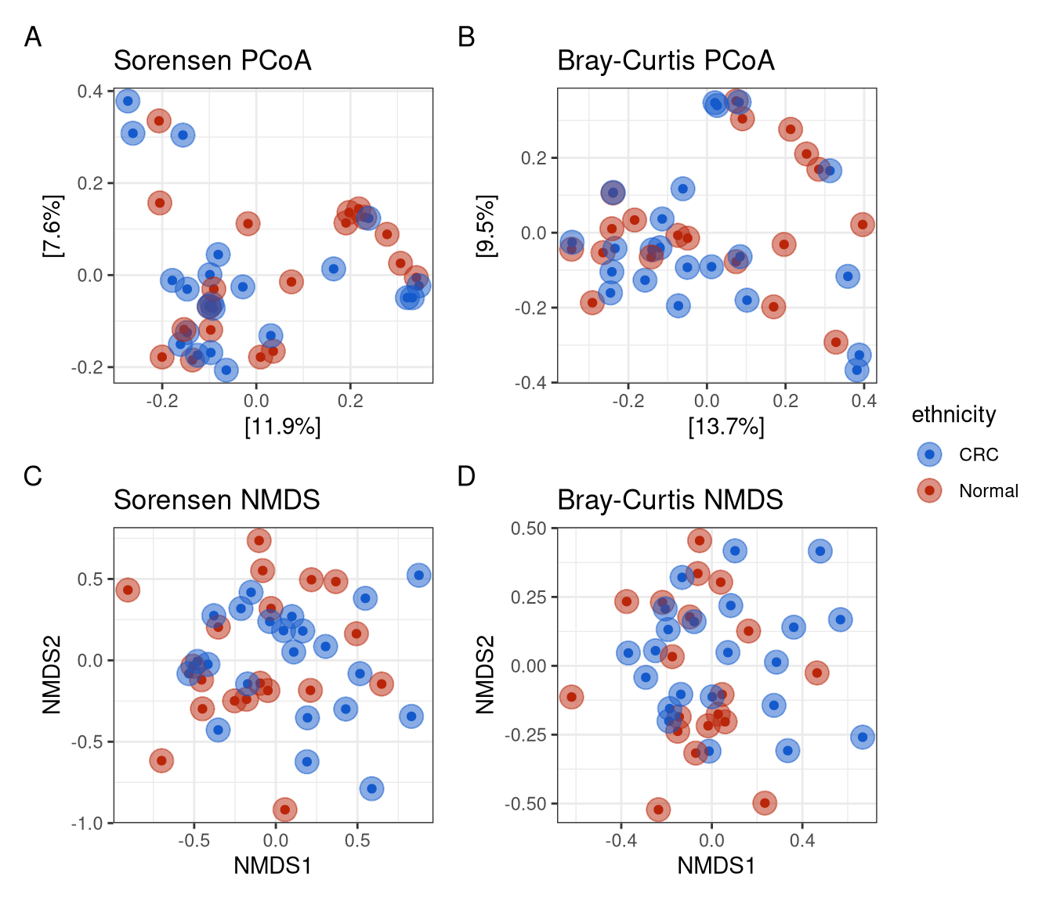
Why is this the case?
No clustering by CRC status: CRC and Normal samples are broadly intermixed across all four ordinations, indicating that CRC does not drive community-wide shifts in gut microbial composition.
Consistent across methods: Both PCoA and NMDS, using both Sorensen and Bray-Curtis, tell the same story, strengthening confidence in this conclusion.
Inter-individual heterogeneity dominates: Host-specific factors appear to be the primary driver of community variation, consistent with the well-known high variability of the human gut microbiome across individuals.

Slide 20
Do we expect heterogenous shifts within individual microbial taxa?

Slide 21
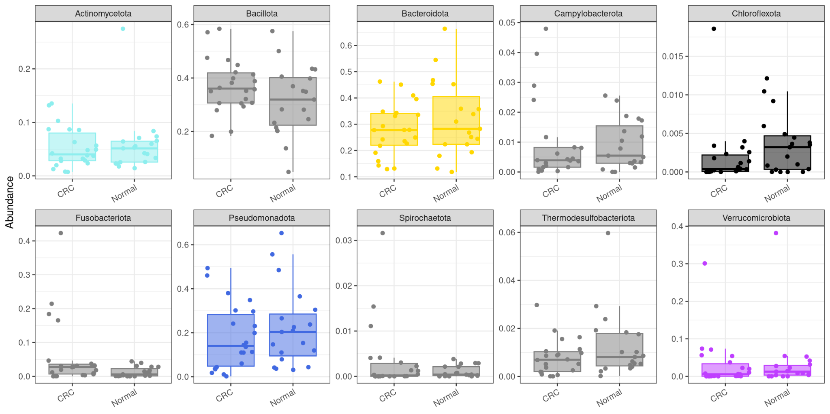
How about 10 most common Phylum?

Slide 22
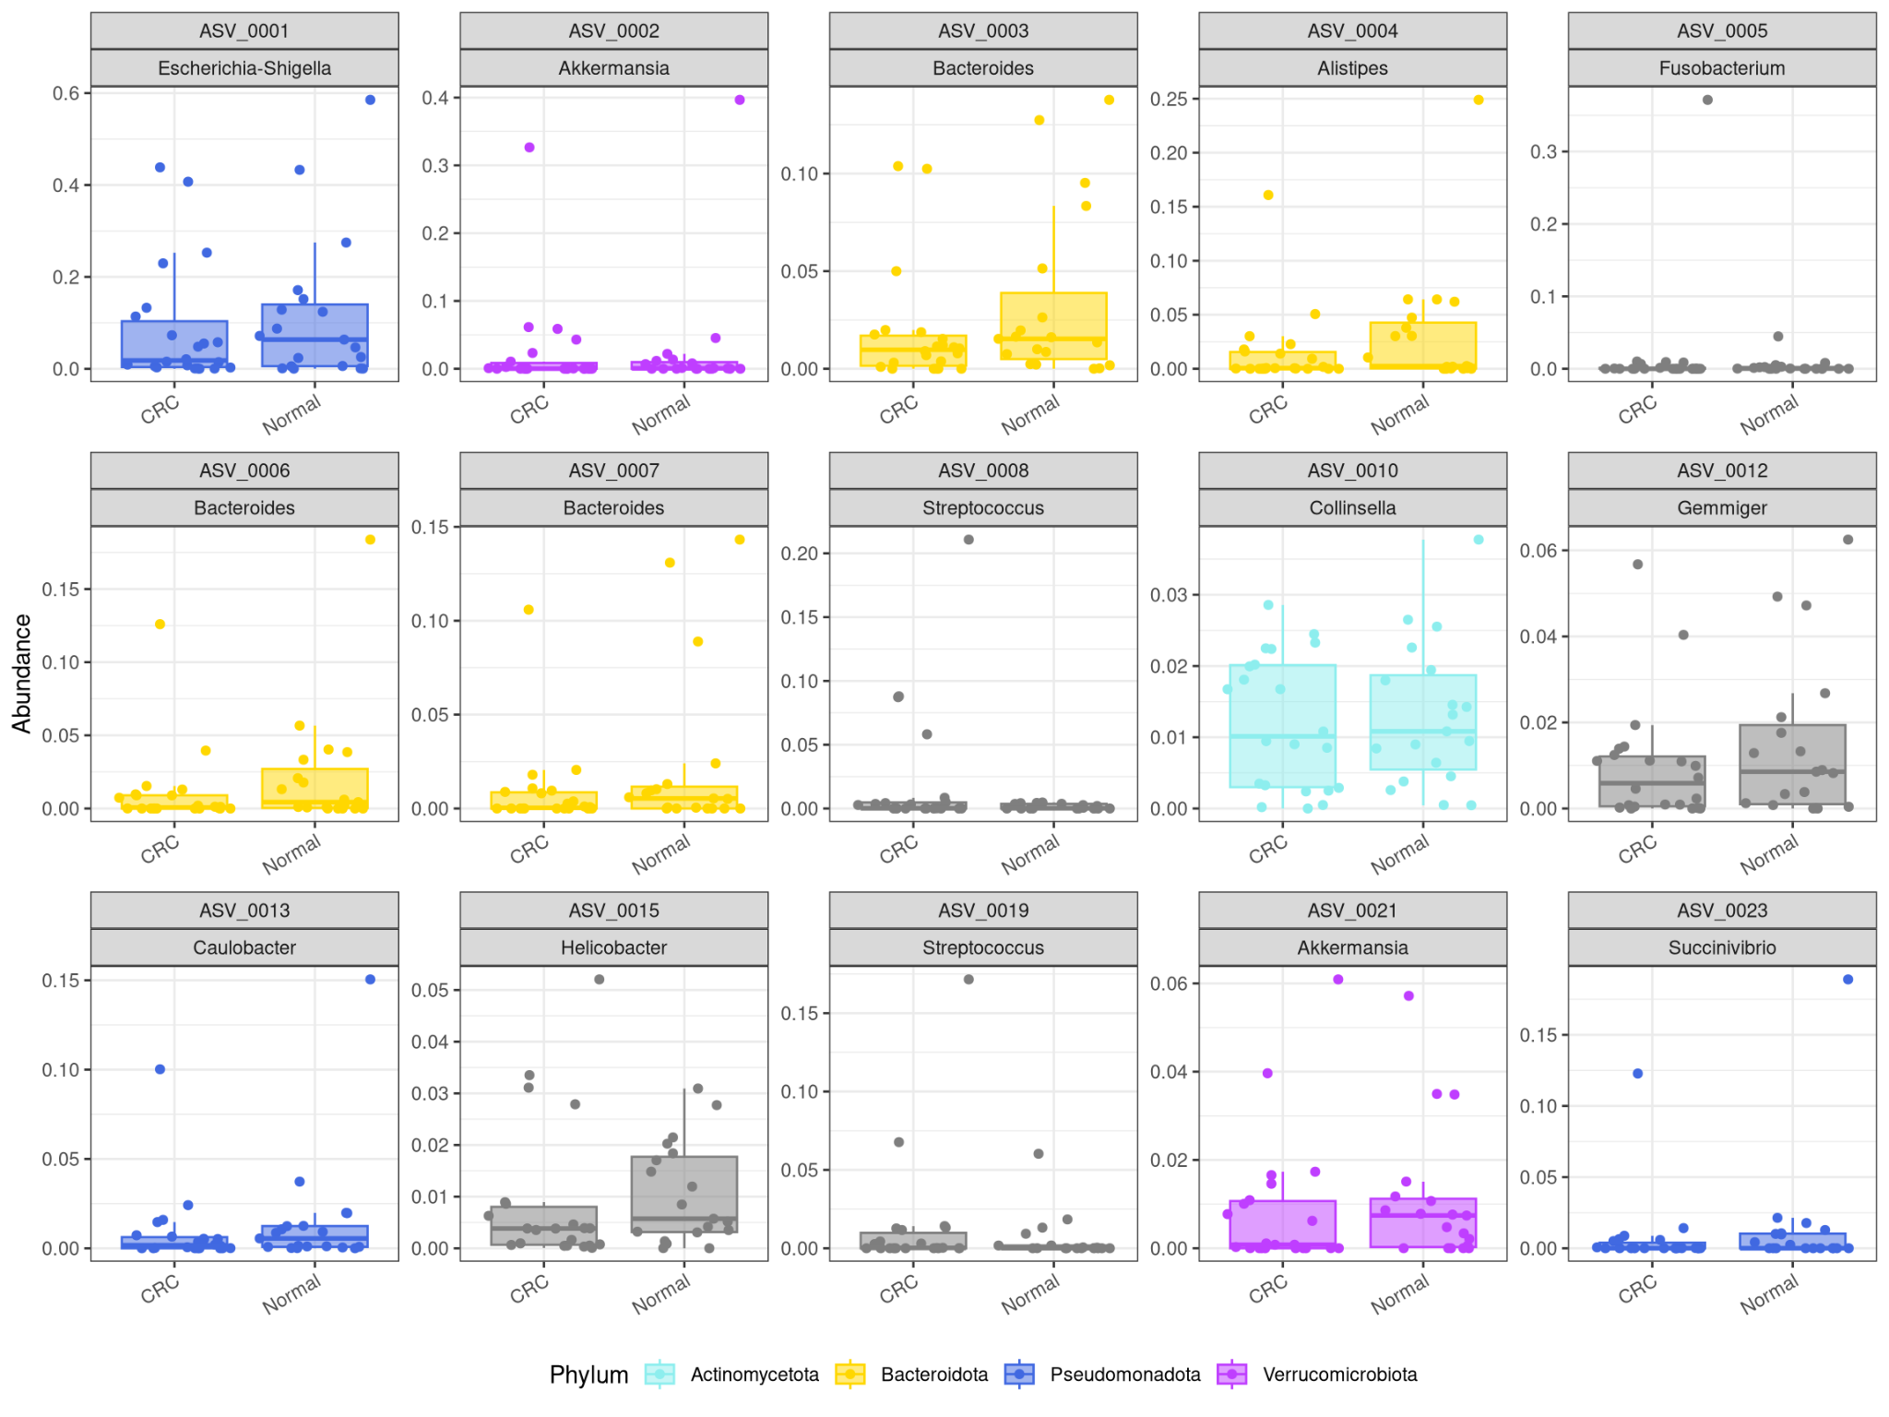
How about 15 most common ASVs?

Slide 23
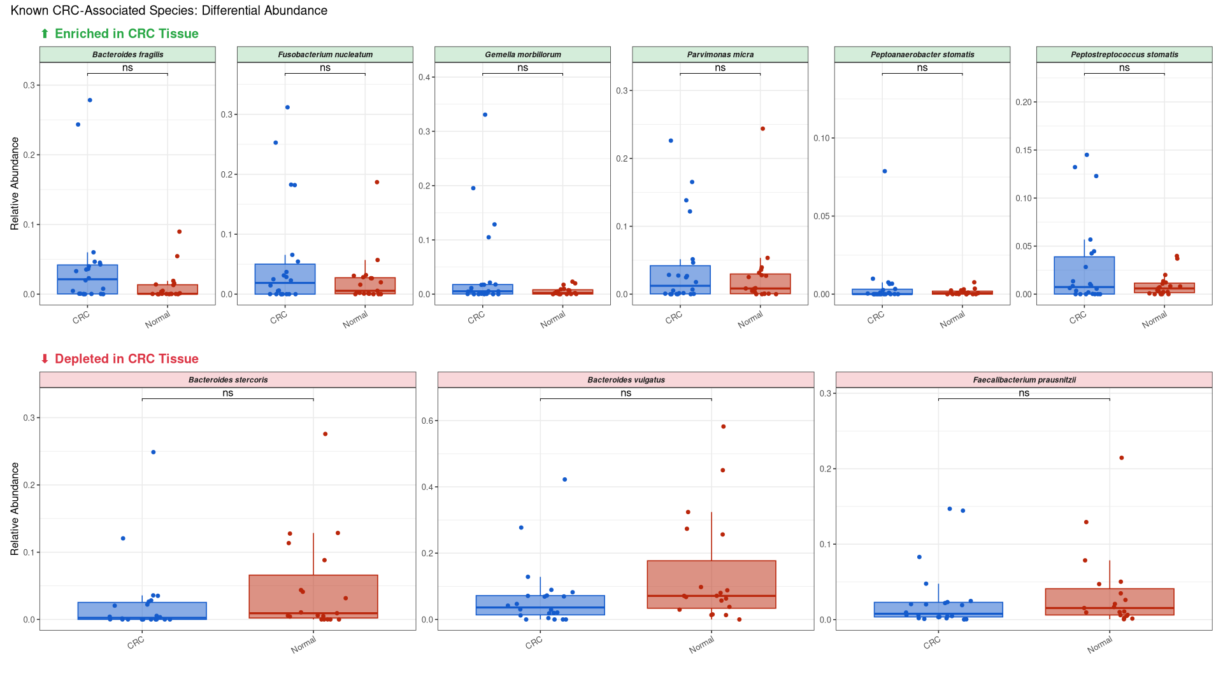
How about canonical species?

Slide 24
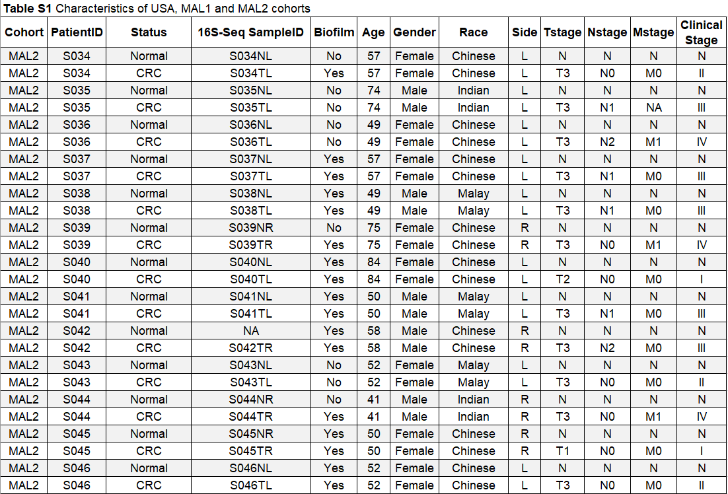
Future Directions…

Slide 25
References
Drewes JL, et al. (2017). High-resolution bacterial 16S rRNA gene profile meta-analysis and biofilm status reveal common colorectal cancer consortia. npj Biofilms and Microbiomes, 3, 34. https://doi.org/10.1038/s41522-017-0040-3
Bray F, et al. (2024). Global cancer statistics 2022: GLOBOCAN estimates of incidence and mortality worldwide. CA: A Cancer Journal for Clinicians, 74(3), 229–263
McMurdie PJ & Holmes S. (2013). phyloseq: An R package for reproducible interactive analysis of microbiome census data. PLOS ONE, 8(4), e61217.
Quast C, et al. (2013). The SILVA ribosomal RNA gene database project. Nucleic Acids Research, 41(D1), D590–D596.
Callahan BJ, et al. (2016). DADA2: High-resolution sample inference from Illumina amplicon data. Nature Methods, 13(7), 581–583.

Slide 26
Independent Re-analysis of the MAL2 Malaysian Cohort
Ezra Seckin
BIOMI 4300
"Testing a Global CRC Microbial Consortium:

