Slide 1
Spotify App - Capstone Project
Chan Yu Heng

Slide 2
Requirement and Problem Statement
Additional Feature
Technology Stack
UI Wireframe
Feature from Angular
Activity Diagram
Frontend / Backend Structure
Database Structure
Demonstration

Slide 3
Requirement and Problem Statement

Slide 4
Requirement and Problem Statement
Functional Requirement
User Registration and Login
List common track and view track a track
Search music track
Add track to favorite list
View favorite track list
Non-Functional Requirement
Useability
Easy navigation
Logging
Clean code
Should be documented and tested

Slide 5
Additional Feature

Slide 6
Additional Feature
Added logout feature
Added delete track from favorite

Slide 7
Technology Stack

Slide 8
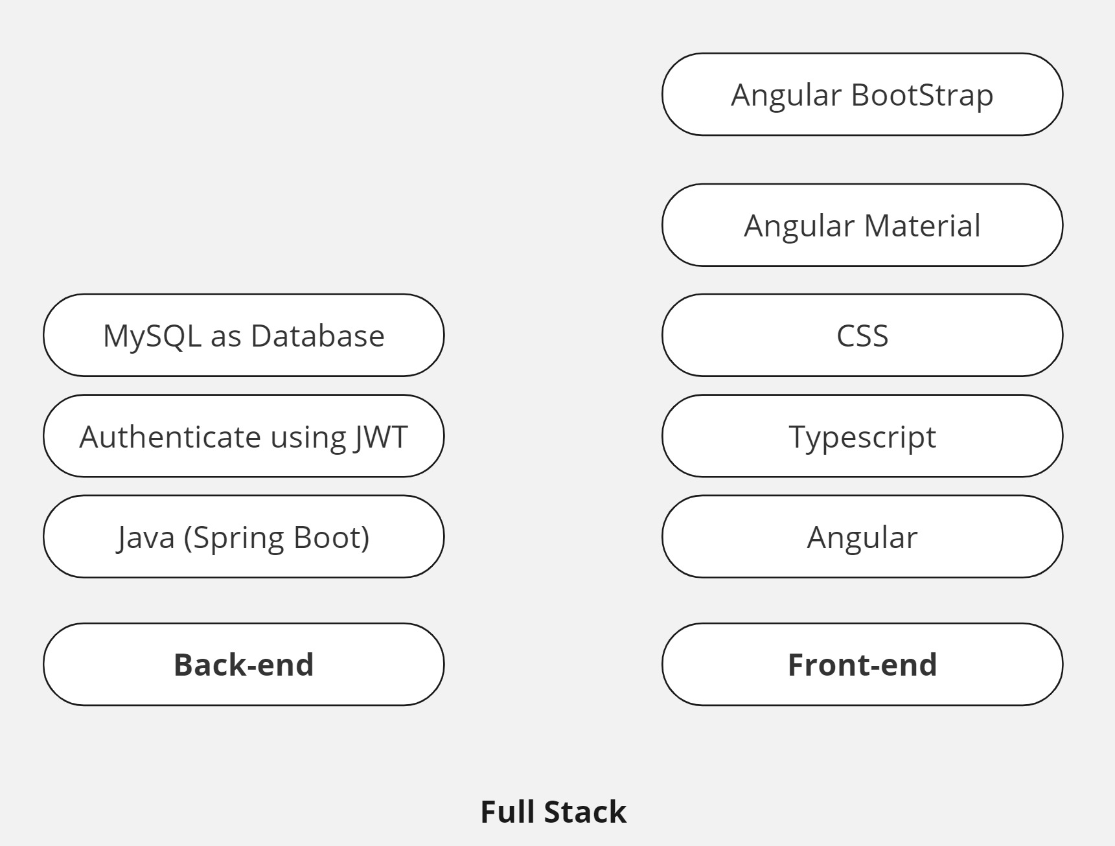
Technology Stack
Notes:
MongoDB:
MongoDB is a non-relational database that stores data in JSON-like documents. It supports arrays and nested objects.
Unlike traditional relational databases (such as MySQL or PostgreSQL), MongoDB is more flexible. It doesn’t require a fixed table structure, making it suitable for scenarios where data instances have varying fields.
Features of MongoDB include document-oriented storage, built-in replication support, and sharding for scalability.
Express.js:
Express.js is a server-side framework that simplifies web and mobile application development.
It allows developers to create single-page, multi-page, and hybrid web apps.
Express.js provides routing, middleware support, and an easy-to-use API for handling HTTP requests.
React.js:
React.js is a powerful front-end library for building user interfaces.
It enables developers to create dynamic, interactive, and reusable UI components.
React’s virtual DOM optimizes rendering performance, making it ideal for modern web applications.
Node.js:
Node.js is a server-side runtime environment that allows JavaScript to run on the server.
It provides event-driven, non-blocking I/O, making it efficient for handling concurrent requests.
Node.js integrates seamlessly with Express.js, allowing developers to build end-to-end JavaScript applications.
In summary, the MERN stack offers versatility, code reuse, and streamlines development by using JavaScript across the entire stack. It’s a great choice for creating powerful web applications that are easy to maintain and scale

Slide 9
Full Stack
MySQL | Fixed Data structure . No changes in the data type for storing. Higher readability in reading database record.
Java Spring Boot | Faster Deployment. No Additional Configuration needed to be done.
JWT Token | Use as a form of Authentication. To verify legitimate user.
Angular | Support Bi-directional data binding. Easily manage code usability. Using dependency Injection.

Slide 10
UI Wireframe

Slide 11
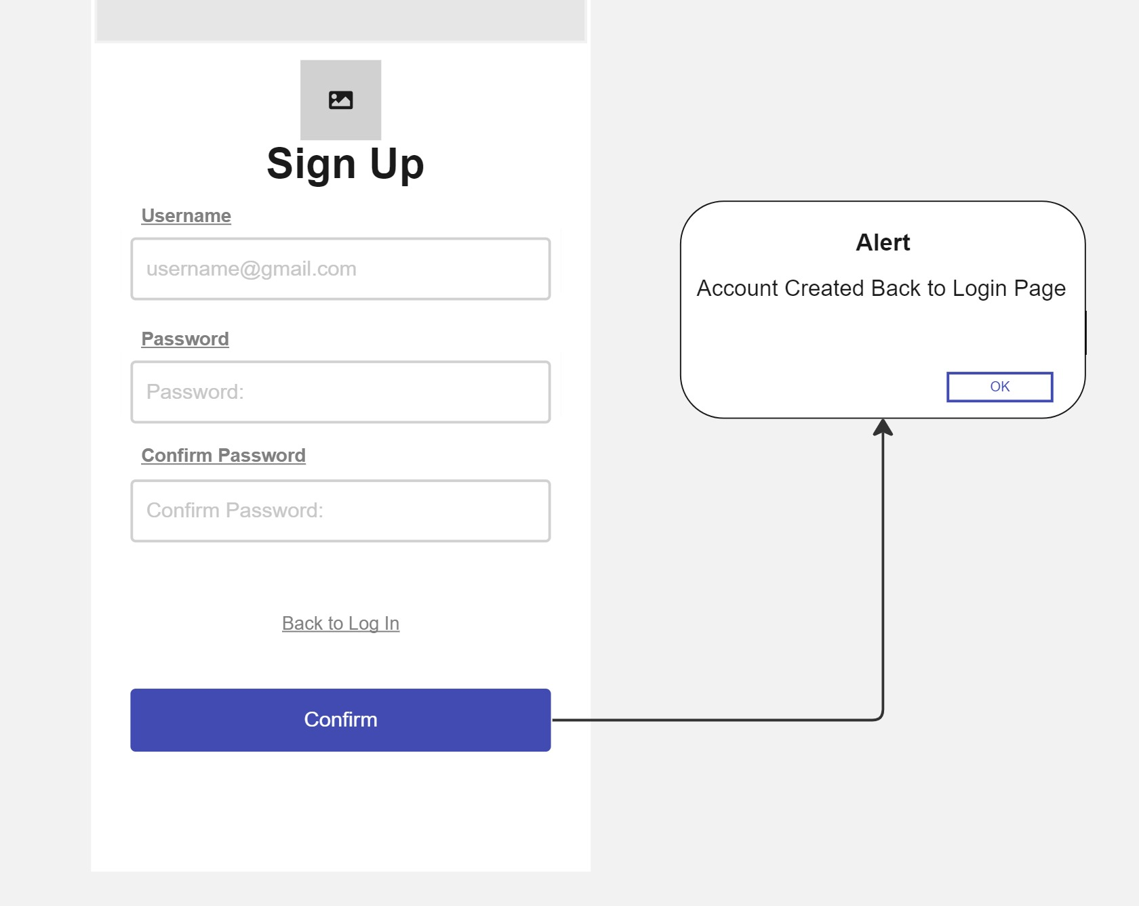
Sign Up
Notes:
MongoDB:
MongoDB is a non-relational database that stores data in JSON-like documents. It supports arrays and nested objects.
Unlike traditional relational databases (such as MySQL or PostgreSQL), MongoDB is more flexible. It doesn’t require a fixed table structure, making it suitable for scenarios where data instances have varying fields.
Features of MongoDB include document-oriented storage, built-in replication support, and sharding for scalability.
Express.js:
Express.js is a server-side framework that simplifies web and mobile application development.
It allows developers to create single-page, multi-page, and hybrid web apps.
Express.js provides routing, middleware support, and an easy-to-use API for handling HTTP requests.
React.js:
React.js is a powerful front-end library for building user interfaces.
It enables developers to create dynamic, interactive, and reusable UI components.
React’s virtual DOM optimizes rendering performance, making it ideal for modern web applications.
Node.js:
Node.js is a server-side runtime environment that allows JavaScript to run on the server.
It provides event-driven, non-blocking I/O, making it efficient for handling concurrent requests.
Node.js integrates seamlessly with Express.js, allowing developers to build end-to-end JavaScript applications.
In summary, the MERN stack offers versatility, code reuse, and streamlines development by using JavaScript across the entire stack. It’s a great choice for creating powerful web applications that are easy to maintain and scale

Slide 12
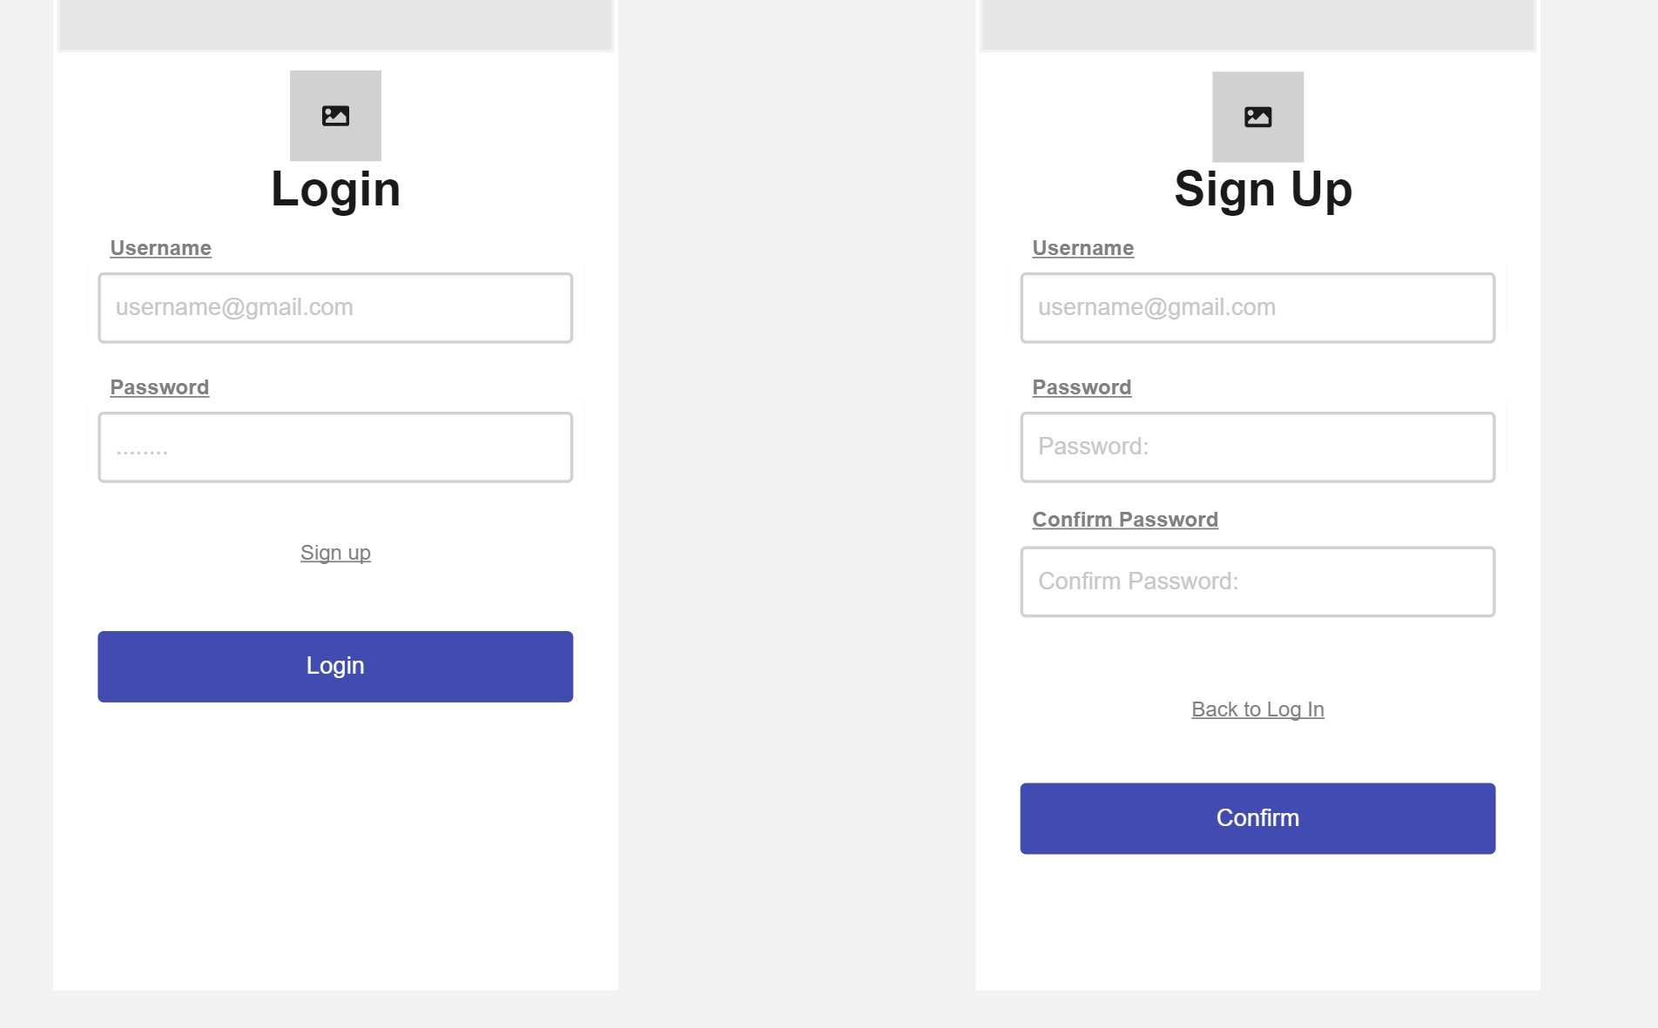
Login and Sign Up
Notes:
MongoDB:
MongoDB is a non-relational database that stores data in JSON-like documents. It supports arrays and nested objects.
Unlike traditional relational databases (such as MySQL or PostgreSQL), MongoDB is more flexible. It doesn’t require a fixed table structure, making it suitable for scenarios where data instances have varying fields.
Features of MongoDB include document-oriented storage, built-in replication support, and sharding for scalability.
Express.js:
Express.js is a server-side framework that simplifies web and mobile application development.
It allows developers to create single-page, multi-page, and hybrid web apps.
Express.js provides routing, middleware support, and an easy-to-use API for handling HTTP requests.
React.js:
React.js is a powerful front-end library for building user interfaces.
It enables developers to create dynamic, interactive, and reusable UI components.
React’s virtual DOM optimizes rendering performance, making it ideal for modern web applications.
Node.js:
Node.js is a server-side runtime environment that allows JavaScript to run on the server.
It provides event-driven, non-blocking I/O, making it efficient for handling concurrent requests.
Node.js integrates seamlessly with Express.js, allowing developers to build end-to-end JavaScript applications.
In summary, the MERN stack offers versatility, code reuse, and streamlines development by using JavaScript across the entire stack. It’s a great choice for creating powerful web applications that are easy to maintain and scale

Slide 13
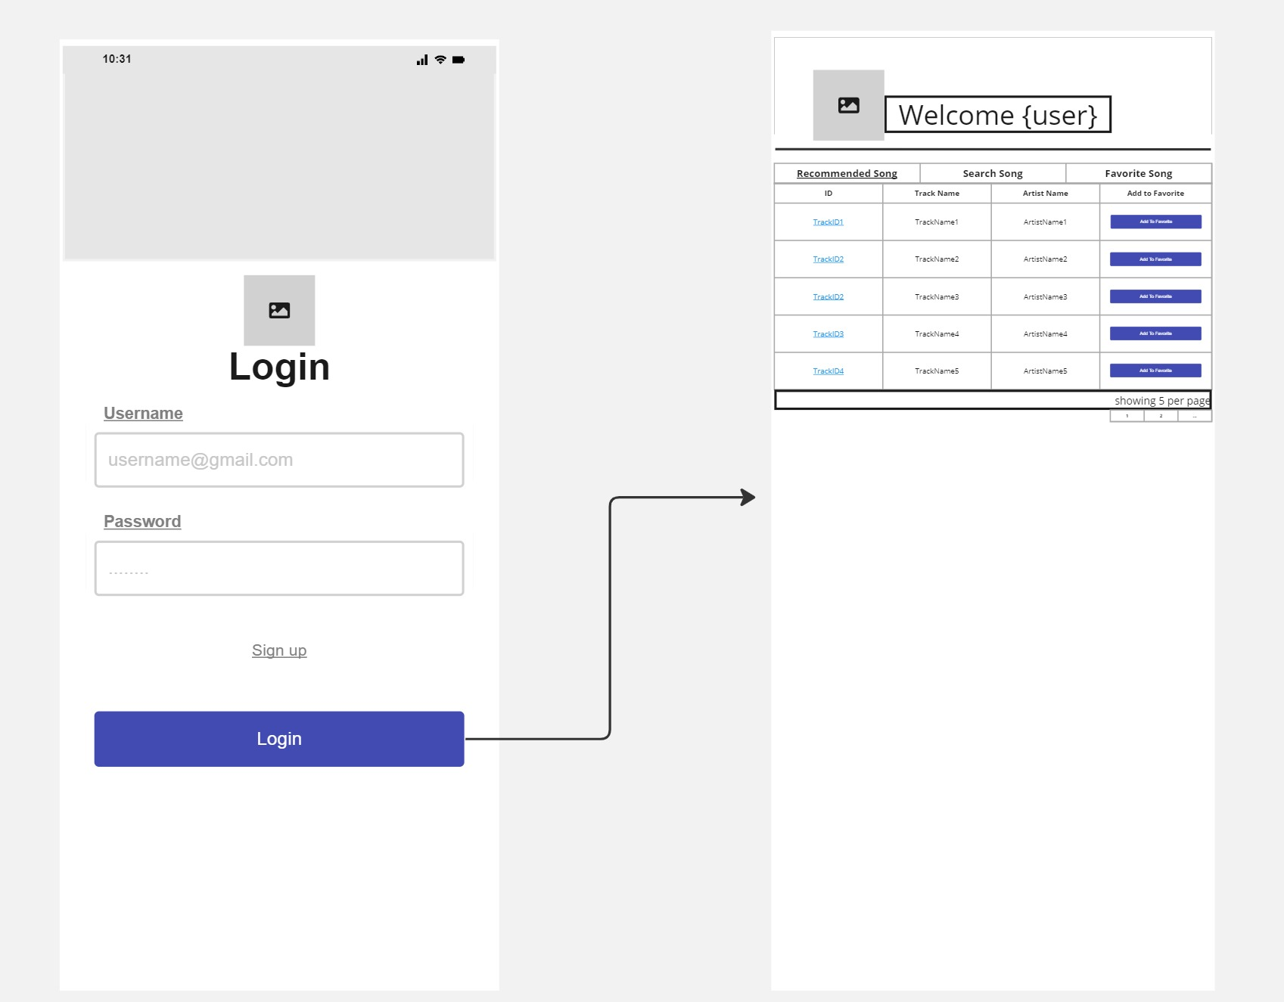
After User Login
Notes:
MongoDB:
MongoDB is a non-relational database that stores data in JSON-like documents. It supports arrays and nested objects.
Unlike traditional relational databases (such as MySQL or PostgreSQL), MongoDB is more flexible. It doesn’t require a fixed table structure, making it suitable for scenarios where data instances have varying fields.
Features of MongoDB include document-oriented storage, built-in replication support, and sharding for scalability.
Express.js:
Express.js is a server-side framework that simplifies web and mobile application development.
It allows developers to create single-page, multi-page, and hybrid web apps.
Express.js provides routing, middleware support, and an easy-to-use API for handling HTTP requests.
React.js:
React.js is a powerful front-end library for building user interfaces.
It enables developers to create dynamic, interactive, and reusable UI components.
React’s virtual DOM optimizes rendering performance, making it ideal for modern web applications.
Node.js:
Node.js is a server-side runtime environment that allows JavaScript to run on the server.
It provides event-driven, non-blocking I/O, making it efficient for handling concurrent requests.
Node.js integrates seamlessly with Express.js, allowing developers to build end-to-end JavaScript applications.
In summary, the MERN stack offers versatility, code reuse, and streamlines development by using JavaScript across the entire stack. It’s a great choice for creating powerful web applications that are easy to maintain and scale

Slide 14
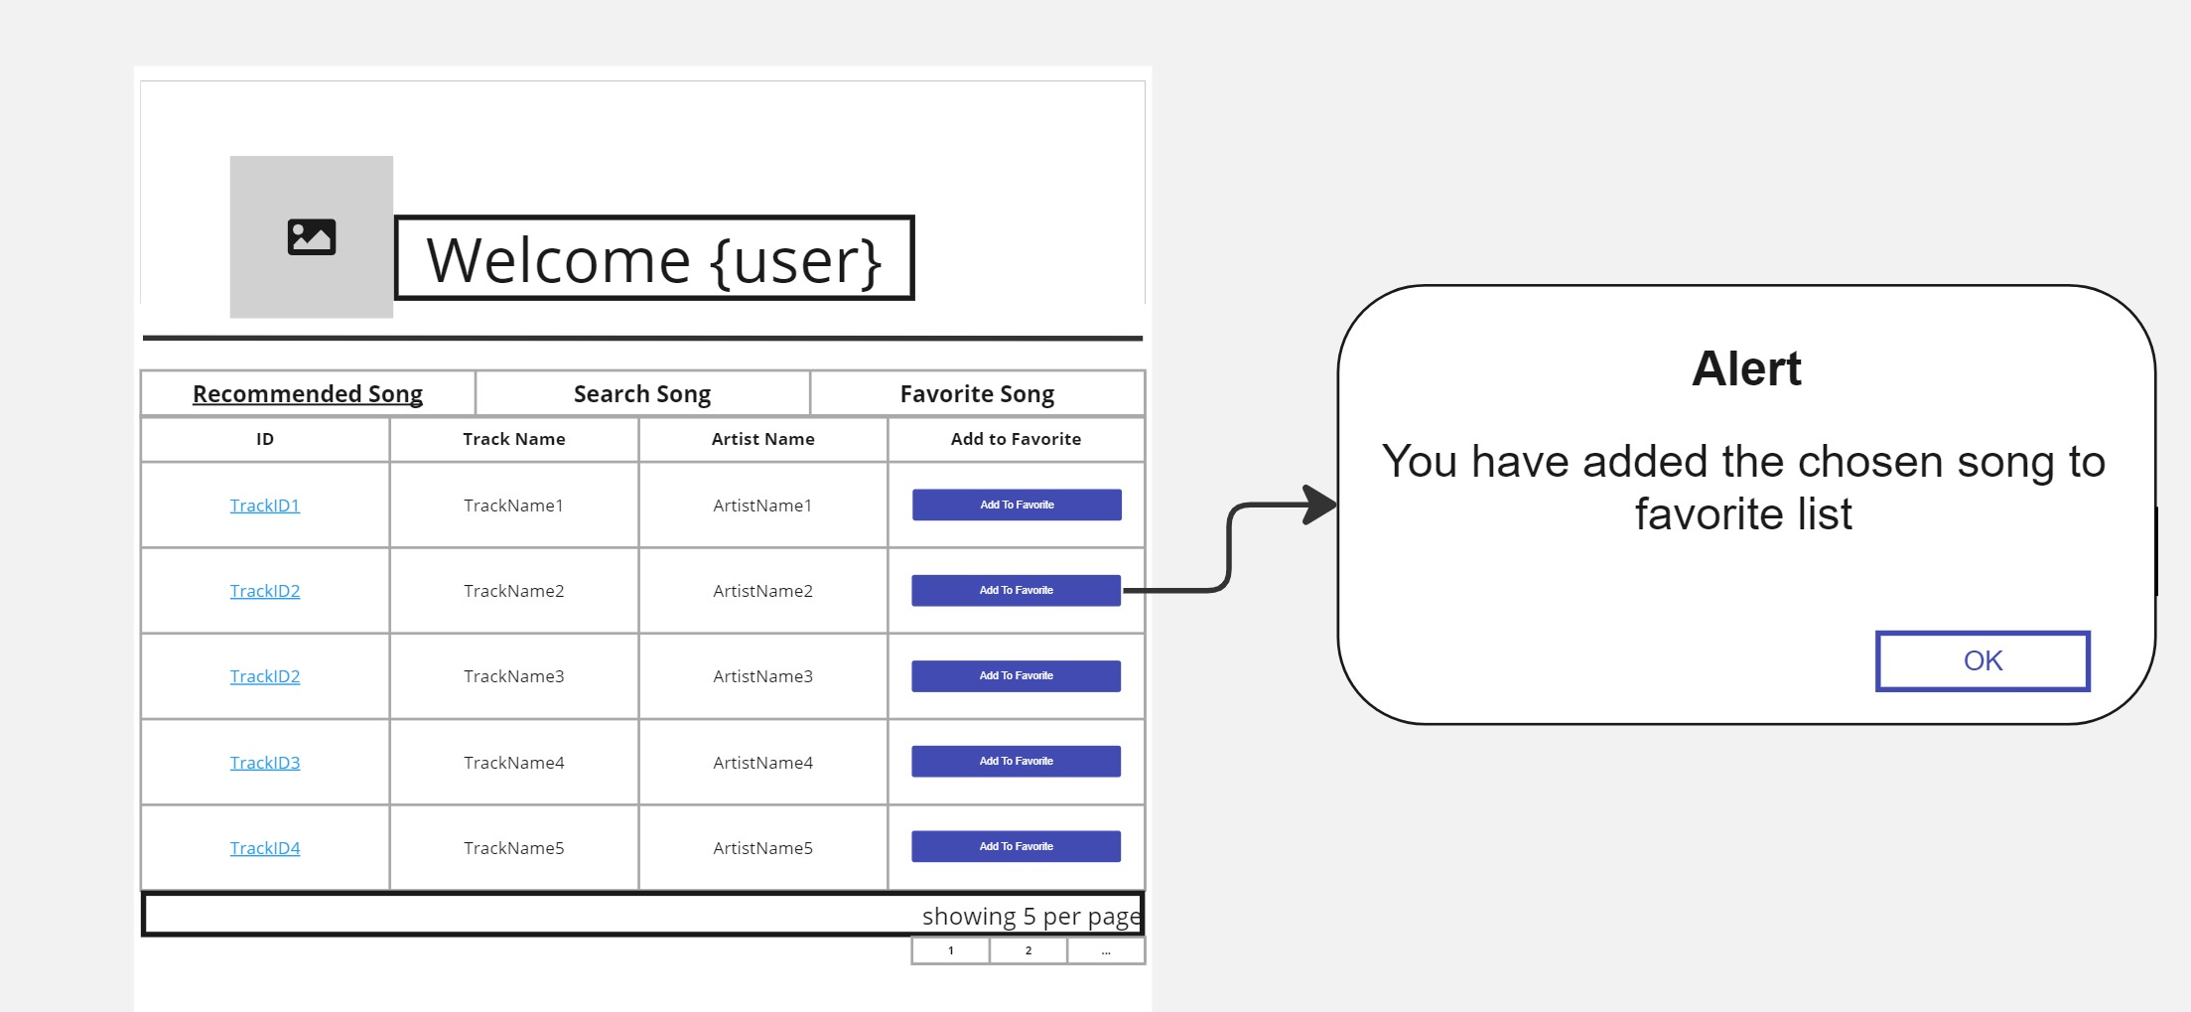
Recommended Song
Notes:
MongoDB:
MongoDB is a non-relational database that stores data in JSON-like documents. It supports arrays and nested objects.
Unlike traditional relational databases (such as MySQL or PostgreSQL), MongoDB is more flexible. It doesn’t require a fixed table structure, making it suitable for scenarios where data instances have varying fields.
Features of MongoDB include document-oriented storage, built-in replication support, and sharding for scalability.
Express.js:
Express.js is a server-side framework that simplifies web and mobile application development.
It allows developers to create single-page, multi-page, and hybrid web apps.
Express.js provides routing, middleware support, and an easy-to-use API for handling HTTP requests.
React.js:
React.js is a powerful front-end library for building user interfaces.
It enables developers to create dynamic, interactive, and reusable UI components.
React’s virtual DOM optimizes rendering performance, making it ideal for modern web applications.
Node.js:
Node.js is a server-side runtime environment that allows JavaScript to run on the server.
It provides event-driven, non-blocking I/O, making it efficient for handling concurrent requests.
Node.js integrates seamlessly with Express.js, allowing developers to build end-to-end JavaScript applications.
In summary, the MERN stack offers versatility, code reuse, and streamlines development by using JavaScript across the entire stack. It’s a great choice for creating powerful web applications that are easy to maintain and scale

Slide 15
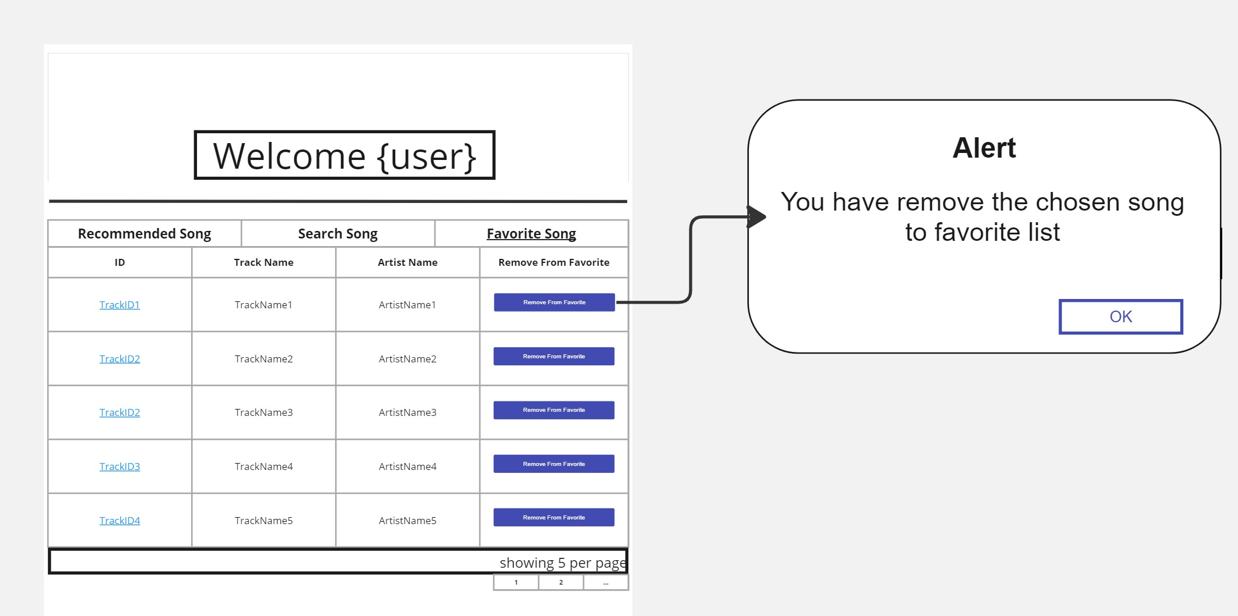
Favorite Song
Notes:
MongoDB:
MongoDB is a non-relational database that stores data in JSON-like documents. It supports arrays and nested objects.
Unlike traditional relational databases (such as MySQL or PostgreSQL), MongoDB is more flexible. It doesn’t require a fixed table structure, making it suitable for scenarios where data instances have varying fields.
Features of MongoDB include document-oriented storage, built-in replication support, and sharding for scalability.
Express.js:
Express.js is a server-side framework that simplifies web and mobile application development.
It allows developers to create single-page, multi-page, and hybrid web apps.
Express.js provides routing, middleware support, and an easy-to-use API for handling HTTP requests.
React.js:
React.js is a powerful front-end library for building user interfaces.
It enables developers to create dynamic, interactive, and reusable UI components.
React’s virtual DOM optimizes rendering performance, making it ideal for modern web applications.
Node.js:
Node.js is a server-side runtime environment that allows JavaScript to run on the server.
It provides event-driven, non-blocking I/O, making it efficient for handling concurrent requests.
Node.js integrates seamlessly with Express.js, allowing developers to build end-to-end JavaScript applications.
In summary, the MERN stack offers versatility, code reuse, and streamlines development by using JavaScript across the entire stack. It’s a great choice for creating powerful web applications that are easy to maintain and scale

Slide 16
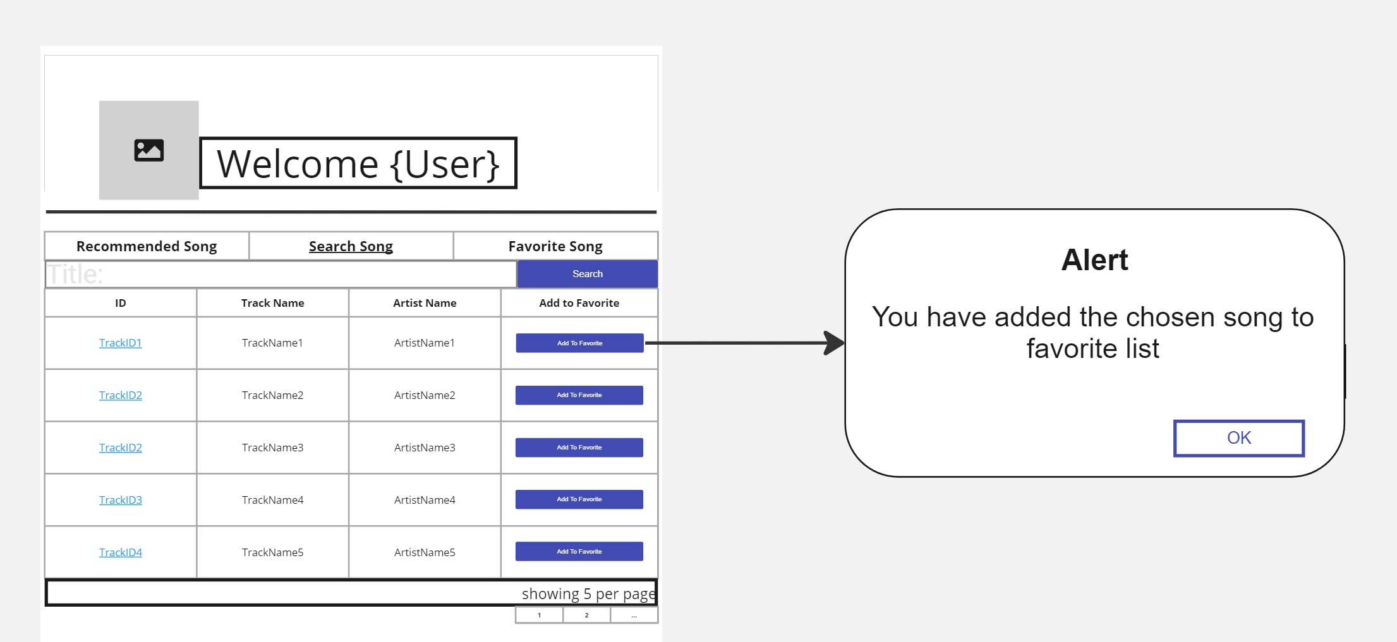
Search Song
Notes:
MongoDB:
MongoDB is a non-relational database that stores data in JSON-like documents. It supports arrays and nested objects.
Unlike traditional relational databases (such as MySQL or PostgreSQL), MongoDB is more flexible. It doesn’t require a fixed table structure, making it suitable for scenarios where data instances have varying fields.
Features of MongoDB include document-oriented storage, built-in replication support, and sharding for scalability.
Express.js:
Express.js is a server-side framework that simplifies web and mobile application development.
It allows developers to create single-page, multi-page, and hybrid web apps.
Express.js provides routing, middleware support, and an easy-to-use API for handling HTTP requests.
React.js:
React.js is a powerful front-end library for building user interfaces.
It enables developers to create dynamic, interactive, and reusable UI components.
React’s virtual DOM optimizes rendering performance, making it ideal for modern web applications.
Node.js:
Node.js is a server-side runtime environment that allows JavaScript to run on the server.
It provides event-driven, non-blocking I/O, making it efficient for handling concurrent requests.
Node.js integrates seamlessly with Express.js, allowing developers to build end-to-end JavaScript applications.
In summary, the MERN stack offers versatility, code reuse, and streamlines development by using JavaScript across the entire stack. It’s a great choice for creating powerful web applications that are easy to maintain and scale

Slide 17
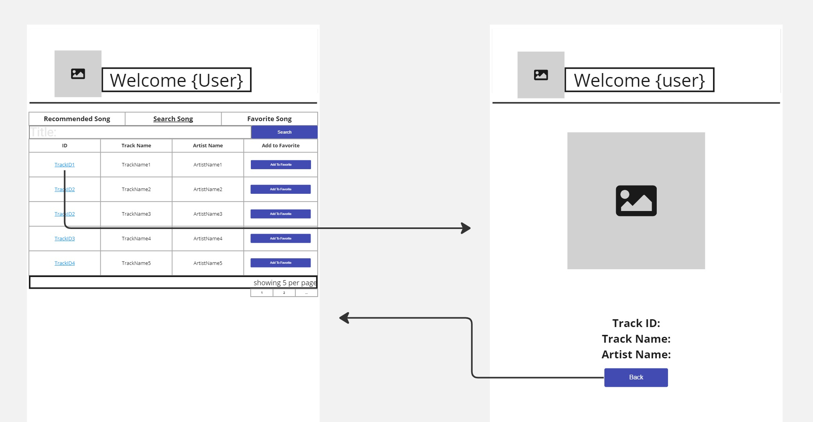
Song Detail
Notes:
MongoDB:
MongoDB is a non-relational database that stores data in JSON-like documents. It supports arrays and nested objects.
Unlike traditional relational databases (such as MySQL or PostgreSQL), MongoDB is more flexible. It doesn’t require a fixed table structure, making it suitable for scenarios where data instances have varying fields.
Features of MongoDB include document-oriented storage, built-in replication support, and sharding for scalability.
Express.js:
Express.js is a server-side framework that simplifies web and mobile application development.
It allows developers to create single-page, multi-page, and hybrid web apps.
Express.js provides routing, middleware support, and an easy-to-use API for handling HTTP requests.
React.js:
React.js is a powerful front-end library for building user interfaces.
It enables developers to create dynamic, interactive, and reusable UI components.
React’s virtual DOM optimizes rendering performance, making it ideal for modern web applications.
Node.js:
Node.js is a server-side runtime environment that allows JavaScript to run on the server.
It provides event-driven, non-blocking I/O, making it efficient for handling concurrent requests.
Node.js integrates seamlessly with Express.js, allowing developers to build end-to-end JavaScript applications.
In summary, the MERN stack offers versatility, code reuse, and streamlines development by using JavaScript across the entire stack. It’s a great choice for creating powerful web applications that are easy to maintain and scale

Slide 18
Feature from Angular

Slide 19
Feature from Angular
Login and Sign Up | <mat-form-field>, <mat-label>, <mat-error>, <mat-button>
Recommended Song | <mat-table>, <mat-paginator>, <mat-button>
Search Song | <mat-form-field>, <mat-label>, <mat-error>, <mat-table>, <mat-paginator>, <mat-button>
Favorite Song | <mat-table>, <mat-paginator>, <mat-button>
Song Detail | <mat-button>
Navigation Bar | <mat-tab>
Loading | <mat-spinner>

Slide 20
Activity Diagram

Slide 21
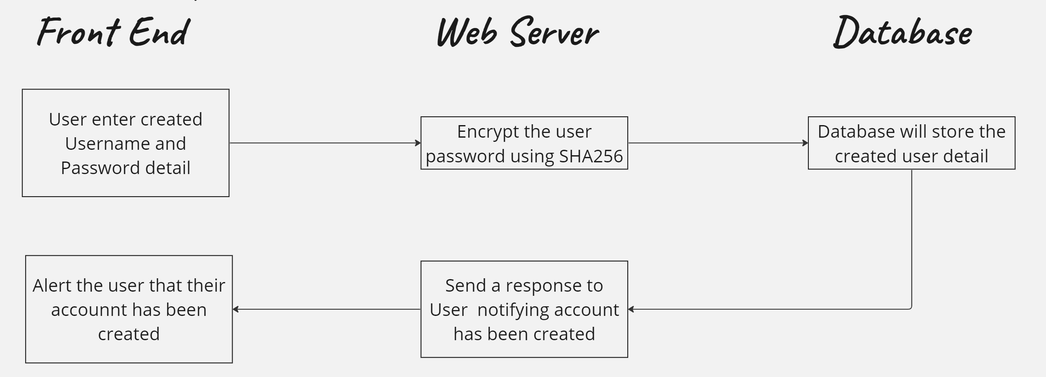
Sign Up Activity Diagram
Notes:
MongoDB:
MongoDB is a non-relational database that stores data in JSON-like documents. It supports arrays and nested objects.
Unlike traditional relational databases (such as MySQL or PostgreSQL), MongoDB is more flexible. It doesn’t require a fixed table structure, making it suitable for scenarios where data instances have varying fields.
Features of MongoDB include document-oriented storage, built-in replication support, and sharding for scalability.
Express.js:
Express.js is a server-side framework that simplifies web and mobile application development.
It allows developers to create single-page, multi-page, and hybrid web apps.
Express.js provides routing, middleware support, and an easy-to-use API for handling HTTP requests.
React.js:
React.js is a powerful front-end library for building user interfaces.
It enables developers to create dynamic, interactive, and reusable UI components.
React’s virtual DOM optimizes rendering performance, making it ideal for modern web applications.
Node.js:
Node.js is a server-side runtime environment that allows JavaScript to run on the server.
It provides event-driven, non-blocking I/O, making it efficient for handling concurrent requests.
Node.js integrates seamlessly with Express.js, allowing developers to build end-to-end JavaScript applications.
In summary, the MERN stack offers versatility, code reuse, and streamlines development by using JavaScript across the entire stack. It’s a great choice for creating powerful web applications that are easy to maintain and scale

Slide 22
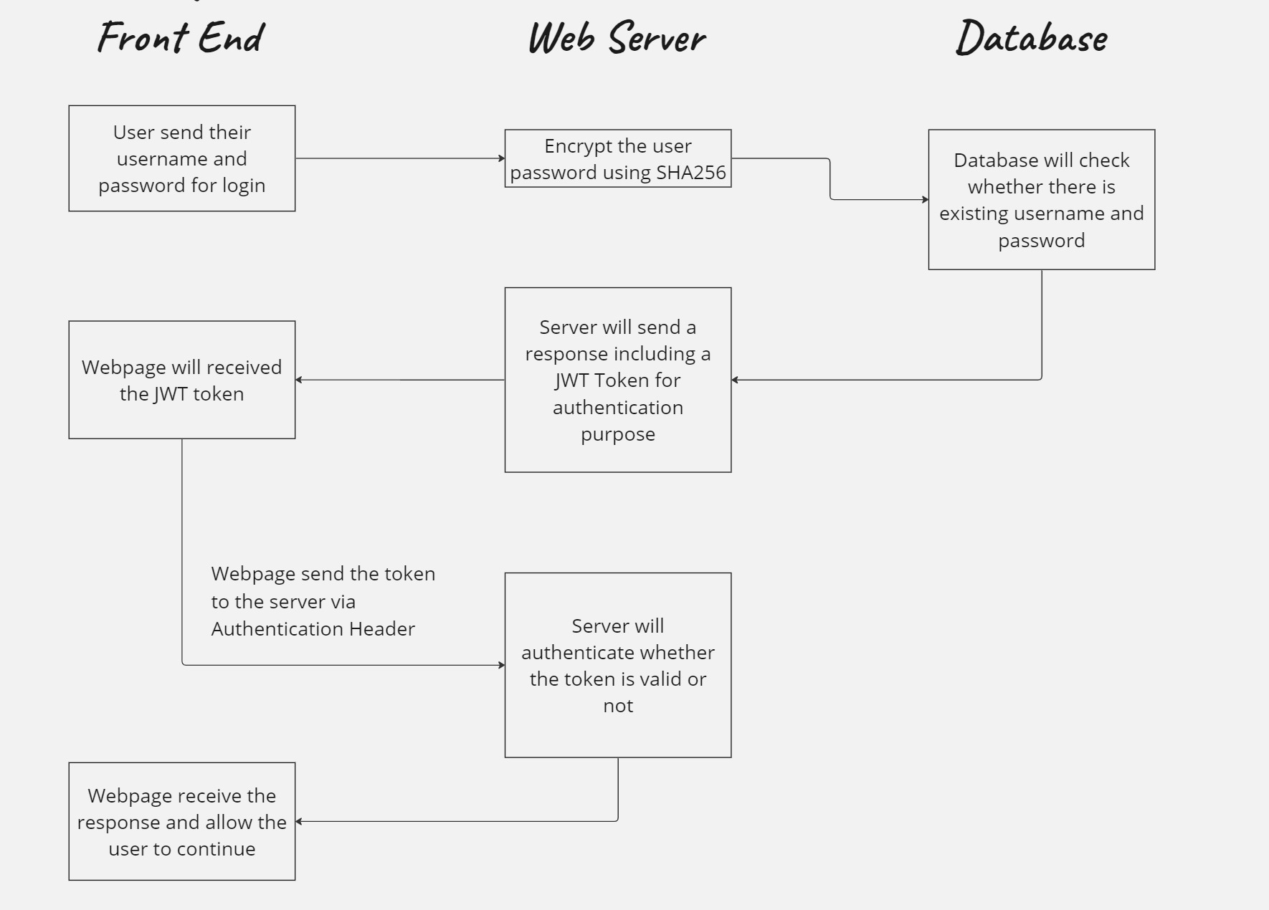
Log In Activity Diagram
Notes:
MongoDB:
MongoDB is a non-relational database that stores data in JSON-like documents. It supports arrays and nested objects.
Unlike traditional relational databases (such as MySQL or PostgreSQL), MongoDB is more flexible. It doesn’t require a fixed table structure, making it suitable for scenarios where data instances have varying fields.
Features of MongoDB include document-oriented storage, built-in replication support, and sharding for scalability.
Express.js:
Express.js is a server-side framework that simplifies web and mobile application development.
It allows developers to create single-page, multi-page, and hybrid web apps.
Express.js provides routing, middleware support, and an easy-to-use API for handling HTTP requests.
React.js:
React.js is a powerful front-end library for building user interfaces.
It enables developers to create dynamic, interactive, and reusable UI components.
React’s virtual DOM optimizes rendering performance, making it ideal for modern web applications.
Node.js:
Node.js is a server-side runtime environment that allows JavaScript to run on the server.
It provides event-driven, non-blocking I/O, making it efficient for handling concurrent requests.
Node.js integrates seamlessly with Express.js, allowing developers to build end-to-end JavaScript applications.
In summary, the MERN stack offers versatility, code reuse, and streamlines development by using JavaScript across the entire stack. It’s a great choice for creating powerful web applications that are easy to maintain and scale

Slide 23
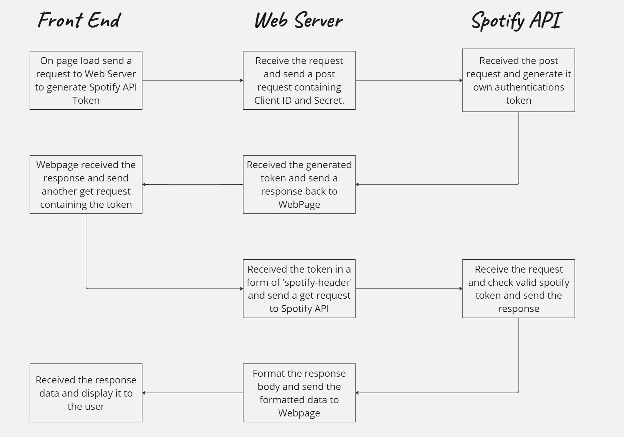
Recommended Song Activity Diagram
Notes:
MongoDB:
MongoDB is a non-relational database that stores data in JSON-like documents. It supports arrays and nested objects.
Unlike traditional relational databases (such as MySQL or PostgreSQL), MongoDB is more flexible. It doesn’t require a fixed table structure, making it suitable for scenarios where data instances have varying fields.
Features of MongoDB include document-oriented storage, built-in replication support, and sharding for scalability.
Express.js:
Express.js is a server-side framework that simplifies web and mobile application development.
It allows developers to create single-page, multi-page, and hybrid web apps.
Express.js provides routing, middleware support, and an easy-to-use API for handling HTTP requests.
React.js:
React.js is a powerful front-end library for building user interfaces.
It enables developers to create dynamic, interactive, and reusable UI components.
React’s virtual DOM optimizes rendering performance, making it ideal for modern web applications.
Node.js:
Node.js is a server-side runtime environment that allows JavaScript to run on the server.
It provides event-driven, non-blocking I/O, making it efficient for handling concurrent requests.
Node.js integrates seamlessly with Express.js, allowing developers to build end-to-end JavaScript applications.
In summary, the MERN stack offers versatility, code reuse, and streamlines development by using JavaScript across the entire stack. It’s a great choice for creating powerful web applications that are easy to maintain and scale

Slide 24
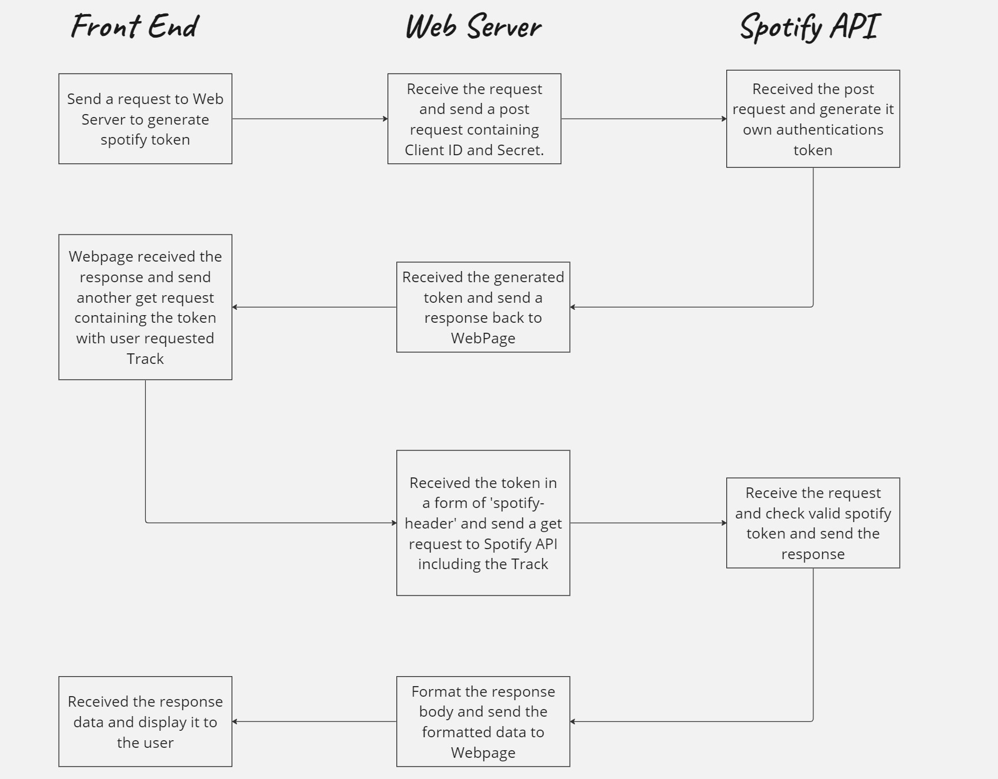
Search Song Activity Diagram
Notes:
MongoDB:
MongoDB is a non-relational database that stores data in JSON-like documents. It supports arrays and nested objects.
Unlike traditional relational databases (such as MySQL or PostgreSQL), MongoDB is more flexible. It doesn’t require a fixed table structure, making it suitable for scenarios where data instances have varying fields.
Features of MongoDB include document-oriented storage, built-in replication support, and sharding for scalability.
Express.js:
Express.js is a server-side framework that simplifies web and mobile application development.
It allows developers to create single-page, multi-page, and hybrid web apps.
Express.js provides routing, middleware support, and an easy-to-use API for handling HTTP requests.
React.js:
React.js is a powerful front-end library for building user interfaces.
It enables developers to create dynamic, interactive, and reusable UI components.
React’s virtual DOM optimizes rendering performance, making it ideal for modern web applications.
Node.js:
Node.js is a server-side runtime environment that allows JavaScript to run on the server.
It provides event-driven, non-blocking I/O, making it efficient for handling concurrent requests.
Node.js integrates seamlessly with Express.js, allowing developers to build end-to-end JavaScript applications.
In summary, the MERN stack offers versatility, code reuse, and streamlines development by using JavaScript across the entire stack. It’s a great choice for creating powerful web applications that are easy to maintain and scale

Slide 25
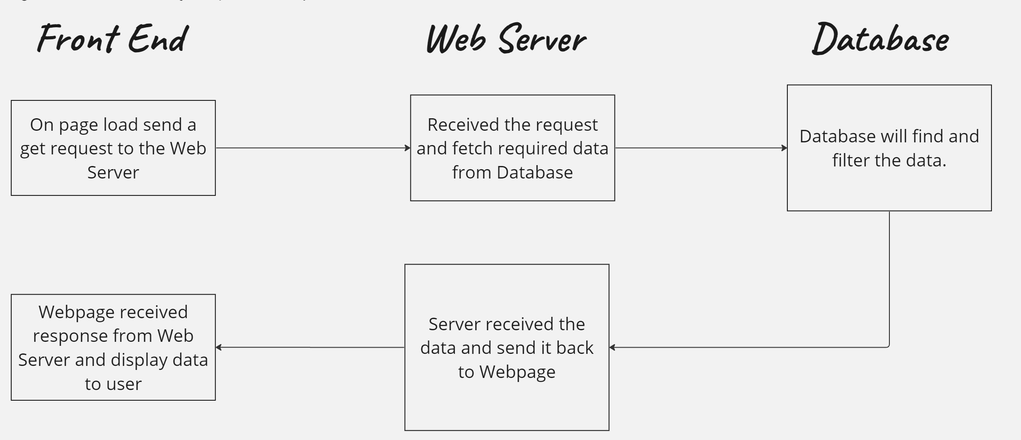
Favorite Song Activity Diagram
Notes:
MongoDB:
MongoDB is a non-relational database that stores data in JSON-like documents. It supports arrays and nested objects.
Unlike traditional relational databases (such as MySQL or PostgreSQL), MongoDB is more flexible. It doesn’t require a fixed table structure, making it suitable for scenarios where data instances have varying fields.
Features of MongoDB include document-oriented storage, built-in replication support, and sharding for scalability.
Express.js:
Express.js is a server-side framework that simplifies web and mobile application development.
It allows developers to create single-page, multi-page, and hybrid web apps.
Express.js provides routing, middleware support, and an easy-to-use API for handling HTTP requests.
React.js:
React.js is a powerful front-end library for building user interfaces.
It enables developers to create dynamic, interactive, and reusable UI components.
React’s virtual DOM optimizes rendering performance, making it ideal for modern web applications.
Node.js:
Node.js is a server-side runtime environment that allows JavaScript to run on the server.
It provides event-driven, non-blocking I/O, making it efficient for handling concurrent requests.
Node.js integrates seamlessly with Express.js, allowing developers to build end-to-end JavaScript applications.
In summary, the MERN stack offers versatility, code reuse, and streamlines development by using JavaScript across the entire stack. It’s a great choice for creating powerful web applications that are easy to maintain and scale

Slide 26
Front / Backend Structure

Slide 27
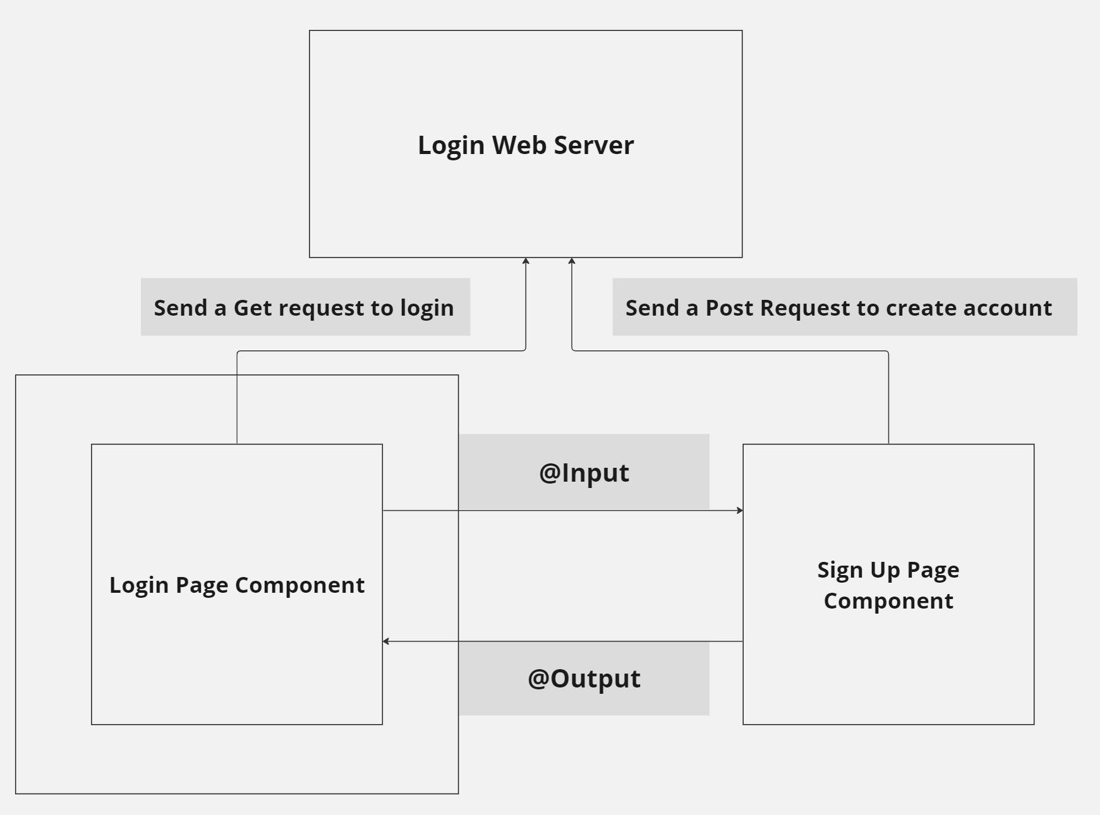
Login and Signup Structure
Notes:
MongoDB:
MongoDB is a non-relational database that stores data in JSON-like documents. It supports arrays and nested objects.
Unlike traditional relational databases (such as MySQL or PostgreSQL), MongoDB is more flexible. It doesn’t require a fixed table structure, making it suitable for scenarios where data instances have varying fields.
Features of MongoDB include document-oriented storage, built-in replication support, and sharding for scalability.
Express.js:
Express.js is a server-side framework that simplifies web and mobile application development.
It allows developers to create single-page, multi-page, and hybrid web apps.
Express.js provides routing, middleware support, and an easy-to-use API for handling HTTP requests.
React.js:
React.js is a powerful front-end library for building user interfaces.
It enables developers to create dynamic, interactive, and reusable UI components.
React’s virtual DOM optimizes rendering performance, making it ideal for modern web applications.
Node.js:
Node.js is a server-side runtime environment that allows JavaScript to run on the server.
It provides event-driven, non-blocking I/O, making it efficient for handling concurrent requests.
Node.js integrates seamlessly with Express.js, allowing developers to build end-to-end JavaScript applications.
In summary, the MERN stack offers versatility, code reuse, and streamlines development by using JavaScript across the entire stack. It’s a great choice for creating powerful web applications that are easy to maintain and scale

Slide 28
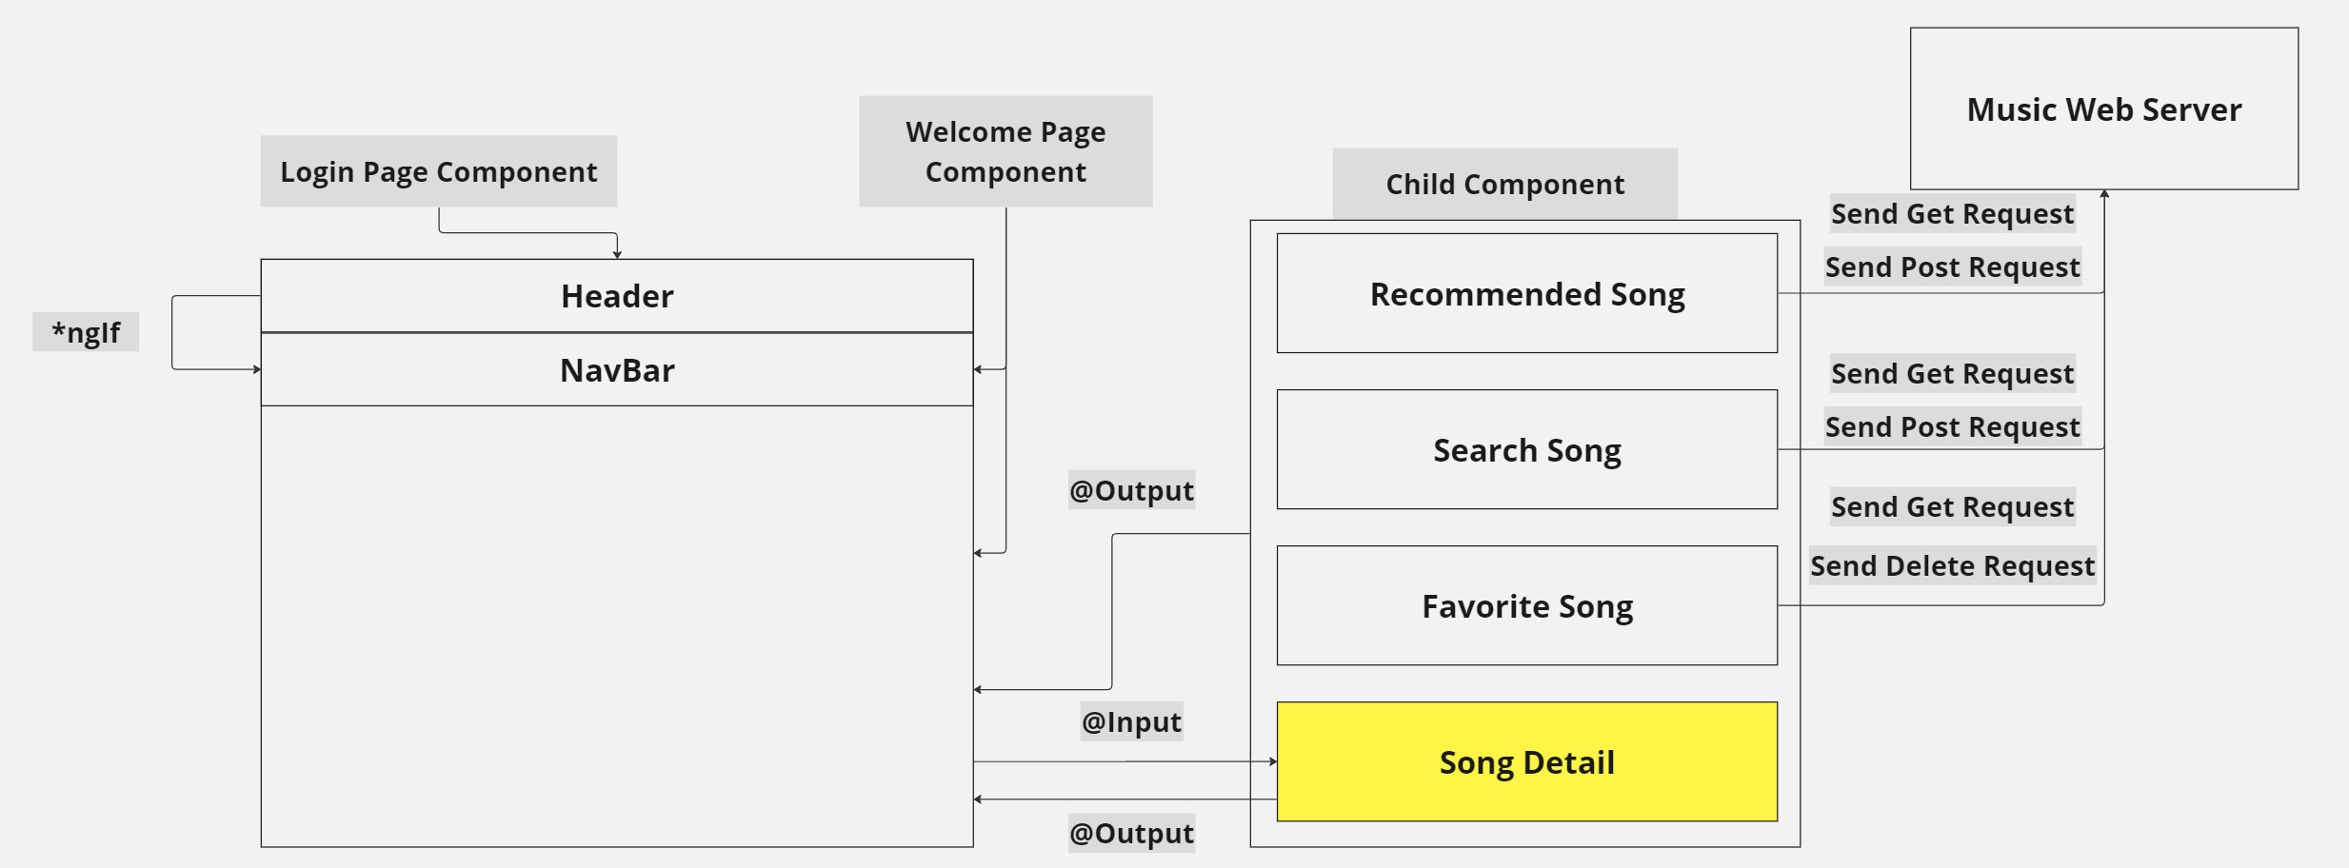
Welcome Page Structure
Notes:
MongoDB:
MongoDB is a non-relational database that stores data in JSON-like documents. It supports arrays and nested objects.
Unlike traditional relational databases (such as MySQL or PostgreSQL), MongoDB is more flexible. It doesn’t require a fixed table structure, making it suitable for scenarios where data instances have varying fields.
Features of MongoDB include document-oriented storage, built-in replication support, and sharding for scalability.
Express.js:
Express.js is a server-side framework that simplifies web and mobile application development.
It allows developers to create single-page, multi-page, and hybrid web apps.
Express.js provides routing, middleware support, and an easy-to-use API for handling HTTP requests.
React.js:
React.js is a powerful front-end library for building user interfaces.
It enables developers to create dynamic, interactive, and reusable UI components.
React’s virtual DOM optimizes rendering performance, making it ideal for modern web applications.
Node.js:
Node.js is a server-side runtime environment that allows JavaScript to run on the server.
It provides event-driven, non-blocking I/O, making it efficient for handling concurrent requests.
Node.js integrates seamlessly with Express.js, allowing developers to build end-to-end JavaScript applications.
In summary, the MERN stack offers versatility, code reuse, and streamlines development by using JavaScript across the entire stack. It’s a great choice for creating powerful web applications that are easy to maintain and scale

Slide 29
Database Structure

Slide 30
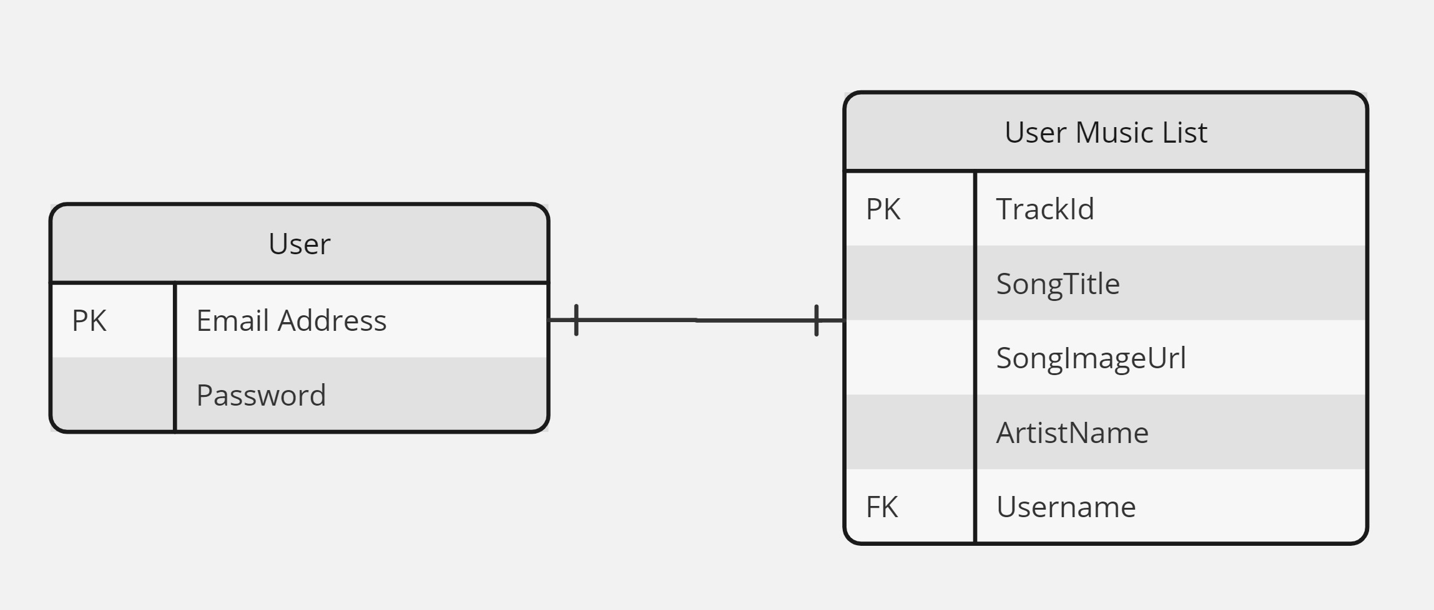
Database Structure
Notes:
MongoDB:
MongoDB is a non-relational database that stores data in JSON-like documents. It supports arrays and nested objects.
Unlike traditional relational databases (such as MySQL or PostgreSQL), MongoDB is more flexible. It doesn’t require a fixed table structure, making it suitable for scenarios where data instances have varying fields.
Features of MongoDB include document-oriented storage, built-in replication support, and sharding for scalability.
Express.js:
Express.js is a server-side framework that simplifies web and mobile application development.
It allows developers to create single-page, multi-page, and hybrid web apps.
Express.js provides routing, middleware support, and an easy-to-use API for handling HTTP requests.
React.js:
React.js is a powerful front-end library for building user interfaces.
It enables developers to create dynamic, interactive, and reusable UI components.
React’s virtual DOM optimizes rendering performance, making it ideal for modern web applications.
Node.js:
Node.js is a server-side runtime environment that allows JavaScript to run on the server.
It provides event-driven, non-blocking I/O, making it efficient for handling concurrent requests.
Node.js integrates seamlessly with Express.js, allowing developers to build end-to-end JavaScript applications.
In summary, the MERN stack offers versatility, code reuse, and streamlines development by using JavaScript across the entire stack. It’s a great choice for creating powerful web applications that are easy to maintain and scale

Slide 31
Demonstration

Slide 32
Thank You
Chan Yu Heng

