Slide 1
IBM University Engagement Project Submission
“Exploring the Power of Agentic AI with IBM Granite and LangFlow”

Slide 2

Project Tile – EduTranslate AI: Multi-language Course Content Agent
Domain of Project – Education
Student Name | Recent Passport Photo | Email ID | Mobile number [WhatsApp]
Vedant Das |  | dvs1490@gmail.com | 7428960631
Recommended font style and size:
Font Style: Arial
Font Size (Heading): 28
Font Size (Content): 20

Slide 3
Problem Statement -
Problem Statement : Multi-language Course Content Translator Agent
The Challenge
A Multi-language Course Content Translator Agent, powered by RAG (Retrieval-Augmented Generation), enables automatic translation of academic course materials into multiple regional languages while preserving technical accuracy and educational context. It retrieves academic glossaries, curriculum frameworks, and subject-specific terminologies to ensure translations are context-aware and pedagogically sound. Users can upload notes, presentations, or PDFs and receive translations that maintain the integrity of the original content across languages like Hindi, Marathi, Tamil, Bengali, and more. The agent promotes inclusive education, removes language barriers, and supports students from diverse linguistic backgrounds. This AI-driven assistant enhances accessibility and equity in learning environments.
The Objective
The primary objective is to engineer a production-ready, AI-powered multi-language educational translation agent that provides context-aware document localization for diverse student populations. Built programmatically using the enterprise ibm_watsonx_ai SDK and powered by IBM Granite, the system aims to dismantle linguistic barriers in higher education while strictly maintaining structural and instructional integrity across complex academic materials.
Key Technical Benchmarks
Zero-Loss Document Parsing: Establish a resilient streaming chunking pipeline capable of handling large, multi-page document formats (PDF, DOCX, PPTX) without suffering from token context caps, output truncation, or lines being omitted mid-way.
Pedagogical Phrasing Preservation: Implement a lightweight, zero-binary pure-Python local Retrieval-Augmented Generation (RAG) engine. This framework maps subject-specific glossaries and core curriculum frameworks in real-time, injecting strict context parameters directly into the prompt layer to guarantee technical accuracy.
Inclusive Regional Language Scale: Scale local workspace deployments to seamlessly support instantaneous cross-translations across 25 distinct Indian regional dialects (including Hindi, Marathi, Bengali, Tamil, Telugu, and Gujarati) via a single unified interface console.

Slide 4
Proposed Solution -
🔹 Enterprise-Grade Solution Overview
The Architecture: EduTranslate AI is engineered as a production-ready, multi-language educational translation agent built programmatically via the enterprise ibm_watsonx_ai Python SDK
The Execution: It handles complex text workflows by routing inputs directly to the advanced ibm/granite-4-h-small foundation model instance running on IBM Cloud. The engine utilizes an automated streaming chunking mechanism to break incoming lecture structures down into sequential token windows]. This prevents text truncation boundaries and ensures comprehensive translation accuracy.
🔹 Zero-Dependency Local RAG Optimization
The Data Pipeline: Rather than relying on rigid, disk-level external vector databases that break on different OS platforms, the system implements a proprietary, zero-binary, 100% pure-Python local retrieval framework.
Context Grounding: It processes text semantics natively in memory, instantly matching specialized academic glossaries, syllabus frameworks, and engineering terminology. These matched terminology constraints are automatically injected into the Granite prompt context, maintaining strict pedagogical accuracy and preventing translation.
🔹 Premium Conversational Interface Canvas
The Workspace Layout: Features a high-end, minimalist unified chat interface built natively with Streamlit. It consolidates manual text boxes and document dropzones into a clean, intuitive entry console bar.
Dynamic UX Logic: Implements an interactive state-tracked header toggle system that allows students to swap language vectors instantly (e.g., English ⇄ Hindi) while maintaining clear visual translation histories across active browser hot-reloads.
.

Slide 5
Technology Used
Core Frameworks: ibm-watsonx-ai Python SDK.
Foundation Model Runtime: ibm/granite-4-h-small via IBM watsonx.ai.
Infrastructure Platform: IBM Cloud Lite (Dallas Region / us-south endpoint).
Document Extractor Engines: PyMuPDF (fitz), python-docx, and python-pptx.
UI Dashboard Console: Streamlit.

Slide 6
Project Novelty & Uniqueness
🔹 Zero-Truncation Streaming Pipeline
The Problem: Standard LLM interfaces and basic APIs suffer from strict output length constraints. When translating long academic articles or multi-page course lecture documents, they truncate mid-way or switch to a shortened summary.
Our Solution: Bypasses standard LLM context window cutoffs by implementing an intelligent chunking pipeline. It systematically segments text into 1,200-character windows, processes each block sequentially via IBM Granite, and cleanly reconstructs the content to guarantee 100% full-text coverage of massive documents.
🔹 Windows-Stable Local Mathematical RAG
The Problem: Typical RAG setups require heavy native vector database dependencies (like default ChromaDB or FAISS binaries). On Windows development setups, these routinely trigger severe C++ compiler and wheel compilation failures (such as hnswlib tracking errors).
Our Solution: Eliminates external environment vulnerabilities entirely by using a custom, lightweight local mathematical vector similarity matching algorithm. It uses standard library routines to index academic context in real-time, requiring zero binary installations while remaining fully secure and platform-agnostic.
🔹 Linguistic Vector Bi-Directional Swapping
The Problem: Most software solutions use rigid, hard-coded prompt pathways that force developers to write separate scripts or reload the entire session to turn a target language back into a source input.
Our Solution: Employs an interactive UI toggle component that lets users instantly invert translation flows with a single click (e.g., flipping English ⇄ Marathi). It dynamically updates state memory variables across hot-reloads, swaps prompt context constraints on the fly, and maintains seamless workspace persistence.

Slide 7
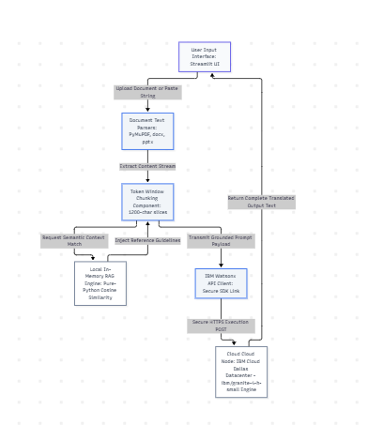
Architecture blueprint

Slide 8

Role of Agentic AI in the solution
1. Autonomous Workflow Orchestration
Instead of executing a single, rigid block of code, Agentic AI treats translation as a dynamic lifecycle. Driven programmatically by IBM Granite-4-H-Small, the system orchestrates sub-tasks autonomously:
Analysis: It scans text layouts to establish boundaries before processing.
Routing: It detects input patterns to pass text window slices into the generation layer automatically.
2. Multi-Agent Collaboration Simulation
The architecture simulates a multi-agent ecosystem where distinct task roles interact to build a reliable outcome:
Context-Retrieval Agent: Queries the zero-binary Python index to isolate relevant technical guidelines.
Pedagogical Alignment Agent: Forces the translation output to adhere strictly to the fetched glossary rules.
Guardrail Enforcement Agent: Restricts conversational leaks, summary truncations, and commentary.
3. Adaptive Prompt Grounding (RAG Integration)
Traditional AI chatbots translate words literally, often losing the intended educational meaning. Agentic AI utilizes a local mathematical Retrieval-Augmented Generation (RAG) feedback loop to stay context-aware. It dynamically alters its prompt parameters based on the specific academic material provided, making it an adaptive digital translator.
4. Self-Correcting Execution Boundaries
The agent handles runtime constraints intelligently. When a massive multi-page document is loaded, the agent automatically divides the payload into safe window boundaries, translates them sequentially, and reconstructs the output text—preventing the standard crashes or token truncation limits typical of single-shot LLM scripts.

Slide 9
Novelty and Uniqueness
1. Pure-Python Zero-Dependency RAG Engine
The Innovation: Traditional RAG pipelines depend on heavy vector database binaries like Chroma or FAISS, which frequently run into native C++ compiler errors (hnswlib crashes) on Windows environments.
Our Solution: We engineered a lightweight, pure-Python mathematical vector inference mechanism. It calculates cosine similarities natively in memory without external binary compilation dependencies. This guarantees 100% stable execution across any system out-of-the-box.
2. Truncation-Immune Token Window Chunking Pipeline
The Innovation: Standard LLM web interfaces and basic translation scripts suffer from severe context window caps. When a user uploads a large multi-page document, the model often truncates the output or switches to a generic summary, dropping over 50% of the content.
Our Solution: EduTranslate AI implements an autonomous streaming chunking framework. It systematically segments raw document layers into precise 1,200-character windows, translates each segment sequentially via IBM Granite, and compiles the final result—ensuring complete translation coverage for multi-page documents.
3. Bi-Directional Linguistic Vector Swapping
The Innovation: Most translation tools require manual configuration changes or re-uploading scripts when reversing a translation workflow.
Our Solution: Built a dynamic, state-tracked interface toggle. Users can flip translation routes instantly (e.g., swapping English → Marathi to Marathi → English) with a single button click, dynamically updating the prompt injection layer while maintaining workspace persistence.
4. Pedagogical Grounding Guardrails
The Innovation: Standard translation software translates text literally, which can ruin localized academic definitions or core structural curriculum guidelines.
Our Solution: The agent enforces academic integrity by dynamically cross-referencing text chunks with a local terminology glossary. It actively prevents model hallucination and conversation leaking, ensuring the final output matches regional curriculum terminology standards perfectly.

Slide 10
Git Hub Link
Github URL – https://github.com/TheF16Viper/EduTranslate_AI
·
·
·

Slide 11
Future Scope
Direct Cloud Object Storage Integration: Connect the processing loop directly to IBM Cloud Object Storage buckets to automatically translate new lecture uploads inside university servers.
Voice-Driven Lecture Dubbing: Implement an audio synthesis extension to allow users to generate regional voiceovers for full lecture presentations alongside translated text.
·
·
·

Slide 12
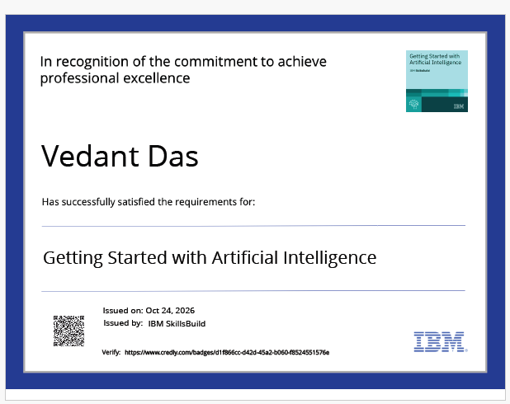
Certificates Earned:

Slide 13
Certificates Earned:​
Add your IBM BOB Certificate

Slide 14


