Slide 1
Grid Stability Prediction
Mid-Semester Progress Report (EE Minor Project)
Prepared by:
Sanskar Gupta (Roll No: 23117091)
[Placeholder Teammate]

Slide 2
Problem Statement
Power grids must maintain stability after disturbances (faults, outages).
Traditional time-domain simulations are highly accurate but computationally expensive.
Goal: Predict whether the system will remain stable or go unstable using ML models, drastically reducing assessment time.
Central Research Question: Can a model generalize to unseen fault conditions?

Slide 3
Methodology & Technology Stack
Test System: IEEE 39-bus New England system (Standard benchmark).
Simulation Engine: ANDES (Open-source, Python-based power system simulator).
ML Pipeline: Scikit-Learn + XGBoost for baseline modeling.
Pipeline Architecture:
Config Generator → ANDES Simulation Harness → Feature Extraction → Stability Labeling

Slide 4
Literature Highlights
Recent work frames Transient Stability Assessment (TSA) as a binary classification problem based on post-fault trajectories.
Deep Learning (CNNs/RNNs) extracts spatio-temporal features, while Ensemble methods (XGBoost) are popular for tabular feature robustness.
Standard Stability Criteria: The maximum relative rotor angle deviation between generators exceeding 180 degrees indicates instability.

Slide 5
Scenario Space Definition
To evaluate our generalization research question, we programmatically generated a diverse dataset.
Load Scaling: 80% to 120% of nominal.
Fault Buses: Selected diverse locations (Buses 2, 16, 26, 29, 39).
Clearing Times: 0.05s to 0.30s.
Contingencies: Selective N-1 transmission line outages.

Slide 6
Dataset Generation Results
450 scenarios simulated in parallel using multi-processing.
Runtime: ~5 minutes for full dataset generation.
Class Balance:
308 Stable cases (1)
142 Unstable cases (0)
Achieved a realistic 2:1 imbalance, providing an excellent foundation for ML training.

Slide 7
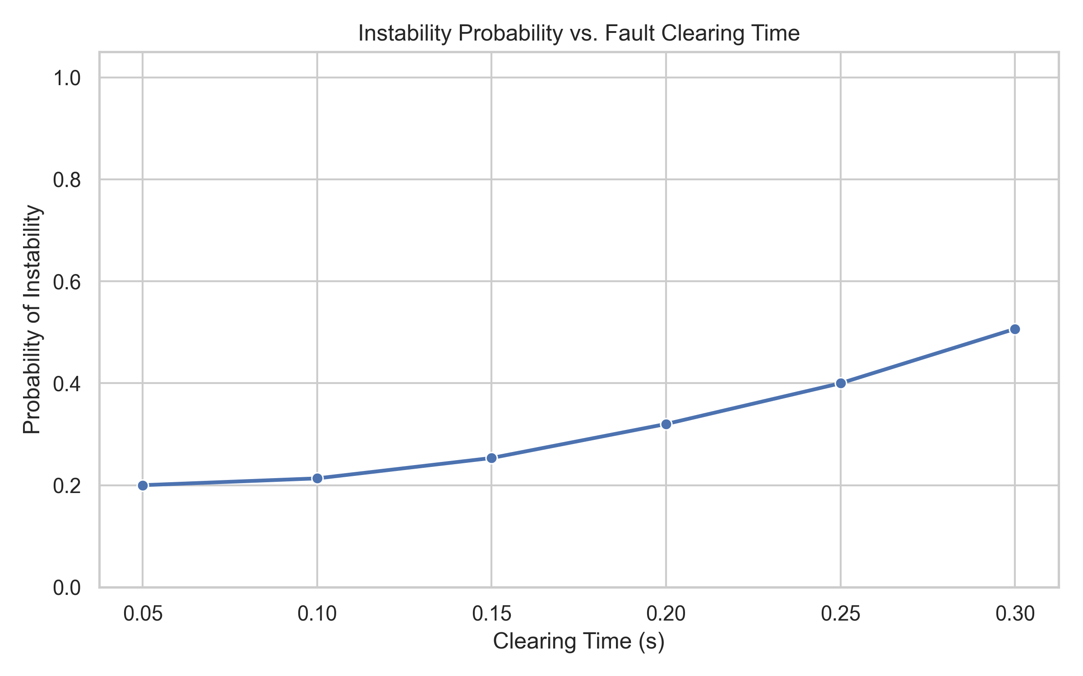
EDA: Stability vs Clearing Time
Physical intuition validated: Longer fault clearing times severely increase the probability of system instability.

Slide 8
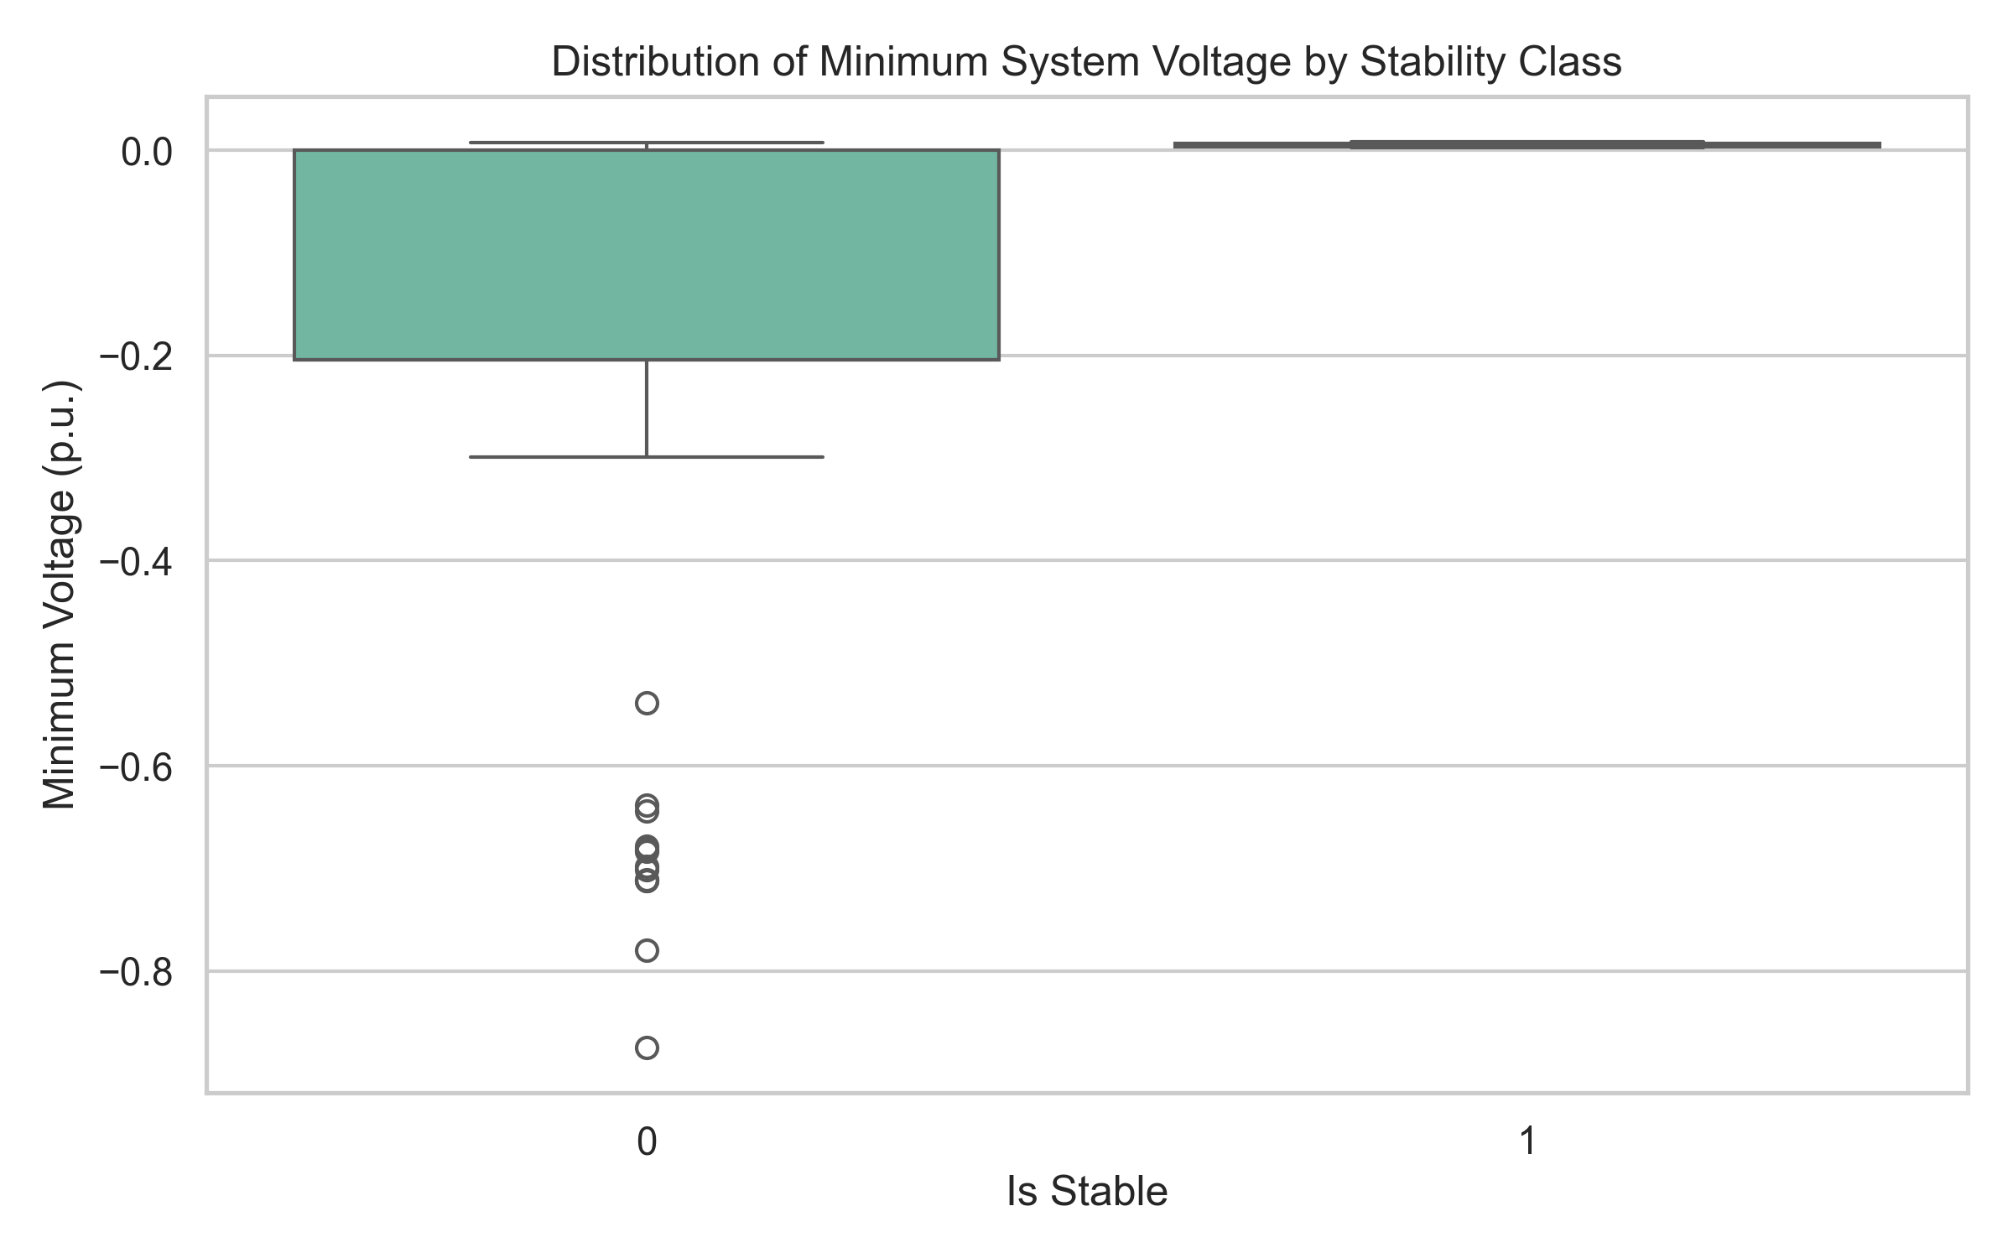
EDA: Feature Distributions
Unstable scenarios correspond heavily with deeper minimum system voltages during the transient window.

Slide 9
Roadmap & Next Steps
Minor Project (This Semester):
Train baseline models (XGBoost, Random Forest).
Execute the core generalization experiments on held-out conditions.
Major Project (Next Semester):
Predict Critical Clearing Time (CCT) with regression.
Apply SHAP explainability.
Build the Streamlit interactive demo.

