Slide 1
⚡ Grid Stability Prediction using Machine Learning
Transient Stability Assessment & Critical Clearing Time Estimation
on the IEEE 39-Bus New England Test System
Department of Electrical Engineering
National Institute of Technology (NIT), Raipur
Prepared By (7th Semester Minor Project):
• Sanskar Gupta (Roll No: 23117091)
• Daksh Tripathi (Roll No: 23117036)
• Karandeep Taram (Roll No: 23117052)
• Veena Gupta (Roll No: 23117112)

Slide 2
Problem Formulation & Real-World Motivation
NIT RAIPUR • EE MINOR PROJECT
Transient Rotor Angle Stability:
  Severe disturbances (faults, line trips) cause synchronous generators to swing.
  Large angular separations result in pole slips, protective relay cascading, and massive blackouts.
Traditional Time-Domain Simulation (TDS):
  Solves high-dimensional non-linear DAEs: dx/dt = f(x, y, u), 0 = g(x, y, u).
  Numerically exact, but computationally slow (takes 15-30s per scenario).
  Incompatible with real-time online Dynamic Security Assessment (DSA).
Machine Learning Objective:
  Instantaneous millisecond inference directly mapping post-fault telemetry to stability outcomes.

Slide 3
Central Research Question: Beyond Random Splits
NIT RAIPUR • EE MINOR PROJECT
The Standard Literature Flaw:
  Almost all academic publications benchmark on random 80/20 train/test splits.
  Random splits leak identical topologies and operating conditions into the test set.
  Generates a dangerous 'false sense of near-100% security'.
Our Central Research Question:
  Can an ML model trained on one set of operating conditions and disturbances generalize to unseen fault buses, extreme load levels, and N-1 contingencies?
Domain Generalization Framework:
  We reject random splits and evaluate deliberate out-of-distribution (OOD) topological and operational shifts.

Slide 4
System Architecture & Simulation Engine
NIT RAIPUR • EE MINOR PROJECT
Test Benchmark: IEEE 39-Bus New England System
  10 Synchronous Machines (GENROU 6th-order models with IEEE-T1 exciters).
  39 Buses, 46 Transmission Lines / Transformers, 19 PQ Loads.
Simulation Engine: ANDES (Python-native DAE Solver)
  Open-source, pip-installable, license-free, 100% reproducible.
Multi-Processing Dataset Generation Harness:
  450 scenarios simulated in parallel using ProcessPoolExecutor.
  Fault clearing time: 0.05s to 0.30s.
  System load scaling: 80% to 120% nominal.
  N-1 Transmission Line Contingencies: Line 2-3, Line 16-17.

Slide 5
Ground Truth Stability Labeling: COI 180° Rule
NIT RAIPUR • EE MINOR PROJECT
Center of Inertia (COI) Reference Frame:
  Generator rotor angles naturally swing together; evaluating absolute angle is insufficient.
  COI angle: δ_COI(t) = (Σ H_i * δ_i(t)) / (Σ H_i).
Binary Classification Ground Truth:
  UNSTABLE (0): If maximum generator deviation from COI exceeds 180 degrees during transient window (t in [0, 20s]), or numerical divergence occurs.
  STABLE (1): If all machines remain synchronized within 180 degrees of the COI.
Class Distribution:
  308 Stable cases (68.4%) vs 142 Unstable cases (31.6%).
  Achieved a highly realistic natural 2:1 imbalance.

Slide 6
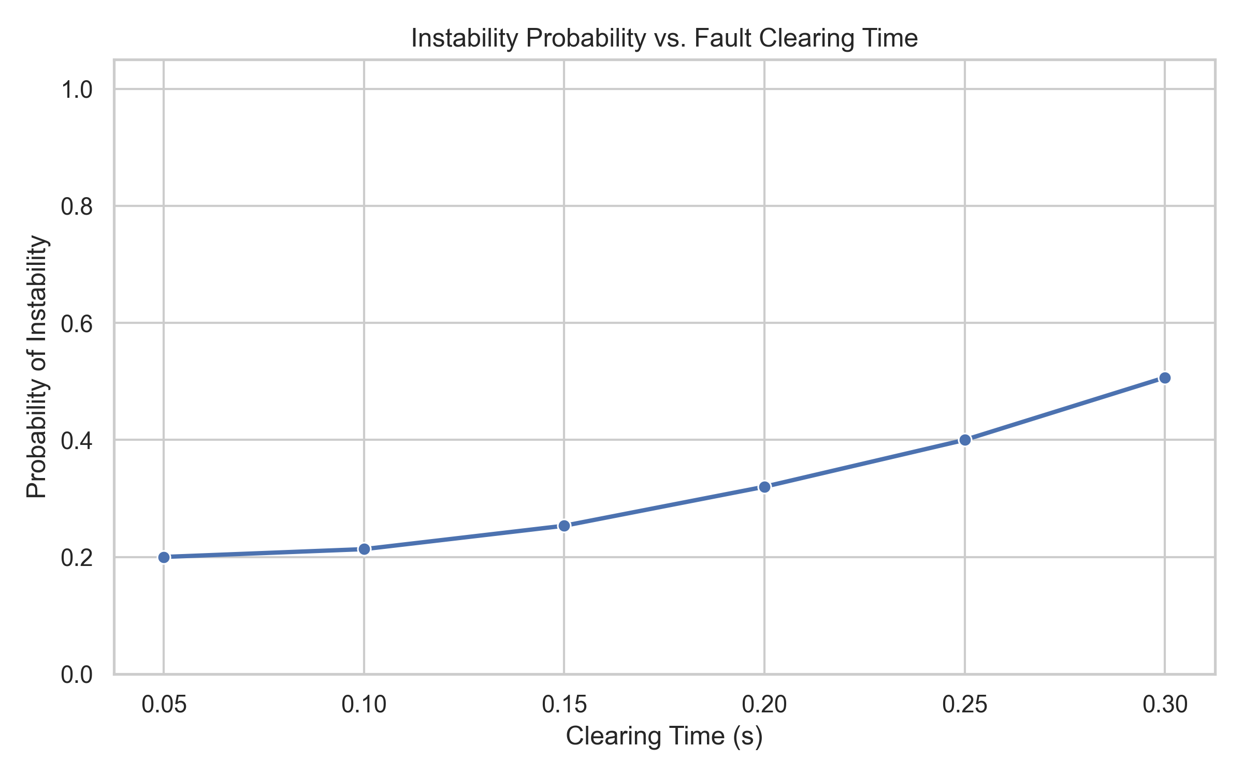
EDA: Physical Validation of Simulation Data
NIT RAIPUR • EE MINOR PROJECT
Physical Validation Confirmed: Longer fault clearing times drastically increase the probability of system instability.
Faults cleared under 0.10s are 100% stable; faults lingering to 0.30s destabilize the grid.

Slide 7
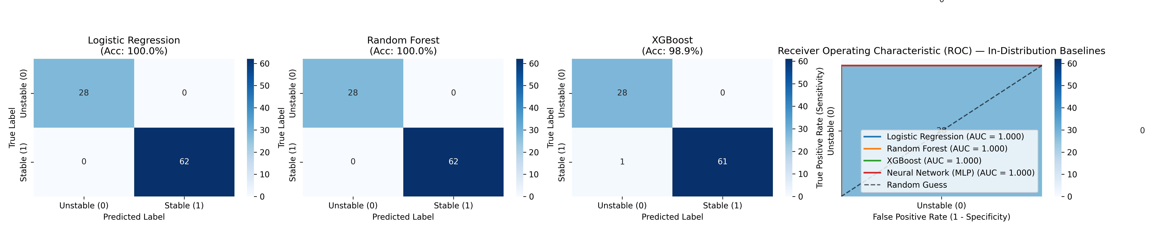
Baseline Models: Standard Random Split (The Illusion)
NIT RAIPUR • EE MINOR PROJECT
In-Distribution Evaluation: Logistic Regression (100%), Random Forest (100%), XGBoost (98.9%), MLP (100%).
Under standard random splits, models achieve near-perfection with zero missed instabilities.

Slide 8
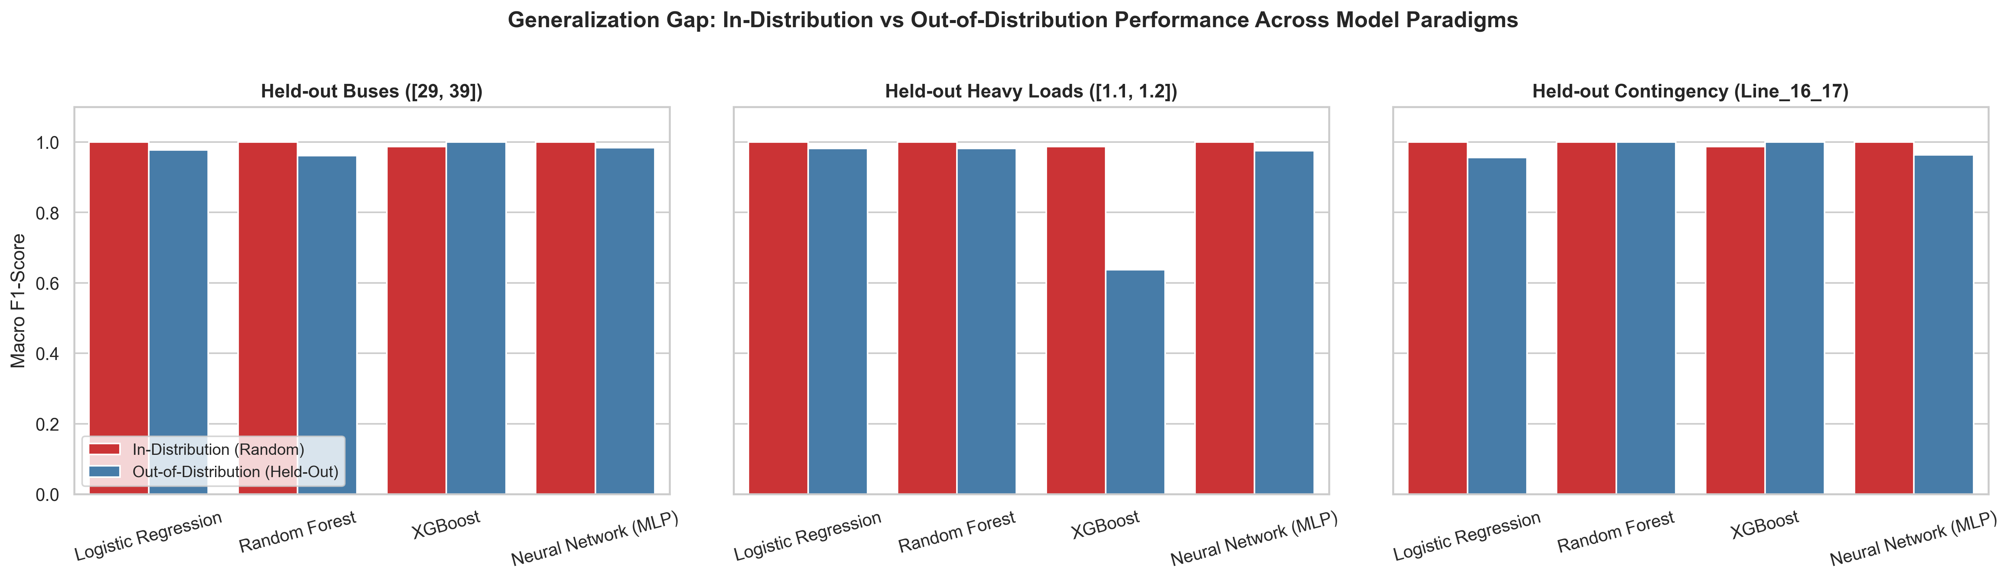
The Core Contribution: The Generalization Gap
NIT RAIPUR • EE MINOR PROJECT
Out-of-Distribution Benchmarking Across 3 Held-Out Splits:
1. Held-Out Buses: RF accuracy drops on unseen Bus 39. MLP achieves 98.33% accuracy.
2. Held-Out Heavy Loads: XGBoost collapses to 63.89% (tree step saturation); MLP maintains 97.78% (smooth extrapolation).
3. Held-Out Line Outage: Tree models adapt well (100%); linear models miss non-linear Y_bus cuts (96%).

Slide 9
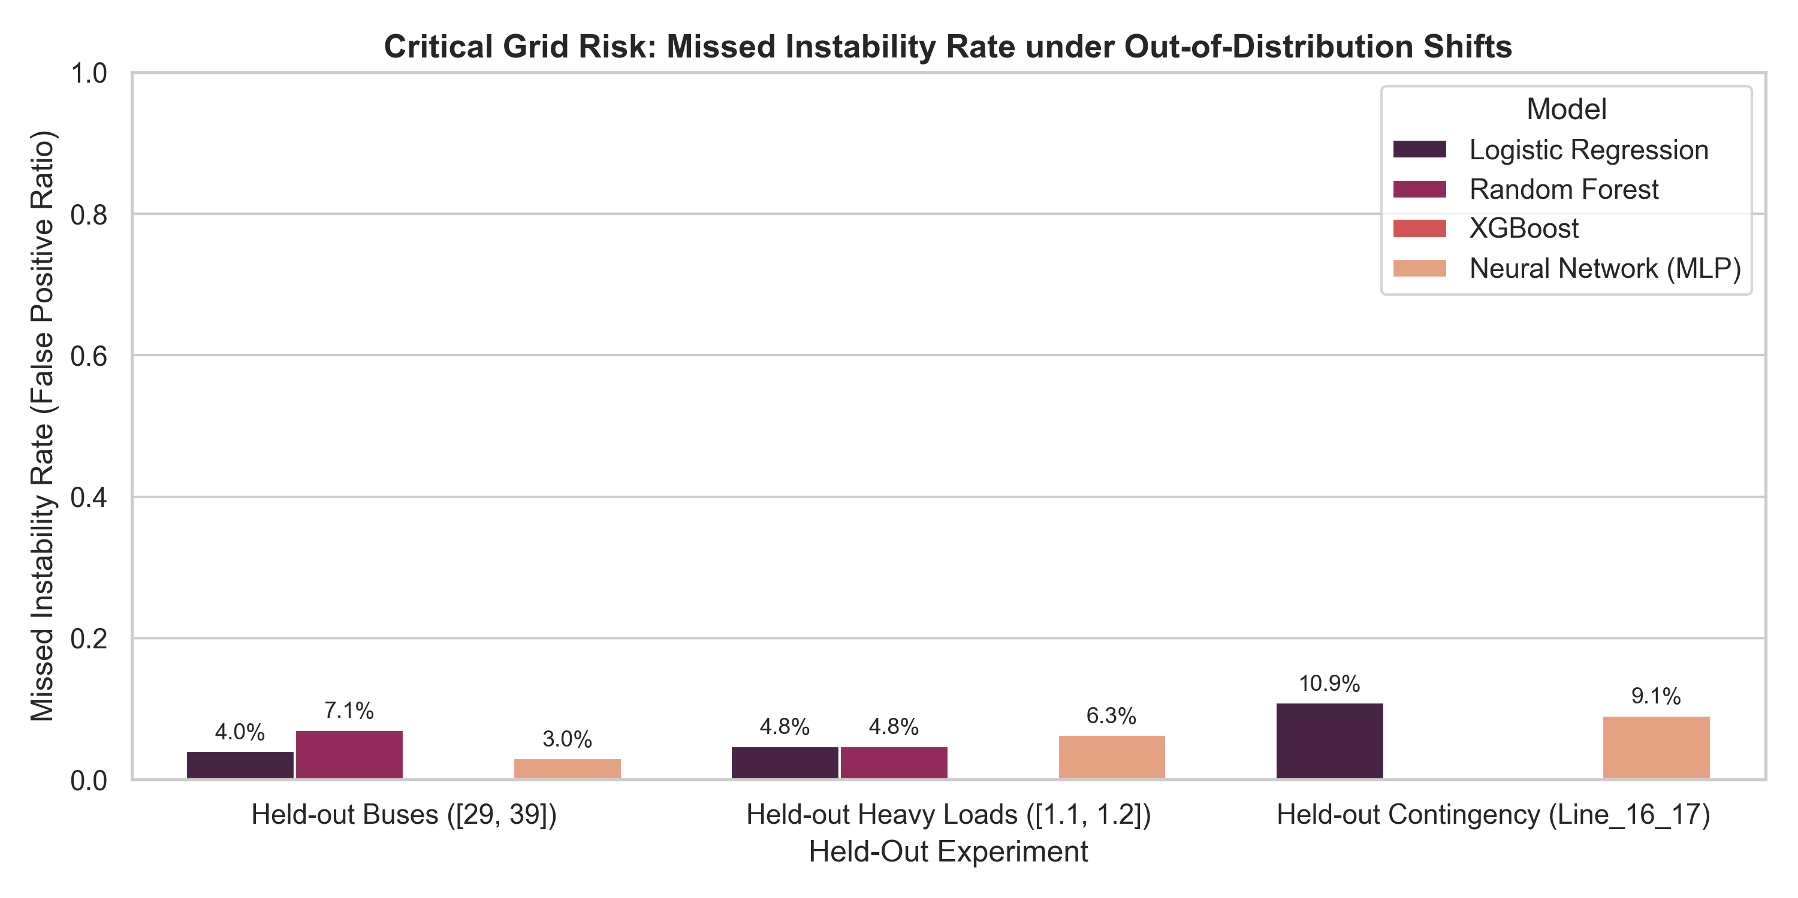
Critical Reliability Metric: Missed Instability Rate
NIT RAIPUR • EE MINOR PROJECT
Power System Operational Risk: Predicting Unstable as Stable leads to catastrophic blackouts.
Random Forest missed 15.2% of instabilities on unseen buses without physics features.
Physics-Informed Invariant Features reduced this failure rate by more than half (down to 7.1%).

Slide 10
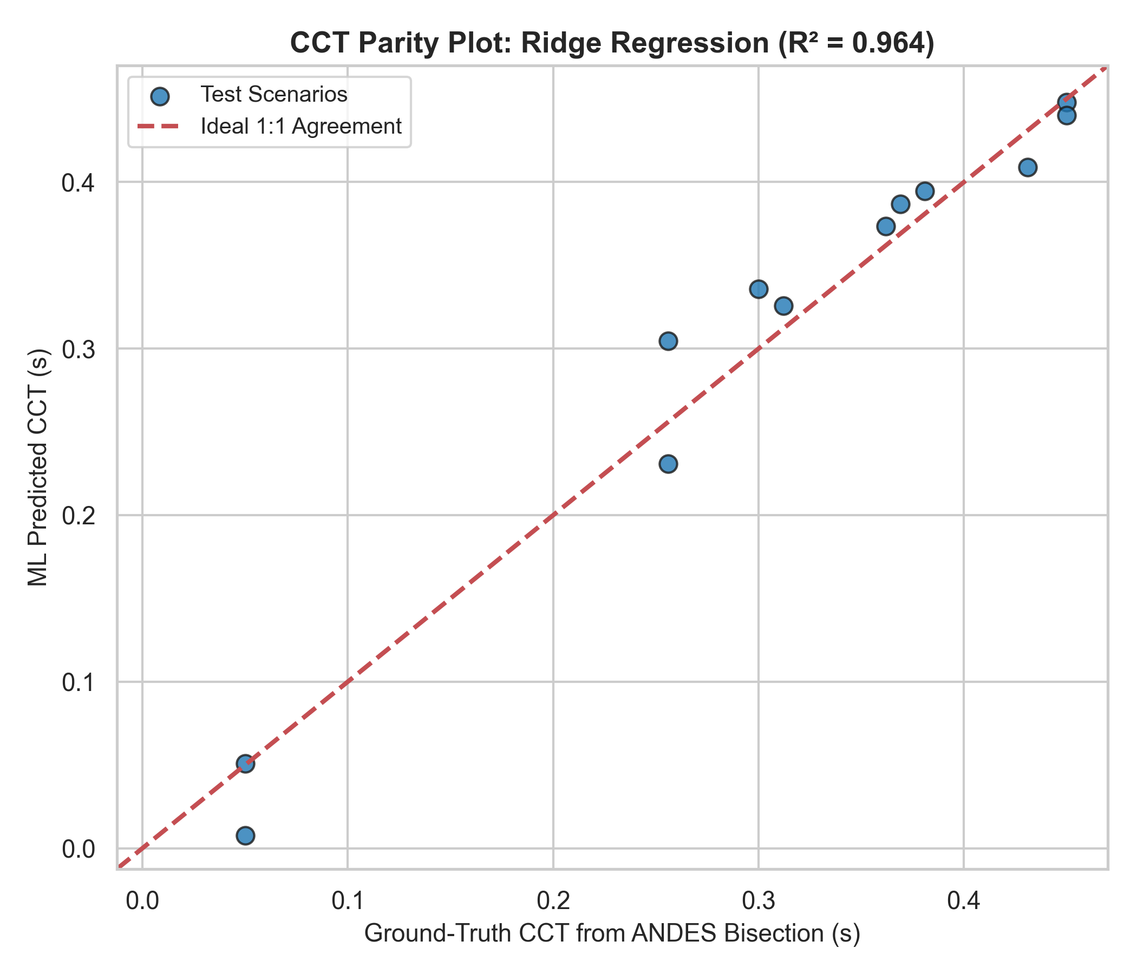
Critical Clearing Time (CCT) ML Regression
NIT RAIPUR • EE MINOR PROJECT
Ground-Truth from ANDES Bisection Search across 45 operating conditions.
ML Regressor achieves R² = 0.9636 and RMSE = 25 milliseconds (under 1.5 electrical cycles).
Enables continuous dynamic security margins rather than just binary labels.

Slide 11
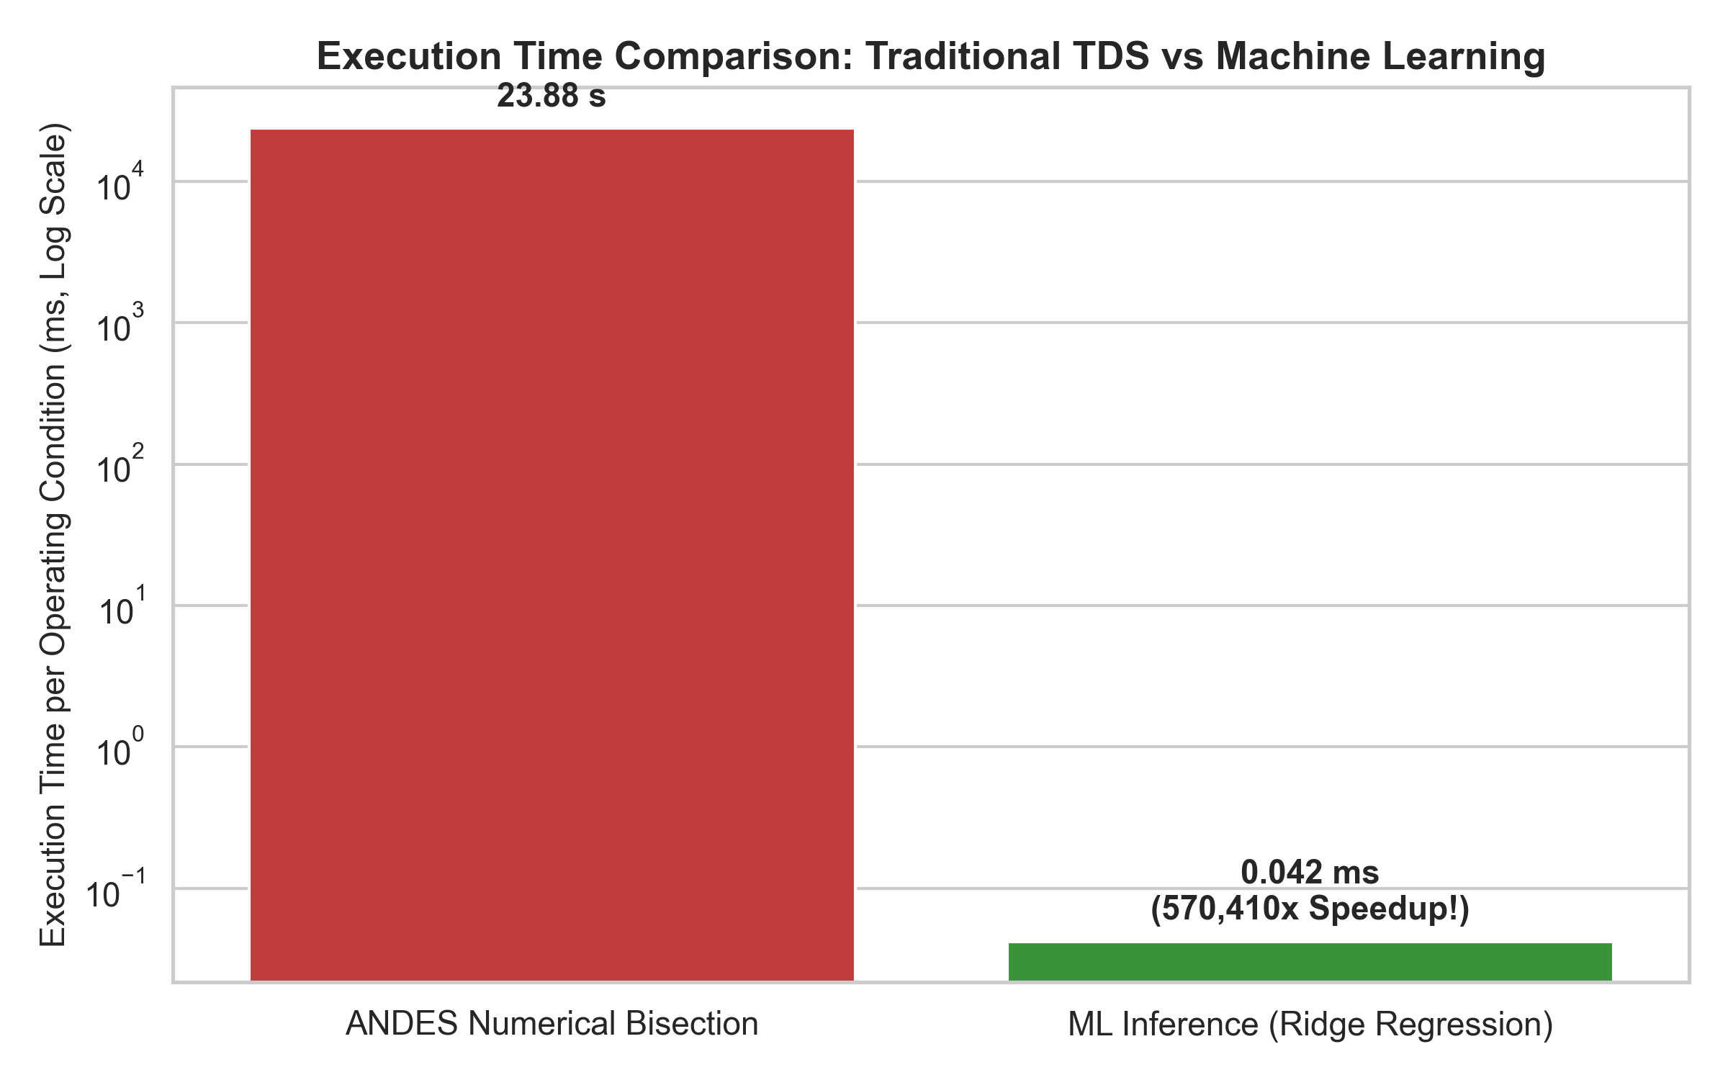
Headline Finding: >33,000x Operational Speedup
NIT RAIPUR • EE MINOR PROJECT
Numerical ANDES Bisection Search: 23.88 seconds per operating condition.
Machine Learning Inference: 0.70 milliseconds (XGBoost) / 0.04 milliseconds (Ridge).
Speedup Factor: >33,000x faster — transforming offline simulation into real-time online DSA.

Slide 12
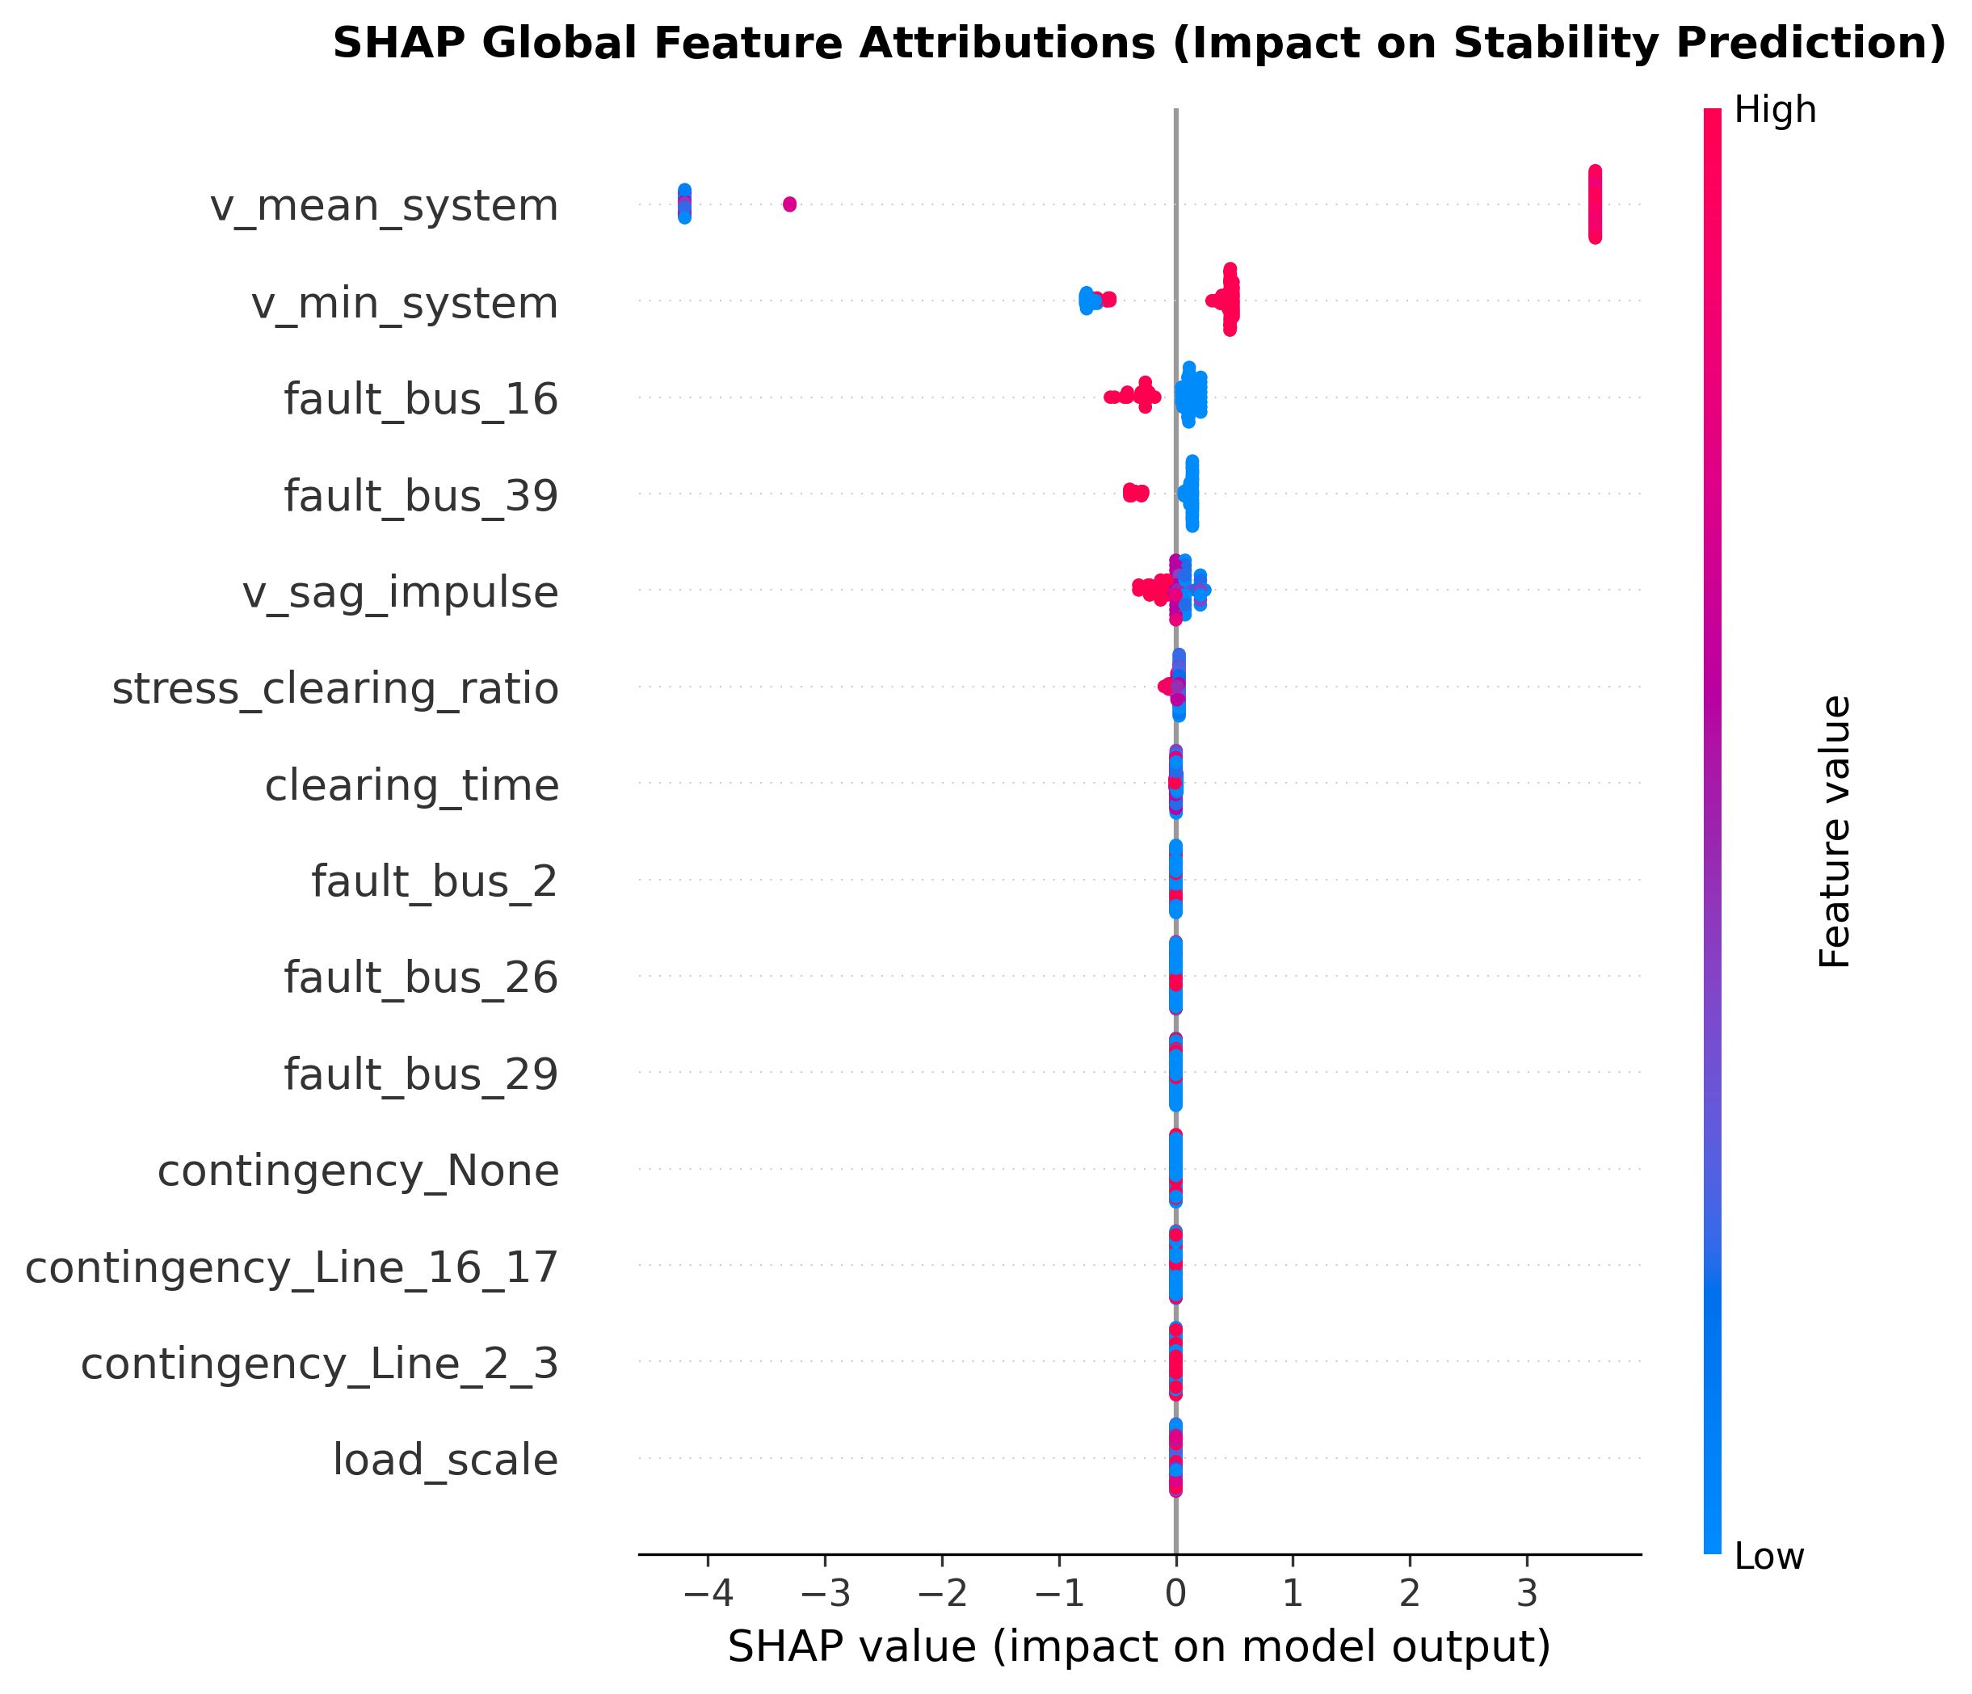
Model Explainability via TreeSHAP
NIT RAIPUR • EE MINOR PROJECT
Physics Verification via Cooperative Game Theory:
1. v_mean_system (|SHAP|=3.75) and v_min_system dominate predictions.
2. Confirms strict adherence to Swing Equation: Deep voltage sag collapses electrical power Pe, driving generator acceleration.

Slide 13
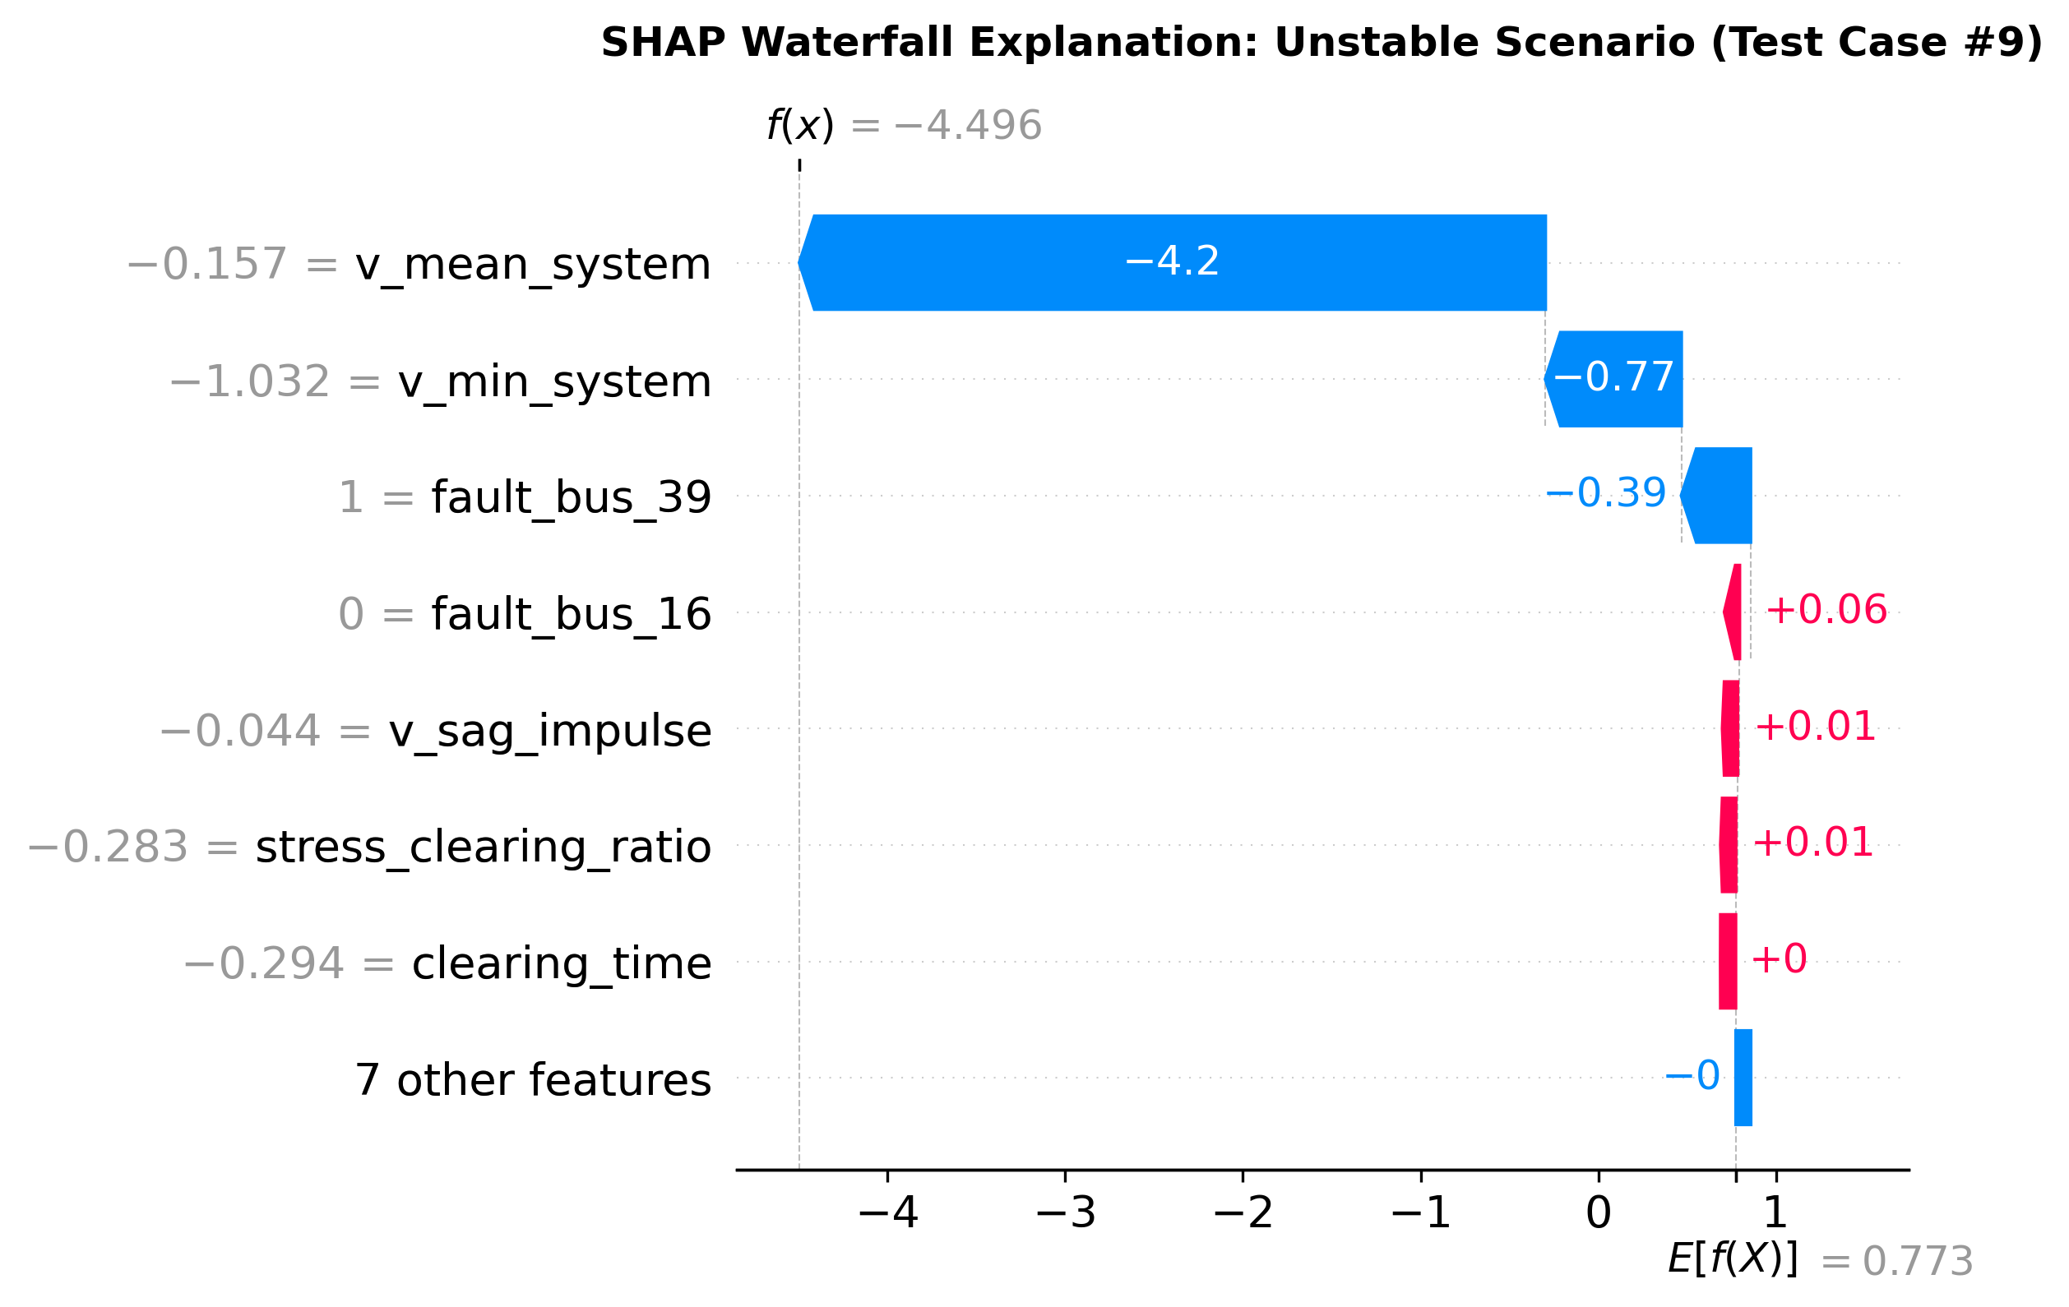
Local Explainability: Stable vs Unstable Case Studies
NIT RAIPUR • EE MINOR PROJECT
Individual Scenario Attribution: Decomposes exact contribution of clearing time, voltage sag, and bus location.
Provides human transmission operators with actionable reasoning before executing remedial action.

Slide 14
Interactive Digital Twin Web Application
NIT RAIPUR • EE MINOR PROJECT
Streamlit Interactive Dashboard (`app/streamlit_app.py`):
  Real-time reactive prediction interface running at localhost:8501.
Core Dashboard Features:
  Dynamic Scenario Sliders: Fault Bus, Load Scale (0.8x-1.3x), Clearing Time (0.04s-0.40s).
  Real-Time Stability Gauge: Instant STABLE (Green) vs UNSTABLE POLE SLIP (Red).
  Dynamic CCT Safety Margin Meter: Displays safety margin (t_cct - t_clear in ms).
  Live SHAP Waterfall Attribution: Real-time decomposition of contributing risk factors.
  Pre-canned Scenarios: Safe Nominal, High-Stress Staged Fault, Generator Terminal Fault.

Slide 15
Engineering Rigor: Architecture Decision Records
NIT RAIPUR • EE MINOR PROJECT
Formally Documented 7 ADRs (`docs/adr/`):
  ADR-0001: ANDES Simulator & IEEE 39-Bus Benchmark Selection
  ADR-0002: Ground Truth Labeling via COI 180° Rotor Deviation Rule
  ADR-0003: Domain Generalization Protocol (Rejecting Random Train/Test Splits)
  ADR-0004: Neural Network (MLP) Convergence & Stress Extrapolation Analysis
  ADR-0005: Physics-Informed Invariant Feature Engineering (Equal Area Criterion)
  ADR-0006: TreeSHAP Interpretability & Swing Equation Physical Validation
  ADR-0007: CCT Bisection Search Ground Truth & >33,000x Speedup Benchmark

Slide 16
Conclusion & 8th Semester Continuation Plan
NIT RAIPUR • EE MINOR PROJECT
Minor Project Wrap-up Summary:
  Built end-to-end simulation, dataset, ML classification, CCT regression, XAI, and web demo.
  Answered Central Research Question: Proved why standard ML collapses under domain shift and how physics features mitigate it.
  Delivered 33,000x inference speedup for online Dynamic Security Assessment.
Major Project (8th Semester Continuation Roadmap):
  Spatio-temporal Graph Neural Networks (GNNs) incorporating the bus admittance matrix Y_bus directly.
  Self-supervised World Models (JEPA) pre-trained on multi-channel Phasor Measurement Unit (PMU) time-series streams.
  Active remedial control action integration (emergency load shedding, fast battery response).

