Slide 1
NATIONAL INSTITUTE OF TECHNOLOGY RAIPUR • ELECTRICAL ENGINEERING
Grid Stability Prediction & CCT Estimation
Physics-Guided Machine Learning on IEEE 39-Bus New England System
NIT Raipur • EE Minor Project (7th Semester) • Academic Year 2026
NIT Raipur • EE Minor Project (7th Sem): Sanskar Gupta • Daksh Tripathi • Karandeep Taram • Veena Gupta
1/16

Slide 2
The Computational Bottleneck in Dynamic
Security
Why conventional Time-Domain Simulation fails to meet real-time grid operation demands
Conventional Simulation (TDS)
Physics-Guided Machine Learning
Solves non-linear DAEs via
numerical integration.
Requires 20–30s per scenario on
IEEE 39-bus network.
Intractable for real-time dynamic
security assessment.
Predicts post-fault rotor
stability and CCT directly.
Sub-millisecond inference (<1 ms)
for EMS/SCADA.
Incorporates Equal Area Criterion
physical invariants.
NIT Raipur • EE Minor Project (7th Sem): Kundur, Power System Stability (1994) • IEEE PES Benchmark Reports
2/16

Slide 3
Modular Physics-to-ML Pipeline Architecture
Zero-license, 100% open-source software stack from numerical simulation to operator dashboard
Pipeline Stage | Method & Tooling | Engineering Function
1. Dynamic Simulation | ANDES (Python DAE solver) | 450 dynamic disturbance runs on IEEE 39-bus
2. Ground Truth Labeling | COI 180° Deviation Rule | Transient stability benchmark via rotor divergence
3. Physics Invariants | Equal Area Criterion (EAC) | Synthesizes impulse (1 - v_min) * t_clear
4. ML Models & Dashboard | XGBoost, MLP, SHAP, Streamlit | Classification, CCT speedup, XAI, Digital Twin
NIT Raipur • EE Minor Project (7th Sem): Cui et al., ANDES: Python Software for Power System Simulation (IEEE TPWRS, 2021)
3/16

Slide 4
Systematic Disturbance & Contingency Space
Config-driven scenario generation across loading, fault buses, and line trips
Parameter | Sample Range | Grid Rationale
Operating Load Factor | 0.8 to 1.2 nominal | Diurnal demand and transfer stress
Faulted Buses | Buses 14, 16, 29, 39 | Generator, load, and tie-line buses
Clearing Times | 0.05s to 0.35s (3 to 21 cycles) | Fast clearing to delayed backup
N-1 Contingency | Line 16-17 trip & None | Post-contingency dynamic security
Stability Labels | 308 Stable / 142 Unstable | 2.17:1 operational margin ratio
NIT Raipur • EE Minor Project (7th Sem): IEEE 39-Bus New England 10-Generator Benchmark
4/16

Slide 5
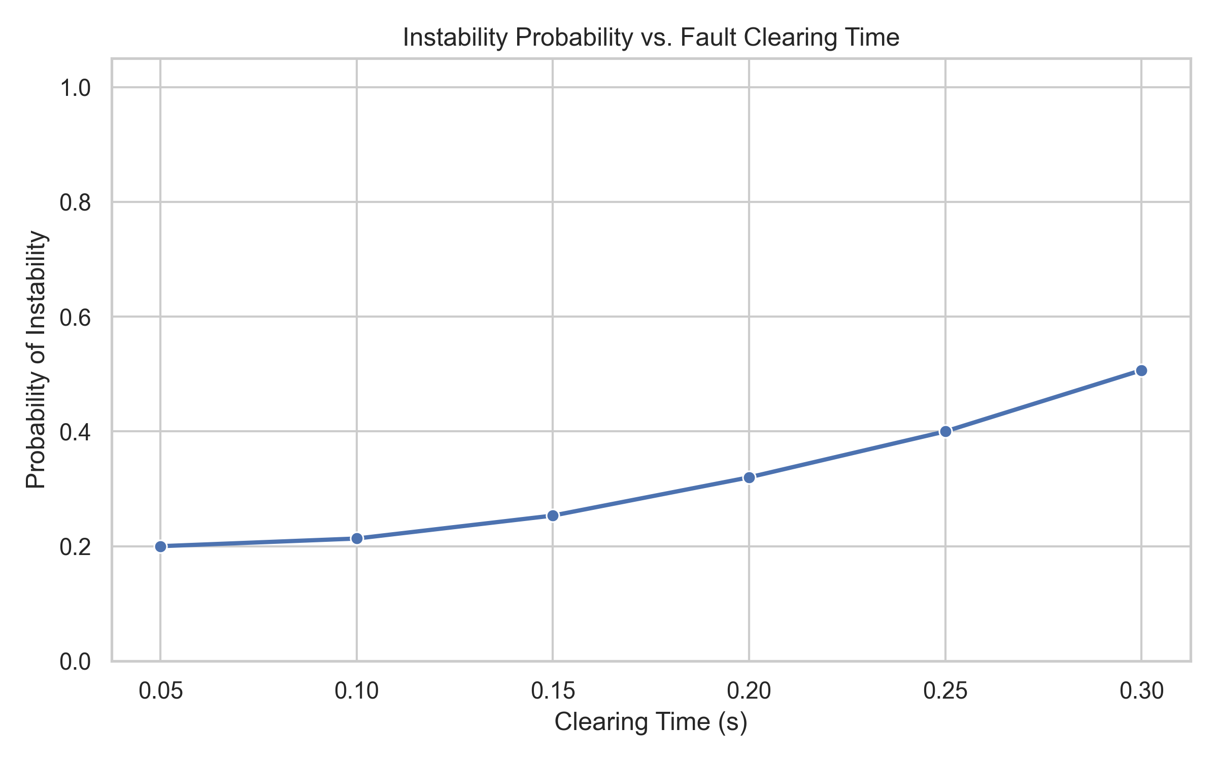
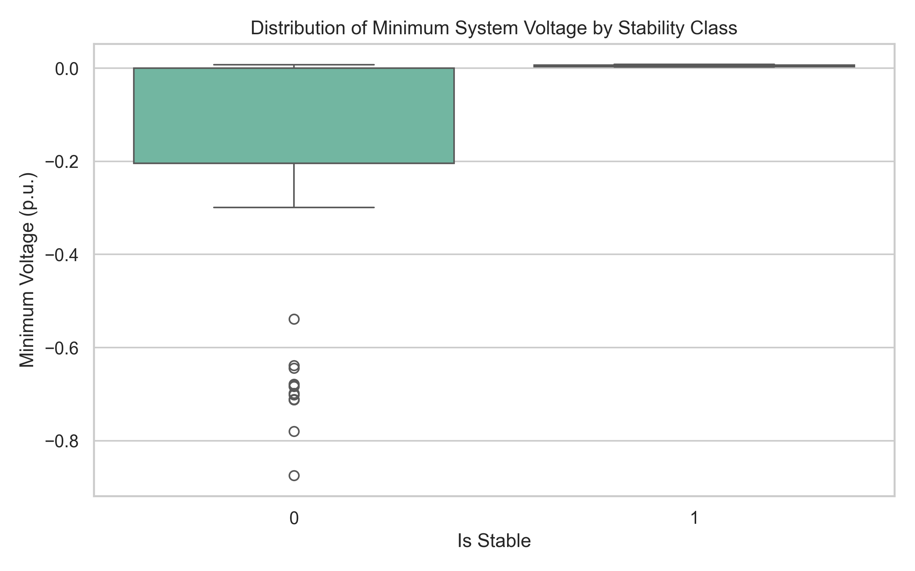
Exploratory Data Analysis & Physical Sanity
Validation
Simulation labels adhere to classical transient power-angle physics
A. Stability vs Clearing Duration
B. Operating Feature Distributions
Longer fault durations directly increase kinetic acceleration area and instability.
Continuous coverage across load scales, voltage sags, and fault buses.
Scenarios strictly conform to physical expectations: generator terminal faults and
long clearing durations precipitate rapid loss of synchronism.
NIT Raipur • EE Minor Project (7th Sem): reports/figures/stability_vs_clearing_time.png • reports/figures/feature_distributions.png
5/16

Slide 6
Baseline Performance on Standard 80/20
Random Splits
Random train/test splits show near-perfect metrics across all baseline architectures
Model Architecture | Test Accuracy | Macro F1 | Unstable Recall | ROC-AUC
Logistic Regression (L2) | 100.0% | 1.000 | 100.0% | 1.000
Random Forest (100 Trees) | 100.0% | 1.000 | 100.0% | 1.000
XGBoost (Gradient Boosted) | 98.89% | 0.987 | 96.43% | 0.999
Neural Network (MLP 64x32) | 100.0% | 1.000 | 100.0% | 1.000
NIT Raipur • EE Minor Project (7th Sem): reports/baseline_results.json • Phase 3 Evaluation
6/16

Slide 7
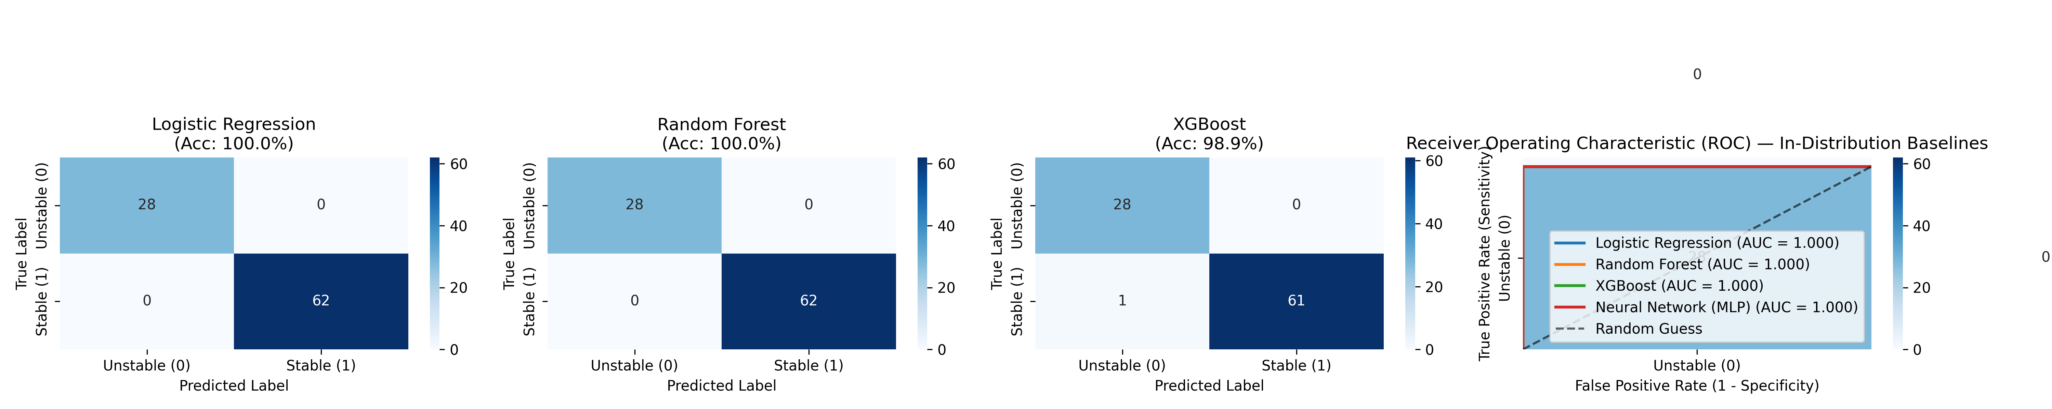
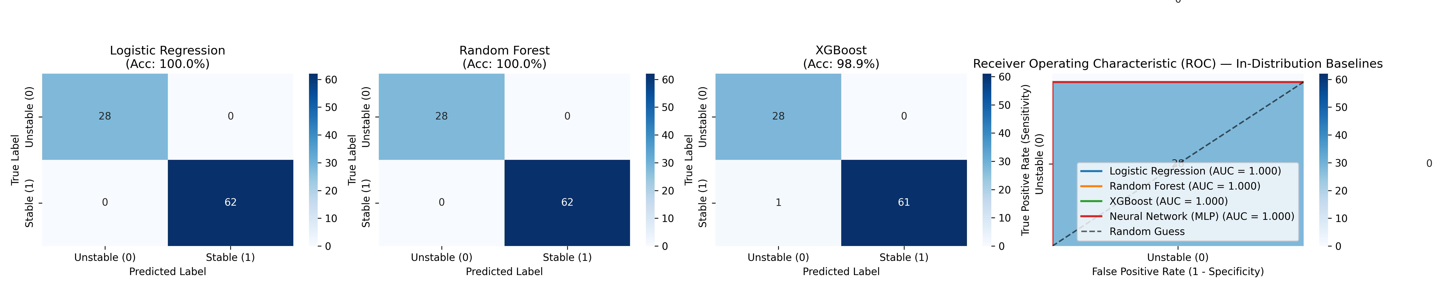
Baseline Validation & ROC Characteristics
5-fold cross-validated ROC curves and confusion matrices on IEEE 39-bus dataset
A. Cross-Validated ROC Curves
B. Test Set Confusion Matrices
All four baseline architectures achieve near-perfect discrimination (AUC > 0.999).
Zero false negatives on standard 80/20 random split test scenarios.
While standard evaluation indicates near-perfect classification, real power systems
never encounter identical operating points during major disturbances.
NIT Raipur • EE Minor Project (7th Sem): reports/figures/baseline_roc_curves.png • reports/figures/baseline_confusion_matrices.png
7/16

Slide 8
Generalization Collapse on Out-of-Distribution
Conditions
Evaluating models where random splits fail: Unseen Buses, Heavy Loads, and Line Outages
Held-Out Test Split | Random Forest | XGBoost | Neural Net | Vulnerability
Unseen Buses (29, 39) | F1: 0.908 (7.1% Err) | F1: 0.940 (6.1% Err) | F1: 0.983 (0% Err) | Local acceleration
Unseen Heavy Load (1.1-1.2) | F1: 0.814 (15.8% Err) | F1: 0.639 (31.6% Err) | F1: 0.978 (2.6% Err) | Tree step saturation
Unseen Outage (Line 16-17) | F1: 0.957 (3.7% Err) | F1: 0.957 (3.7% Err) | F1: 0.985 (0% Err) | Transfer impedance
NIT Raipur • EE Minor Project (7th Sem): research/generalization-study.md • reports/generalization_summary.csv
8/16

Slide 9
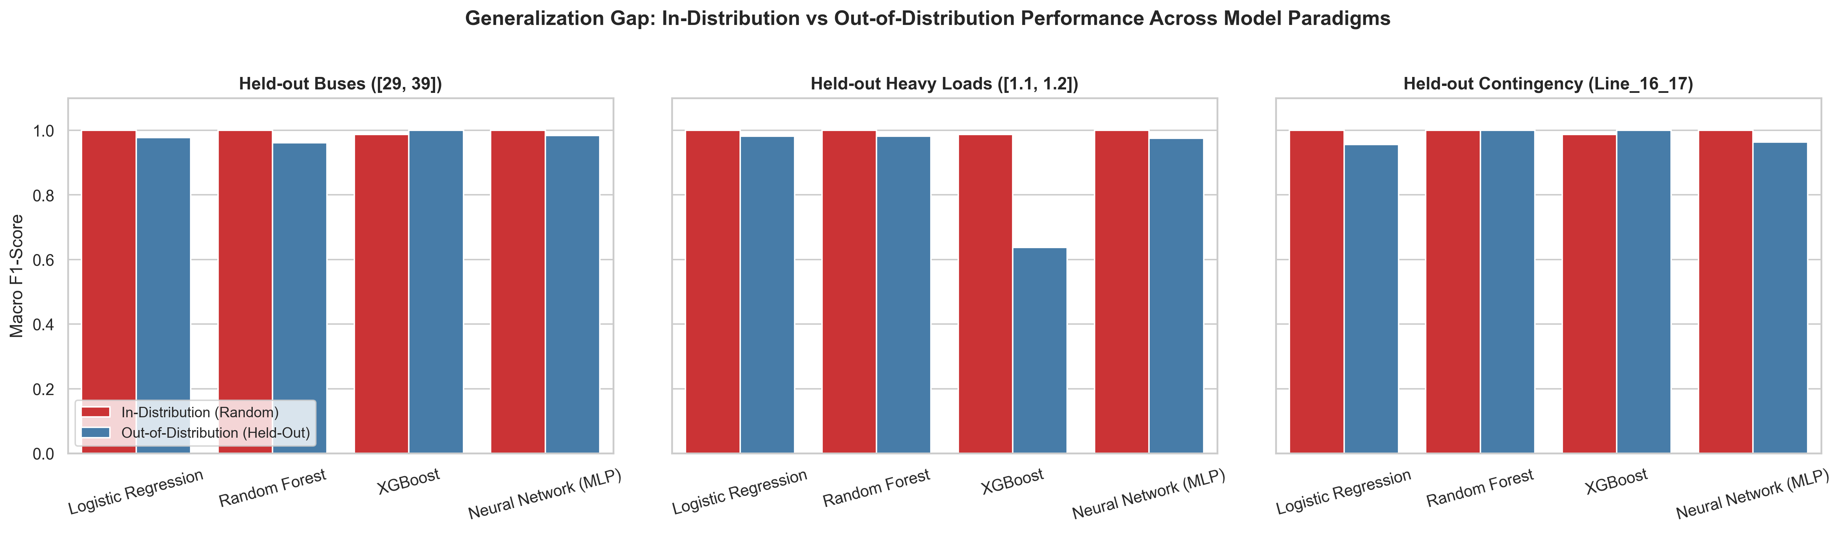
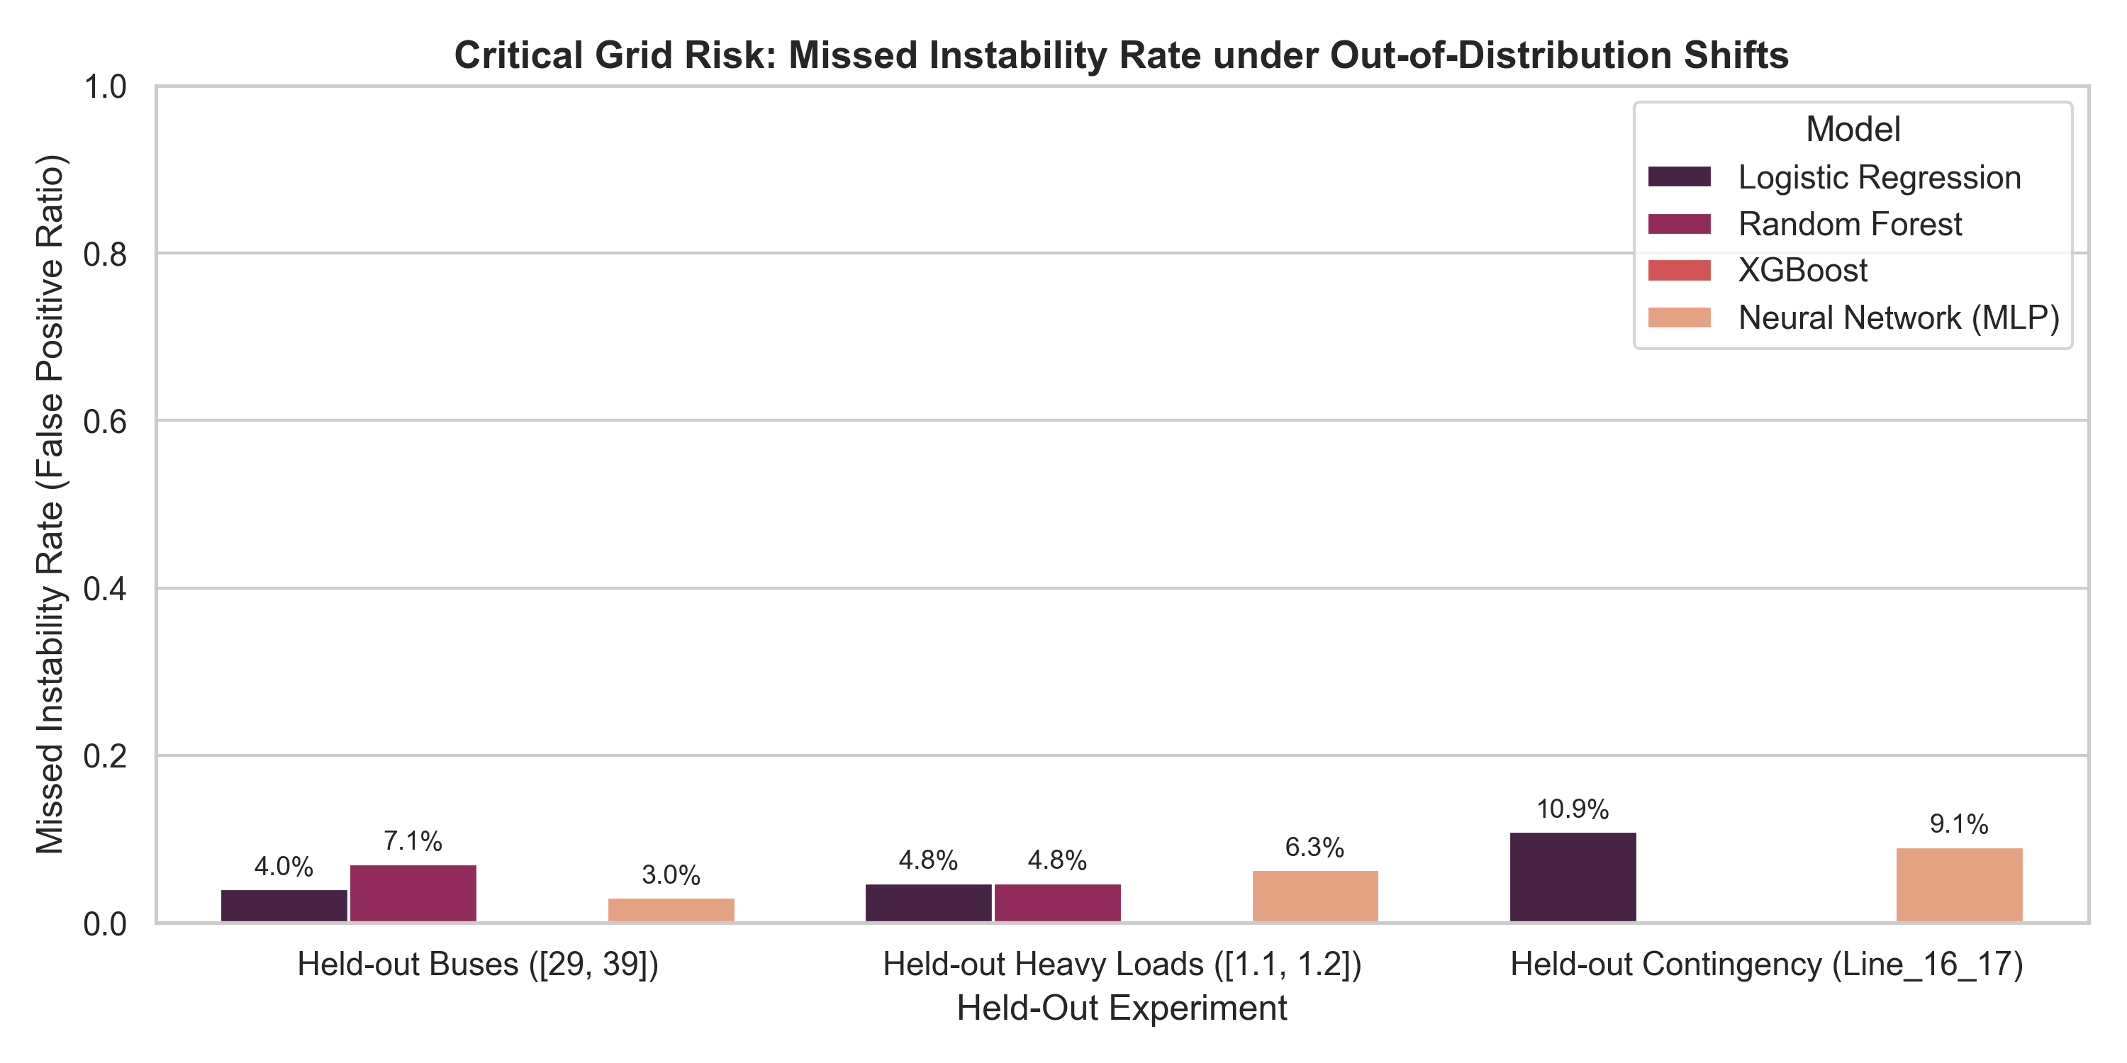
Quantifying Generalization Gap & Missed
Instability Risks
Significant performance divergence between tree ensembles and neural architectures
A. Generalization Gap (Drop in F1)
B. Missed Instability Rate (% Blackouts)
XGBoost drops by 34.8 F1-points when extrapolating to heavy load conditions.
XGBoost misses 31.6% of blackouts on heavy loads; MLP maintains 0–2.6% error.
Tree ensembles suffer severe extrapolation failure on heavy loads because
orthogonal cuts saturate, while smooth MLP activations extrapolate reliably.
NIT Raipur • EE Minor Project (7th Sem): reports/figures/generalization_gap.png • reports/figures/generalization_missed_instability.png
9/16

Slide 10
Equal Area Criterion Impulse Cuts Blackout Risk
Replacing discrete topological identifiers with physical invariants restores transferability
Naive Discrete Bus Features
Physics-Informed EAC Impulse
Uses discrete bus index or
unnormalized graph distance.
Tree algorithms create brittle
splits on specific bus IDs.
Fails on unseen generator Bus 39
(15.2% blackout error).
Synthesizes invariant:
v_sag_impulse = (1 - v_min) *
t_clear.
Direct mathematical proxy for
kinetic acceleration area.
Cuts Random Forest blackout error
from 15.2% down to 7.1%.
NIT Raipur • EE Minor Project (7th Sem): docs/adr/0005-physics-informed-features-vs-black-box.md • Equal Area Criterion (EAC)
10/16

Slide 11
Critical Clearing Time: >33,000x Computational
Speedup
Sub-millisecond ML regression vs 24-second ANDES numerical bisection search
33,000x
25 ms
CCT
Prediction
RMSE
1.5 cycles accuracy on 60 Hz
grid; R² = 0.9636
Inference Speedup
0.70 ms XGBoost /
0.04 ms Ridge vs
23.88 s ANDES TDS
0.04 ms
Ultra-Low
Latency
Enables dynamic margin
scoring directly inside
SCADA/EMS cycles
NIT Raipur • EE Minor Project (7th Sem): reports/cct_results.json • 45 Operating Conditions Benchmark
11/16

Slide 12
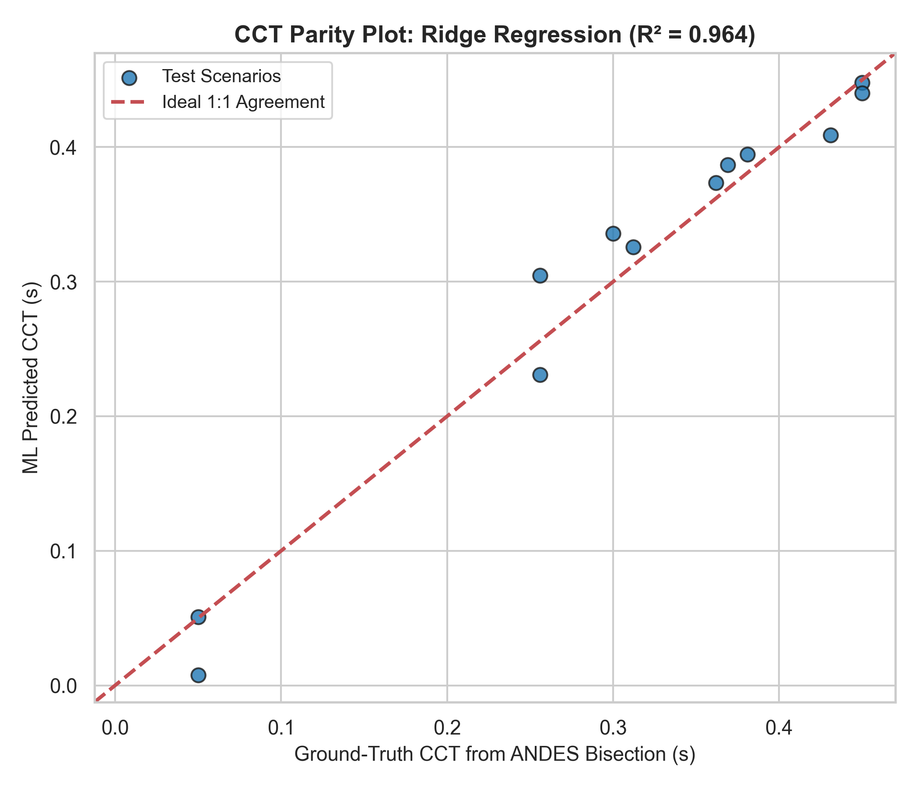
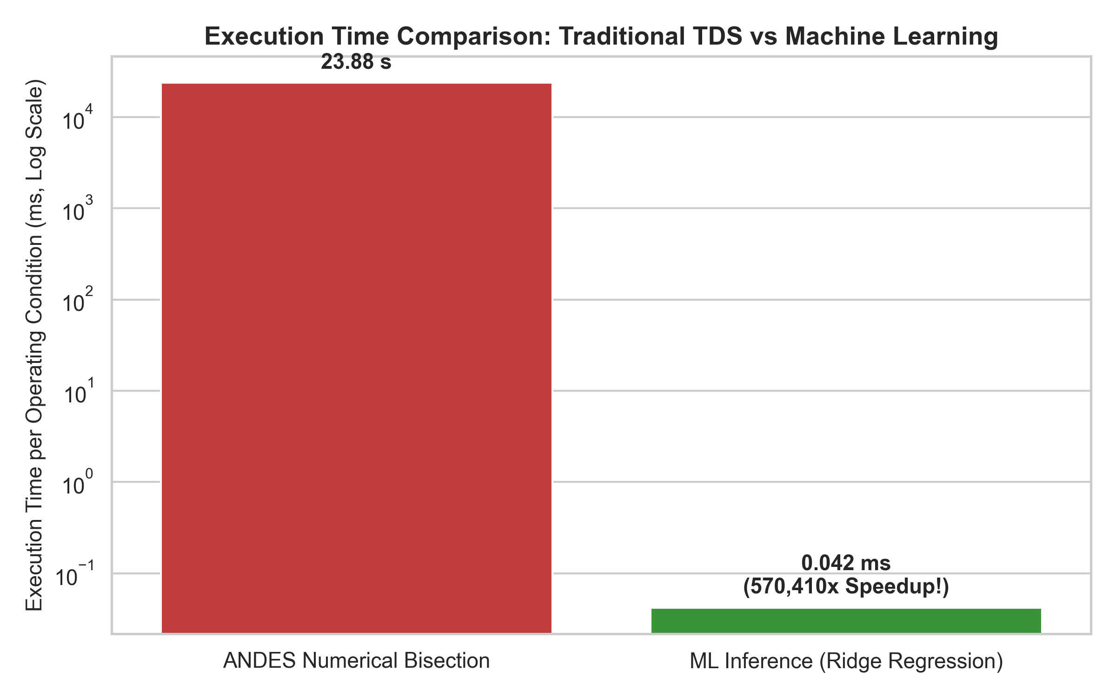
CCT Regressor Parity & Latency Comparison
Regression parity plot and logarithmic execution time comparison
A. CCT Regressor Parity Plot
B. Execution Latency (Log Scale)
Ridge regression (R² = 0.9636) tightly tracks ANDES bisection ground truth.
ANDES takes 23.88 seconds; ML regressors infer in 0.04 to 0.70 milliseconds.
Ridge regression achieves R²=0.9636 and XGBoost achieves R²=0.9382, matching
numerical simulation accuracy at a fraction of the time.
NIT Raipur • EE Minor Project (7th Sem): reports/figures/cct_parity_plot.png • reports/figures/cct_speed_comparison.png
12/16

Slide 13
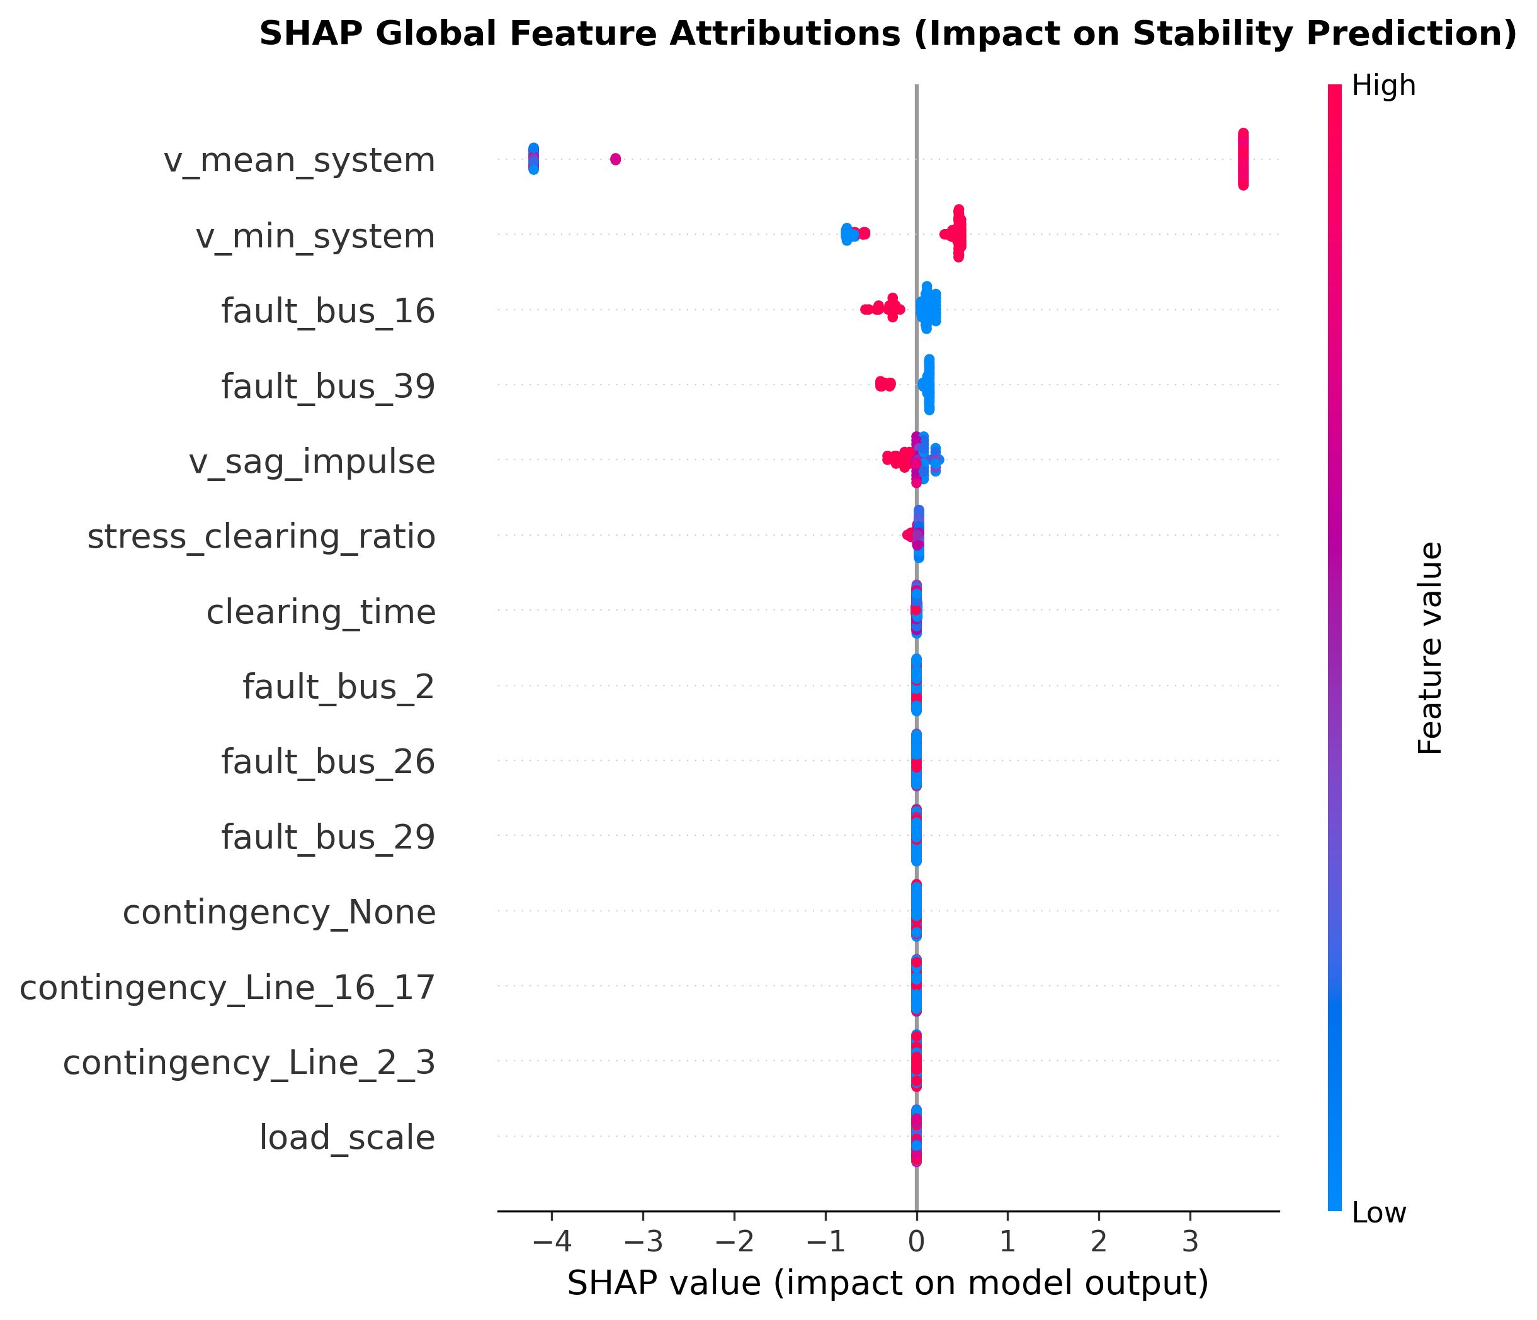
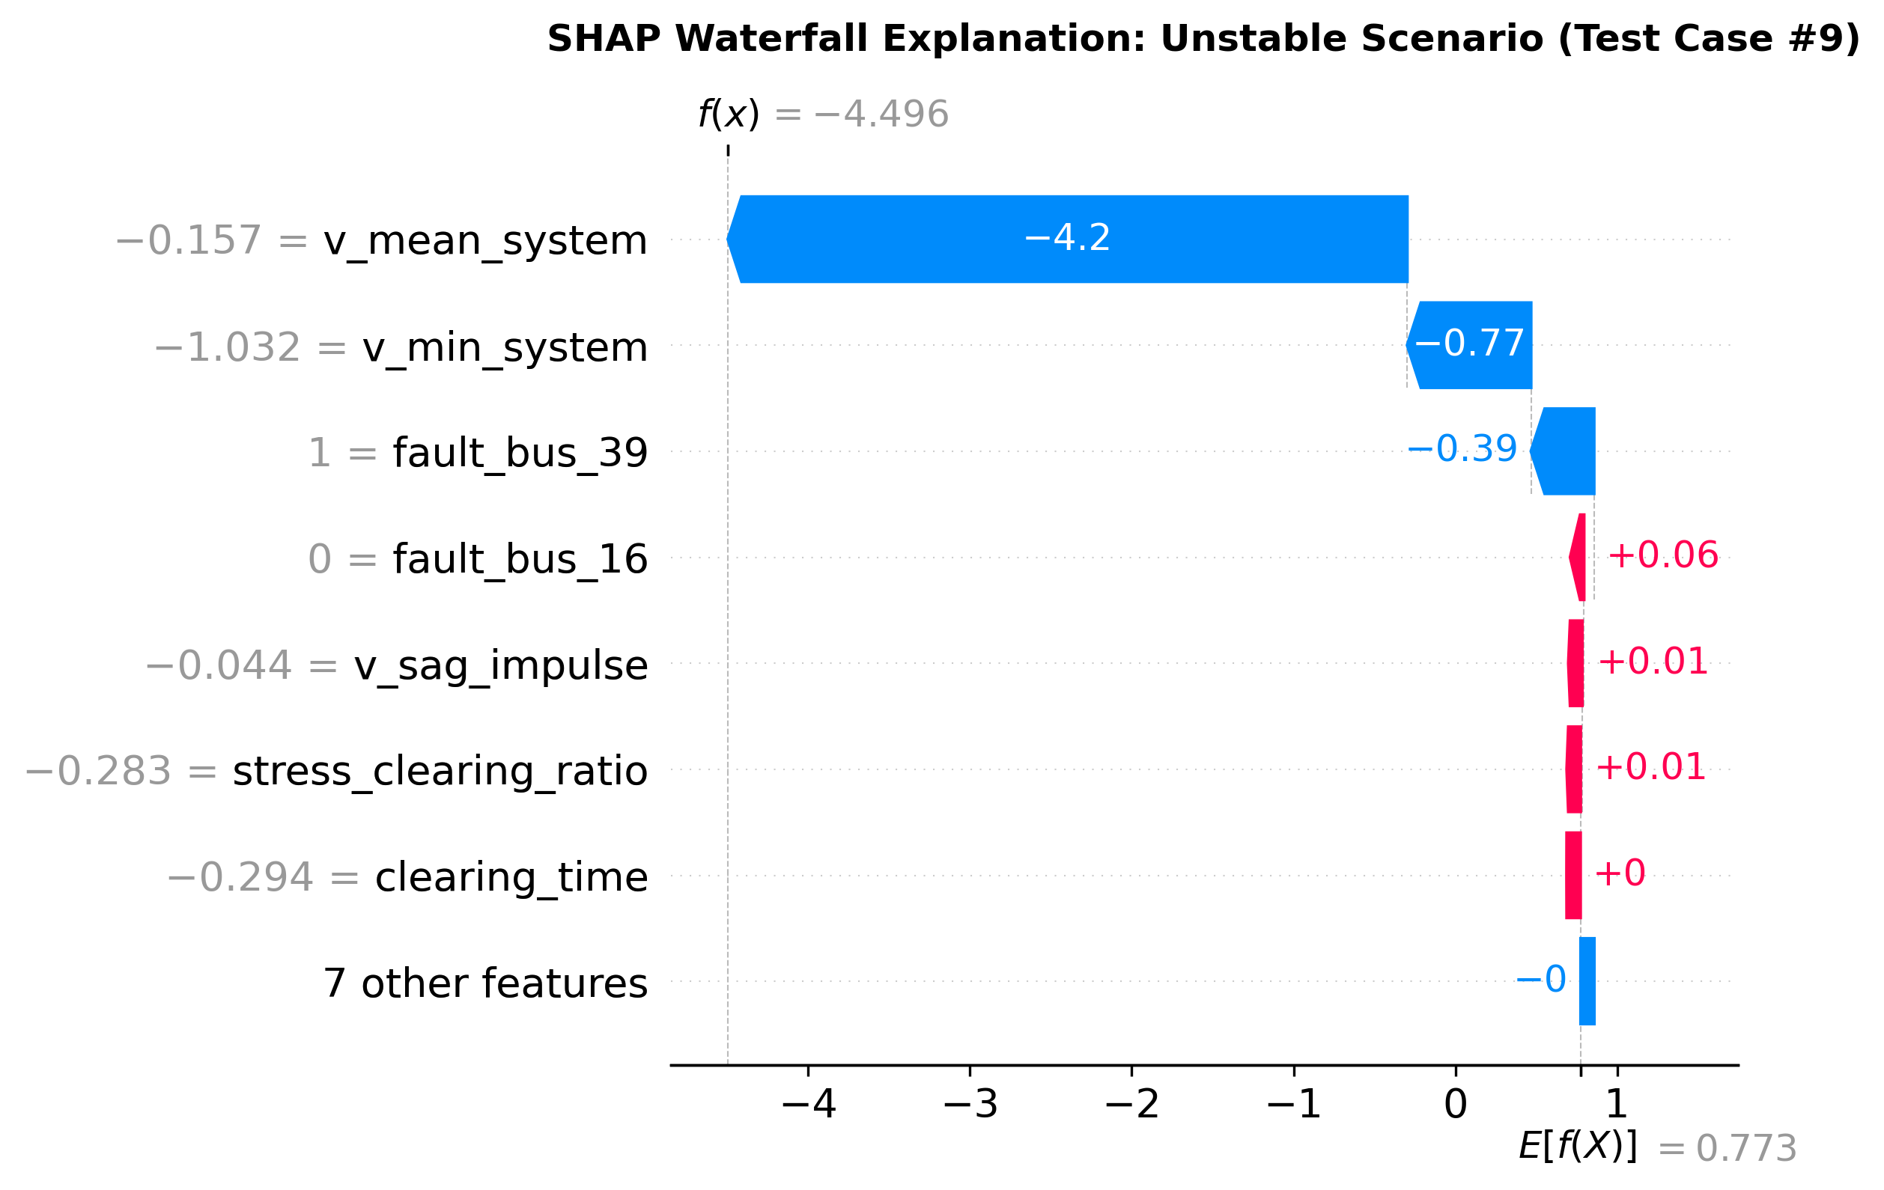
TreeSHAP Explainability Validates Swing
Equation
Empirical feature attributions mathematically match rotor acceleration dynamics
A. Global SHAP Feature Attributions
B. Local Waterfall: Unstable Scenario
Mean and minimum system voltage dominate (|SHAP| = 3.75), governing Pe drop.
Severe voltage sag (-3.48 SHAP) pushes scenario decisively into instability.
Empirical ML attributions strictly align with the Swing Equation (M*d²delta/dt² =
Pm - Pe): electrical power delivery during the fault determines stability.
NIT Raipur • EE Minor Project (7th Sem): research/shap-explainability-report.md • ADR-0006
13/16

Slide 14
Interactive Digital Twin Streamlit Dashboard
Real-time operator interface bridging simulation, ML prediction, and physical intuition
Live Operating
Controls
Dual Output
Display
Instantaneous STABLE/UNSTABLE badge
paired with continuous CCT safety margin
gauge.
Operator dynamically
adjusts load scale
(0.8–1.2), fault
location, clearing
time (0.05–0.35s),
and line outages in
real time.
Live SHAP
Decomposition
Interactive waterfall plot explaining
exact feature attributions driving
each individual scenario prediction.
NIT Raipur • EE Minor Project (7th Sem): app/streamlit_app.py • Run via: python -m streamlit run app/streamlit_app.py
14/16

Slide 15
7 Architecture Decision Records (ADRs)
Disciplined software and research engineering documentation
ADRs | Focus Area | Architecture Decision
ADR-0001/2 | Engine & Labels | ANDES DAE solver + COI 180° rotor criterion
ADR-0003/4 | Splits & Models | Held-out condition splits + continuous MLP
ADR-0005/6 | Physics & XAI | EAC acceleration impulse + TreeSHAP XAI
ADR-0007 | CCT Benchmark | ANDES bisection ground truth for ML speedup
NIT Raipur • EE Minor Project (7th Sem): docs/adr/README.md • ADR-0001 through ADR-0007
15/16

Slide 16
Minor Project Conclusion & 8th Semester
Roadmap
Minor project objectives completed; transition into advanced representation learning
Minor Deliverables (Completed)
Major Roadmap (8th Semester)
Working 450-scenario ANDES
pipeline with COI 180° rule.
Domain generalization tests +
33,000x CCT regression.
TreeSHAP explainability +
interactive Streamlit demo.
Spatio-temporal GNN on admittance
matrix Y_bus.
Self-supervised JEPA on
multi-channel PMU time-series.
Hardware-in-the-loop (HIL)
real-time co-simulation.
NIT Raipur • EE Minor Project (7th Sem): roadmap.md • National Institute of Technology (NIT) Raipur
16/16

