Slide 1
Data Driven AI
Week 3 - Lecture 1: Exploratory Data Analysis
Dr. Abirami Gunasekaran
CHS 2406: Data-driven AI

Slide 2
What is Exploratory Data Analysis (EDA)?
An approach to data analysis that employs a variety of techniques (mostly graphical) to investigate datasets and summarise their main characteristics.
The analysis of datasets can be based on various numerical methods and graphical tools.
Exploring data for patterns, trends, underlying structure, deviations from the trend, anomalies and strange structures.
It facilitates discovering unexpected as well as confirming the expected patterns or hypotheses.

Slide 3
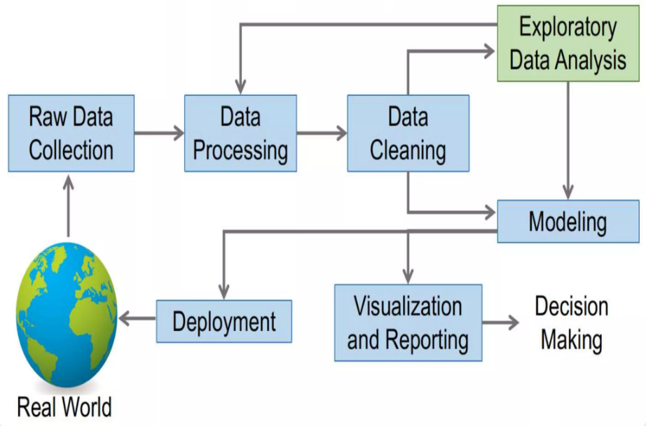
Where is EDA in Data Science Process?

Slide 4
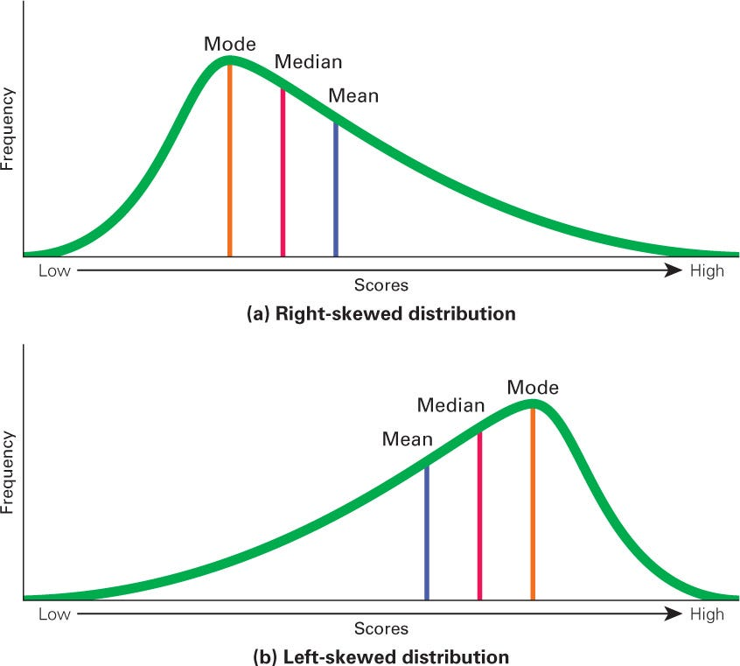
Goals of EDA
Know your Data
Structure, relationships, patterns
Distributions, Central tendency measures
Unique values, value range
Detect Data issues
Missing values, inconsistencies, outliers
Look at every variable
Test assumptions (e.g. normal or skewed data)
Identify useful raw data & transformations (e.g. log(x))

Slide 5
Typical Data Formats
Tabular data
Most common type
Represented by rows & cols
.csv or DB files
JSON data
Lightweight data interchange format
Represent structured data
Web applications and APIs
XML data
Store and transport data
Represent hierarchical structures
Webservices, config. Files
Text data
Doc, articles, emails, social media posts, etc.
Represent unstructured data
Time series data
Data collected over time
With time stamps
.csv or DB files
Spatial data
Represent geographical features
Maps, GPS coordinates or satellite imgs
.Geojson, Geotiff, shapefiles
Image data
Represent visual information in pixel grids
.JPEG, PNG, TIFF, etc
Graph data
Represent relationships between entities
Social n/w data, recommendation and n/w analysis
Graph DBs, edge lists, adjacency lists

Slide 6
Steps of EDA
Generate good research questions
Data restructuring: You may need to make new variables from the existing ones.
Instead of using two variables, obtaining rates or percentages of them
Creating dummy variables for categorical variables
Based on the research questions, use appropriate graphical tools and obtain descriptive statistics.
Try to understand the data structure, relationships, anomalies, unexpected behaviors.
Try to identify confounding variables, interaction relations and multicollinearity, if any.
Handle missing observations
Decide on the need of transformation (on response and/or explanatory variables).
Decide on the hypothesis based on your research questions

Slide 7
Basic interpretation of Data
New cancer cases in the U.S. based on a cancer registry
• The rows in the registry are called observations they correspond to individuals
• The columns are variables or data fields they correspond to attributes of the individuals

Slide 8
EXAMPLE 1
Data from the Places Rated Almanac (Boyer and Savageau, 1985)
9 variables from 329 metropolitan areas in the USA
Climate mildness
Housing cost
Health care and environment
Crime
Transportation supply
Educational opportunities and effort
Arts and culture facilities
Recreational opportunities
Personal economic outlook
+ latitude and longitude of each city
Questions:
How is climate related to location?
Are there clusters in the data (excluding location)?
Are nearby cities similar?
Any relation between economic outlook and crime?
What else???

Slide 9
EXAMPLE 2
In a breast cancer research, main questions of interest might be
Does any treatment method result in a higher survival rate? Can a particular treatment be suggested to a woman with specific characteristic?
Is there any difference between patients in terms of survival rates (e.g. Are white women more likely to survive compared to black women if they are both at the same stage of disease?)

Slide 10
EXAMPLE 3
In a project, investigating the well-being of teenagers after an economic hardship, main questions can be
Is there a positive ( and significant) effect of economic problems on distress?
Which other factors can be most related to the distress of teenagers? e.g. age, gender,…?

Slide 11
AFTER EDA
Confirmatory Data Analysis:
Verify the hypothesis by statistical analysis
Get conclusions and present your results nicely.

Slide 12
Common types of EDA
Summative analysis
High level overview -- dataset characteristics
E.g. mean, median, and stddev
Univariate analysis
Focusing on distribution and properties of individual variables
E.g. Histogram, count plot
Bivariate analysis
Examining relationships between pairs of variables
E.g. correlation analysis, scatter plots
Multivariate analysis
Extending bivariate analysis to multiple variables simultaneously
E.g. Stacked bar charts
Visualisation methods
Exploring data graphically
E.g. histograms, box plots, heatmaps

Slide 13
Cross-classification of EDA Methods
Univariate non-graphical
Measuring central tendency – mean, median, mode and distribution
Multivariate non-graphical
Cross tabulation, Correlation analysis
Univariate graphical
Histograms, Boxplots
Multivariate graphical
Scatter plots
Non-graphical
Graphical

Slide 14
Non-graphical EDA : Summarising Data With Tables and Plots
Examine the entire data set using basic techniques before starting a formal statistical analysis.
Familiarising yourself with the data.
Find possible errors and anomalies.
Examine the distribution of values for each variable.
5-number summaries:
For each continuous feature, the statistical description is used to provide various summary statistics such as
The feature's number of records, maximum, minimum values, mean and dispersion of data from the center, as well as its percentage of the overall data set as 25%, 50%, and 75%

Slide 15
Summarising Variables
Categorical variables
Frequency tables - how many observations in each category?
Relative frequency table - percent in each category.
Continuous variables
Bin the observations (create categories .e.g., (0-10), (11-20), etc.) then, treat as ordered categorical.
The goal for both categorical and continuous data is data reduction while preserving/extracting key information about the process under investigation.

Slide 16
Categorical Data Summaries
Tables
Cancer site is a variable taking 5 values
categorical or continuous?
ordered or unordered?

Slide 17
Frequency Table
Frequency Table: Categories with counts
Relative Frequency Table: Percentage in each category

Slide 18
Graphical EDA: Univariate visualisation:
Age histogram of 10 adult leukemia patients
Histogram - is a bar chart constructed using the frequencies or relative frequencies of a grouped (or binned) continuous variable
E.g. Ages of 10 adult leukemia patients:
35; 40; 52; 27; 31; 42; 43; 28; 50; 35
Advantages:
Shows variability, Skewness, modalities, outliers, strong patterns
Issues
It discards some information (the exact values), retaining only the frequencies in each bin

Slide 19
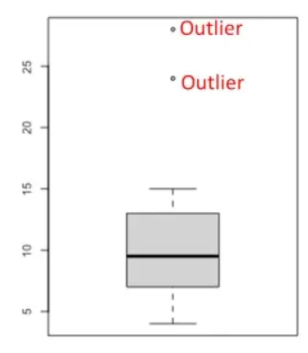
Univariate visualisation
Boxplots - is a graphical representation of a dataset's distribution showing the
median, quartiles (Q1 and Q3), outliers, IQR, and skewness
Advantages
Visualises spread and skewness
Detects outliers
Summarises large datasets compactly
Issues
Limited details - (e.g.) no multiple modes/specific data points
Misinterpretation leads to misleading conclusions
Other univariate methods
Count plot, Pie chart, etc.

Slide 20
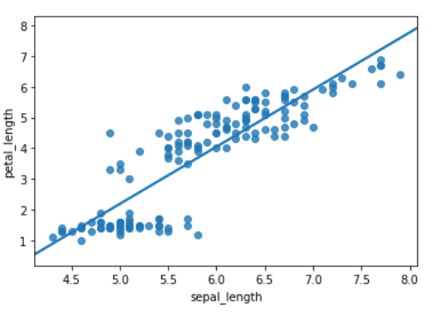
Bivariate visualisation
To analyse two continuous variables – use scatterplot – display values for 2 variables for set of data points
E.g. Comparing the sepal_width and petal_length features (from iris dataset)
Advantages
Visualises relationships
Identifies patterns
Issues
Overplotting
Limited to two variables
Interpretation can be subjective to the viewer
Other bivariate methods
Heat map, Swarm plot, Line chart, etc.

Slide 21
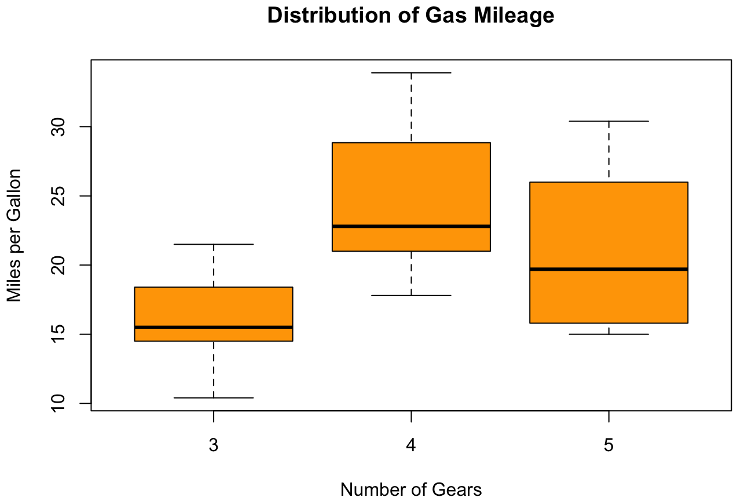
Bivariate visualisation
To analyse two variables – one continuous, one categorical –
Use Side by side boxplots - compare the distributions of a continuous variable across two or more categorical groups
E.g. Distribution of Gas Mileage by Number of Gears
Advantages
Compact representation
Direct comparison bw multiple groups
Visualises outliers
Issues
Leads to misinterpretation if not analysed with context
Limited detail – no distribution shape/data points are shown
https://homepages.gac.edu/~anienow2/MCS_142/R/R-boxplot2.html

Slide 22
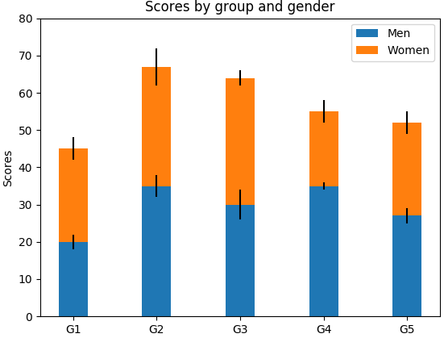
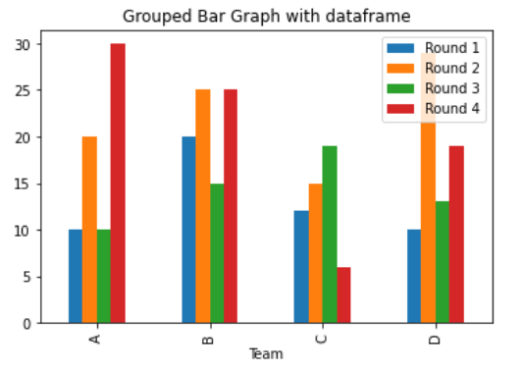
Multivariate visualisation
To analyse three variables – two categorical and one continuous variables - use stacked or grouped bar chart
In grouped bar chart, bars are grouped side by side for each category, while in stacked bar chart, bars are divided into segments stacked on top of one another to show the contribution of each sub-category
Advantages
Clear and compact comparison
Easy to interpret
Issues
Overcrowding – for many categories, bars become hard to read
If not designed carefully, it may lead to misleading conclusions

Slide 23
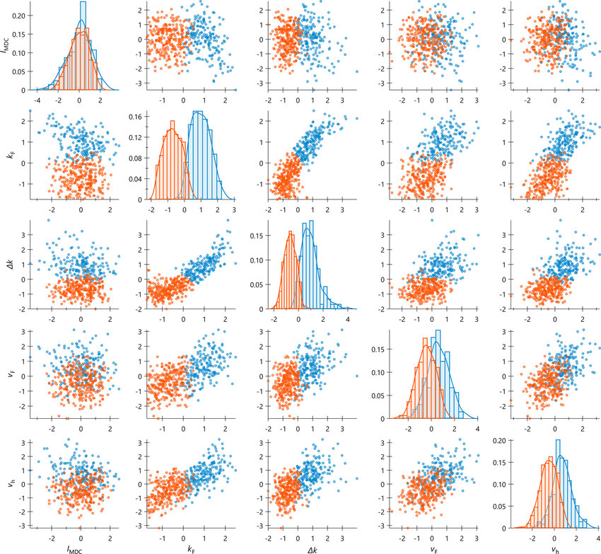
Multivariate visualisation
More than 2 variables – to show the relationships between pairs of multiple continuous variables - pairwise scatter plots
Each cell in the matrix represents a scatter plot comparing two variables
Advantages
complete visual summary of relationships
Visualises relationships
Detects outliers
Issues
not suitable for comparing categorical variables.
Complex when dealing with a high number of variables and relationships are non-linear.
Overplotting

Slide 24
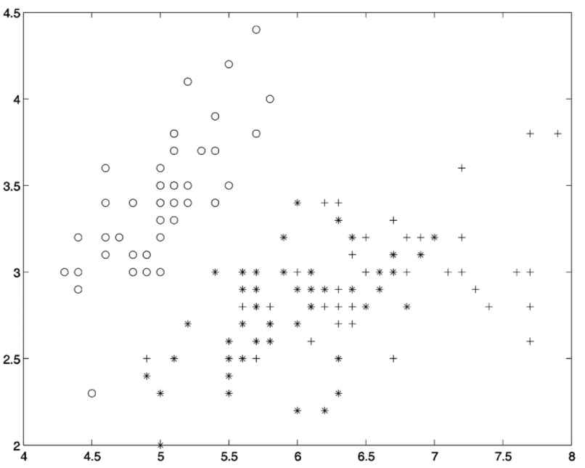
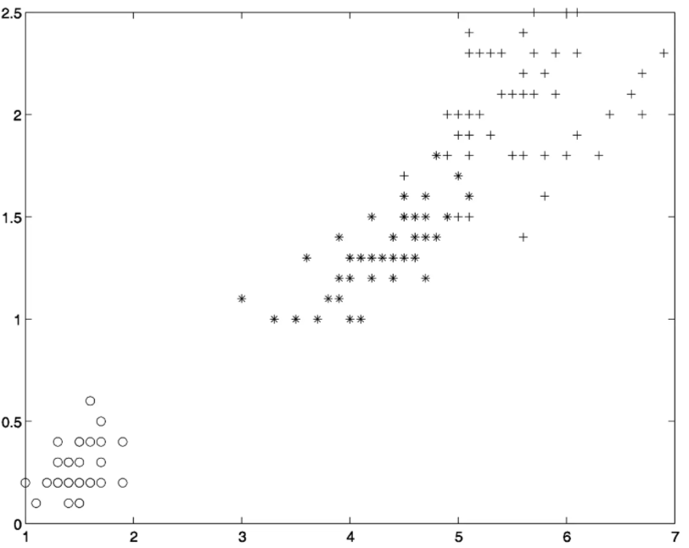
What do you interpret from these charts?
Feature 1 & Feature 2
Feature 3 & Feature 4
How many classes are there? Which class(es) has more distinct characteristics?
Which feature combination will be more informative to classification models?

Slide 25
Python Libraries
The widely used libraries for data visualisation in Python
Matplotlib
creating static, animated, and interactive plots in Python
Example Usage:
import matplotlib.pyplot as plt
Seaborn
a statistical data visualisation library, built on top of matplotlib
provides high-level, attractive, and informative graphics.
Example Usage:
Import seaborn as sns
Plotly
library for creating interactive plots
supports web-based visualisations and interactive dashboards
Example Usage:
import plotly.express as px

Slide 26
Best Practices:
Start with simple summaries and visualisations.
Identify and address data quality issues.
Don’t assume patterns—explore various plots.
It is almost always a good idea to perform univariate EDA on each of the components of a multivariate EDA before performing the multivariate EDA.
Common Mistakes to Avoid:
Over-relying on summary statistics without visual checks.
Ignoring outliers and missing data.

Slide 27
Any Questions?

Slide 28
Automated EDA
pip install sweetviz
import sweetviz as sv
import pandas as pd
# Load your dataset
df = pd.read_csv("your_dataset.csv")
# Generate the Sweetviz report
report = sv.analyze(df)
report.show_html("sweetviz_report.html")

