Slide 1
Tmn2073 computer security
Group member:
Mohammad Farhaan Iqbal (59404)
Nur Asma binti Hasan (53104)
Fatin shahirah binti amanzuria(55978)
Siti Ameera binti azahar(57870)
Amira izzati shahila binti ahmad rizal(55453)

Slide 2
Block-chat
Decentralized chat – chatting over blockchain in a secure way

Slide 3
Problem statement
Centralized system for communication
Misuse of data
Loss of ownership of communication
Security in current communication medium

Slide 4

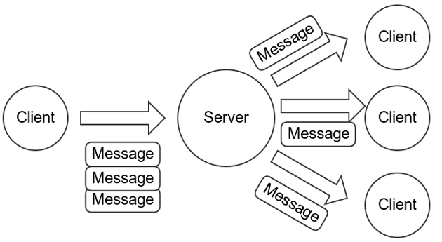
Current chat systems

Slide 5
objective
Build a communication system where the people are in control
Allow for possible deniability
Create darkness is communication

Slide 6
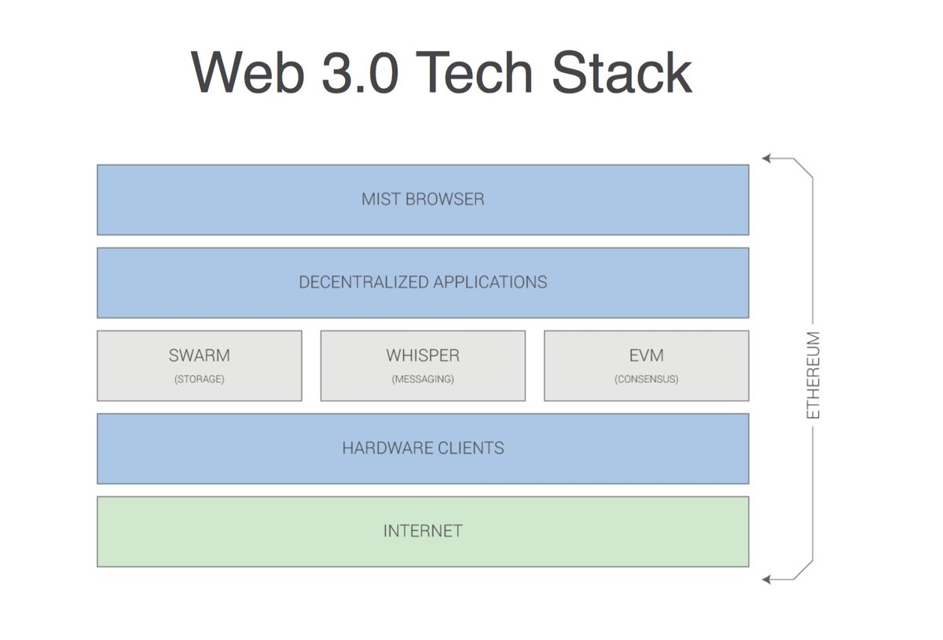

Slide 7
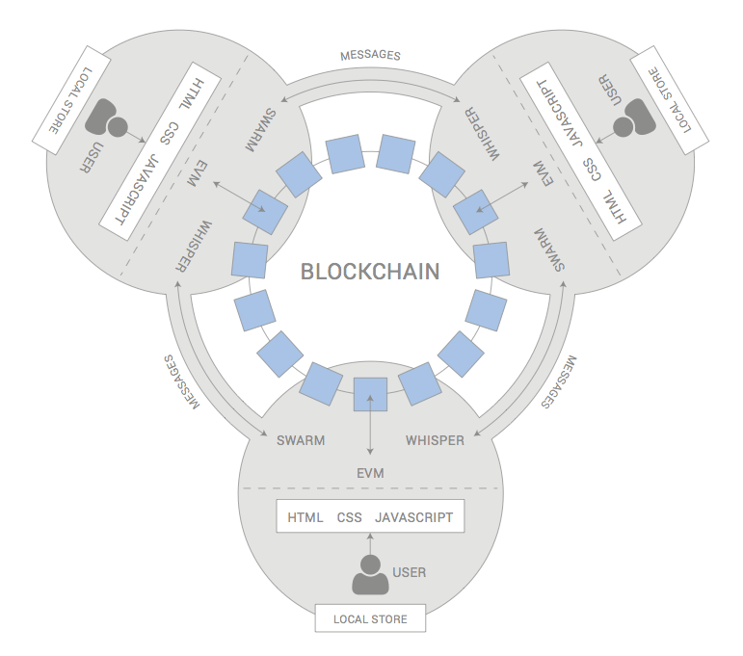

Slide 8
WHAT is a dapp?
Decentralized application where there is no centralized server and the app run locally
Blockchains are used to allow for storage and data sharing

Slide 9
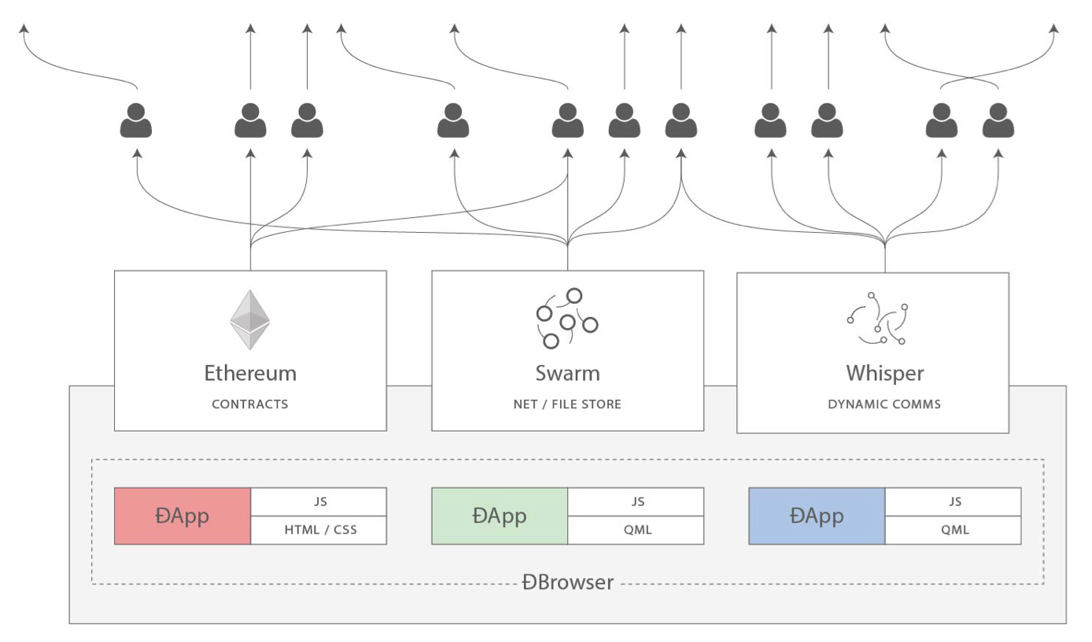

Slide 10
Specification of whisper protocol
Low-level API only exposed to DApps, never to users.
Low-bandwidth Not designed for large data transfers.
Uncertain-latency Not designed for RTC.
Dark No reliable methods for tracing packets or
Typical usage:
Low-latency, 1-1 or 1-N signaling messages.
High latency, high TTL 1-* publication messages.
Messages less than 64K bytes, typically around 256 bytes.

Slide 11
END

