Slide 1

predictive models for stock volatility
Abdullah Fashola

Slide 2
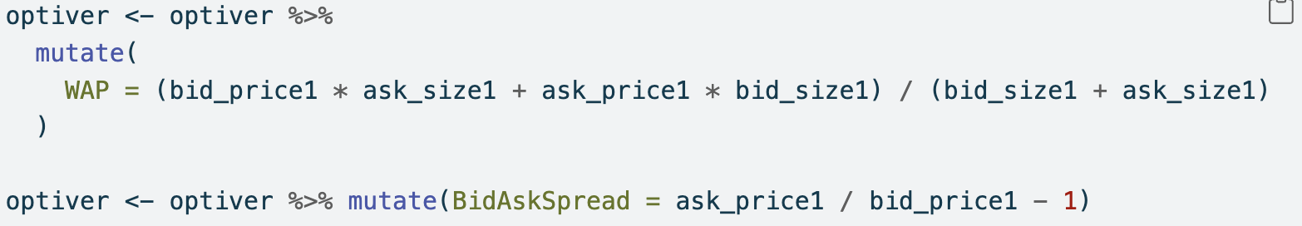
linear regression¹
1. University of Sydney. (2025). DATA3888_2025 Lab: Week 3 – Time Series Data - Optiver. Available at: https://canvas.sydney.edu.au/courses/65141/modules/items/2667174

Slide 3
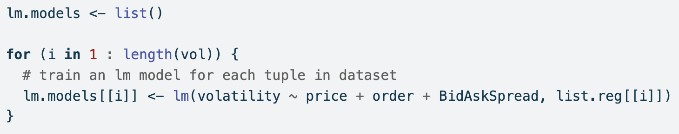
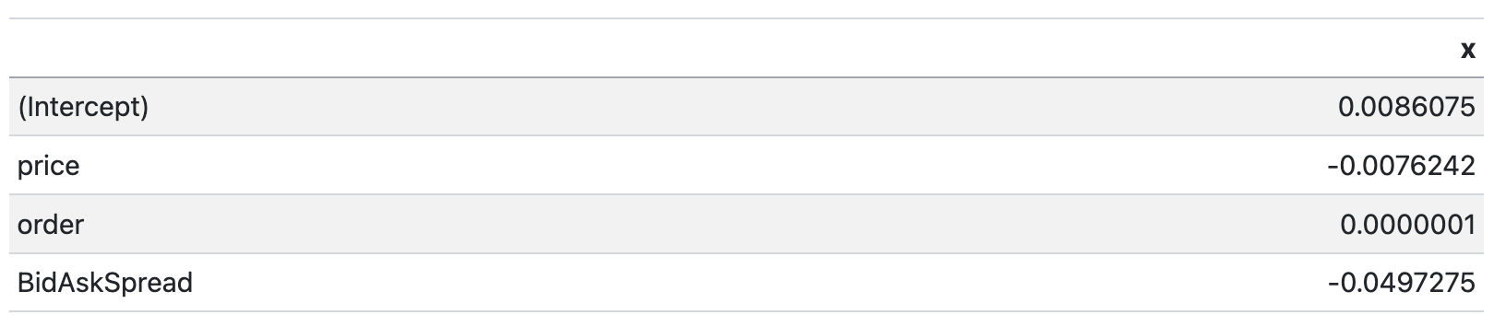
Linear regression¹
volatility = – 0.0076 (price) – 0.0000001 (order) – 0.049 (BidAskSpread) + 0.008
1. University of Sydney. (2025). DATA3888_2025 Lab: Week 3 – Time Series Data - Optiver. Available at: https://canvas.sydney.edu.au/courses/65141/modules/items/2667174

Slide 4
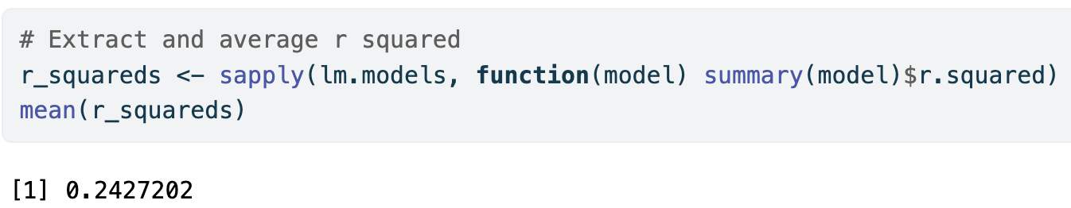
Linear regression

Slide 5
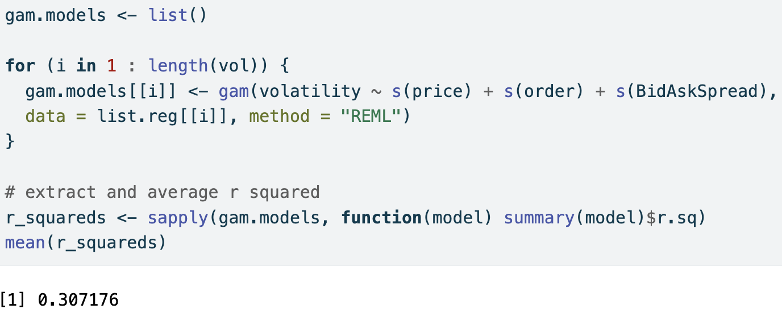
GAM^{1, 2}
1. Rahul, K. (2023). Generalized Additive Model. WallStreetMojo. Available at: https://www.wallstreetmojo.com/generalized-additive-model/
2. Wood, S. (2025). Package ‘mgcv’. Cran. Available at: https://cran.r-project.org/web/packages/mgcv/mgcv.pdf

Slide 6
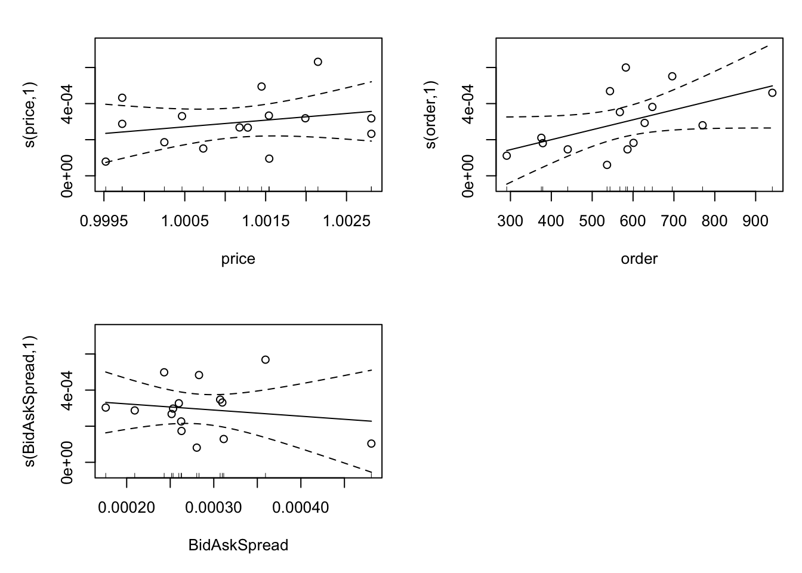
GAM¹
1. Hemelstrand, S. (2023). How to interpret a GAM model output. Cross Validated. Available at: https://stats.stackexchange.com/questions/603477/how-to-interpret-a-gam-model-output

Slide 7
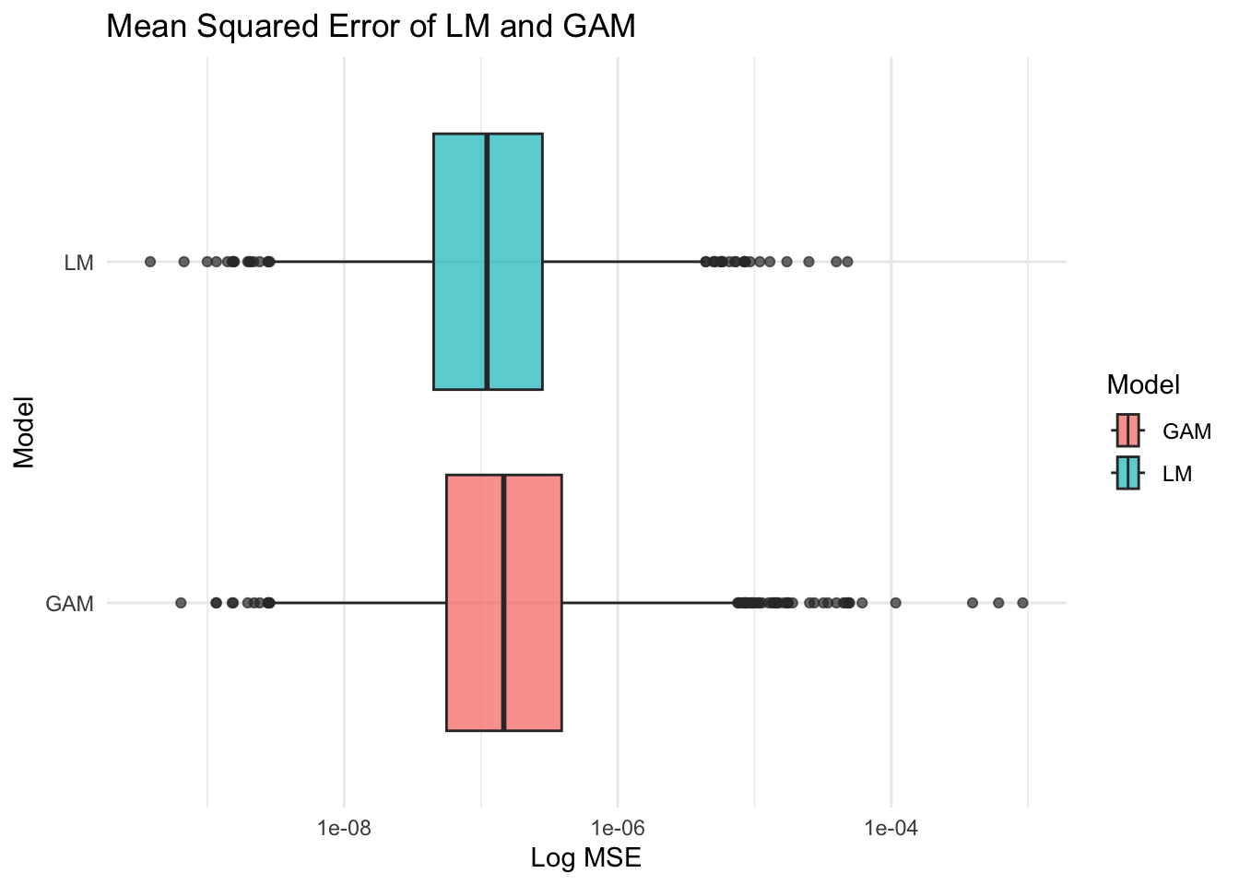
MODEL EVALUATION¹
1. University of Sydney. (2025). DATA3888_2025 Lab: Week 3 – Time Series Data - Optiver. Available at: https://canvas.sydney.edu.au/courses/65141/modules/items/2667174

