Slide 1
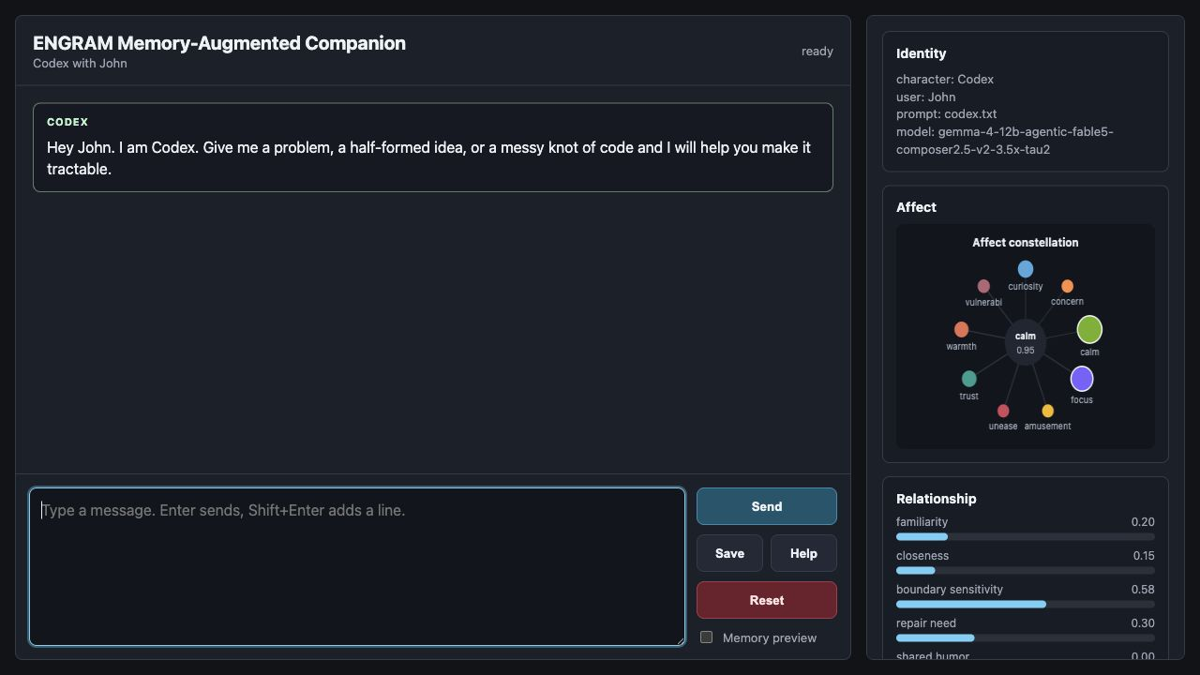
EXECUTIVE BRIEFING
ENGRAM
A local-first, memory-augmented AI assistant
What the PoC demonstrates, how it is controlled, and what it would take to move toward an enterprise pilot.
CIO audience · 24 June 2026

Slide 2
The PoC proves an operating model, not just a chatbot
ENGRAM combines local inference, persistent organizational memory, controlled knowledge ingestion, live verification, and an inspectable quality loop in one working experience.
Control
The model endpoint, histories, prompts and vector memory are operated locally in the current design.
Continuity
Three memory types preserve conversations, reusable knowledge and learned procedures across sessions.
Adaptation
Every response can be validated, improved and translated into bounded future guidance without rewriting the personality file.
Relevance
A concrete test bed for private AI patterns, knowledge continuity and governed agent behavior.
Source: ENGRAM2 implementation review, 24 June 2026
2

Slide 3
Architecture: local orchestration around a replaceable model
The model is one component. The durable value sits in memory, context assembly, ingestion and governance logic.
Experience
Orchestration
Intelligence
Memory
Knowledge
→
→
→
→
Browser PoC Terminal interface
Prompt assembly Commands Context routing
Local LLM via LM Studio Optional Ollama path
ChromaDB Episodic Semantic Procedural
Web search + URL PDF/text/code Vision input
Cross-cutting controls
Character prompt · user identity · validation · adaptive guidance · backup/reset · memory inspection
Source: ENGRAM2 implementation review, 24 June 2026
3

Slide 4
A broad PoC with enterprise-relevant primitives
Implementation facts, not benchmark claims
3
35
5 MB
8
memory domains
conversation turns
file-ingest limit
adaptive rules
Events, knowledge and procedures are separated.
Recent dialogue is retained before trimming.
Text and source code are validated before storage.
Five corrective and three reinforcing rules maximum.
Also implemented
Web verification · direct URL reading · PDF ingestion · text/code ingestion · image analysis · Markdown/LaTeX rendering
Source: ENGRAM2 implementation review, 24 June 2026
4

Slide 5
Capability scope
Six capability domains now work together in one local experience.
MEMORY
Semantic recall across conversations, facts and reusable procedures
KNOWLEDGE
Ingest URLs, PDFs, text files and source code into vector memory
VERIFICATION
DuckDuckGo search and direct page retrieval for current or specific facts
MULTIMODAL
Image input path for charts, diagrams and screenshots when the model supports vision
EXPERIENCE
Browser UI with state visualization, memory inspection and rich Markdown/math/code output
QUALITY
Self-critique, missing-code repair, tool-token cleanup and bounded adaptive prompt guidance
Source: ENGRAM2 implementation review, 24 June 2026
5

Slide 6
Adaptive quality is bounded and inspectable
The personality file remains authoritative. Validation only updates a small, inspectable guidance layer.
1
2
3
4
Generate
→
Validate
→
Improve
→
Learn
Answer using prompt, memory, context and tools.
Score quality, accuracy, formatting and character consistency.
Return a corrected answer when the first response is weak.
Retain a short, reusable rule for future prompts.
Guardrails
Prompt-scoped · deduplicated · capped · injection-like lessons rejected · visible via /learning · reversible
Source: ENGRAM2 implementation review, 24 June 2026
6

Slide 7
Control foundations exist; production assurance does not
Domain
Implemented in the PoC
Required for enterprise use
Data locality
Local model, state and vector DB paths
Host access, encryption and retention controls
Traceability
Memory inspector, metadata and vector previews
Audit log and policy-grade provenance
Quality
Validation score, improved reply and learned guidance
Independent evaluation set and acceptance thresholds
Recovery
Backup-before-reset with identity preserved
Managed backup lifecycle and restore testing
External data
Search snippets and direct URL retrieval
Approved connectors, source policy and content controls
Source: ENGRAM2 implementation review, 24 June 2026
7

Slide 8
From PoC to a controlled enterprise pilot
Sequence investment behind evidence. Avoid turning a broad prototype into an ungoverned internal platform.
1
2
3
Stabilize
Pilot
Industrialize
2–4 weeks
6–8 weeks
after evidence
Configuration cleanup Error handling Telemetry Evaluation harness
One use case Named users Curated knowledge Human review
Identity and access Policy connectors Auditability Deployment automation
Pilot success gates: answer quality · groundedness · latency · user value · operating cost · control compliance
Source: ENGRAM2 implementation review, 24 June 2026
8

Slide 9
Recommended CIO decision
Proceed to a narrow, controlled pilot — not a general enterprise rollout.
Sponsor
Govern
Measure
Select one bounded, knowledge-intensive internal use case.
Name data, security, risk and business owners before pilot access.
Approve explicit quality, cost, latency and control success gates.
Source: ENGRAM2 implementation review, 24 June 2026
The PoC has earned the right to be evaluated. The next investment should buy evidence, controls and operational learning.
9

