Slide 1

Project Mission Project Title
Enter Group Member Names
(Note, please save this Powerpoint file using a filename including your group mission Project Title of:
E96_Final_Presentation_<E96_Project_Title>.ppt
E96C Internet of Things Final Presentation

Slide 2
IOT Toy Project: Wizdget Wand
Wilson Jusuf, Hanif Lim, Varun Narayanan
E96C Internet of Things Final Presentation

Slide 3
Presentation Objective
The objectives for the presentation are these:
Provide documentation of your team’s accomplishments in E96
Provide experience in technical presentation preparation and delivery
Provide documentation that you may use for your future goals in interviews for internships or undergraduate research opportunities.
NOTE: Don’t show this slide.

Slide 4
Product Development Mission
Length: One Slide
Please include a short description of your project mission.
This describes the benefits of your IoT system to detection of motion patterns.
What is the problem?
Toy wands sold in theme parks are dull and passive. Children are forced to use their imagination to cast spells.
By our observation, the most interactive wand was the one in Universal Studios Hollywood Harry Potter World, where the wand’s motion was detected by a poorly hidden infrared sensor in some areas. This would cause some ‘magical event’ to occur (e.g. doors unlocking)

Slide 5
Solution
We wanted to create interactivity by leveraging motion pattern detection.
We wanted to create a portable wand that can be used to control objects and furniture in real life without an external sensor.
Ideally, the wand could turn lights and household appliances on and off, closing curtains, etc.
For presentation purposes , we limit this to a real-time website to simulate our home.

Slide 6

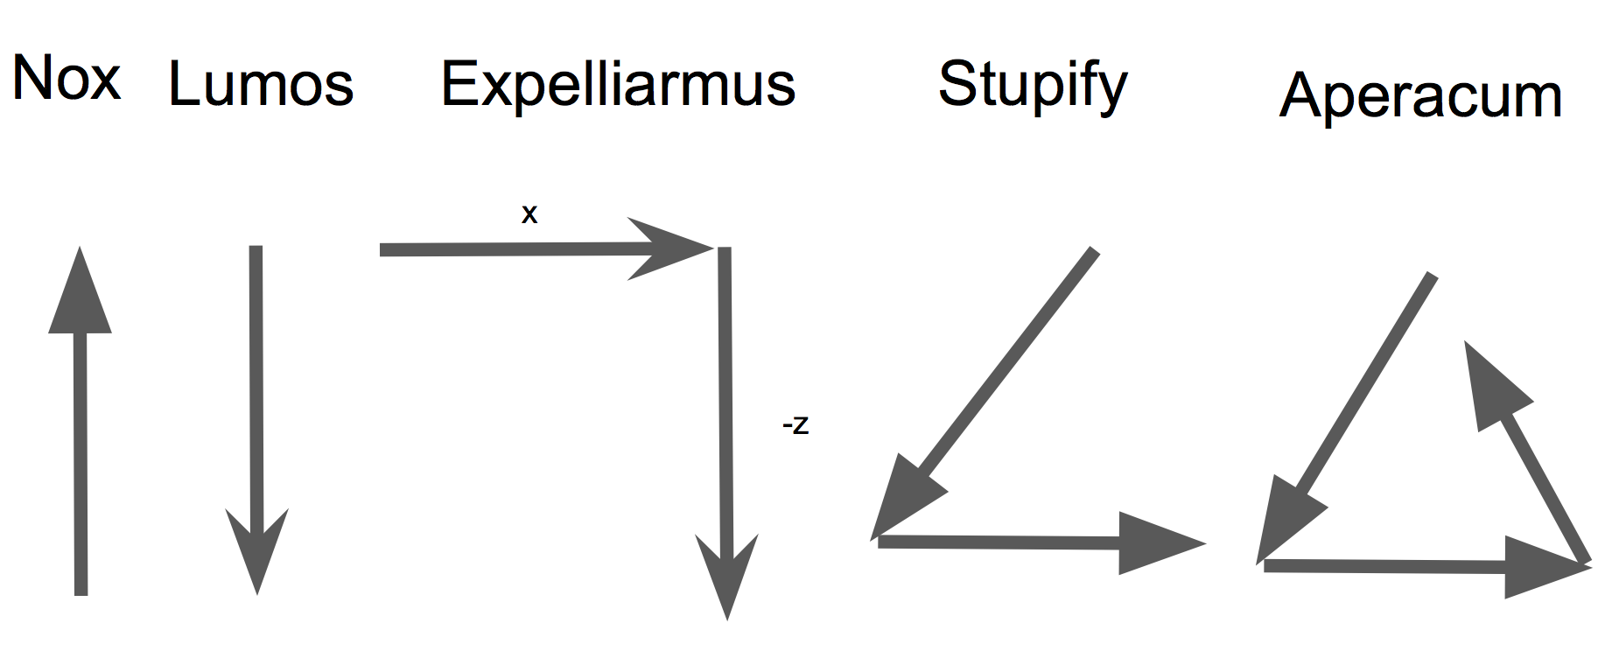
Design Overview: Technical Approach
Length: Two or More Slides
This is a summary that should describe your systems including:
Signal acquisition from motion sensors. Please include a code screen capture.
State machine description.
Please include a code screen capture.
We want to detect certain harry potter spells.

Slide 7
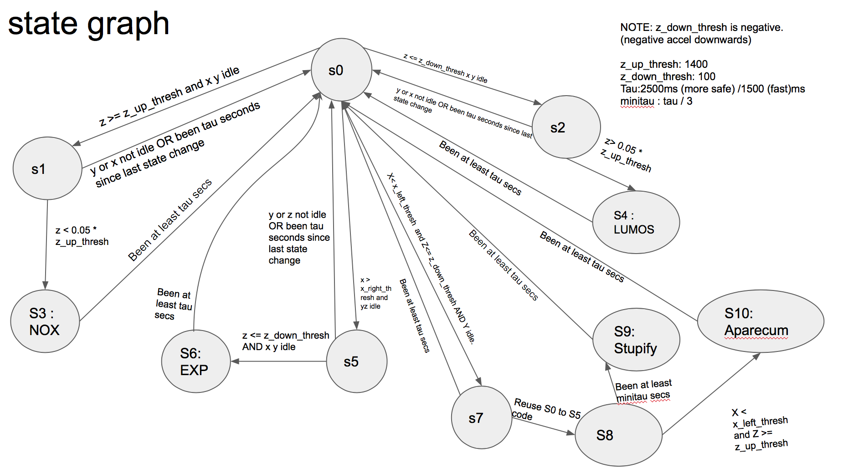
Design Overview: Technical Approach
Length: Two or More Slides
This is a summary that should describe your systems including:
Signal acquisition from motion sensors. Please include a code screen capture.
State machine description.
Please include a code screen capture.
We designed the motion capture algorithm by creating a state graph to detect different gestures by acceleration data. We would then detect a series of gestures to form spells.

Slide 8
IoT System Implementation
Length: Two or More Slides
This can include a description of your system operation.
This could include a screen capture from the terminal session showing detection of a motion.
This can also include a video of a system demonstration (this is optional)
We broadcast x, y, z acceleration data of the SensorTile by low-energy Bluetooth.
The state propagation resides in a beaglebone machine.
Finally, changes to state and successful spellcasting is relayed onto a web server which displays the information in real time.
Data transfer method
Low-energy Bluetooth
Unix pipe
Unix pipe
HTTP, WebSocket
Beaglebone
Client
SensorTile Device
UNIX PIPE
C++ program instance (contains state propagation code)
UNIX PIPE
STM32 SensorTile
gatttool
Web Server
Web page
Data
x, y, z acceleration data
x, y, z acceleration data
Web page (HTTP GET), Live updates on State change, successful spellcasts.
State change, successful spellcasts.

Slide 9
Design Overview: Technical Challenges
Length: One Slide
This is a brief section summarizing the nature of the design constraints and challenges you have recognized in delivering your product mission.
The IOT wand will need to discern between different states and not falsely report spells
This was the hardest design challenge we’ve had. We had to fine tune the acceleration thresholds so that it was the right sensitivity.

Slide 10
Team and Responsibilities and Contributions
Length: Two or More Slides
Each team member should include one or two bullets describing their responsibilities and contributions. This can include one or two slides.
----Wilson----
Designed state graph for motion detection.
Wrote C++ program for beaglebone to capture state changes
Wrote Web server program to showcase wand motion
Coded spells

Slide 11
Team and Responsibilities and Contributions
Length: Two or More Slides
Each team member should include one or two bullets describing their responsibilities and contributions. This can include one or two slides.
----Hanif----
Designed the state graph to motion detection
Set-upped the code to relay data to BeagleBone machine
- Coded spells

Slide 12
Team and Responsibilities and Contributions
Length: Two or More Slides
Each team member should include one or two bullets describing their responsibilities and contributions. This can include one or two slides.
----Varun----
Set up the node server
Implemented the interactive webpage
Coded spell

Slide 13
Future IoT Missions
Length: One Slide
This describes your next steps:
Concepts for new IoT technology based on your experience in E96
Description of how E96 experience of team members may have guided plans in any fields for future undergraduate research, internship opportunities, and long range career planning.
In the future:
The wand could be used as a gesture control remote to do everyday tasks
ie Turning on/off light, closing the curtain.
We could host the codes on a Raspberry Pi to improve portability
Learning Points:
Gained an appreciation for sensors, and learned how they could be
integrated to future hackathons or hobby projects.
Learned the tools to gather vast and diverse set of data that will be useful
for future career.

Slide 14
Additional Optional Information
Please include any additional information in slides in this appendix. We may not have time to present these due to the overall class time constraint.

