Slide 1
GCL Final Project
Felix Gomez, Michael Clopton, Normil Luccin
Notes:
Hello everyone. I’m Felix, and alongside Mike and Norm, we are team GCL. For our final project, we built a highly available, event-driven Recommender System API.

Slide 2
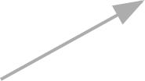

System Architecture & Deployment
Zero-downtime, containerized ML pipeline.
settings_input_component
Apache Kafka
code
cloud_queue
bolt
Data Ingestor
Validation
layers
hub
model_training
GitHub
CI/CD Actions
Docker
Multi-Stage Build
Render
Hosting
FastAPI
Async API Layer
cloud
Model Worker
Decoupled Data Pipeline: Real-time events are streamed to Kafka, ensuring the primary API remains responsive.
Scalable R2 Storage: Durable data lake in Cloudflare R2 stores Parquet snapshots and versioned model artifacts.
Automated Hot-Swapping: FastAPI dynamically pulls validated model artifacts from the R2 registry for zero-downtime updates.
Schema Enforcement: Ingestor workers validate Kafka events against strict schemas before storage.
monitoring
Cloudflare R2
Snapshots & Registry
Monitoring
Prometheus & Grafana
Notes:
Here is the event-driven architecture powering our Recommender API.
Our primary goal was to deploy a resilient and scalable machine learning API that goes beyond just serving predictions. We built this to support zero-downtime model hot-swapping and full real-time observability.
To pull this off, we used a modern data stack: FastAPI for the backend, Docker for strict containerization, Apache Kafka for event streaming, and Cloudflare R2 for our model registry. Everything is deployed through an automated CI/CD pipeline and monitored live by Prometheus and Grafana.
It starts with our automated CI/CD pipeline. Pushing code to GitHub triggers a multi-stage Docker build, producing a secure, lightweight container that deploys automatically to Render.
At the application layer, our FastAPI gateway handles user requests. But instead of processing analytics synchronously, it instantly fires event data into Apache Kafka. Using Kafka as our broker completely decouples our fast API from our heavy data processing.
In the background, our Stream Ingestor consumes those Kafka events, validates the data, and batches it into Cloudflare R2 as Parquet snapshots. Finally, when we retrain our models on that data, the new artifacts are uploaded back to R2, and our system securely hot-swaps the active model with zero downtime.
Now, let me drop these slides and show you our Live API system in action:
(During the Live API demo):
As you can see, the API is live and actively serving recommendations. But the real power of this architecture is how we handle updates. I will hand it over to Normil to show how we hot-swap our models without taking the system offline.

Slide 3
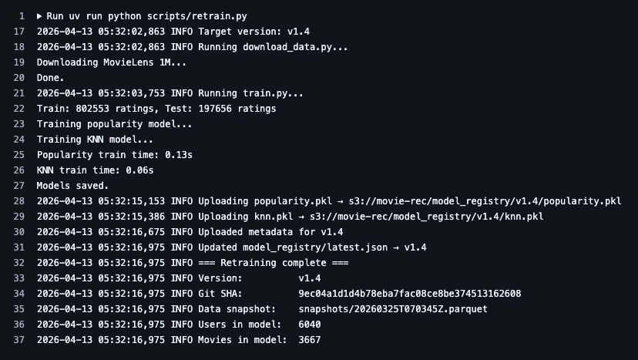
Hot-swap/Retrain Switch
Models are able to be swapped using the switch url (/switch?model={latest or model-version})
Retraining models can also be done manually
Automated through Github Actions (weekly)
Current/Former model versions are retained in the registry (Cloudflare R2)

Slide 4
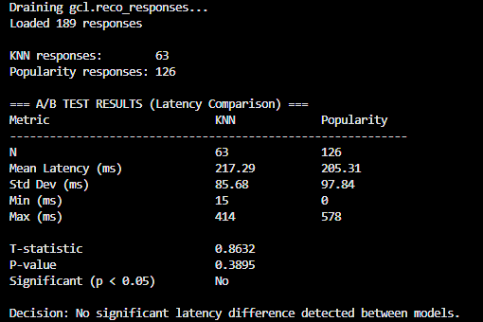
A/B Experiment: KNN vs Popularity
189 probes from Kafka logs (63 KNN, 126 popularity)
Both models: 100% success rate
Latency: KNN 217ms vs popularity 205ms
Welch's t-test: p = 0.389, not significant
Decision: keep KNN as default (better accuracy, same speed)

Slide 5
Thank You!
Please feel free to ask any questions to the group through your preferred method!

