Slide 1
Federated Learning With IoT Devices
Submitted in the partial fulfillment for the award of the degree of
BACHELOR OF ENGINEERING
IN
COMPUTER SCIENCE and ENGINEERING - INTERNET of THINGS
Under the Supervision of:
Sir Piyush Samanth
Submitted by:
Rishabh Anand 19BCS4525
Udita Mitra 19BCS4662
Vandana Chauhan 19BCS4532
Khushwant Rathore 19BCS4644
Abhishek Gupta 19BCS4579
Department of AIT-CSE
DISCOVER . LEARN . EMPOWER

Slide 2
Outline
Introduction to Project
Problem Formulation
Objectives of the work
Methodology used
Results and Outputs
Conclusion
Future Scope
References

Slide 3
Introduction to Project
The rapid development of Internet of Things (IoT) systems has led to the problem of managing and analyzing the large volumes of data that they generate.
Traditional approaches that involve collection of data from IoT devices into one centralized repository for further analysis are notalways applicable due to the large amount of collected data, the use of communication channels with limited bandwidth, security and privacy requirements, etc.
Federated learning (FL) is an emerging approach that allows one to analyze datadirectly on data sources and to federate the results of eachanalysis to yield a result as traditional centralized data processing.
FL is being actively developed,and currently , there are several open-source frameworks that implement it.

Slide 4
Project Definition
This project presents a demonstration of Federated Learning after an extensive and comparative review and analysis of the existing open-source FL frameworks, including their applicability in IoT systems.
We evaluated the following features of the frameworks:
=> Ease of use and deployment
=> Development
=> Analysis capabilities
=> Accuracy
=> Performance

Slide 5
Project Overview
We are using a custom built oximeter to generate data and then analysis the Heart Rate and SPO2 of different individuals and then predict things like who has a higher chance of getting a heart attack and who is running low on SPO2.
People may not want to share their heart rate information with general public, so instead they hash their reading before passing the information.
We then aggregate that data onto our process and then, predict the desired information and keep the private information private.

Slide 6
Problem Formulation
The main objective of this paper is to design not only a heart rate monitoring system but also to made a Federated System.
Federated learning (FL) is a feasible solution to solve the problems of data islands, break data barriers, and protect data security and privacy, especially in the context of the Internet of Things , and big data.
Distributed IOT and big data users need to collaboratively train a classification or regression model to implement perfect data prediction results without compromising privacy.
Unlike privacy-preserving outsourced training, rather than submitting data to the centralized cloud server, users train data locally in FL.
The federated center is only responsible for aggregating the gradient information (or model parameters) uploaded by users and distributing the global training model.

Slide 7
Objectives
The goal of distributed learning is to scale the parallel processing of a large amount of data, while the purpose of FL is to process data, i.e., train a model, directly on the data sources.
Distributed learning works with identically and independently distributed (IID) data, which are collected in a single repository, from which they are extracted for further training. FL can treat IID data as non-IID data because training can be performed on sources connected with each other, i.e., sources that store different types of data about the same artifacts or events, or independent data sources.
Another difference is the usage of network nodes. Distributed learning usesnetwork nodes as computing resources for scaling, while FL uses nodes as data sources and performs calculations as close to the data as possible.

Slide 8
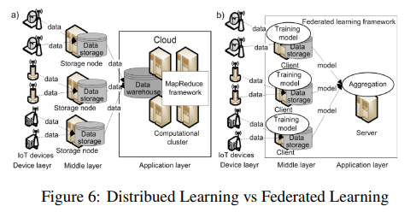
Methodology used

Slide 9
The following methodology will be followed to achieve the objectives defined for the proposed research work:
1. Detailed study of Federated Learning frameworks for IoT will be done.
2. Data will be generated in-house using various sensors and custom built devices for the training and simulation of FL.
3. An in-depth study and Hands-on experience on existing approaches of Federated Learning will be done, to identify the Relative pros and cons for developing an efficient system
4. Various Hardware and software-related parameters will be identified to evaluate the proposed system.
5. Data security and user privacy will be maintained.
6. Comparison of our newly implemented approach with exsiting approaches will be done.
7. Testing of the project by applying different conditions on it, so remove the remaining minorities in the project and to distinguish it in a better way.

Slide 10
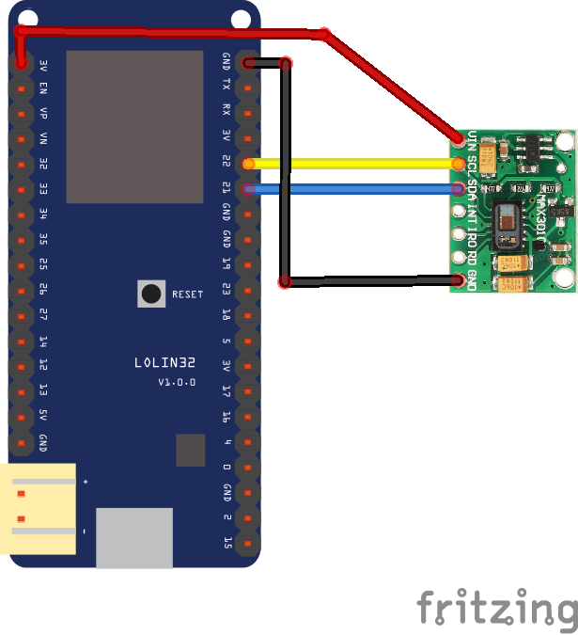
Results and Outputs
Circuit Digram:

Slide 11

Hardware Code

Slide 12

Hardware Code

Slide 13
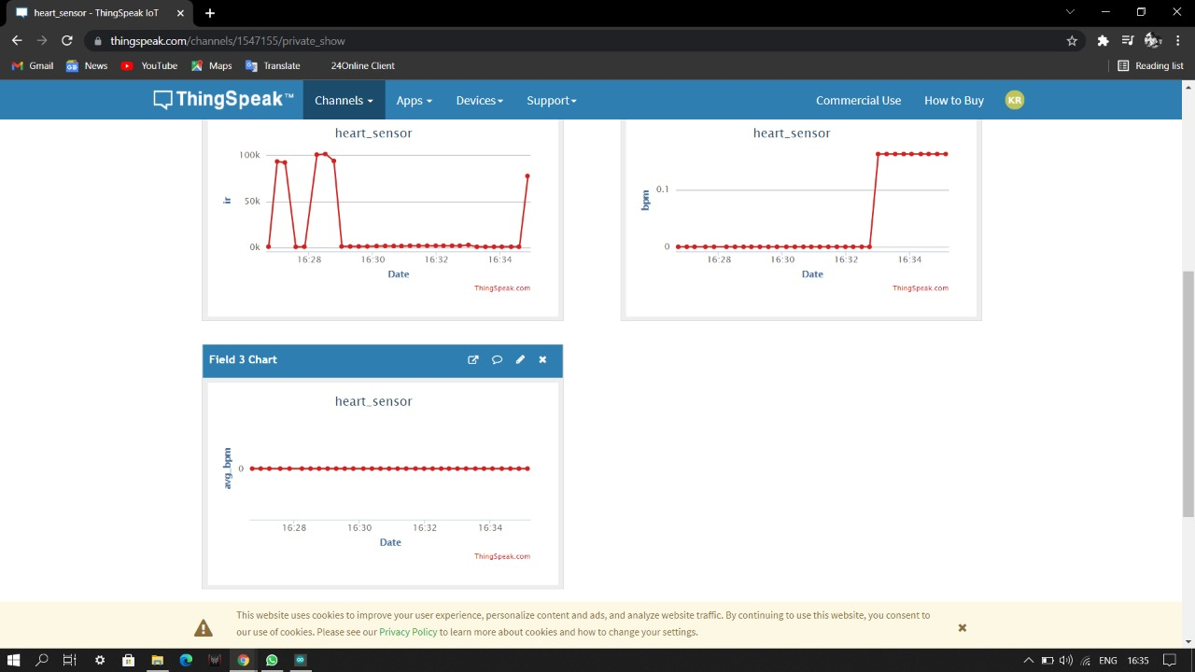

Slide 14

Data Generation

Slide 15

Data Generation

Slide 16

Data Generation

Slide 17

Data Generation

Slide 18

Data Generation

Slide 19
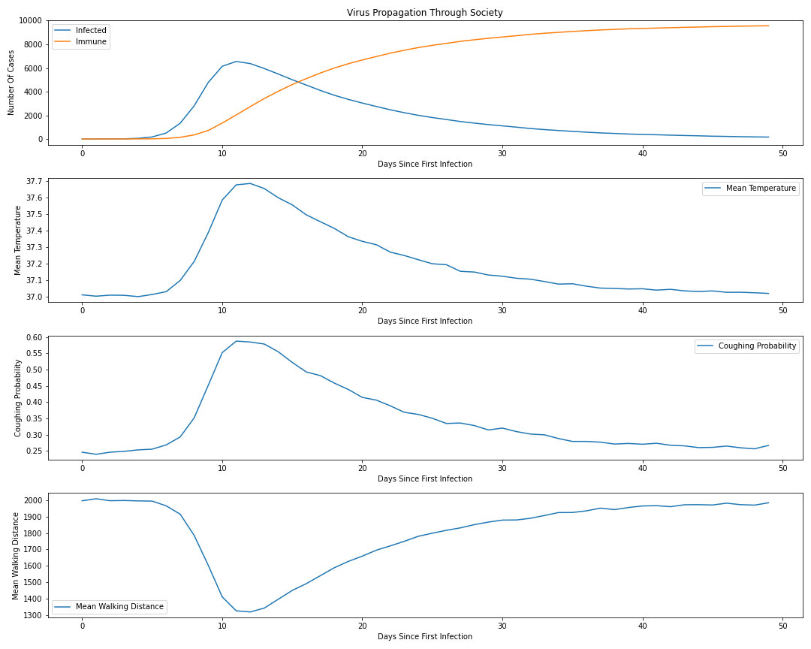
Results

Slide 20
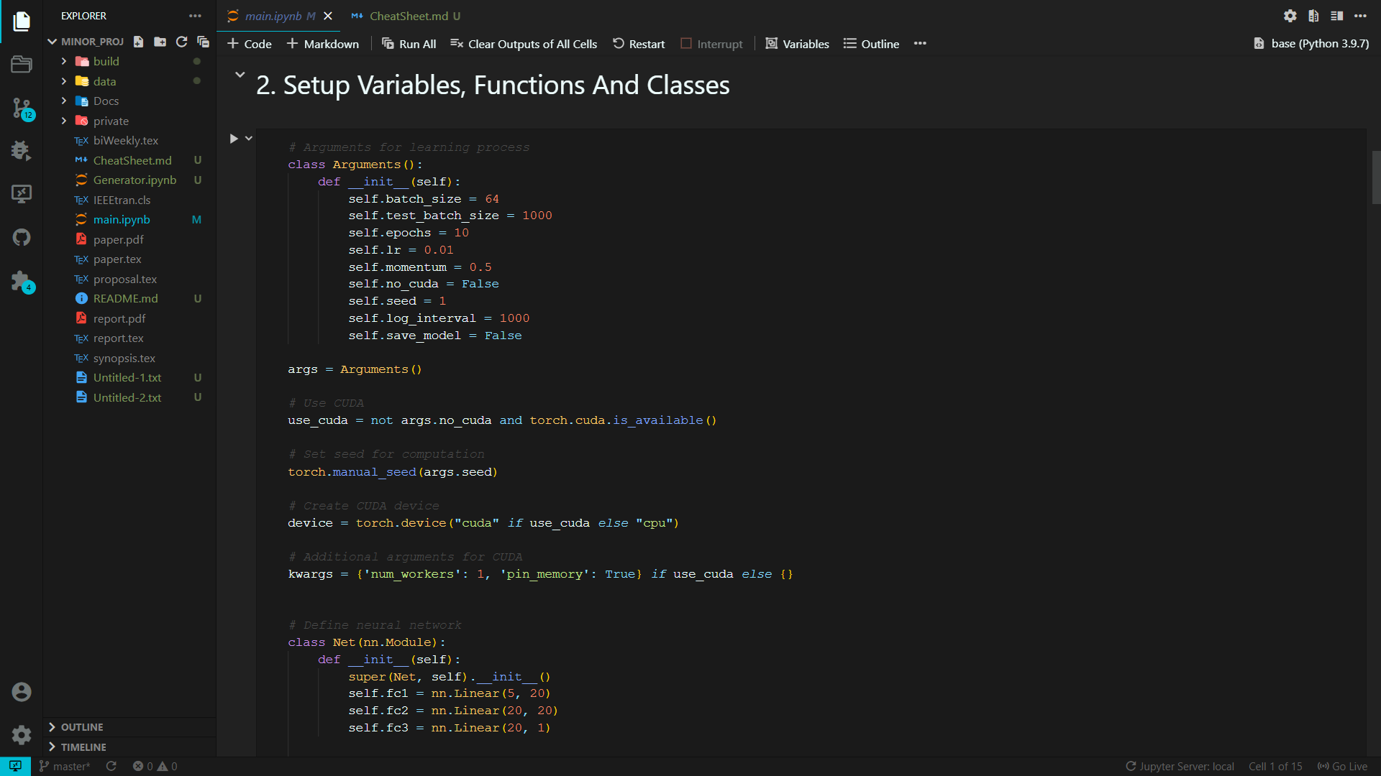
Data Prediction

Slide 21
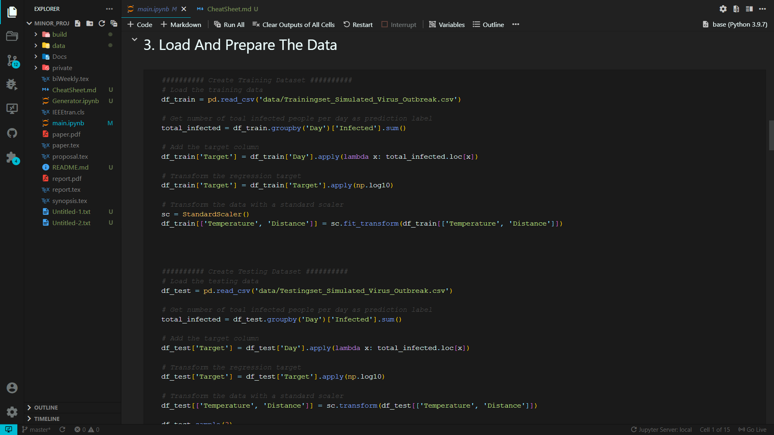
Data Prediction

Slide 22
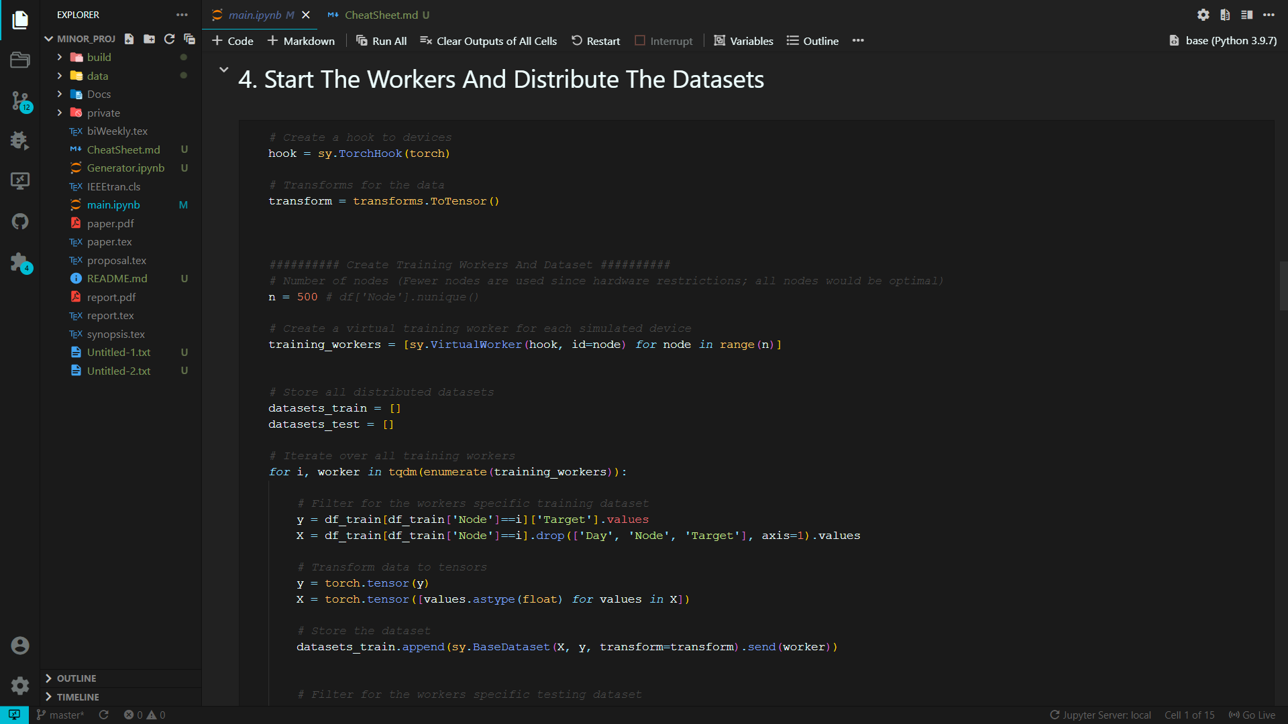
Data Prediction

Slide 23

Data Prediction

Slide 24
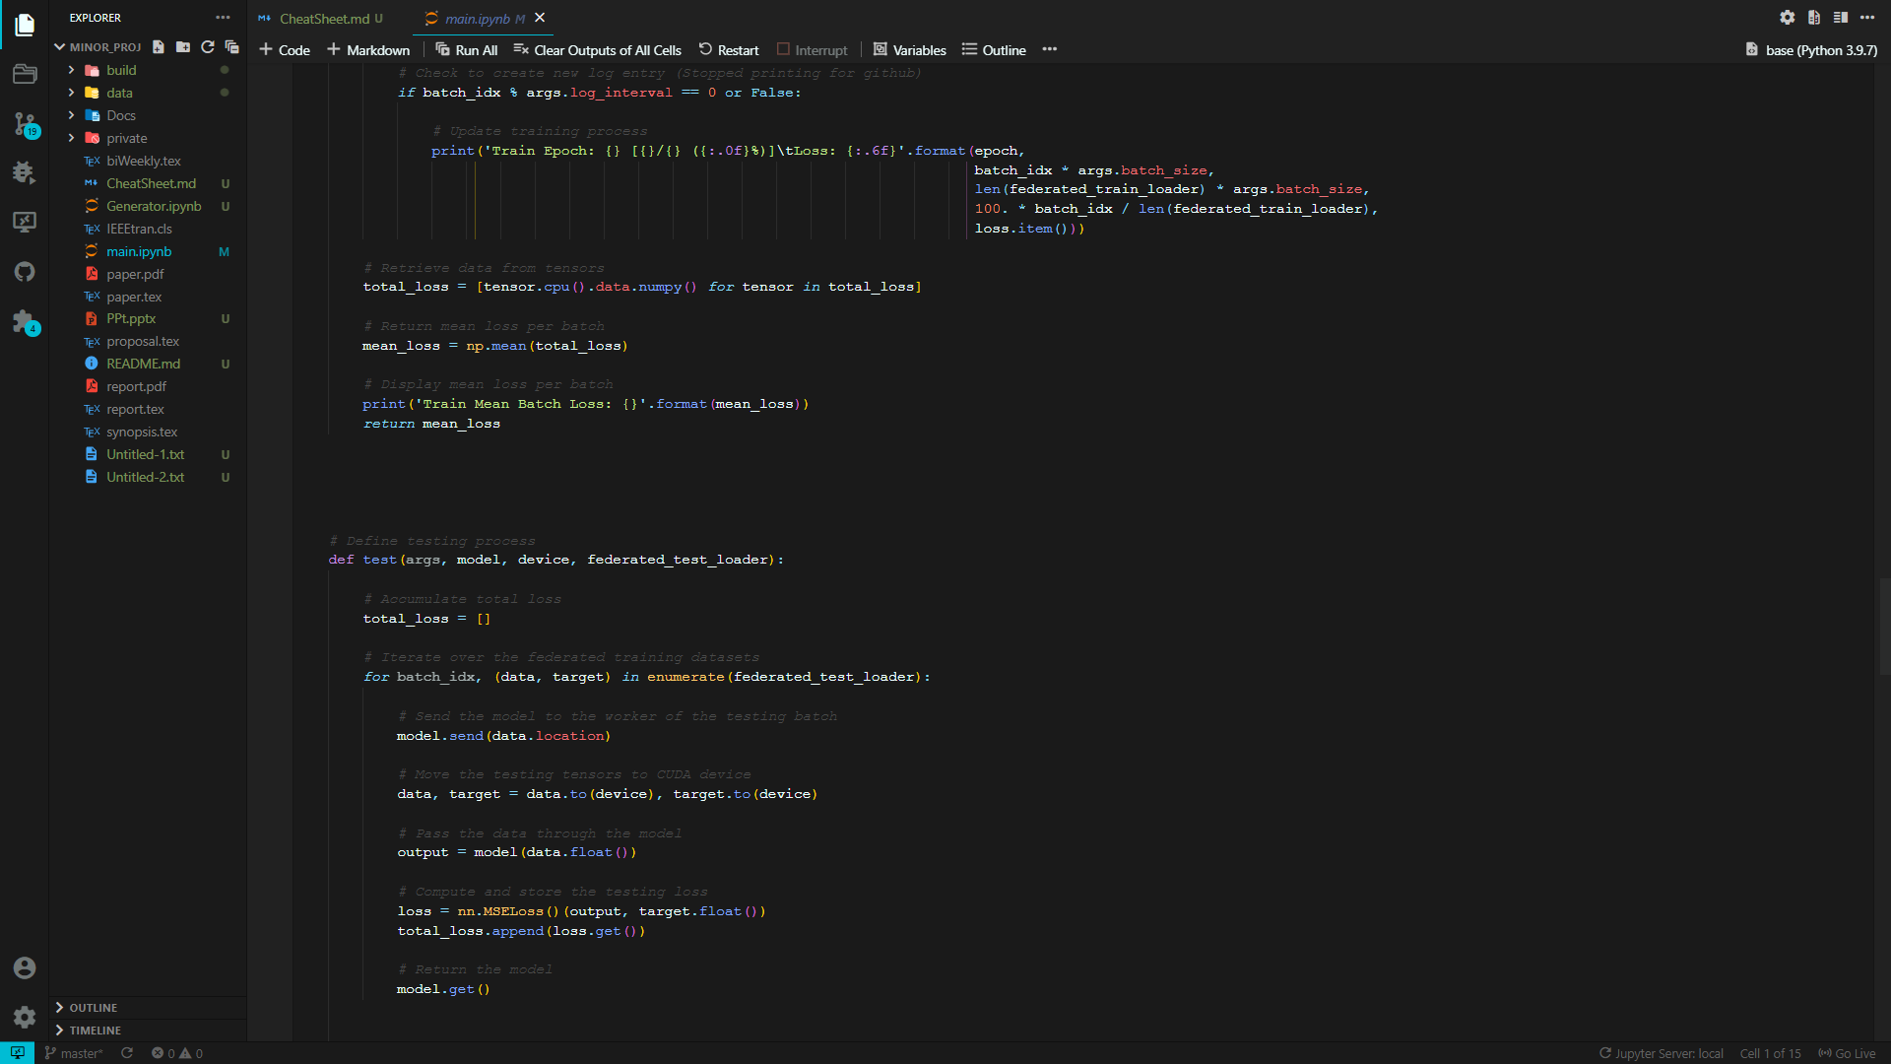
Data Prediction

Slide 25
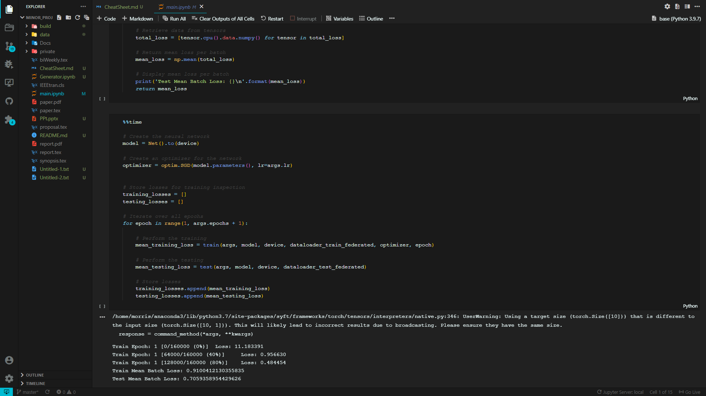
Data Prediction

Slide 26
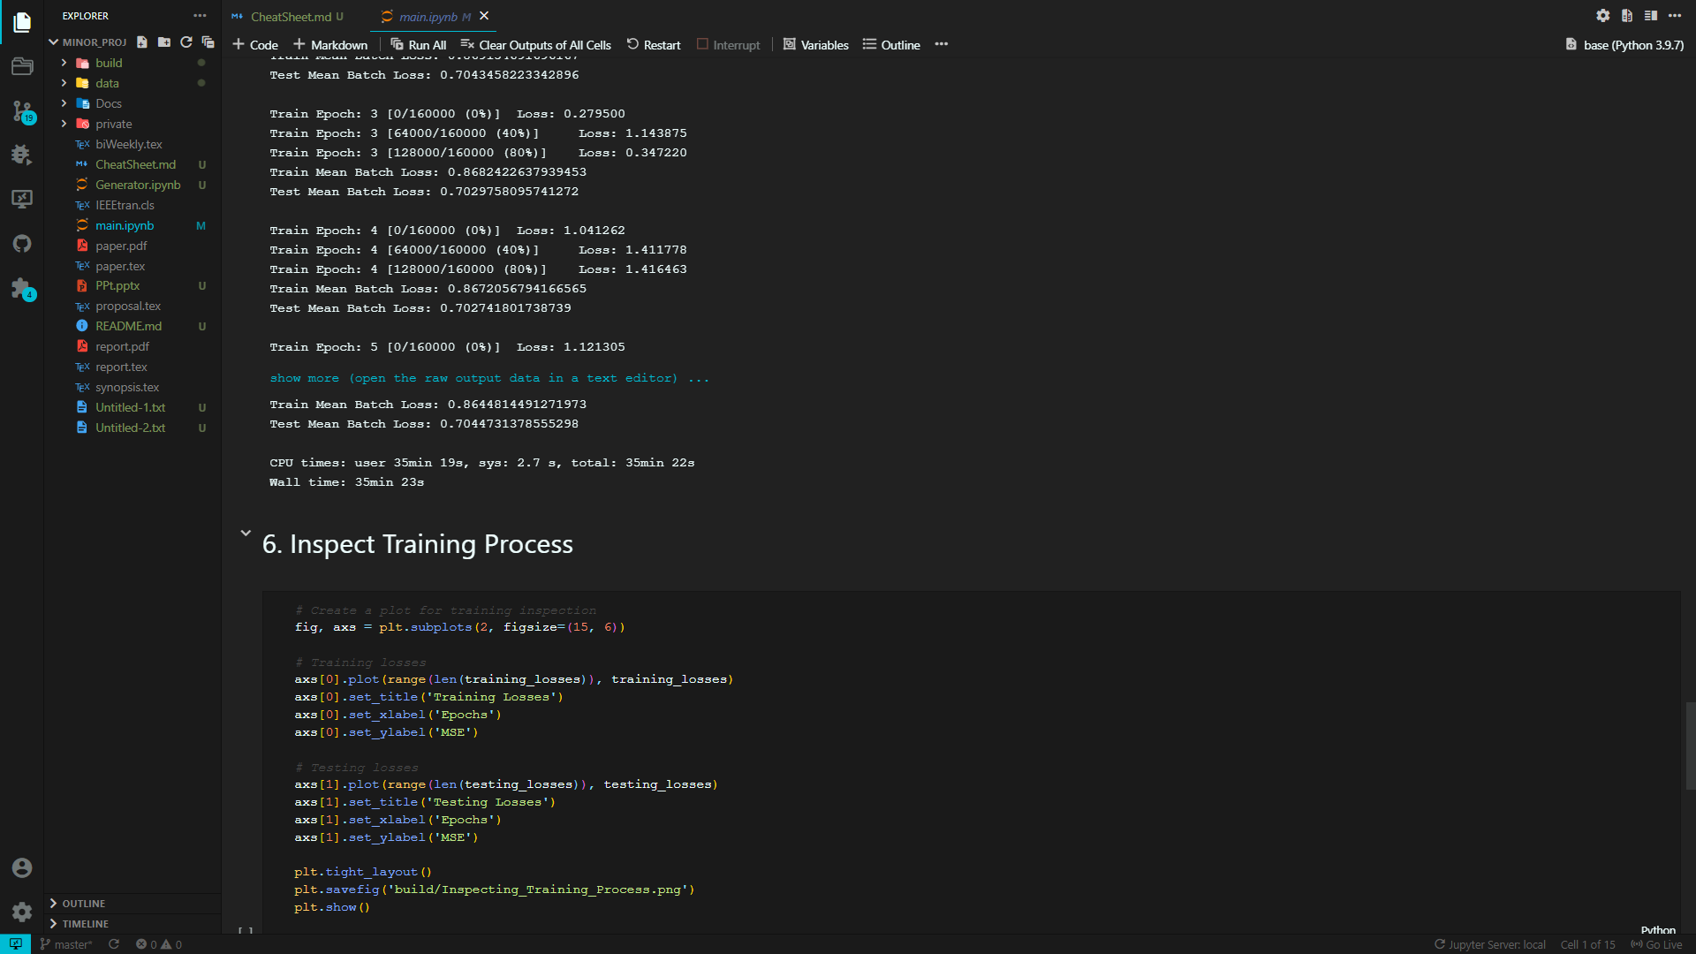
Data Prediction

Slide 27
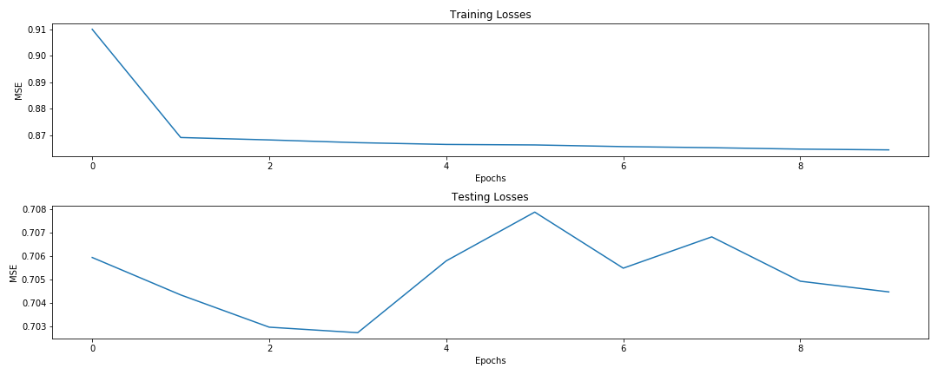
Results

Slide 28
Conclusion
We compared all federated learning frameworks and evaluated their characteristics.
Currently, all of them are being actively developed, and soon, they are expected to have new features and new properties.
The results of the evaluation of the federated learning frameworks’ features and experiments shows that PFL is the most ready for industrial use.
The federated mode is also implemented in the FATE framework. It works well for deep learning, but has limitations on the neural network layers used.
It also contains implementations of decision trees and linear models, but they do not function yet.

Slide 29
Future Scope
Federated learning is an active and ongoing area of research.
There are a number of critical open directions yet to be explored.
Few promising research directions surrounding the previously discussed challenges (expensive communication, systems heterogeneity, statistical heterogeneity, and privacy concerns), and introduce additional challenges regarding issues such as productionizing and benchmarking in federated settings.

Slide 30
References
1. Santucci, G. From internet of data to internet of things. In Proceedings of the International Conference on Future Trends of the Internet, Luxembourg, 28 January 2009.
2. Tsai, C.W.; Lai, C.F.; Vasilakos, A.V. Future Internet of Things: Open Issues and Challenges. Wirel. Netw. 2014, 20, 2201–2217.
3. Atzori, L.; Iera, A.; Morabito, G. The internet of things: A survey. Comput. Netw. 2010, 54, 2787–2805.
4. Gubbi, J.; Buyya, R.; Marusic, S.; Palaniswami, M. Internet of Things (IoT): A vision, architectural elements, and future directions. Future Gener. Comput. Syst. 2013, 29, 1645–1660. [CrossRef]
5. Voigt, P.; Von dem Bussche, A. The EU general data protection regulation (GDPR). In A Practical Guide, 1st ed.; Springer International Publishing: Cham, Switzerland, 2017.
6. California Consumer Privacy Act Home Page.
7. Personal Data Protection Act 2012.

