Slide 1
AI Educational Chatbot
Submitted in the partial fulfillment for the award of the degree of
BACHELOR OF ENGINEERING
IN
Computer Science and Engineering (IoT)
Submitted by:
Rishabh Anand
19BCS4525
Under the Supervision of:
Ms Aanchal Sharma
Department of AIT-CSE
DISCOVER . LEARN . EMPOWER

Slide 2
Outline
Introduction to Project
Problem Formulation
Objectives of the work
Methodology used
Results and Outputs
Conclusion
Future Scope
References

Slide 3
Introduction to Project
In a world, ruled by knowledge and one that runs on information, it becomes crucial for a person to know what is happening around him.
But with the abundance of knowledge and information it becomes difficult for a person to keep his own data bank up to date with all the facts flowing around him.
This is where my project comes in. Every piece of knowledge, every bit of information just one question away. Not only that, but it also helps you to keep your data bank up to date with the latest information.
Sure you could just google stuff and get that required bit of data but google is big and the results are crowded. How do you fiter out the important parts of the information that is relevant to you ?

Slide 4
How to you personalize it to the area or to the institution that you are in ? With my project, of course. Not only are the results about ”your” institute, but it also comes with the relevance that you didn’t know you needed.
The results are summarized, directly from your own instutute’s webpages. The results are personalized to your needs. The results come in a conversational manner. It’s like talking to the dean of the college but in a far more friendly and fun way. So now you won’t have to go to the poorly designed college webpage. All you need to do is talk to this bot, like you would talk to one of your friends and all the information that you need is given to you. Instantly.
This project solves the problem of FOMO in an elegant way. Thereby, making the world, or at least your world, a better place.

Slide 5
Problem Formulation
Provide information related to campus activities and placements by compiling different data sources and presenting the data in a elegant and effective layout which is personalized and relevant to different users.
Missing out on this information causes a lot of issues for them such as missing::
• Placement drives
• Events
• Tests
• Submissions

Slide 6
Objectives
The major tasks include ::
• Generating a data-bank using institute’s site
• Generating a data-bank using institute’s noticeboards
• Regularly updating the data-bank
• Providing a user-friendly way to convey this information to the relevant people.
• Providing a way to personalize the information to the user.

Slide 7
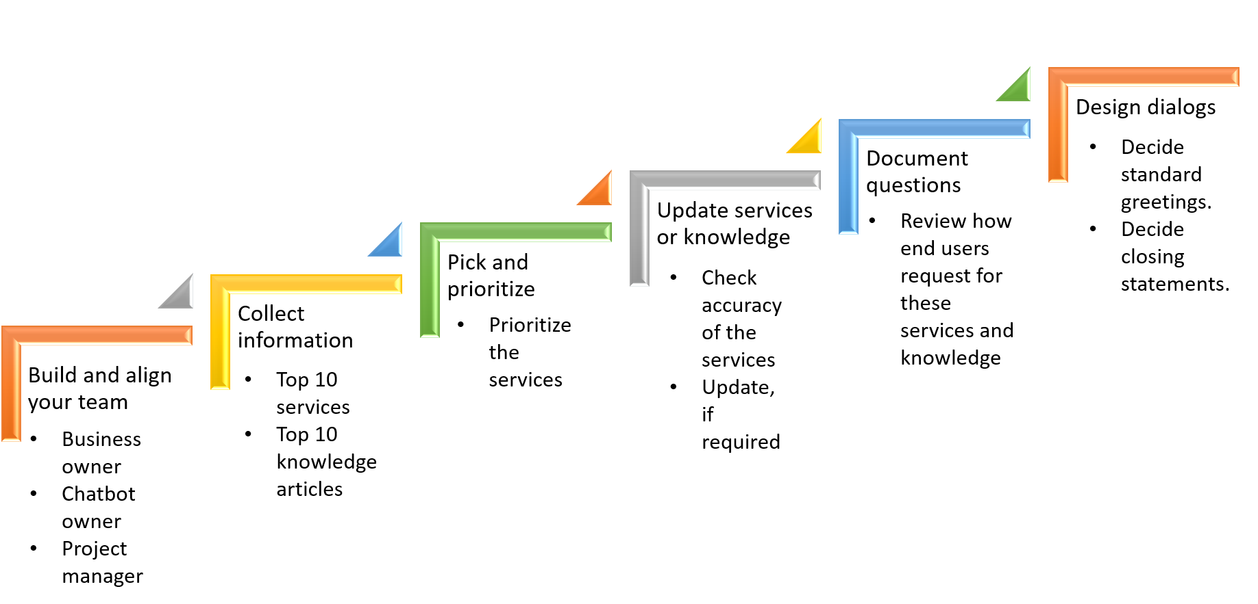

Slide 8
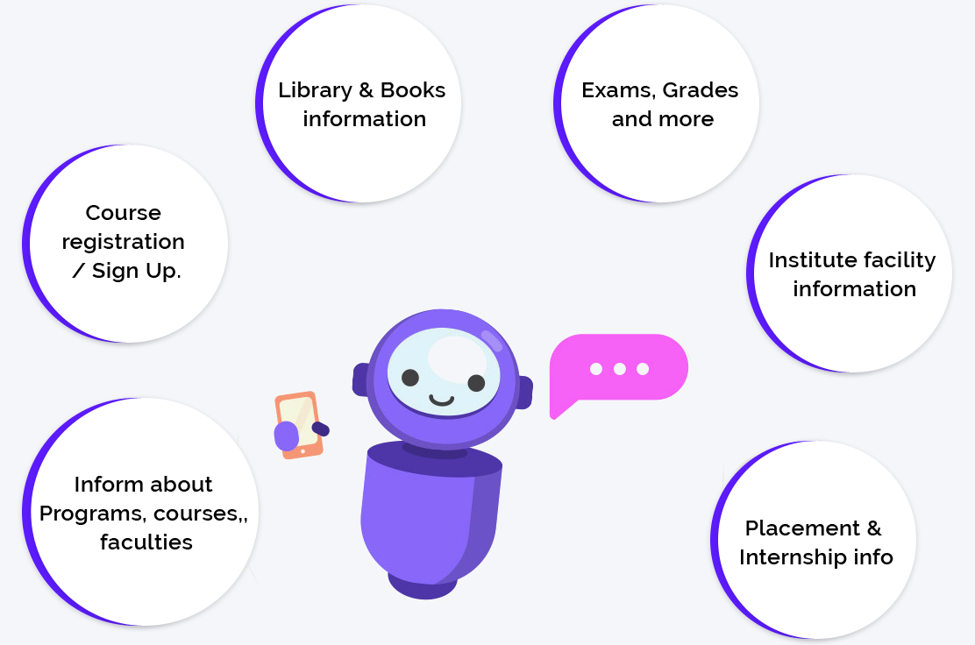
Methodology used

Slide 9
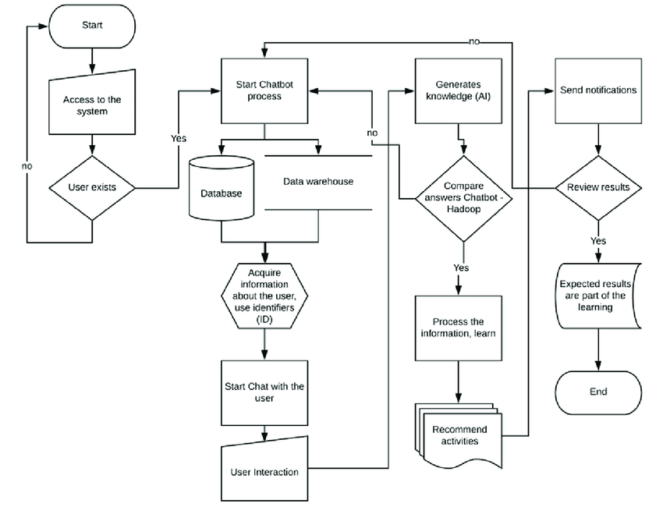

Slide 10
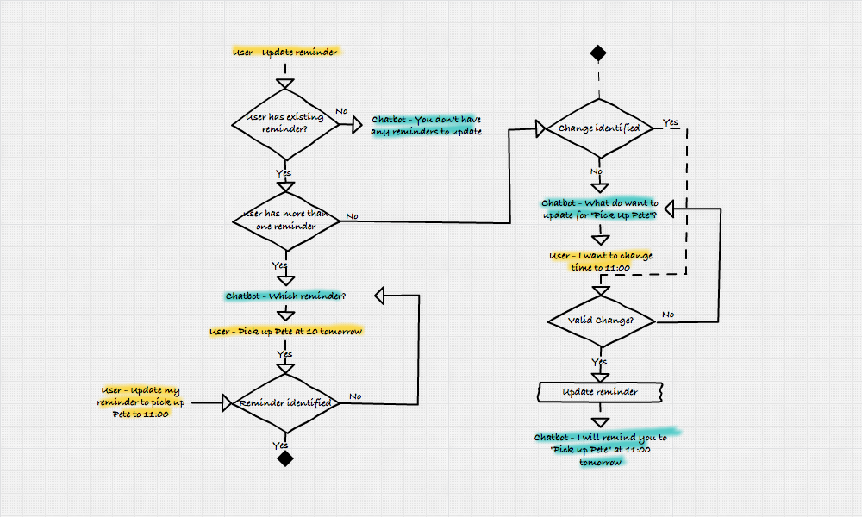

Slide 11
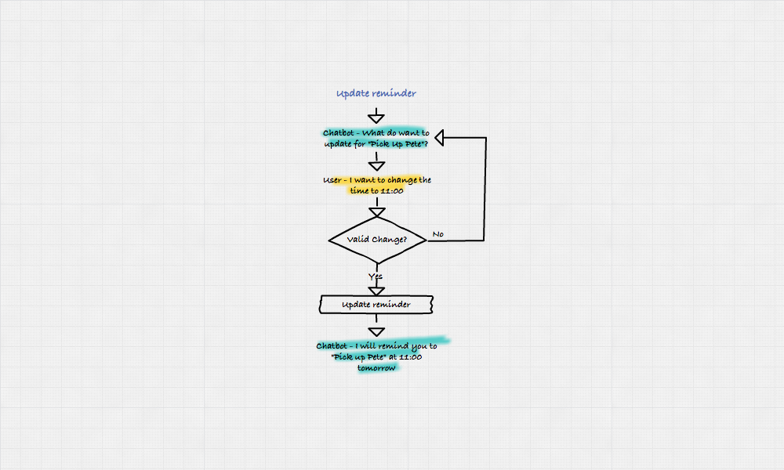

Slide 12
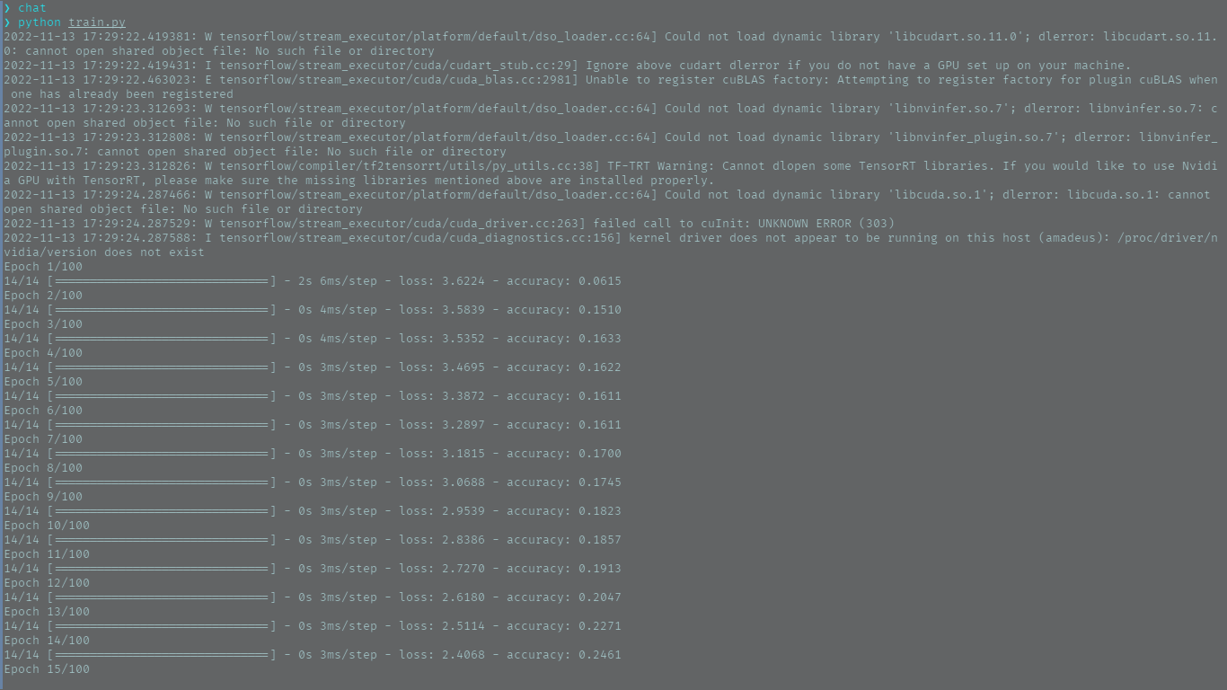
Results and Outputs

Slide 13
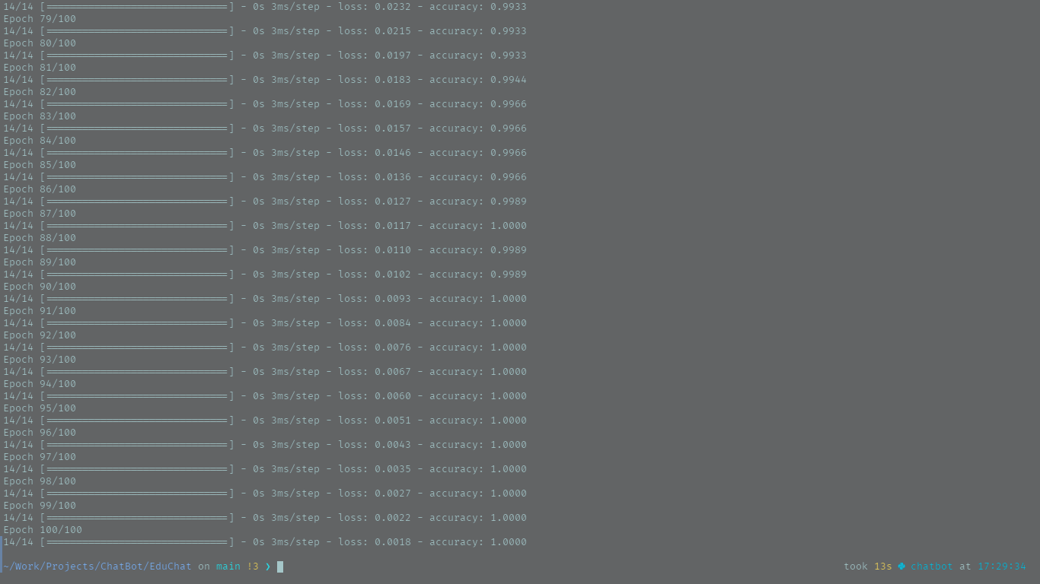

Slide 14
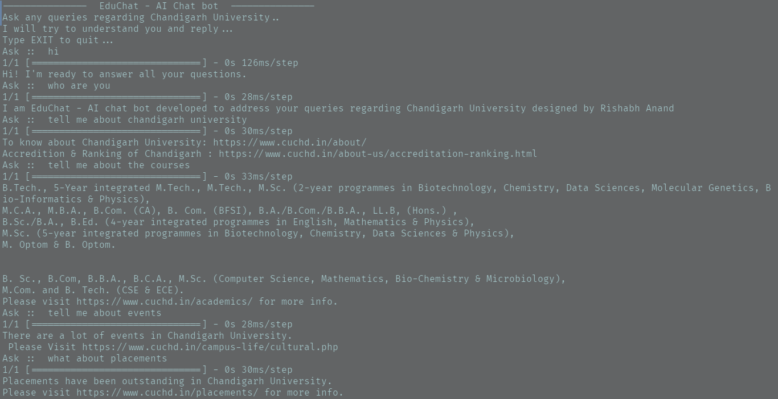

Slide 15
Conclusion
This project was a great learning experience for m. It also addresses the given issue greatly and provides a solution that is actually eliminating the problem to a impressive extent. With more time and effort put into the solution might land us somewhere that solves it completely.
This project was able to provide a solution to most of users queries and help its users keeps you their data bank up to date with the latest information.
It was able to filter out the required information effectively and provide students with the specific personalized result, which were summarized, directly from the instutute’s webpages.

Slide 16
Future Scope
Something that I would like to add to this bot is multi-channel support for whatsapp, telegram, or other apps that Gen-Z uses so that they can find all the information wherever they are and won't have to rely on a separate app or interface. This would make the entire experience more seamless and easy to use and would potentially increase the user base.
Also, the email reader functions and the custom CSSs that people might opt in for will be added in later versions. Currently the function is a lot slower as I am using scraping up until now to excess the emails and provide users with the desired information.
In future versions I would like to add an outlook or GMAIL API that users might opt into for faster access to their data.
Another reason, I didn't add this feature now was because it takes a lot to secure this personal data from all the users.

Slide 17
References
• Designing an Educational Chatbot: A Case Study of CikguAIBot NA Nasharud-
din, NM Sharef, EI Mansor. . . - 2021 Fifth . . . , 2021 - ieeexplore.ieee.org . . .
Therefore, this paper introduces a chatbot for teaching artificial intelligence (AI)
through Malay language, namely CikguAIBot. We emphasize on the development
and evaluation design . . .
• Opportunities and challenges in using AI chatbots in higher education S Yang, C
Evans - Proceedings of the 2019 3rd International . . . , 2019 - dl.acm.org . . . in
the areas of educational simulation, educational software’ training, and helpdesk
support, to support our study. In each case study, an AI virtual chatbot prototype
has been proposed. . . .

