Slide 1
ARL RFE Application
Rachel Choi and Sami Glasco (F15B1)

Slide 2
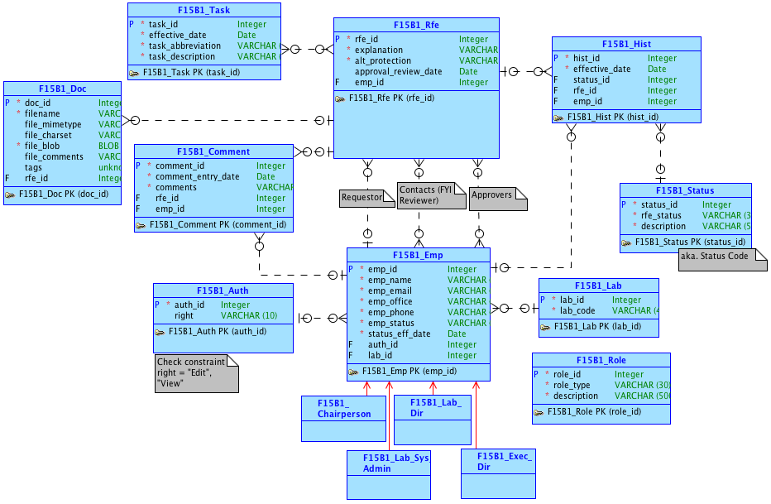
Conceptual Model
Notes:
Used a single Hist table for tracking all statuses.
Current status is the row with the most recent date.
Status table is used just as a reference table for the RFE status.
One-to-many relationship between Auth and Emp.

Slide 3
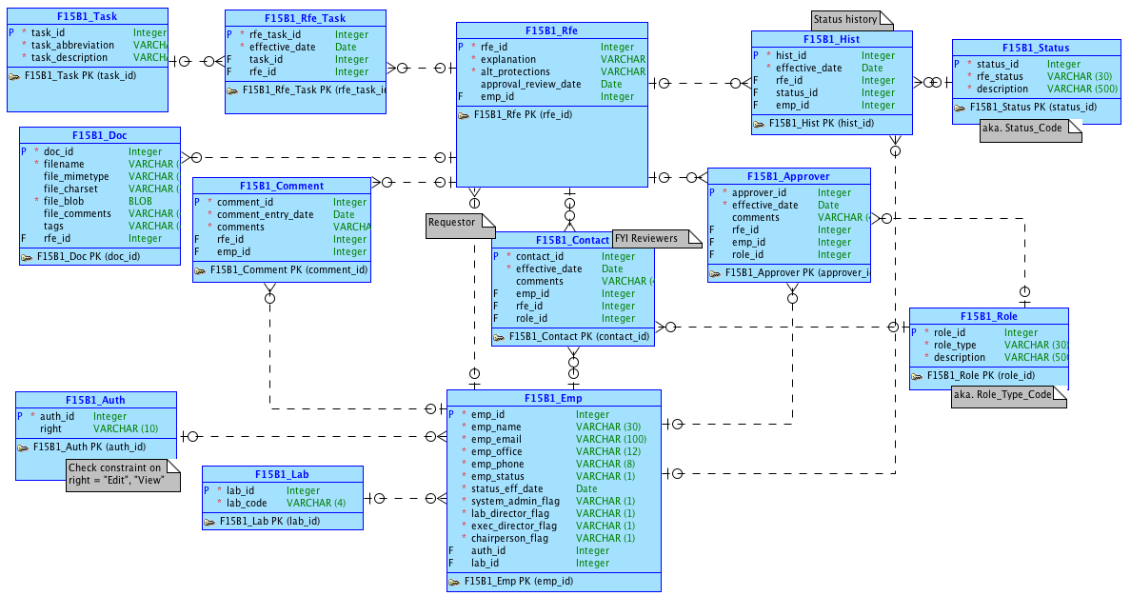
Logical Model
Notes:
Created 3 tables for the 3 many-to-many relationships.
Moved the effective_date into the Rfe_Task because that is the date a task is assigned to a RFE.
Role table has a one-to-many relationship with Contact table and Approver table.

Slide 4
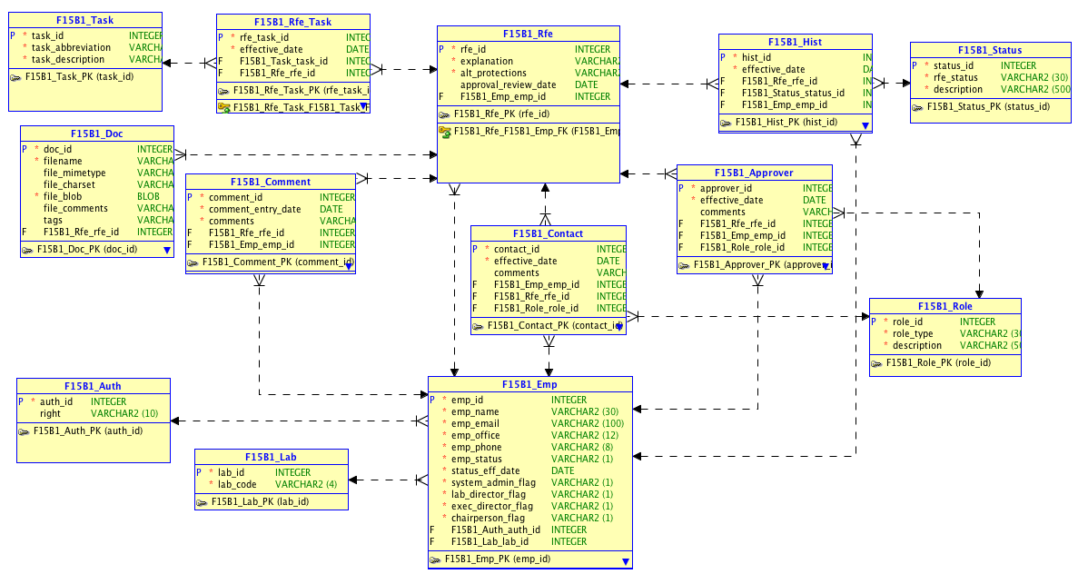
Relational Model

Slide 5
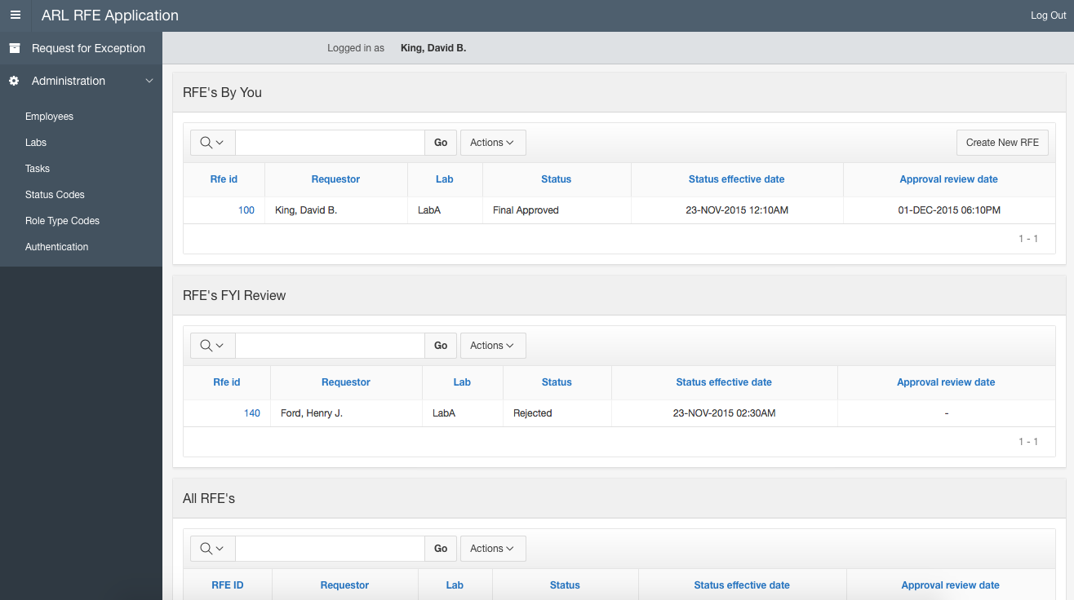
Regular lab employee’s view of the RFE page.
RFE’s the logged in employee is a contact of.
Notes:
Clicking the RFE ID will take you to the RFE Details page.
You can search for specific RFE’s with the search bar and you can sort RFE’s by clicking the column label.
Under Administration, you can access pages where you can create, edit, or view data.

Slide 6
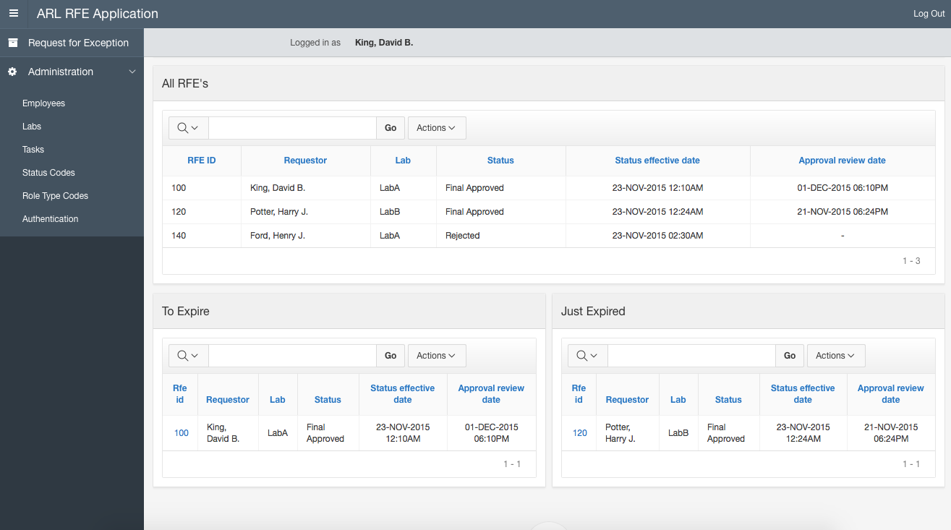
RFE’s that are about to expire in 35 days.
RFE’s that recently expired.
Notes:
At the bottom of the RFE page, there is a report that lists all RFE’s (ID not clickable).
Below that, are reports that show RFE’s that are about to expire and that recently expired.

Slide 7
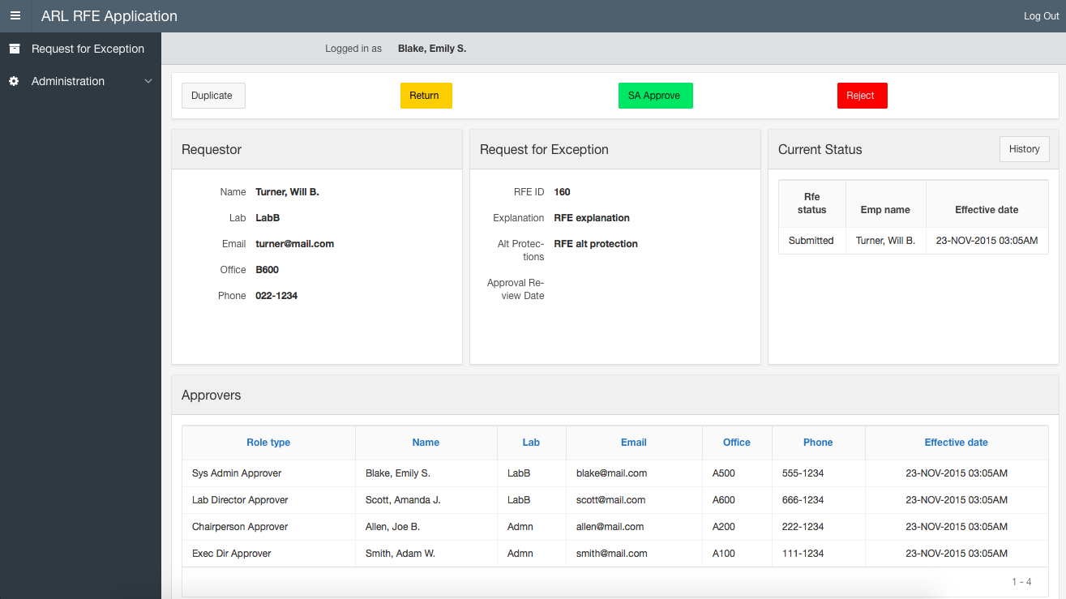
System Admin’s view of the RFE Details page.
Notes:
The Lab director’s, Chairperson’s, and Executive Director’s view of the RFE Details page is similar to this.
Only difference is the “Approve” button and its behavior.
The Requestor’s view of the RFE Details page have “Submit” or “Recall” button, and a “Duplicate” button.
Approvers for RFE’s are automatically added based on the Requestor’s lab when a RFE is created.
We used triggers to do this.

Slide 8
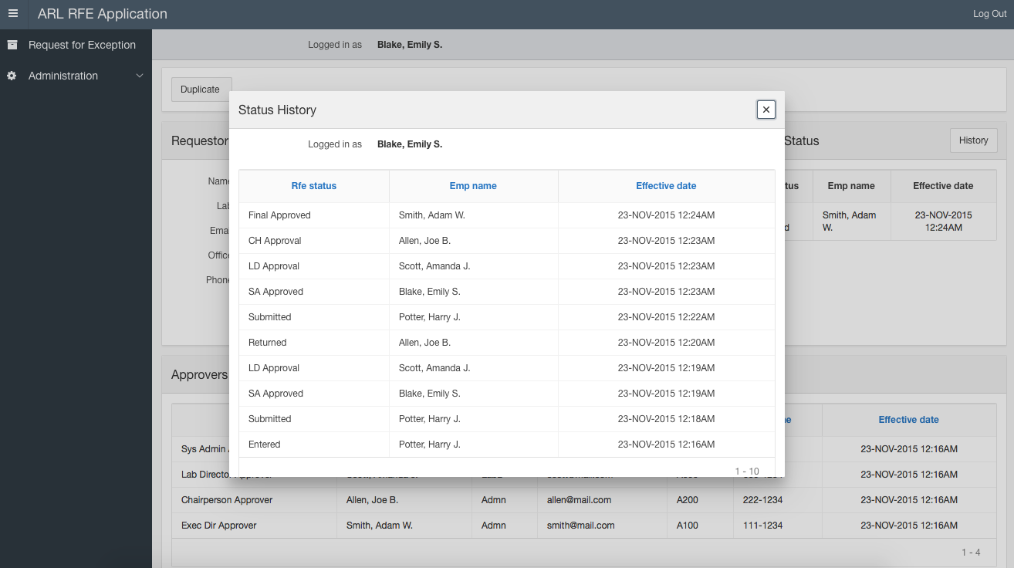
Notes:
The initial “Entered” status is inserted by a trigger when a RFE is created.
After that, the Status History of a RFE is updated when the “Approve” buttons are clicked.
We do this with Dynamic Actions.

Slide 9
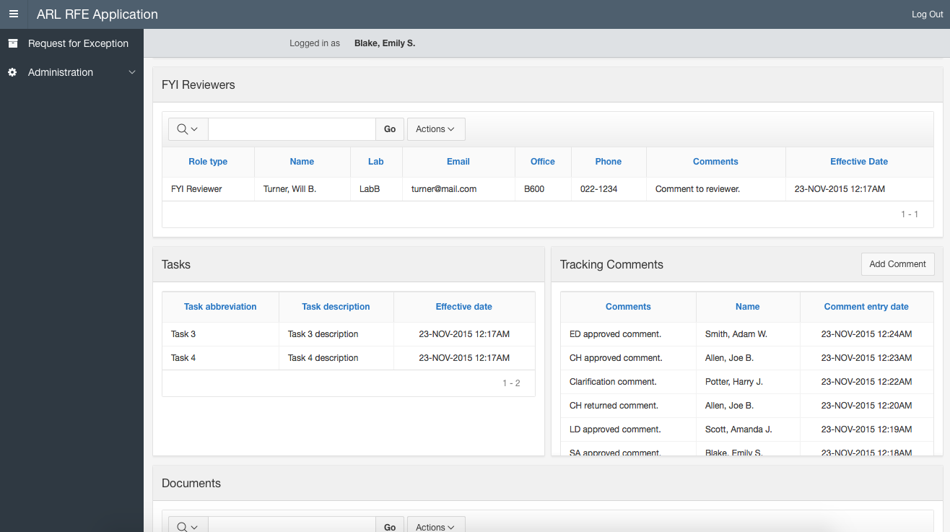
Notes:
RFE Details page also shows FYI Reviewers, Tasks, Tracking Comments, and Documents.
After a RFE is submitted, only Comments can be added.

Slide 10
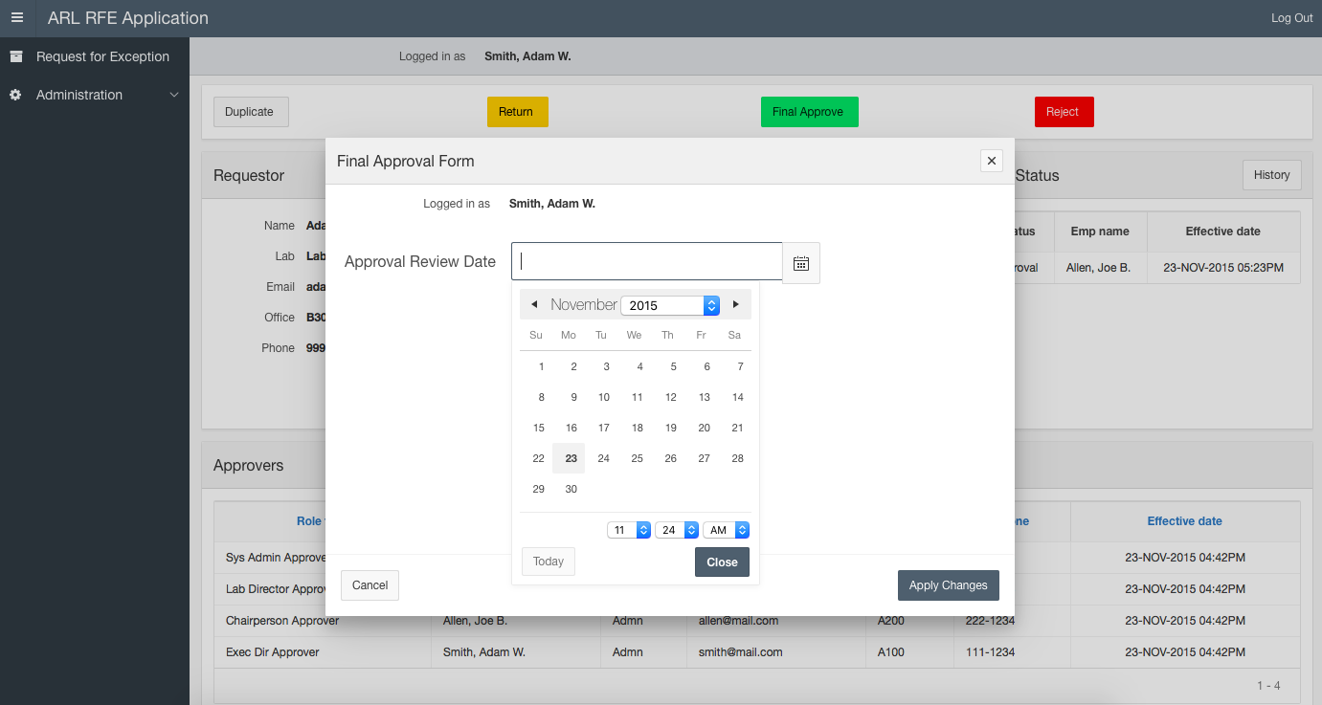
Notes:
When the Executive Director approves a RFE, he can set the Approval Review Date which is the date the Final Approval expires.

Slide 11
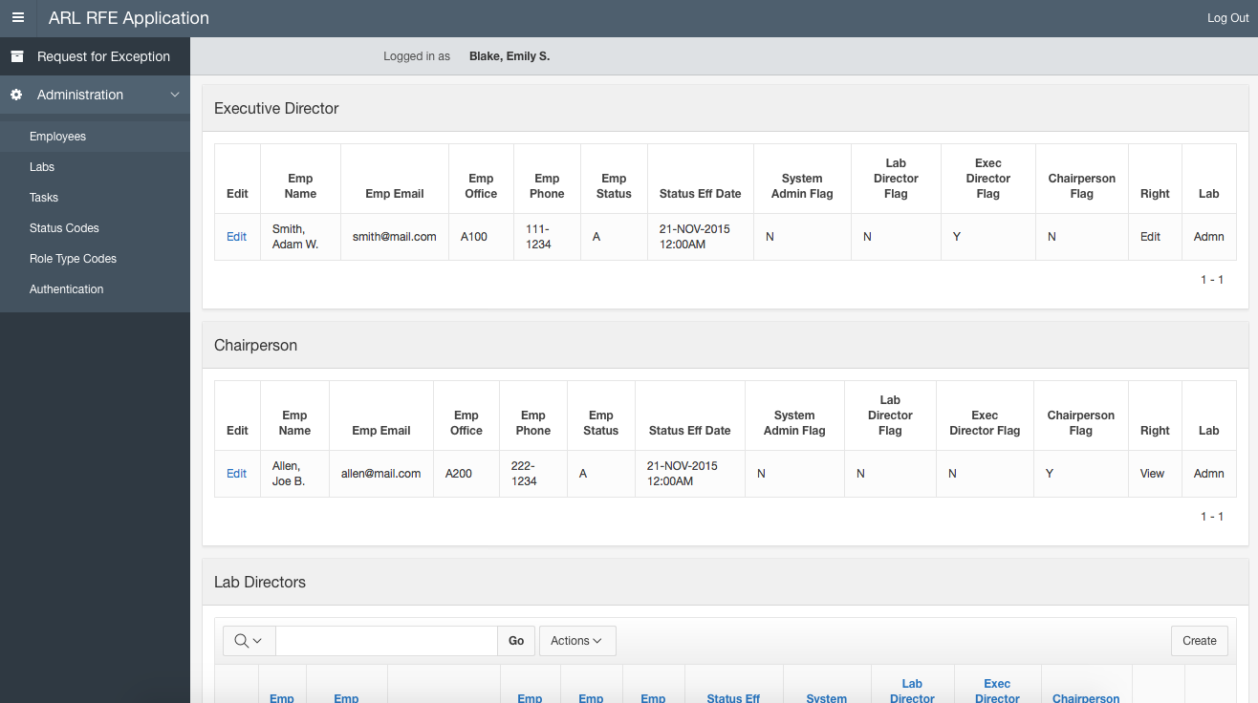
Notes:
In the Employees page, employees are grouped by their types.
Since there can be only one Executive Director and Chairperson, you can create a new ED and CH only if there is none.

Slide 12
Part 2: APEX Mobile App

Slide 13
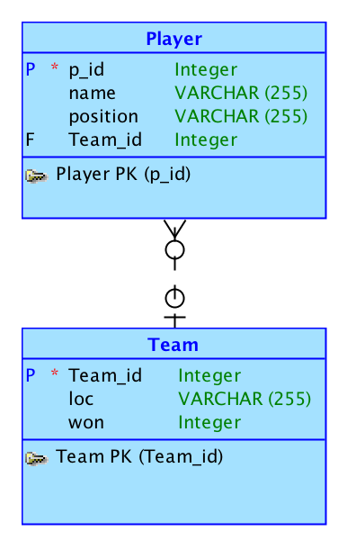
Conceptual Model
Notes:
This application will allow you to view a few Quidditch teams, their respective players, and number of World Cup wins.

Slide 14
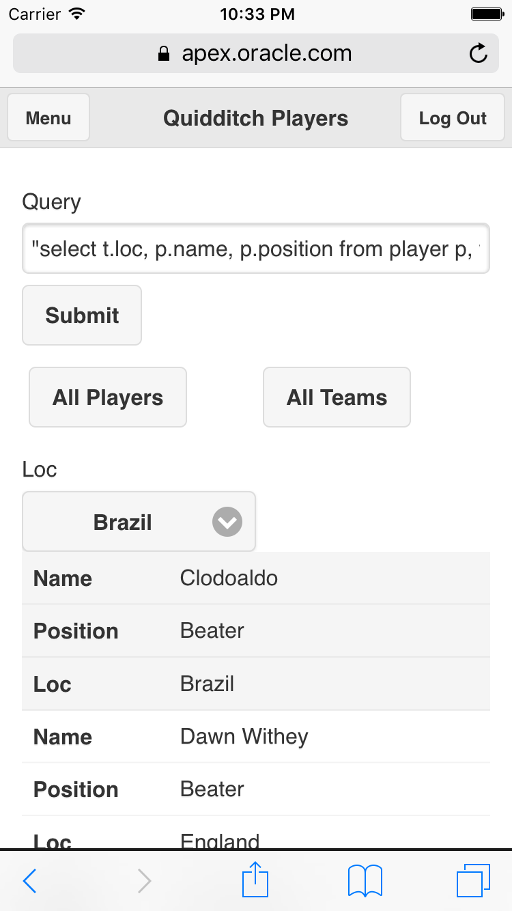
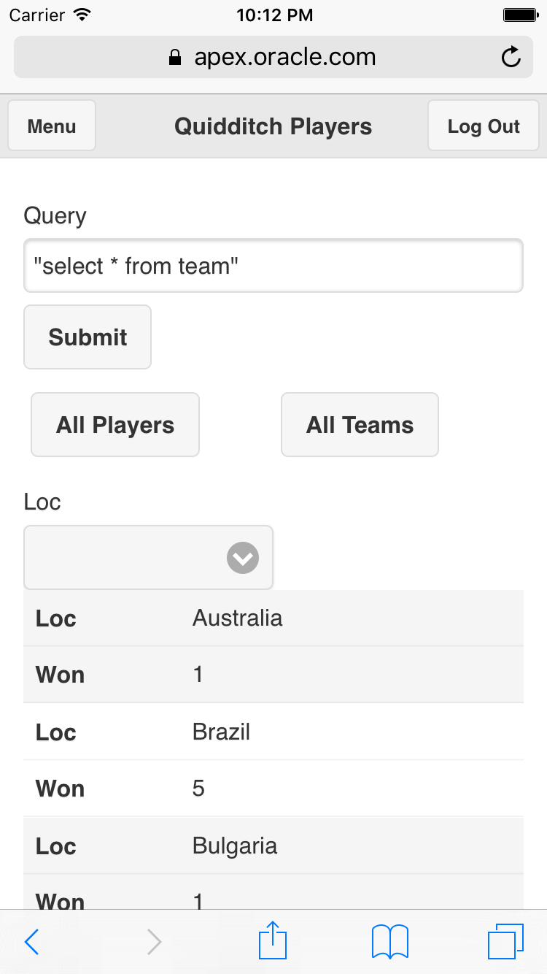
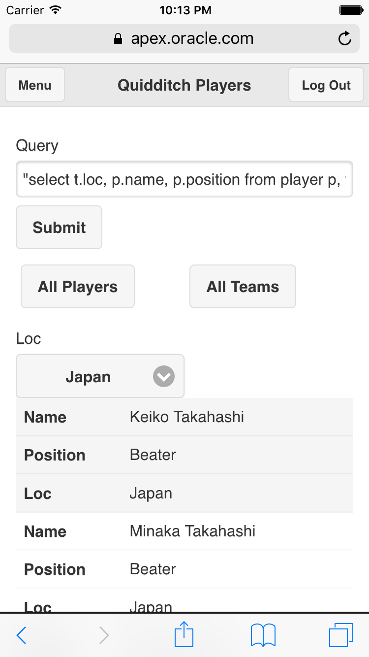
Notes:
This application will allow you to view a few Quidditch teams, their respective players, and number of World Cup wins.

