Slide 1
2DT902 – Computer Organization
Introduction to the course and the subject

Slide 2
Welcome to 2dt901
The course is called Computer Organization (sw Datorns Uppbyggnad)
Lectures (≈10). Lecturer: Tomas Nilsson
Laboratory work (4 labs, 4,0p)
You will work in groups of 2 students/group.
Lab work is mandatory.
Both hardware (digital circuits) and programming (ARMv6 ASM + low-level C)
Lab teacher: Mehdi Saman Azari. Will contact you on Slack in end of April.
Communication: Mostly on Slack, join channel #2dt901_computer-organization now!

Slide 3
Planning 2DT901 Spring 2024
Lecture | Week | Content | Connected to lab
L1 | 13 | Introduction, basic computer architecture, the development environment, simple assembly programming | 1
L2 | 14 | Binary representations, binary arithmetics, two’s complement, hexadecimal numbers | 1
L3 | 15 | Instruction sets, LEGv8 Assembly language, instruction coding, shifting operations, LEGv8 simulator | 1
Lab 1 | Week 15-16 Deadline 21/4 | Lab 1: LEGv8 Assembly language programming in simulator. | 1
L4 | 16 | Digital circuits: Introduction. Gates, truth tables, Boolean algebra, Karnaugh maps | 2

Slide 4
Planning 2DT901 Spring 2023
Lecture | Week | Content | Connected to lab
L5 | 17 | Combinational and sequential digital circuits | 2
Lab 2 | 17-18 Deadline 5/5 | Lab 2: Designing and building digital circuits | 2
L6 | 18 | Introduction to Rpi Pico microcontroller, ARMv6m instruction set, compiling and uploading programs, connecting LEDs to the Pico | 3
L7 | 19 | Subroutines, using the stack, nested subroutines | 3
Lab 3 | 19-20 Deadline 19/5 | Lab 3: Programming the Rpi Pico | 3
L8 | 20 | Memory operations on the Pico, using PC relative addressing | 3

Slide 5
Planning 1DT301 Autumn 2022
Lecture | Week | Content | Connected to lab
L9 | 21 | Introduction to C programming and low level C programming of the Rpi Pico | 4
L10 | 21 | Memory hierarchy, caches and virtual memory | -
Lab 4 | 21-22 Deadline 2/6 | Lab 4: Interrupts and C programming on the Pico | 4
Exam | 27 May | Written exam
Lab Re-Take | 23-24 Deadline 16/6 | Re-take for all four lab assignments | 1-4
Re-exam | August | Written exam
Schedule on TimeEdit. Check it continously!
https://cloud.timeedit.net/lnu/web/schema1/ri1Y7X9QQ9wZ66Qv750Q3315yYY72Z.html

Slide 6
About the course
Introduction to computer/microprocessor design and archtecture.
Programming in an Assembly language (close to the hardware).
The microcomputer we will use is Raspberry Pi Pico.
Released in January 2021.
Retail price of $4 (≈50 SEK).
Based on microcontroller RP2040, a 32-bit dual ARM Cortex-M0+ chip.
The Pico has 264 kB of RAM and 2 MB of Flash Memory.

Slide 7
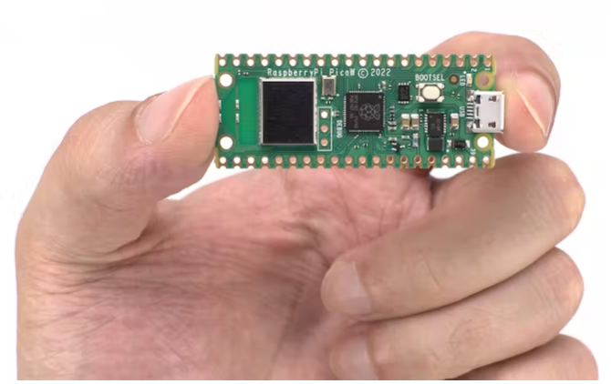
The Rpi pico microcontroller
The Rpi Pico will be used to learn ARMv6 Assembly programming in this course.
However, an emulator for LEGv8 will be used in the first lab assignment.
The Pico can be connected to various hardware components such as LEDs, pushbuttons and LCD displays.
The Pico does not have an operating system, so we can have more direct access to its hardware compared to a Personal Computer.

Slide 8
Computer architecture
Description of the organization and implementation of a computer system.
Describes the components of the system and their interconnections.
Most common architecture: Stored Program Concept.
Program instructions are stored in electronic or optical memory.
Patented by Konrad Zuse in 1936, for the computer Z1.
Von Neumann: Program data and instruction data in the same memory.
Harvard: Separate storage for instruction data and program data.
The ARM Cortex M0+ is based on von Neumann architecture (Wikipedia)

Slide 9
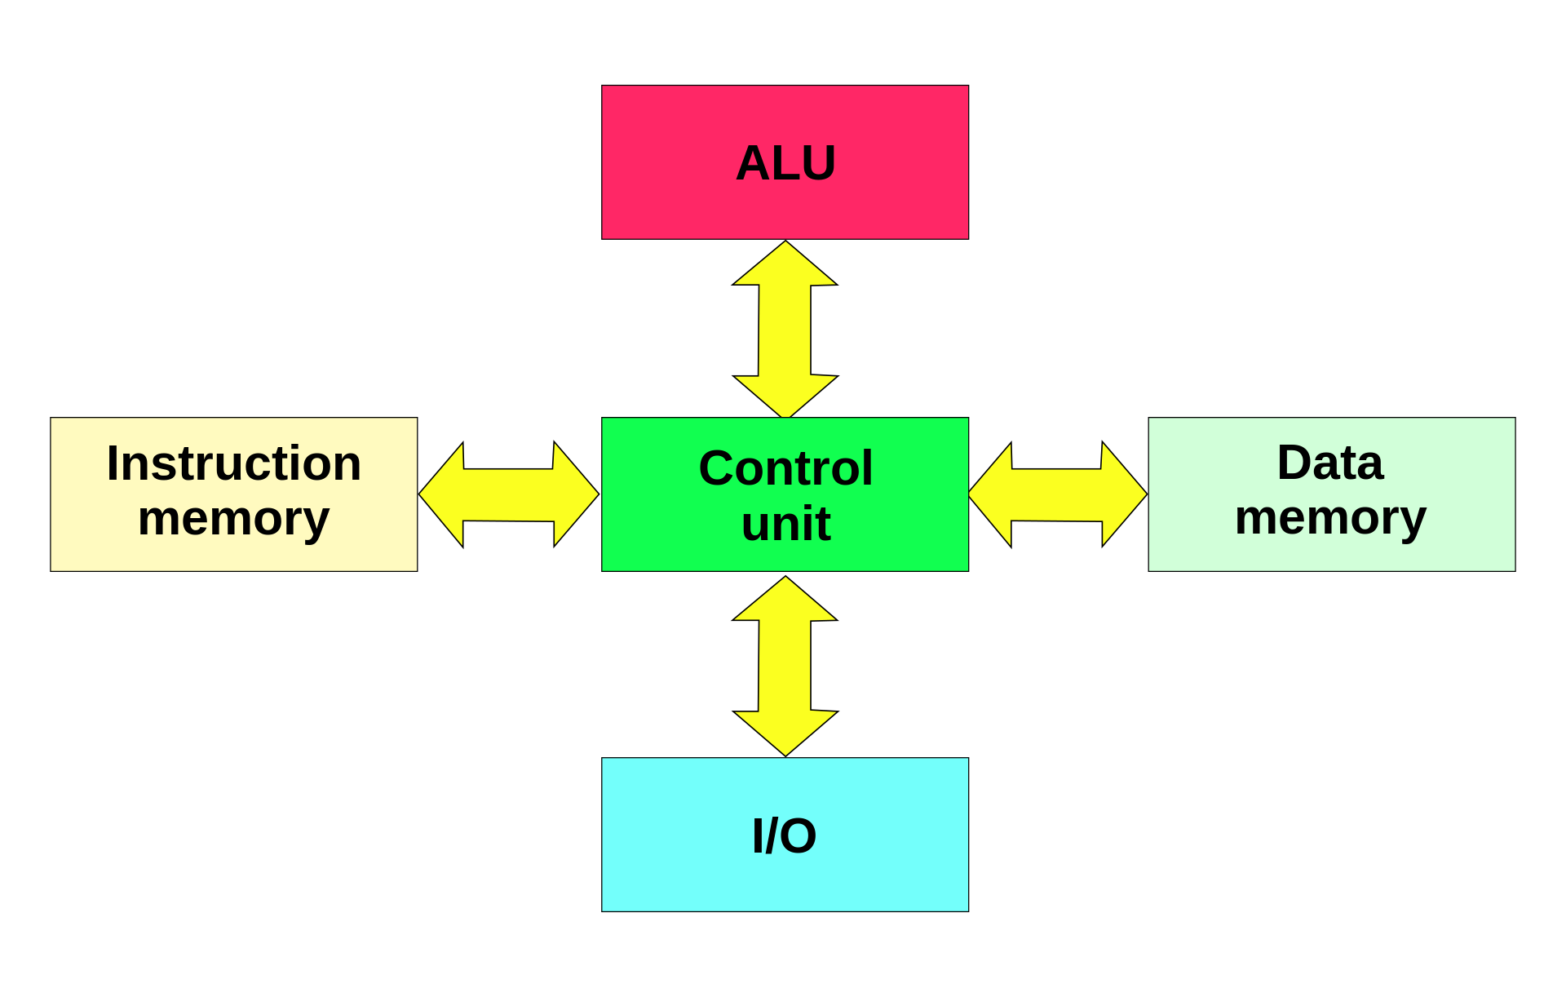
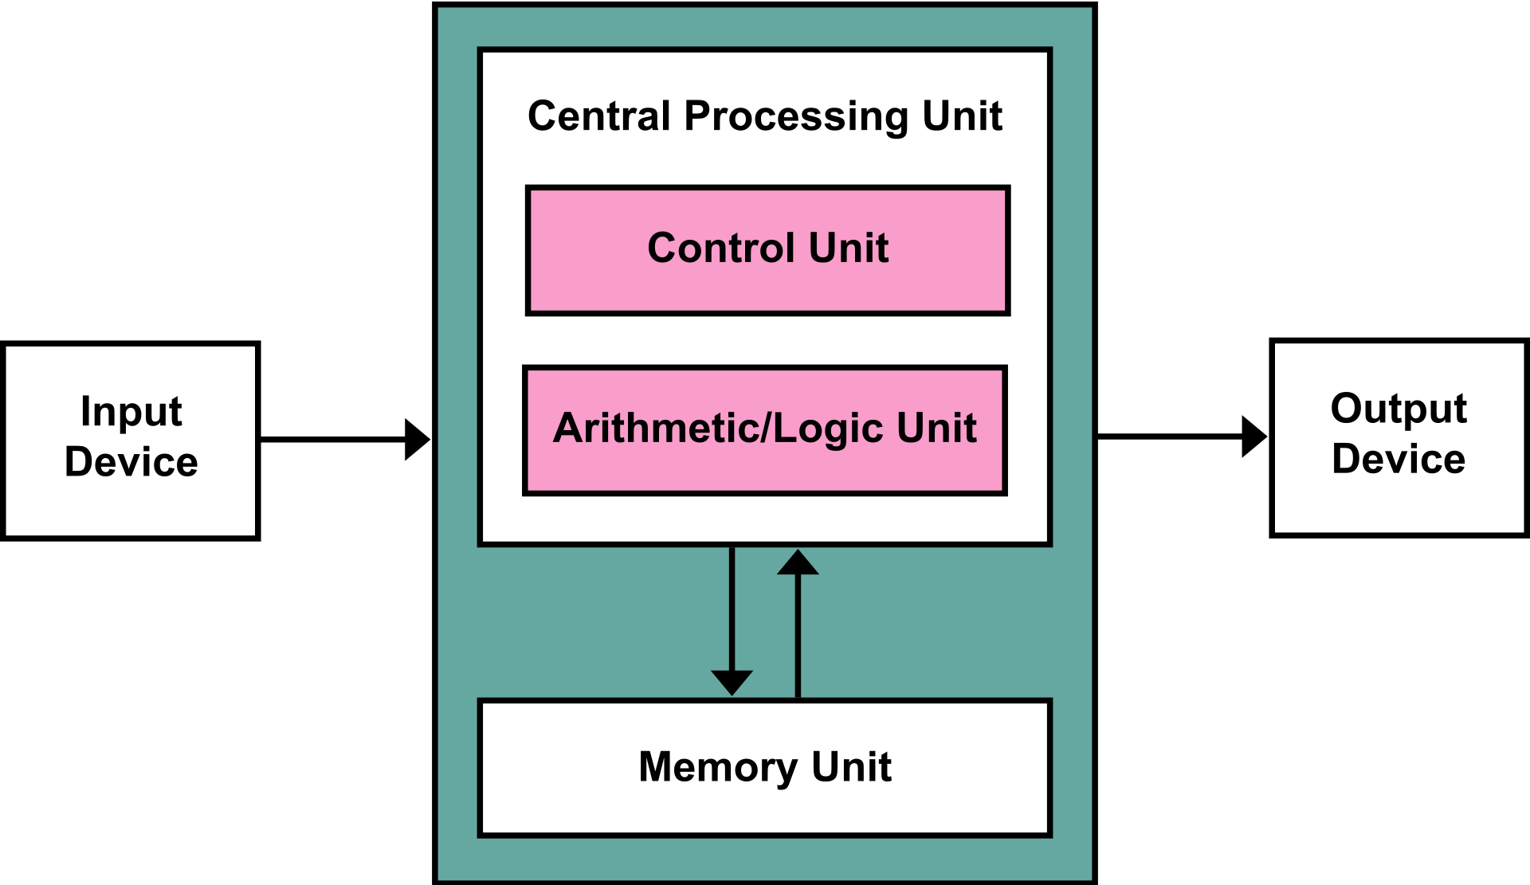
Von Neumann vs Harvard
(Pictures from Wikipedia)

Slide 10
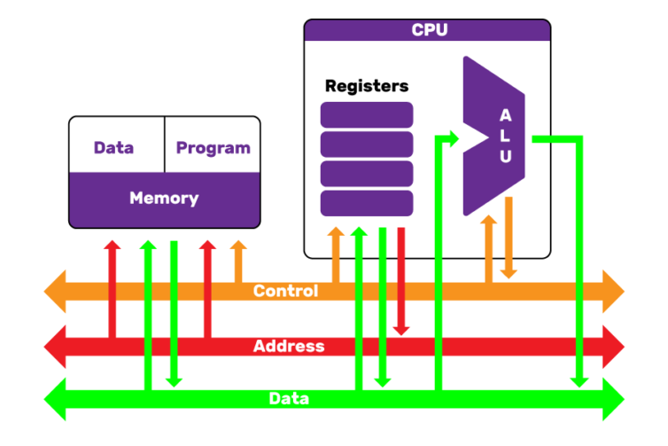
Simple CPU model
The picture shows the most important parts of a microprocessor.
ALU (Arithmetic Logic Unit): Performs arithmetic operations (like addition and subtraction) and logic operations.
Registers: Small and very fast memory cells, one register can store one binary number.
Buses: Parallel wires to transfer data, memory addresses, and instructions.

Slide 11
Important to understand
The CPU can only operate on data in the registers.
To change data in the main memory (RAM), the following must be done:
Transfer data from memory to a register.
Perform the desired operation on the data.
Move the data back to the memory.
Some architectures (e.g. x86) can perform operations where data is both in registers and in memory.
The ARM architecture can only operate on data in registers. This is called a Load-Store Architecture!

Slide 12
Binary numbers
On a basic level, everything inside a computer is a binary number.
A binary number only uses the digits 0 and 1.
Data, instructions, and memory addresses are all represented by binary numbers.
Inside the computer, high voltage means 1 and low voltage 0.
Important to understand the binary number system and how to convert a binary number to decimal (base 10) and hexadecimal (base 16).
In the next lecture, this will be studied more in detail.

Slide 13
Machine code
The CPU can only execute ”machine code” consisting of 0s and 1s.
For example: 10001011000 00010 000000 00001 00011
A 32-bit machine code instruction.
On a particular CPU, the instruction could mean: ”Add the numbers in register x1 and x2, store the sum in register x3”.
Machine code is diffucult for a programmer to understand.
Programmers do not write programs in pure machine-code today!

Slide 14
Assembly language
An assembly language makes low-level programming much easier!
Each machine instruction is translated to a nmemonic (an instruction name)
For example: add x3, x1, x2
The CPU still needs to run machine code so assembly code must be translated.
The program translating assembly code to machine code is called assembler.

Slide 15
ARM Architecture
ARM (Advanced RISC Machine) is a family of RISC based computers.
Originally developed by Acorn for their computer BBC Micro in the 1980s.
Since then, several generations have been released.
Today, ARMv6, ARMv7, and ARMv8 are the most commonly used versions.
The processor in the Raspberry Pi Pico is called ARM Cortex M0+
Based on a subset of ARMv6 instruction set called Thumb.
The Thumb subset uses only 16-bit instructions to save memory.

Slide 16
Risc vs cisc
CISC: Complex Instruction Set Computer
A large set of complex instructions.
Some instructions can do many operations.
The most complex instructions take many clock cycles to complete.
Example: The Intel x86 processors (The CPU in your desktop/laptop)
RISC: Reduced Instruction Set Computer
Relatively small set of instructions.
Each instruction can only do one operation.
Most RISC instructions takes one clock cycle to complete.
Example: ARM processors (like the one in Raspberry Pi Pico)

Slide 17
High-level languages
Today, most programming is done in high-level languages like C/C++, Java, C#, Python.
The CPU can still only execute machine code!
A compiler is a program that translates high-level code (e.g. C-code) to Assembly code. The final result is an executable binary file.
Some languages, like Python, are interpreted instead of compiled.
The Python code is translated to machine-code during run-time. No executable binary file is created!

Slide 18
Until next lecture
Read Sections 1.1 – 1.5 (until page 28) in Patterson&Hennessy.
Download simulator for LEGv8 Assembly programs: https://github.com/arm-university/Graphical-Micro-Architecture-Simulator
Try the following program in the simulator: MOVZ x1, #44 MOV x2, x1 ADDI x2, x2, #10 ADD x3, x1, x2
Read Section 2.4 (pages 75-82) about binary numbers!

Slide 19
Next lecture
Binary numbers and binary arithmetics (addition, subtraction, two-complementary form)
Hexadecimal and octal numbers, conversions dec-hex-bin
Operations of computer hardware
Artithmetics
Logical operations
Instruction sets
Translating Assembly code to binary representations

