Slide 1
2DT901: Computer Organisation Lecture 10
Introduction to C language and C programming on Pico

Slide 2
The C programming language
C was developed in 1972 by Dennis Ritchie at AT&T.
Initial purpose: Development of the UNIX operating system.
C is a small high-level language that allow low-level concepts.
History: Algol 60 -> BCPL -> B -> C
C++ is an extension to C. C is a subset to C++.

Slide 3
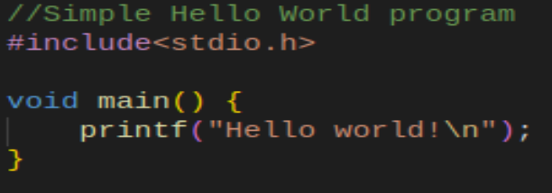
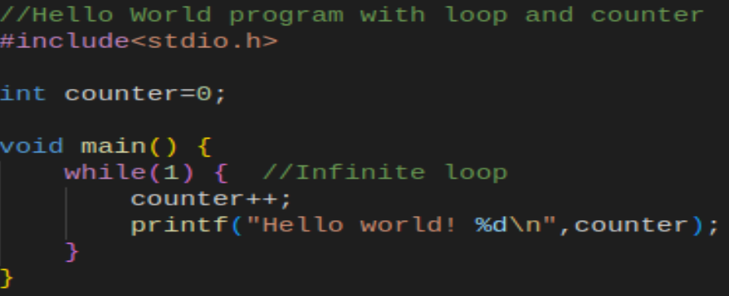
Simple C programs
The %d in means space for an integer value.

Slide 4
C functions
A C function needs a return type and can take a list of parameters.
If a function does not return a value, the type void is used.
Exemple 1: int func1(int a, int b) Takes two integer parameters, returns an integer
Example 2: void func2(float a, float b, float c) Takes two floating point variablers as parameters, returns nothing

Slide 5
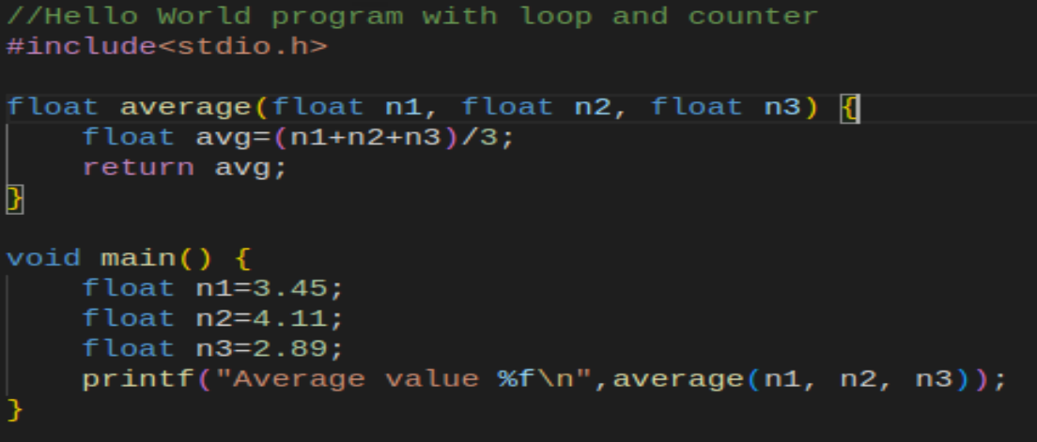
Simple program with function

Slide 6
A C program for Rpi Pico
The Rpi Pico has an extensive library of C function in the SDK.
A C program for Rpi Pico can be built with cmake and make exactly in the same way as the ASM program we have seen so far.
The source file should have extension .c
Use a similar CMakeLists.txt file, where the C source file is included.
When the printf() function is used, the C program needs to call the function stdio_init_all(); to enable output of data through USB.

Slide 7
Data types in C
A variable in C needs to have a data type.
Standard types are: int integer, example: int n=344; float floating point number, example: float n=3.45; double floating point number with double precision, ex: double n=3.45; char One character, example: char chr=’A’;
It is also possible to define arrays of the types: int myNumbers[] = {25, 50, 75, 100};
Strings are represented as arrays of characters.

Slide 8
Bits used for data types
How many bits are used for an int variable?
That depends on the architecture and the compiler!
Example: On Rpi Pico: int uses 32 bits => range -2 billion -- +2 billion On Arduino, int uses 16 bits => range -32k -- +32k’
Special types: unsigned int, use if number cannot be negative.
long int: Uses at lease 32 bits (on Rpi Pico: 32 bits)
long long int: Uses at least 64 bits (on Rpi Pico: 64 bits)
A special type is uint32_t. Always unsigned 32-bit, independent of architecture.
Function sizeof() can be used to check number of bytes used, ex. sizeof(int)

Slide 9
Arithmetic and special instructions
+ Addition
- Subtraction
* Multiplication
/ Division, if integer / gives quotient, ex. 17/5 = 3
% Remainder of integer division, ex. 17%5 = 2
++ Increment by 1, ex. int a=3; a++; //Same as a=a+1
+= Increment by constant, ex. a+=5; //same as a=a+5;
*= Multiply and store, ex. a*=4; //same as a=a*4;

Slide 10
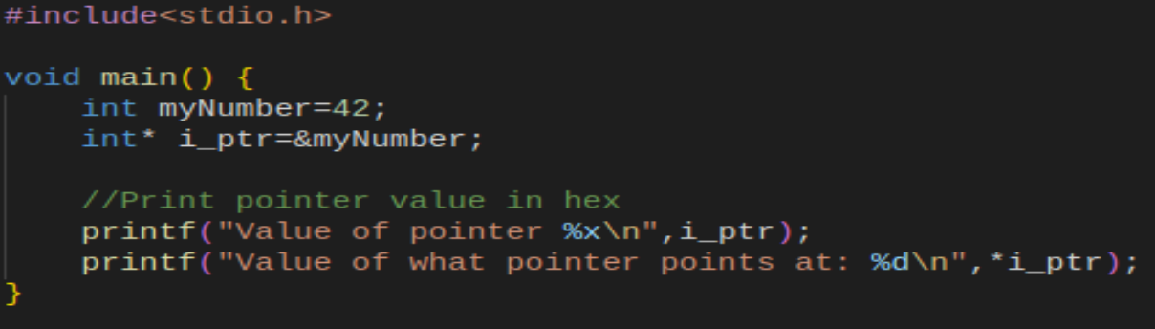
Pointer types
A pointer type is declared with an * after the data type. Ex: int* i_ptr;
A pointer contains the memory address to a variable.
To get the address of a variable, the & operator can be used.

Slide 11
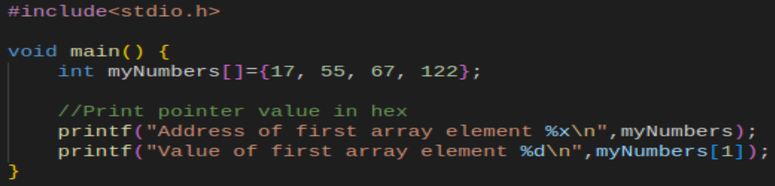
Array name is a pointer!

Slide 12
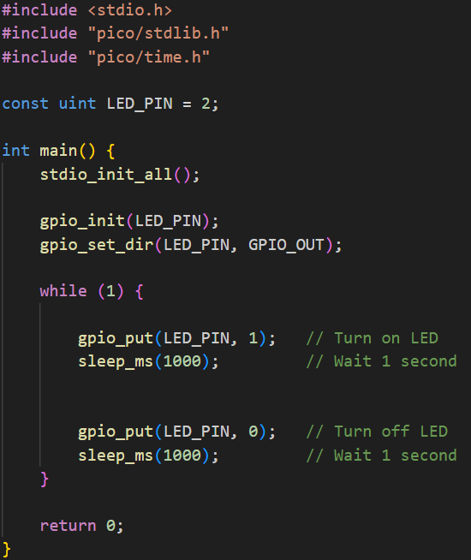
C program for flashing LEDs

Slide 13
Bit manipulation in C
In C, it is possible to manipulate bits in different ways:
>> binary right shift
<< binary left shift
& bitwise and
| bitwise or
Example: int a=7; int b=a<<2; //Shift number in a left 2 steps, store in a

Slide 14
Example: Bitmask
Suppose we have a binary number and want to check if bit 7 is 1 or 0
A bitmask can be used, which is a binary number 0100 0000
Example: int input = 0b11001001; int mask = 0b01000000; int result = input & mask;

Slide 15
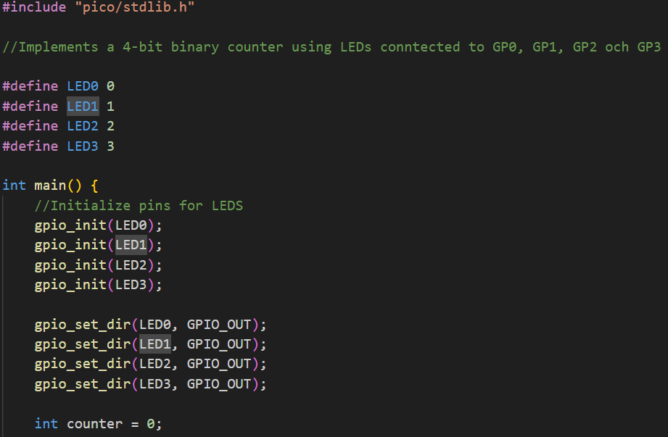
Example: 4-bit binary counter

Slide 16
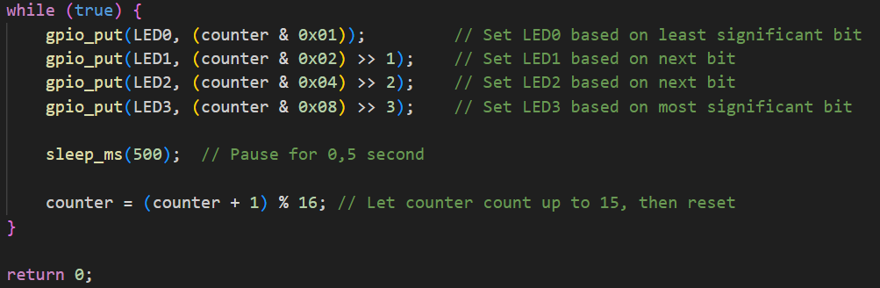
4-bit counter: Main loop

Slide 17
Hardware addresses
By using pointers, it is possible to access hardware registers.
For example, registers can be used to turn on or turn off GPIO-pins.
In principle, similar to what we did in the previous lecture.
To access the SIO registers, use the base address 0xd0000000
In C code, a pointer to SIO base can be declared as: uint32_t *SIO = (uint32_t *)0xd0000000;
Registers to set a GPIO pin or read input values are offset addresses from the base address.

Slide 18
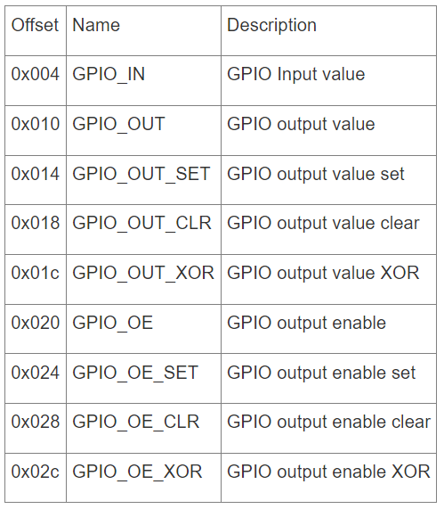
Hardware registers for the SIO
Use the SIO base address d0000000 The offset values in the table are offsets from the SIO base address.

Slide 19
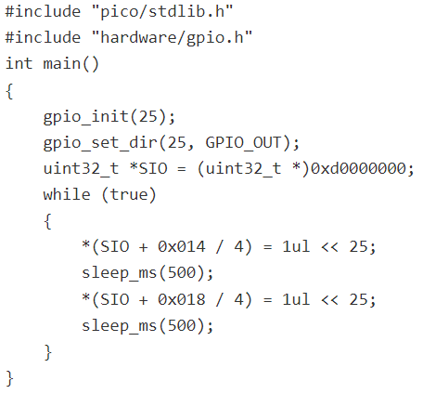
Ex: Program to flash built-in LED
The program flashes the built-in LED. Turn on a pin by writing a 32-bit binary number to *(SIO + 0x014 /4 )
The binary address should have a 1 in the position corresponding to the pin, for example, 000.000100 to turn on pin GP2
Constant 1ul means 32-bit unsigned number with value 1, that is,
00000000000000000000000000000001

Slide 20
Exercises
Extend the counter program to make a 5-bit counter
Connect two buttons to the Rpi Pico, and write a program with the following functions:
One button to increment the counter
One button to decrement the counter
Re-write the program in the last example to flash LEDs on GP2, GP5 and GP7 simulatnously by writing to hardware registers.

Slide 21
Recommended reading
Introduction to C: https://www.freecodecamp.org/news/the-c-programming-handbook-for-beginners/
Read about programming the Pico in C using hardware registers: The Pico/W In C: Direct To Hardware (i-programmer.info)

