Slide 1
2DT901: Computer Organization Lecture 11
Interrupts and timers in C

Slide 2
Polling
Polling means to constantly check if some event has happened
Example: Loop: Check if button1 is pushed down If button1 is down, turn on LED Check if button 2 is pushed down If button2 is down, turn off LED
Polling takes a lot of resources for the constant checking

Slide 3
Busy waitning
The programs flashing LEDs have been structured in this manner:
Repeat
Turn on LED
Wait one second
Turn off LED
Wait one second
Most of the time, the program is just waiting.
While waitning, the program can not do anything else.
This is called "busy wait" and is often a bad thing.
The solution: Use interrupts instead!

Slide 4
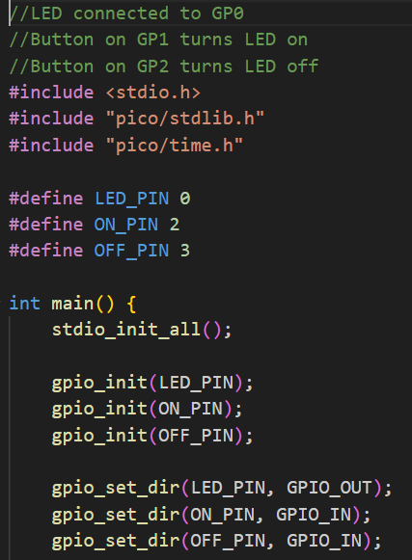
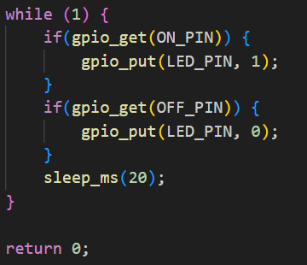
C program using polling

Slide 5
Interrupts
Interrupts are used to send a signal to the system if an event happens.
Example: Set up and interrupt to occur if a button is pressed
When the interrupt happens:
The normal program loop is interrupted.
The interrupt handler function is called.
When the interrupt handler has finished, the normal program loop is resumed.
Interrupts are often a more efficient way to handle events compared to polling.
The reason is that the program does not have to constantly check if something happens.

Slide 6
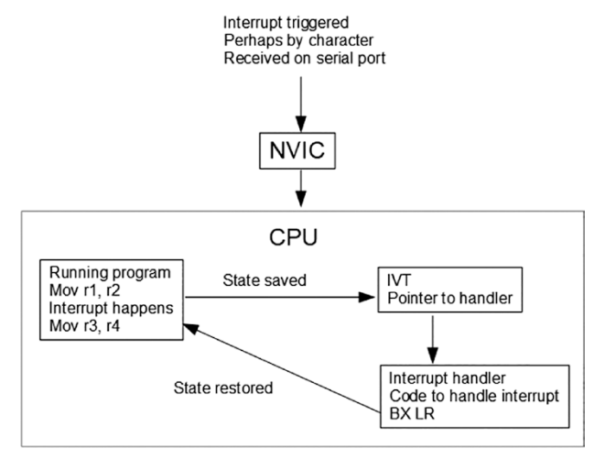
The interrupt calling process

Slide 7
Different types of interrupts
There are two different types of interrupts:
Interrupts generated from within the CPU, for example hardware malfunction or reset interrupt
Interrupts generated externally, for example an input signal on a GPIO pin.
Each interrupt type has a number, called IRQ (Interrupt ReQuest).
On the ARM Cortex, the internal interrupts have negative IRQs and the externally generated ones have a positive IRQ.
Interrupts can also have different priorities.
See Smith, pages 203-204

Slide 8
Interrupt vector
The IRQ numbers are used to index in the interrupt vector table (IVT).
The IVT is like an array in memory, where each index number (IRQ) refers to the interrupt vector.
To use the IVT, the program needs to have the memory address to the start of the IVT.
Each item in the array is called an interrupt vector.
The interrupt vector is a pointer (memory address) to the interrupt handler.
The interrupt handler is a subroutine that handled the interrupt.

Slide 9
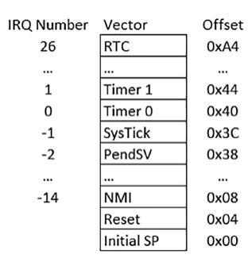
Interrupt vector on the pico

Slide 10
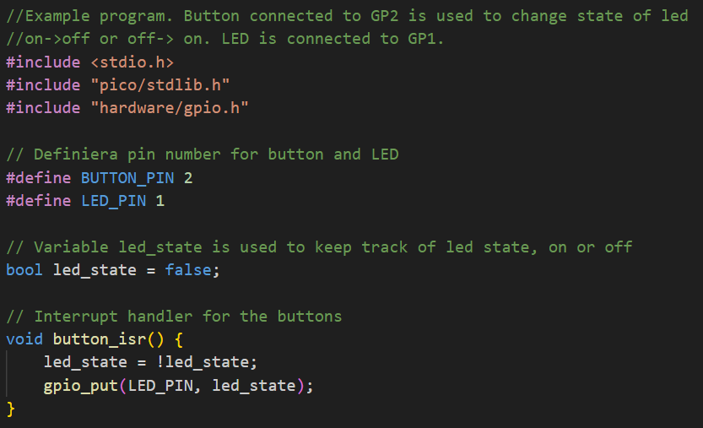
Example C program using interrupts

Slide 11
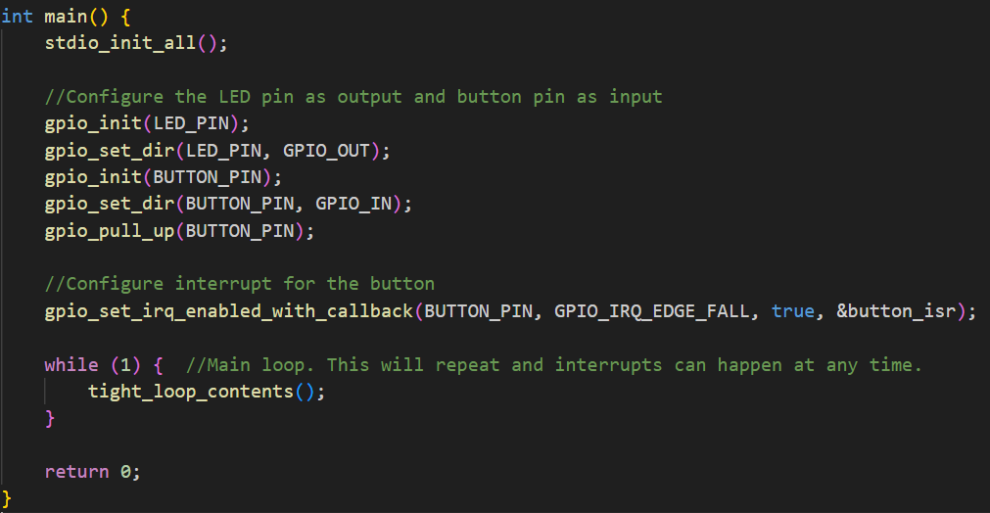
C-program, continued…

Slide 12
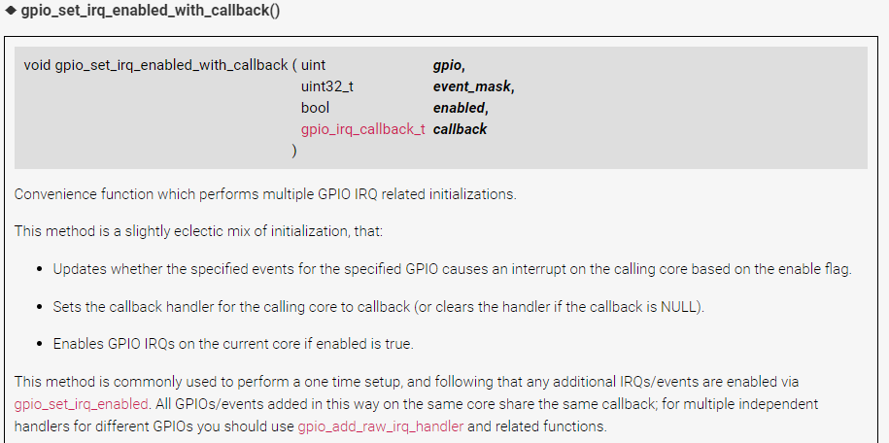
From the SDK documentation

Slide 13
Timer interrupts
In the standard example of the flashing LED, the function sleep_ms is used.
A better solution is to use the built-in timer hardware and use timer interrupts.
With timer interrupts, a timer is set to a number of microseconds.
When the time has passed, the timer interrupt handler function is called.
After that, the timer is reset and the timer is restarted.
The RP2040 CPU has alarm timers, that are represented as 64-bit integers.
The timers are incremented every microsecond.

Slide 14
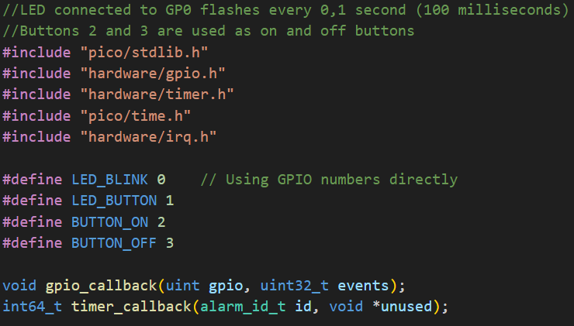
Example with timer interrupts

Slide 15
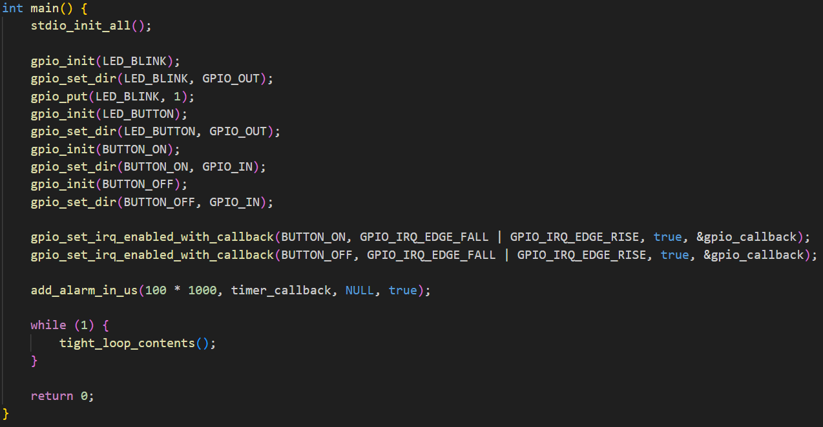
Timer interrupt example, continued

Slide 16
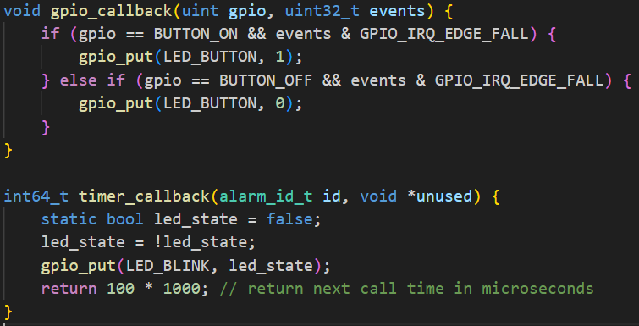
Timer example: Interrupt handler functions

Slide 17
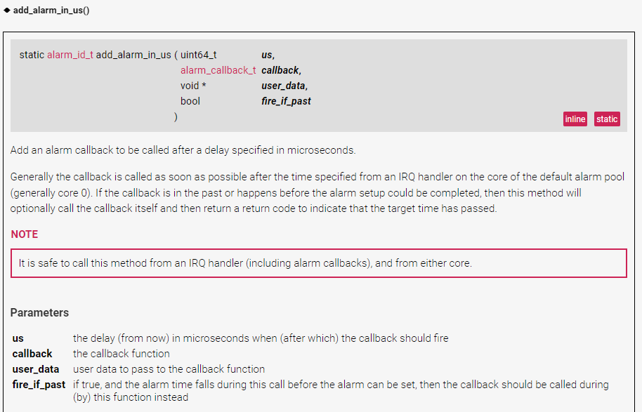
From the SDK documentation

Slide 18
Reading and links
Documentation for C SDK:
Function add_alarm_for_us(…) used for timer interrupts: https://www.raspberrypi.com/documentation/pico-sdk/high_level.html
Function gpio_set_enabled_with_callback(…) used for GPIO interrupts: https://www.raspberrypi.com/documentation/pico-sdk/hardware.html#ga6165f07f4b619dd08ea6dc97d069e78a
Read chapter 10 in Smith’s book for an introduction to interrupts and Assembly code.
Patterson & Hennessy: Read Section 4.9, more general theory about interrupts and exceptions

