Slide 1
2DT901: Computer Organization Lecture 11
Virtual memory, memory hierarchy and pipelining

Slide 2
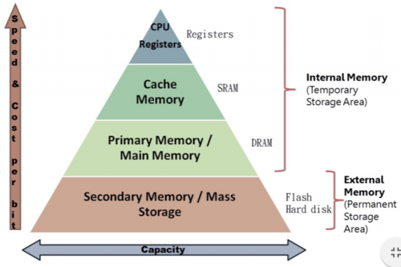
Memory hierarchy
The pyramid shows the capacity and speed for different memory types.
Fast memorys are very expensive compared to slower memories.
Virtual memory is a technique to allow primary and secondary memory to work together to form a large virtual memory, that gives the illusion of a large primary memory.

Slide 3
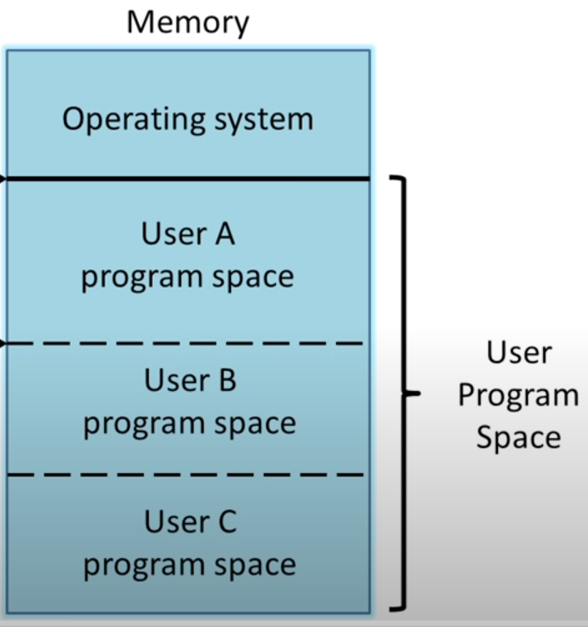
Memory protection
Virtual memory also provides protection between different programs.
It is very important that different programs are blocked from writing into memory used by another program.
This is solved with virtual memory.
With virtual memory, each program gets its own set of virtual memory addresses, disconnected from the memory sets used for other programs.

Slide 4
What is virtual memory?
Virtual memory allows a computer to use more memory than is physically available.
This is made possible by using the secondary memory (Hard disk, SSD) as a cache for the primary memory.
Virtual memory also provides memory protection by separating virtual addresses from psysical addresses.
With virtual memory, a program can not write inside memory used by another program.
When virtual memory is used, the programmers don’t need to worry about limited primary memory (RAM).

Slide 5
Virtual addresses
In a virtual memory system, each program runs in its own virtual memory space.
A program can not access a physical address directly.
The virtual memory space can be larger than the physical memory available.
Virtual memory implements translation between virtual addresses and physical addresses.
To implement support for virtual memory in an OS, the CPU needs to have support for virtual memory.
The hardware component that handles the virtual memory is called Memory Management Unit (MMU).

Slide 6
Address translation
When a program needs a memory address, the OS provides a virtual adress.
This virtual address is then, using a combination of hardware and software, translated to a physical address. This is called address translation or address mapping.
The virtual memory space is divided into memory blocks, called pages.
If a program requests a page which is not in memory, a page fault occurs.
After a page fault, the missing page must be loaded into memory from SSD or HDD and another page be moved to it.
This process is called swapping.

Slide 7
Blocks and pages
Virtual memory also provides relocation.
Relocation maps virtual addresses to different physical addresses.
All virtual memory systems today use fixed-sized blocks call pages.
It is not required that a program is located in one contigous memory area.
The only requirement to load a program into virtual memory is that enough virtual pages are available to fit the program.

Slide 8
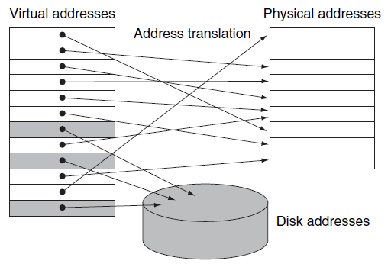
Mapping of pages
Some virtual addresses are connected to addresses in physical memory, others are stored on disk.
Virtual memory can have more addresses than is available in physical memory.

Slide 9
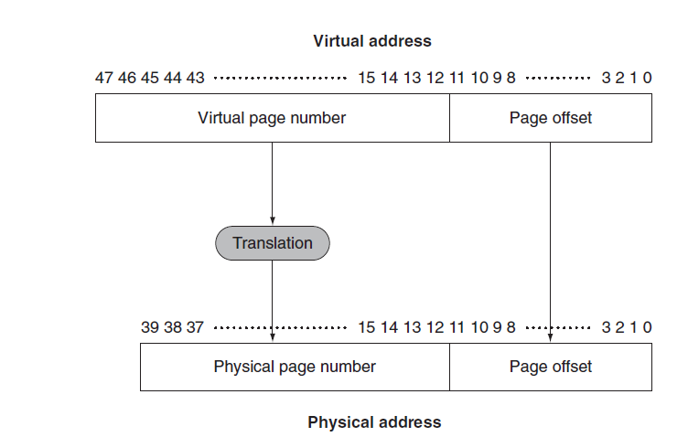
Pages and page offset
A virtual memory address is divided into a virtual page number and a page offset.
The size of the virtual addresses on ARMv8 is bigger than the size of the physical addresses.
This means that more virtual than physical memory can be potentially available.

Slide 10
Page fault
When a page is required by the CPU, the MMU checks if the page is available in primary memory (RAM).
If it’s not, an event called a page fault occurs.
After a page fault, the required page must be loaded into primary memory from secondary memory and another moved from primary to secondary.
This process is called swapping, and has large performance penalty, because secondary memory (HDD, SSD) are very slow compared to RAM.

Slide 11
Page placement
Because of the high penalty, it is important that the operating system use efficient algorithms to optimize page placement.
The page to be swapped out during a page fault should be a page that will not be needed in a long time.
To determine if a page is in physical memory or not in an efficient way, a page table is used.
The page table is a register that helps map the virtual addresses to the physical addresses. Each program has its own page table.
The page table keeps track of whether a page is in physical memory or not by using a bit called the valid bit.

Slide 12
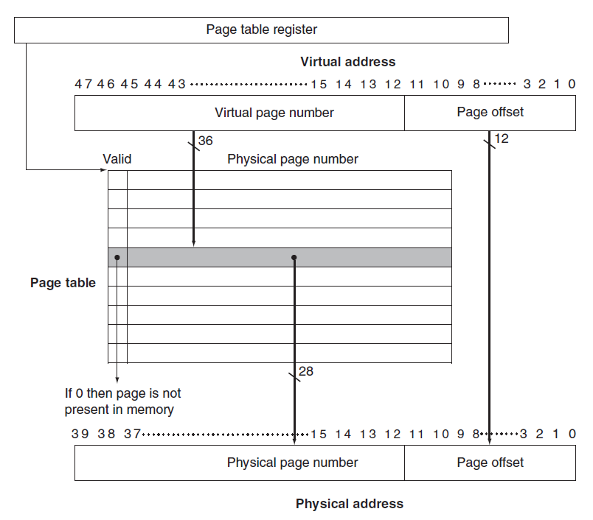
A page table
When a page is needed, the page table is checked.
If the valid bit is 0, the page is not present in physical memory and a page fault occurs.

Slide 13
Dirty bit
If a page has been written to (modified), it needs to be copied back to disk when swapped with another page.
If the page has only been read, the page is already on disk and does not need to be written back.
To determine if a page has been written, a dirty bit is used in the page table.
The dirty bit is set to 1 if it has been written to after loading it from disk.

Slide 14
The TLB
TLB (Translation Look-Aside Buffer) is a technique to make translation between virtual and physical addresses faster.
The purpose of the TLB is to reduce the time to get data from a memory address.
Without TLB, to get data from an address, two operations need to be done:
Get the physical address by translating the virtual address
Read the data from the physical address
The TLB works as a cache memory for the page table.
The ref bit in the table indicates if the page is stored in physical memory.

Slide 15
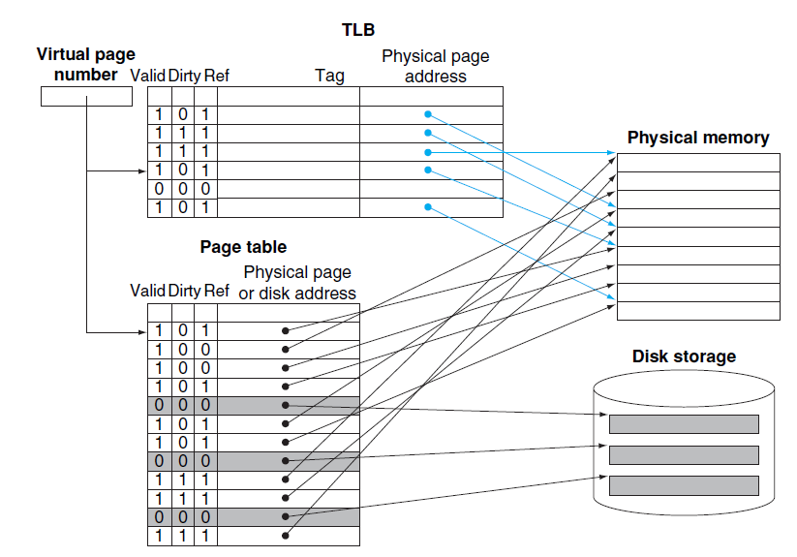
Virtual memory with TLB

Slide 16
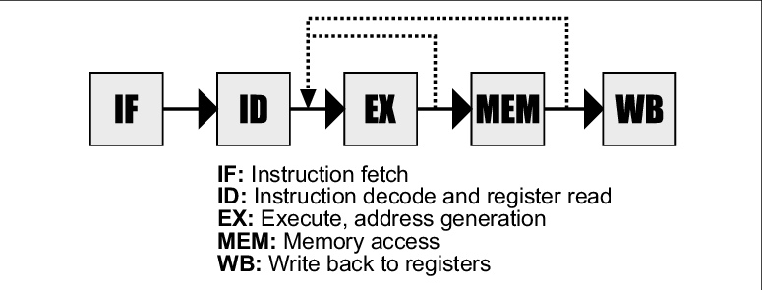
Pipelining
One important way increase the speed of a computer programs is data pipelining.
In a pipelined architecture, data flows through a series of stages, done in sequence. See picture below!
One peace of data must go through all the stages before the computation is complete.
The advantage of pipelining is that a new piece of data can enter the pipeline before the previous piece of data has completed all stages.
Multiple instruction can be overlapped in execusion, much like an assembly line.

Slide 17
From Patterson&Hennessy: Laundry example
This is an everyday situation where the concept of pipelining is used.
Think of four laundry stations:
Place dirty clothes in the washer
When washer has finished, place the wet clothes in the dryer
When dryer is finished, put the dry clothes on a table and fold them.
When folding is finished, put the clothed away in a cabinet.
It we have a lot of laundry, It would not be very efficient to do let one load of laundry at a time go through all the stages, it can be done in parallel.
For example, when load 1 is in the dryer, put load 1 in the washer

Slide 18
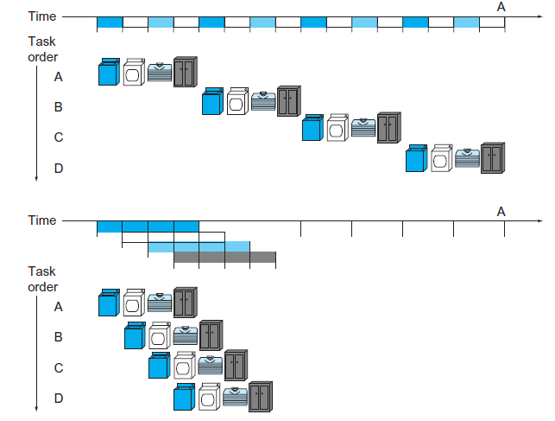
Sequential vs pipelined laundry

Slide 19
Througput increase
In the ideal situation, the throught (work done per time unit) increases by a factor equal to the number of stages in the pipeline.
In the laundry example, the ideal increase in throught will be a factor four.
This requires that all stages are equal.
If one station takes longer, for example, suppose that the dryer takes twice the time to complete compared to the washer, the increase in througput will be smaller.
The stage that takes the longest time will set the limit to the increase of througput.

Slide 20
Stages of a instruction execusion
Typically, the following five stages are needed for a LEGv8 instruction (page 285):
Fetch instruction from memory.
Read registers, decode instruction.
Execute operation or calculate an address.
Access an operand in data memory.
Write the result into a register.
When executing a program, much time can be saved by letting the next instruction start before the previous has gone through all stages.

Slide 21
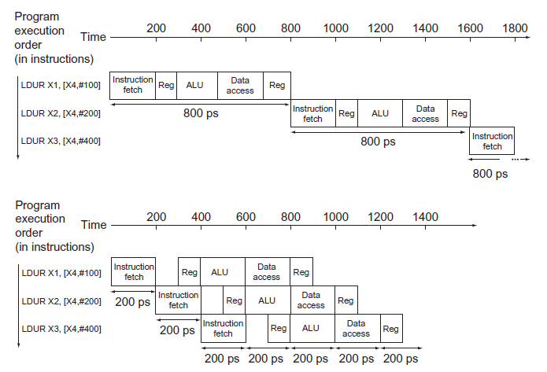
Sequential vs pipelined execution of LEGv8

Slide 22
Limits to performance increase
The increase in performance is generally not proportional to the number of pipeline stages.
One limit is that some instructions, like memory access, are much slower than register access.
Like in the laundry analogy, the slowest stages put the limit of performance increase.
Also, there are some situations where the next instruction depend on the previous one.
These are called pipeline hazards.

Slide 23
Pipeline Hazards
Three types of events (hazards) that can prevent instructions from being executed (page 292):
Structural Hazards: If the hardware architecture prevents a combination of two instruction to run at the same time.
Data Hazards: If an instruction cannot run because it needs result from previous instruction. Example: ADD X2, X0, X1 SUB X4, X2, X3 The second instruction needs the result from the first instruction.
Control Hazards: If the instruction fetched is not the instruction that is needed. Often occurs when the program takes another branch in a conditional statement.

Slide 24
Recommended reading: Virtual Memory
Patterson & Hennessy section 5.7, pages 441-456
Sections 5.1-5.6 about memory hierarchies, cache memory and virtual machines is also recommended and makes it easier to understand section 5.7
Youtube videos:
https://www.youtube.com/watch?v=4e18yybPo1E
https://www.youtube.com/watch?v=8yO2FBBfaB0

Slide 25
Recommended reading: Pipelining
Patterson & Hennessy: Section 4.5, pages 283-297
Youtube videos:
Introduction to the ARM Pipeline Architecture (youtube.com)
1 3 1 Pipelining Principles (youtube.com)

