Slide 1
2DT901: Computer Organization Lecture 2
Lecture 2: Binary numbers and computer arithmetics

Slide 2
Decimal number systems
The number system we use every day is based on the number 10.
Because of this, we require 10 different symbols (figures), 0, 1, …, 9.
The system is a position system, which means that the position of a figure determines its value.
Example: 2398 = 2·10³+3·10²+9·10¹+8·10⁰ =2·1000+3·100+9·10+8·1
10³
10²
10¹
10⁰
2
3
9
8

Slide 3
Binary number system
The binary number system uses base 2 instead of 10
Only two figure symbols are required: 0 and 1
The system is a positional number system, just as the decimal system.
Example: 1101_{bin} = 1·2³+1·2²+0·2¹+1·2⁰ =1·8+1·4+0·2+1·1=13_{dec}
Computers use the binary system because it is much easier to implement.
0 means low voltage (0 volts), 1 means high voltage (for example 3.3 volts).
Larger binary numbers need many bits -> difficult for humans to read

Slide 4
Exercises
Convert the following decimal numbers to binary form:
37_{dec}
32_{dec}
152_{dec}
Convert the following binary numbers to decimal form:
100101_{bin}
11111_{bin}

Slide 5
Bit, byte and word
One binary digit is called a bit. It is the smallest unit of information.
Eight bits form a byte.
The size of a word depends on the architecture.
If the architecture is 16 bits, the word size is 16 bits.
If the architecture is 32 bits, the word size is 32 bits.
If the architecture is 64 bits, the word size is 64 bits.
All modern desktop computers today use 64-bit word size.

Slide 6
Arithmetics
Important to understand that addition is the basic arithmetic operation.
The other basic operations are strongly related to addition.
Subtraction is addition with a negative number.
Integer multiplication is repeated addition: 3•4=3+3+3+3
Division is repeated subtraction with multiples of the divisor.
20/4=5, because 4 can be subtracted from 20 five times.
23/4=5 R 3, where 3 is the remainder. Can be written 23/4=5+3/4 or 5,75
Division algorithm: 23=5•4+3

Slide 7
Addition algorithm
The common addition algorithm, known to you from elementary school, is called the ripple-carry-algorithm.
The algorithm works exactly the same way for decimal and binary numbers (and all other bases!)
1 | 1 | 1
 | 3 | 7 | 8
+ | 7 | 6 | 9
1 | 1 | 4 | 7
1 | 1 |  | 1
 | 1 | 1 | 0 | 1
+ | 0 | 1 | 0 | 1
1 | 0 | 0 | 1 | 0
In this case, the addition of two 3-digit decimal number gives a 4-digit number
In this case, the addition of two 4-digit binary number gives a 5-digit number

Slide 8
Overflow
A computer always has limited space to store a binary number!
A 32-bit architecture can store binary numbers with up to 32 bits.
That gives room for 2³² = 4 294 967 296 different integer numbers
If unsigned integers: Largest integer is 4 294 967 295
If signed integers: Largest integer is 2 147 483 647
If the result of an addition exceeds the maximum number of bits, the operation will result in an overflow.

Slide 9
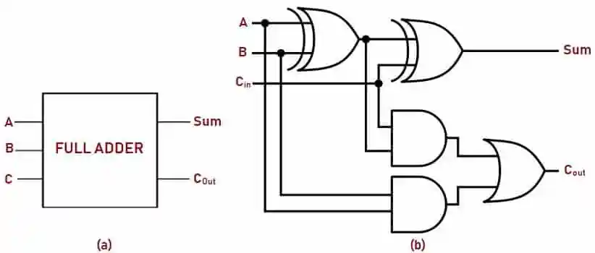
Circuit for 1-bit addition
The addition circuit is a fundamental part of a microprocessor.
The addition hardware is included in the Arithmetic Logic Unit (ALU).
You will learn more about digital circuits later in this course!

Slide 10
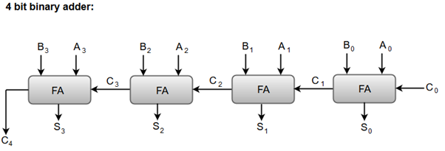
4-bit adder cirquit
Four Full Adders can be combined to form a 4-bit adder.
In the same way, a 32-bit adder can be constructed from 32 Full Adders.
A fast addition curquit is fundamental for the performance of the computer system!

Slide 11
Subtraction
A subtraction can always be written as an addition with a negativt number.
Example: 122-17 = 122+(-17) or 1001-0110 = 1001+(-0010)
Negative binary numbers in a computer can be represented as:
A number where the left-most bit is a sign bit: 0 if positivt, 1 if negative
Two's-complementary form: The most common form used.
Use of Two's-complementary form leads to simpler hardware.

Slide 12
About two’s complement
The method was invented by John von Newmann in 1945 while working on the EDVAC computer.
It works if fixed bit-length is used and the overflow bit is ignored.
Example: 8-bit numbers: What is the result of the addition 0000 0001 + 1111 1111?
1 | 1 | 1 | 1 | 1 | 1 | 1 | 1
 | 0 | 0 | 0 | 0 | 0 | 0 | 0 | 1
+ | 1 | 1 | 1 | 1 | 1 | 1 | 1 | 1
(1) | 0 | 0 | 0 | 0 | 0 | 0 | 0 | 0

Slide 13
About two’s complement
If the overflow bit is ignored, the result of the addition 0000 0001 + 1111 1111 = 0000 0000
If a+b=0, then we must have the identity b=-a
That is, the number 1111 1111 is the additive inverse number to 0000 0001.
The number 1111 1111 is called the two’s completent to 0000 0001.
This is how subtraction works in a CPU. Instead of subtracting, the processor adds with the two’s complement.

Slide 14
Example: Subtraction
Calculate the subtraction 1101-1011. Use the two’s complement method.
Invert all bits of the number 1011 => 0100
Add 1 to the number. 0100+0001=0101. This is the two's-complement of 1011!
Write the subtraction as addition: 1101-1011=1101+0101. Ignore the overflow bit!
1 | 1 |  | 1
 | 1 | 1 | 0 | 1
+ | 0 | 1 | 0 | 1
(1) | 0 | 0 | 1 | 0
1101-1011=0010

Slide 15
Hexadecimal numbers
Large binary numbers are much longer (more digits) than decimal numbers.
For example, 783_{dec} = 1100001111_{bin}
Because of this, binary numbers are difficult for humans to work with.
Binary numbers are often expressed as hexadecimal numbers (base 16).
Hex numbers are much shorter and more suitable for humans to handle!

Slide 16
The hexadecimal system
Bin | Hex | Dec
0000 | 0 | 0
0001 | 1 | 1
0010 | 2 | 2
0011 | 3 | 3
0100 | 4 | 4
0101 | 5 | 5
0110 | 6 | 6
0111 | 7 | 7
1000 | 8 | 8
1001 | 9 | 9
1010 | A | 10
1011 | B | 11
1100 | C | 12
1101 | D | 13
1110 | E | 14
1111 | F | 15
With 4 bits, 2⁴=16 different numbers can be represented.
With decimal numbers, some of them require two digits.
If the hexadecimal system is used, one four-bit binary number represents exactly one hexadecimal number.
The hexadecimal number uses base 16 and thus required 16 different number symbols: 0, 1, 2, 3, 4, 5, 6, 7, 8, 9, A, B, C, D, E, F

Slide 17
Converting bin⬄hex
Example: Write the following binary numbers to base 16.
10010011 Divide the number in groups of four, convert each four-group to base 16: 1001 0011_{bin} = 93_{hex}
101101 Insert 0s in the beginning, to make full four-groups. 0010 1101_{bin} = 2D_{hex}
Example: Write the following hex number in base 2.
3CA_{hex} = 0011 1100 1010_{bin} = 1111001010_{bin}

Slide 18
Converting hex⬄dec
When converting from hex to dec, write each number and its power of 16 in decimal form.
Example: 24C3hex = 2·16³+4·16²+12·16¹+3·16⁰ = 9411_{dec}
When converting dec to hex, find the maximum number of the highest power of 16, continue with the next digit to the right and so on…
Example: Convert 1374_{dec} to base 16.
16³ 16² 16¹ 16⁰
0 | 5 | 5 | E
=5·16²+5·16¹+14·16⁰=1374_{dec}

Slide 19
Operations of hardware
To command a microprocessor, the instructions must be expressed in its special language.
Each processor family has its own language. For example, an ARM processor and an Intel x86 processor have different languages.
The languages of different processors are quite similar, so it is quite easy to learn for example x86 Assembly language if you know ARM Assembly language.
The reason for the similarities is that all processors are constructed from similar hardware components.
However, there are important differences, for example the number of registers, the length of instructions, the memory organization, …

Slide 20
DEC and hex as constants
The instruction MOVZ X1, #457 inserts the decimal constant number (immediate value) into register X1.
To specify a hex value, put 0x before the number! Example: MOVZ X1, #0x457 MOVZ X1, #0xFD4E

Slide 21
Octal numbers
The octal system has base 8.
To convert a binary number to octal form, divide the number in groups of three.
For example: 100 111 010 111_{bin} = 4727_{oct}
Converting oct to dec: 634_{oct}=6⋅8²+3⋅8¹+4⋅8⁰ = 412_{dec}
The octal system was mostly used in historical computers that used word sizes such as 6 bits, 12 bits, 24 bits, 36 bits, for example UNIVAC, PDP-8, and IBM Mainframes.
Modern computers use 16-bit, 32-bit or 64-bit word length, which means that hexadecimal numbers are more convenient to use.

Slide 22
A bad joke?
Why do programmers always mix up halloween and christmas?

Slide 23
Until next lecture
Read Section 2.4 in Patterson&Hennessy
Work with the following exercises:
Convert the binary number 110101 to a decimal number.
Convert the decimal number 2198 to a binary number.
Convert the hexadecimal number 4E5 to binary and decimal form.
Convert the binary number 11010110001 to hexadecimal form.
Calculate the sum 101101+1011. Work in binary form!
Calculate the difference 11011-1011. Work in binary form and use the two’s complement method!

