Slide 1
2DT901: Computer Organization Lecture 4
Introduction to digital circuits
Logic gates, boolean algebra and combinational circuits

Slide 2
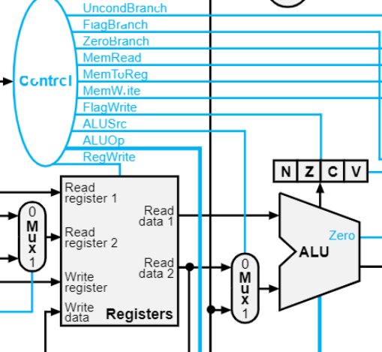
Components in a computer
En processor (CPU) består av tre grundläggande komponenter:
ALU: Arithmetic Logic Unit. Genomför aritmetiska och logiska operationer. Innehåller bland annat adderare och komparator.
Register: Ett register är ett minne som kan innehålla ett binärt tal. Processorn innehåller ett antal register.
Styrenhet (Control Unit): Styr hur processorns olika delar ska fungera (till exempel om vi ska skriva till eller läsa från ett register).

Slide 3
Digital (Logic) circuits
All components in a computer system (like ALU, registers, control unit, memory) are examples of logic circuits, also called digital circuits.
Digital circuits are hardware components (based on transistors) that manipulate binary information.
The transistor based electronic circuits are modelled as logic gates.
Designers of digital circuits can ignore the internal electronics of a gate.
A gate implements a logical function.
The basic logical functions are AND, OR, NOT.

Slide 4
Binary variables and values
A binary variable can take on one of two values.
The values can have different names: True/False, 1/0, Yes/No, High/Low.
Logical operators operate on binary values.
Examples:
1 AND 0 = 0
1 OR 0 = 1
NOT 1 = 0

Slide 5
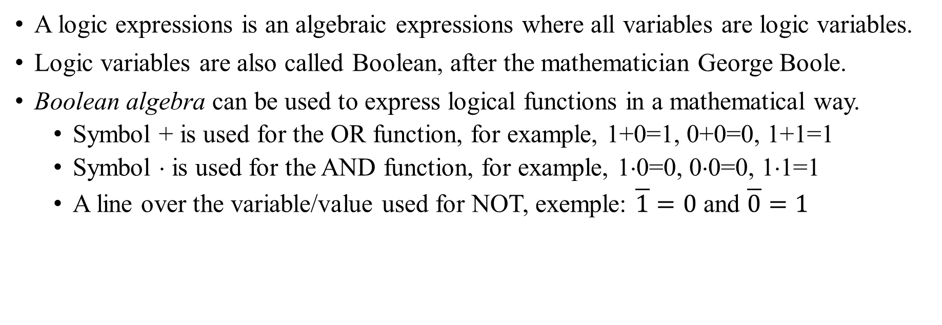
Logic (Boolean) expressions
A logic expressions is an algebraic expressions where all variables are logic variables.
Logic variables are also called Boolean, after the mathematician George Boole.
Boolean algebra can be used to express logical functions in a mathematical way.
Symbol + is used for the OR function, for example, 1+0=1, 0+0=0, 1+1=1
Symbol ⋅ is used for the AND function, for example, 1⋅0=0, 0⋅0=0, 1⋅1=1
A line over the variable/value used for NOT, exemple: $\overline{1}=0$ and $\overline{0}=1$

Slide 6
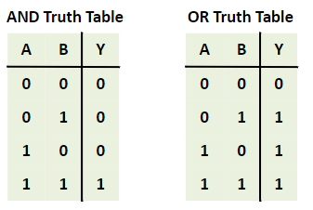
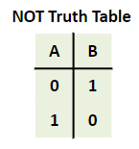
Truth tables
A truth table is a way to describe all possible values of a Boolean function.
Can be useful for Boolean function with up to 4 variables. Not practical for functions with more variables, as the number of rows grow exponentially.

Slide 7
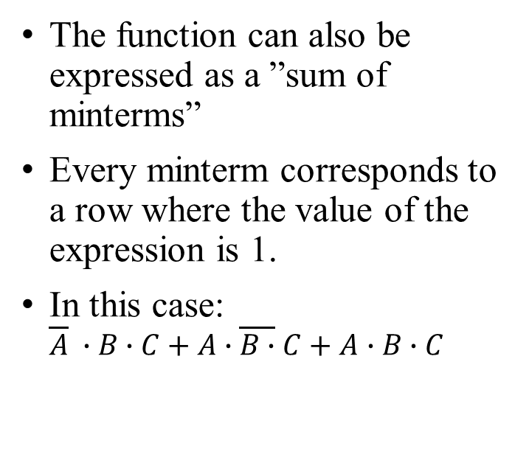
Example: Truth table for a complex expression
The Boolean expression (A+B) ⋅C can be expressed with the following truth table
A | B | C | A+B | (A+B)⋅C
0 | 0 | 0 | 0 | 0
0 | 0 | 1 | 0 | 0
0 | 1 | 0 | 1 | 0
0 | 1 | 1 | 1 | 1
1 | 0 | 0 | 1 | 0
1 | 0 | 1 | 1 | 1
1 | 1 | 0 | 1 | 0
1 | 1 | 1 | 1 | 1
The function can also be expressed as a ”sum of minterms”
Every minterm corresponds to a row where the value of the expression is 1.
In this case: $\overline{A} ∙B∙C+A∙\overline{B∙}C+A$ $∙B∙C$

Slide 8
Logic gates
The logic gate is the basic building block for digital circuit.
AND, OR, NOT are the most important gates.
All logic functions can be implemented with these three gates!
There are also special functions such as NOR, NAND, XOR available as gates.
Internally, a gate is build with transistors.
There are two common standards for gates:
Distinctly shaped symbols, common in America
Rectangular shaped symbols, common in Europe

Slide 9
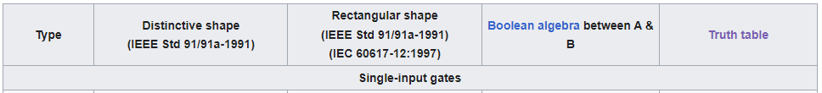
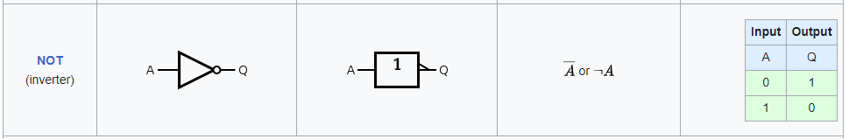
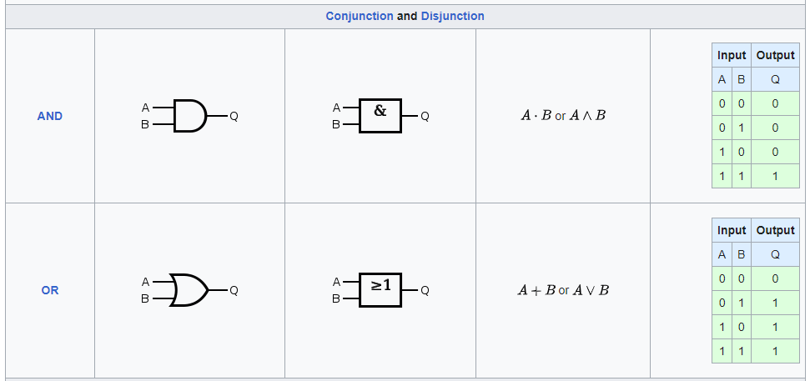
Basic logic gates
Table from Wikipedia
https://en.wikipedia.org/wiki/Logic_gate

Slide 10
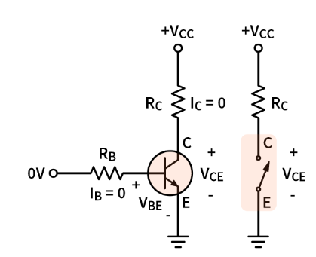
How are the gates constructed?
The basic component is the transistor.
A transistor is like an electrically controlled switch.
A transistor can be open (digital 1) or closed (digital 0)

Slide 11
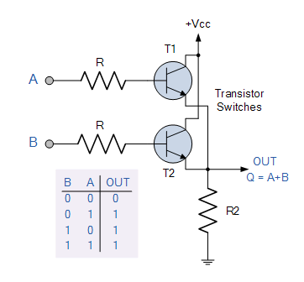
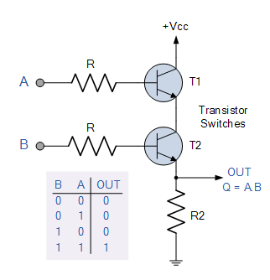
Transistor implementation of basic gates
OR gate
AND gate
When building digital systems, the internal transistor representation of the gates is rarely important.
For digital construction, the logic gate can often be seen as the smallest component (abstraction).

Slide 12
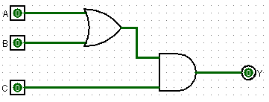
Implementing logic functions
A Boolean expression can be implemented by connecting gates.
Example: The following circuit implements the function Y= (A+B)⋅C
Circuit made with Logisim

Slide 13
Simulation of digital circuits
There are several software systems that can be used to build and simulate circuits.
For building circuits from gates and simulating them, Logisim is recommended Logisim download | SourceForge.net Download and run! Java runtime required.
For simulating circuits based on IC:s (closer to the real world), Tinkercad can be used. www.tinkercad.com Run in browser

Slide 14
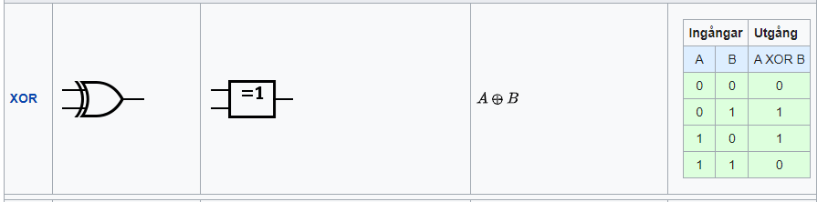
The XOR function
The output of the eXclusive OR function is 0 if the inputs if the inputs are equal, 1 if the inputs are not equal.
The picture below shows the symbols and truth table for the XOR function.

Slide 15
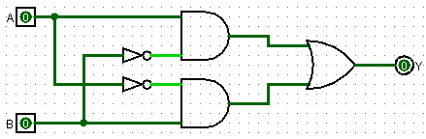
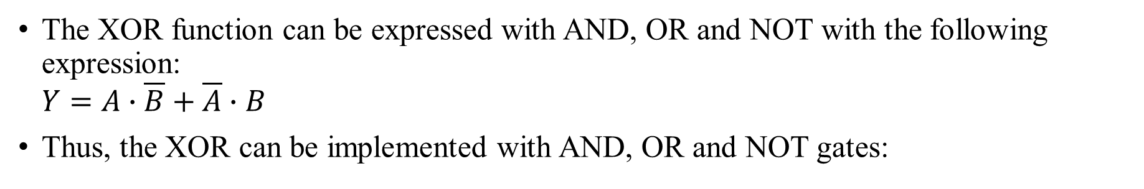
Boolean function for XOR
The XOR function can be expressed with AND, OR and NOT with the following expression: $Y=A∙\overline{B}+\overline{A}∙B$
Thus, the XOR can be implemented with AND, OR and NOT gates:

Slide 16
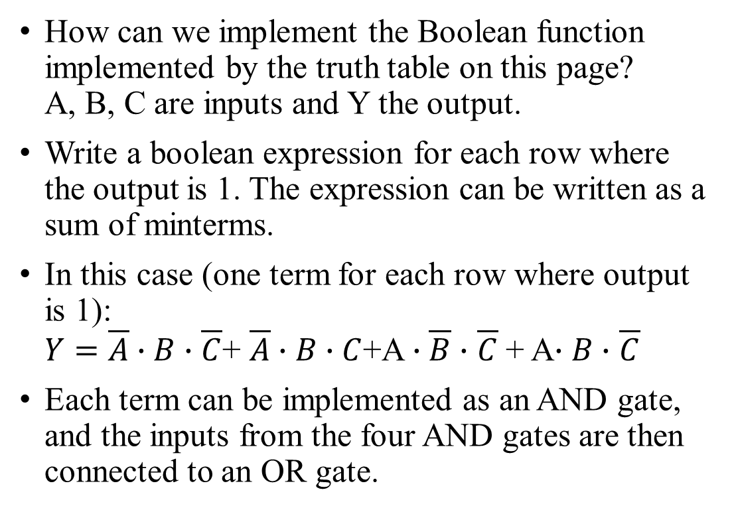
How to implement a Boolean function
How can we implement the Boolean function implemented by the truth table on this page? A, B, C are inputs and Y the output.
Write a boolean expression for each row where the output is 1. The expression can be written as a sum of minterms.
In this case (one term for each row where output is 1): $Y=\overline{A}∙B∙$ $\overline{C}$+ $\overline{A}∙B∙C$+A $∙\overline{B}∙$ $\overline{C}$+ A$∙B∙$ $\overline{C}$
Each term can be implemented as an AND gate, and the inputs from the four AND gates are then connected to an OR gate.
A | B | C | Y
0 | 0 | 0 | 0
0 | 0 | 1 | 0
0 | 1 | 0 | 1
0 | 1 | 1 | 1
1 | 0 | 0 | 1
1 | 0 | 1 | 0
1 | 1 | 0 | 1
1 | 1 | 1 | 0

Slide 17
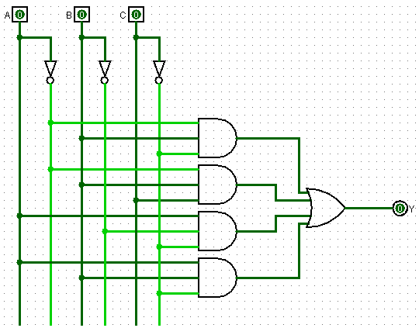
Implementation with logic gates
In this implementation, each term in the Boolean expression is implented in one AND gate.
This is not the simplest form!
How can we find an implementation with the least number of gates to realize the same function?

Slide 18
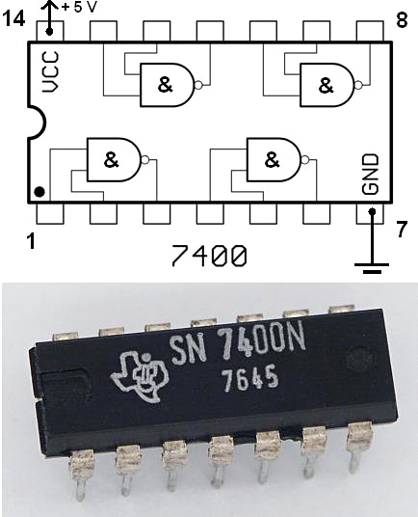
Logic gates as physical components
In the physical world, logic gates are almost always implemented in Integrated Circuits (IC).
Usually, there are 4-6 gates in each IC.
The 7400 series is the most common family of integrated logic circuits.

Slide 19
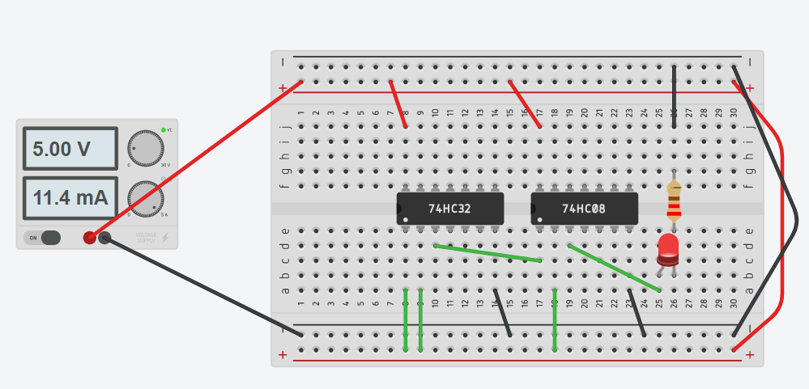
Implementation of a combinational function
The picture below shows the function Y= (A+B)⋅C implemted with two ICs:
7432: Quad OR gates
7408: Quad AND gates

Slide 20
Combinational circuits: Examples
A combinational circuit is a logic circuit where the input is a function of the inputs (and nothing else).
This means that a combinational cirquit does not have a memory (does not store state).
Important combinational circuits are:
Adders (performs addition of binary numbers).
Comparators (checks if two binary numbers are equal).
ALUs (performs logical and arithmetic operations).
Multiplexors (data selectors, selects one of several inputs as output).
Decoders

Slide 21
Recommended reading
Patterson & Hennessy: Appendix A: A.1 – A.5, pages A-1 – A-37

