Slide 1
2DT901: Computer Organization Lecture 5
Digital circuits
Karnaugh maps, adders and sequential circuits

Slide 2
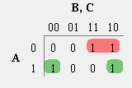
Simplification of digital circuits
From the previous lecture: Write a Boolean expression for the rows where output is 1
Y=A•B•C+A•B•C+A•B•C+A•B•C
A Karnaugh map is a truth table written as the picture below.
To simplify an expression, mark maximal groups of 1 that are powers of 2.
Write an expression for the groups of 1s
Y=A'B+AC'
A​ | B​ | C​ | Y​
0​ | 0​ | 0​ | 0​
0​ | 0​ | 1​ | 0​
0​ | 1​ | 0​ | 1​
0​ | 1​ | 1​ | 1​
1​ | 0​ | 0​ | 1​
1​ | 0​ | 1​ | 0​
1​ | 1​ | 0​ | 1​
1​ | 1​ | 1​ | 0​

Slide 3
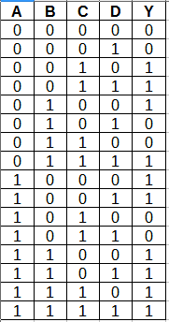
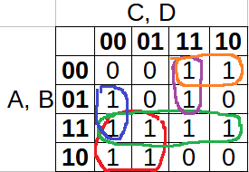
Karnaugh map with four inputs
$$Y=A∙B+A∙\overline{C}+B∙\overline{C}∙\overline{D}+\overline{A}∙C∙D+\overline{A}∙\overline{B}∙C$$

Slide 4
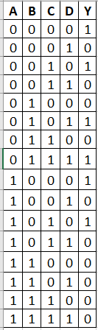
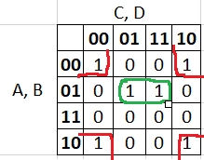

Karnaugh maps: Example 2
$Y=\overline{B}∙\overline{D}+$ $\overline{A}∙B∙D$

Slide 5
Adder (addition circuit)
One of the most important parts of the ALU is the adder.
An adder calculates the sum of two binary numbers.
The first step is to build a 1-bit adder, that can add two one-bit numbers.
The result is one bit.
0+0=0
0+1=1
1+0=1
1+1=10 Here, the result is two bits. The left bit is ”overflow” or carry for next bit.

Slide 6
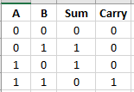
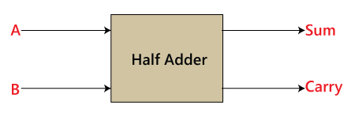
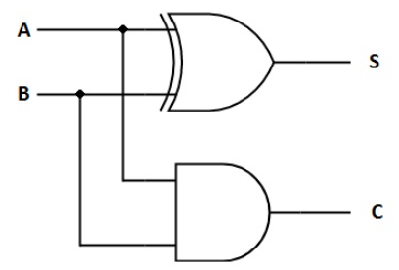

Half adder and full adder
The half adder takes two 1-bit numbers and calculates the sum and carry.
Y=A$⊕$B+A·B

Slide 7
Full adder
To build an adder for more bits, the idea is to connect several 1-bit adders.
To make this work, an adder must be able to take a carry bit from another adder as input.
This type of adder is called a full adder.
The full adder can be connected in series to other full adders to build adders for longer binary numbers, for example, 8-bit adders, 16-bit adders, 32-bit adders, …

Slide 8
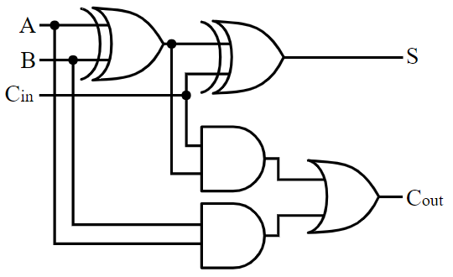
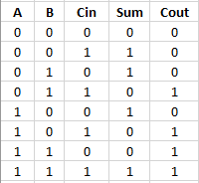
Building a full adder

Slide 9
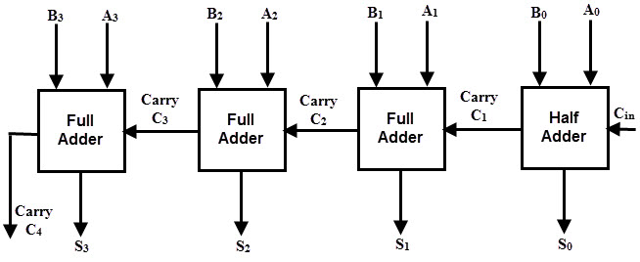
A 4-bit adder
Here, four full adders are connected in series to form a 4-bit adder.
In exactly the same way, a number of Full Adders can be connected to make adders for binary numbers of any length!

Slide 10
Combinational and sequential circuits
There are two different groups of digital circuits:
Combinational circuits, where the output is completely determines by the input.
For example: Adders, comparators
In a combinational circuit, the output from a gate is not connected ”backwards” in a feedback loop.
Sequential circuit, where the output is not only a function of the inputs, but also on what happened previously. This type of circuits is a type of memory that can save a state of the circuit.
Example: Memory circuits, counters, shift registers
A sequential circuit has a feedback loop.

Slide 11
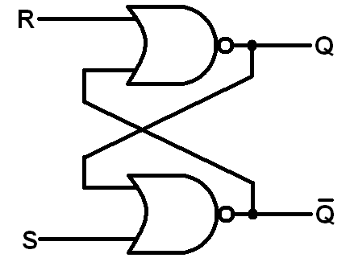
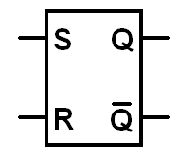
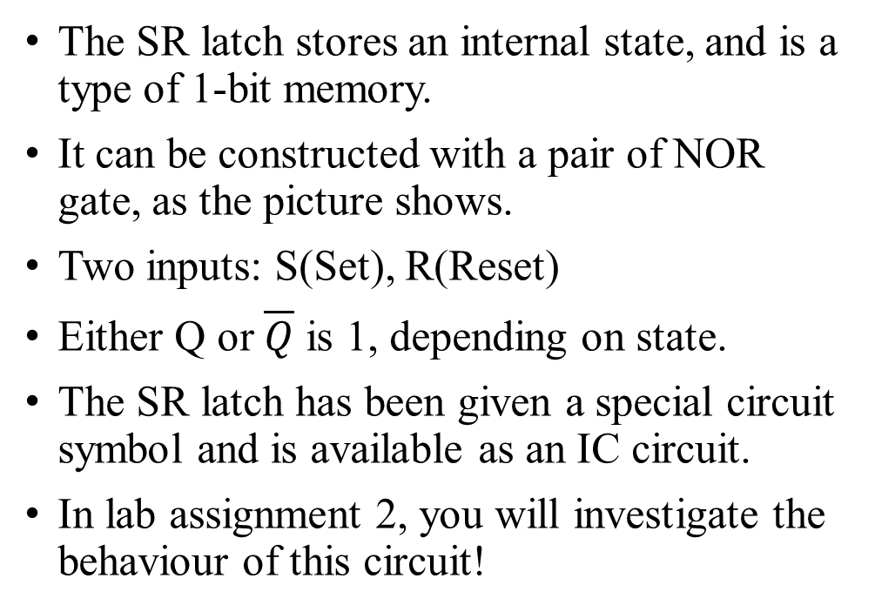
Example: SR latch
The SR latch stores an internal state, and is a type of 1-bit memory.
It can be constructed with a pair of NOR gate, as the picture shows.
Two inputs: S(Set), R(Reset)
Either Q or $\overline{Q}$ is 1, depending on state.
The SR latch has been given a special circuit symbol and is available as an IC circuit.
In lab assignment 2, you will investigate the behaviour of this circuit!

Slide 12
Recommanded reading and videos
Karnaugh maps and simplification of logic expressions: https://www.youtube.com/watch?v=RO5alU6PpSU https://www.youtube.com/watch?v=J71fceNlGAY
Adders: Patterson&Hennessy, Appendix A.5 https://www.youtube.com/watch?v=ecn-8iGDRSo
Secuential circuits and memory elements: Patterson&Hennessy, Appendix A.8 https://www.youtube.com/watch?v=L5V1IxFhq0k

