Slide 1
2DT901: Computer Organization Lecture 6
Introduction to microcontroller Raspberry Pi Pico

Slide 2
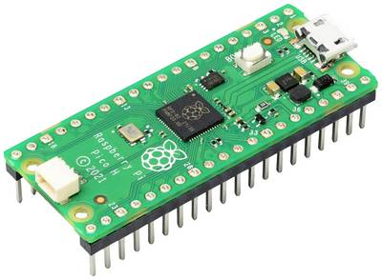
The raspberry pi pico
The Raspberry Pi Pico is a microcontroller based on the RP2040 microprocessor.
264 kB RAM memory.
2 MB of flash storage.
30 GPIO (General Purpose Input/Output) pins.’
Can be programmed in:
Assembly
Rust
MC/C++
icroPython

Slide 3
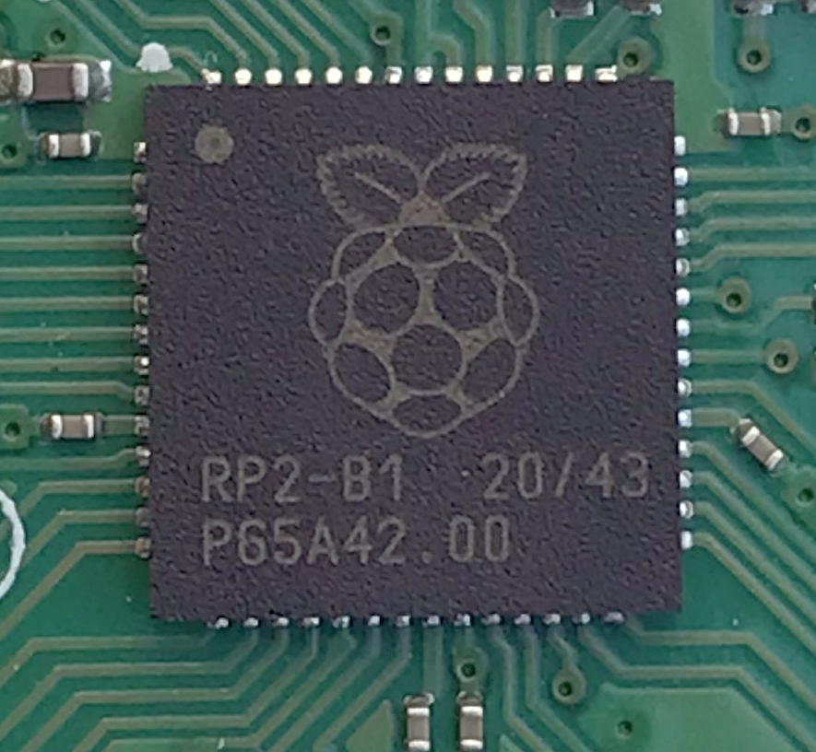
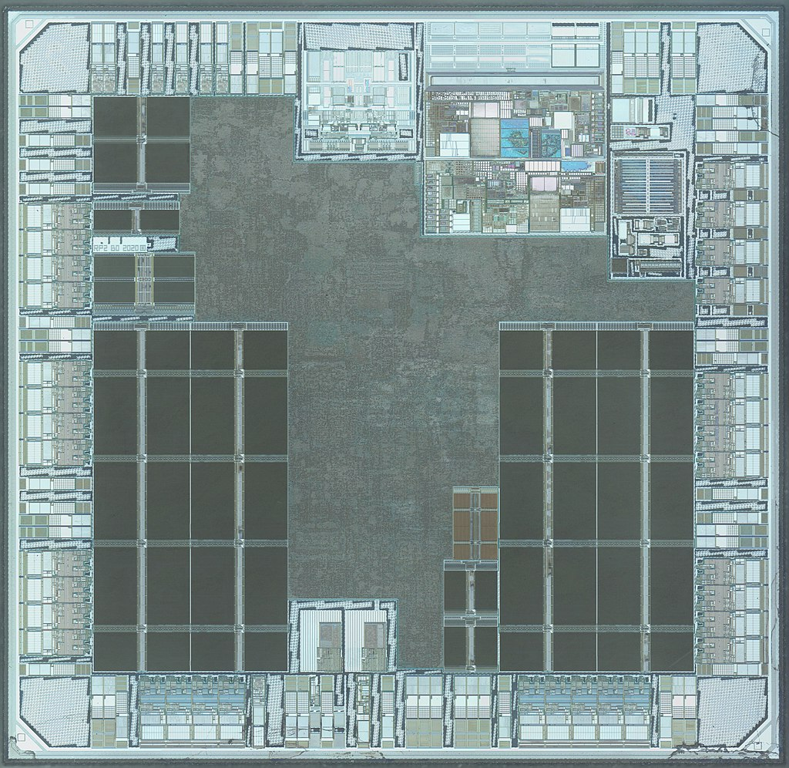
The RP2040 cpu
The chip is an ARM Cortex-M0+ processor.
ARMv6-M architecture (32-bit architecture)
Dual 32-bit cores.
Implements the Thumb instruction set.
Simplified version of ARMv6-M
16-bit instructions

Slide 4
The armv6-m instruction set
The Pico uses a subset of ARMv6 called Thumb instructions or ARMv6-M.
This means a reduced set of instructions and only 16-bit instruction length!
The reason for the 16-bit limit is (of course) to minimize memory requirements.
The architecture has 15 registers, named R0 – R15
In the Thumb mode (16-bit instructions) only registers R0 to R7 can be accessed by most instructions.
The reason is that only 3 bits in the instructions are used for memory!

Slide 5

Example of an ARMv6-m instruction
Let us look at the instruction add r5, r3, r2.
As described in the picture below, the following number of bits are used:
7 bits for the opcode, in this case 0001100
3 bits for Rm => 010 = 2 (register R2)
3 bits for Rn => 011 = 3 (register R3)
3 bits for Rd => 101 = 5 (register R4)
Bit pattern for instruction: 0001100 010 011 101

Slide 6
How to program the pico
It is not possible to connect keyboard and monitor to the Pico.
To program it, a host computer must be used.
The program is compiled on the host computer, then the binary file is copied to the Pico.
The best host computer to use is a Raspberry Pi 3 or better with Rpi OS.
Second best is to install Rpi OS on a PC or in a virtual machine.
There is a script in the book (Smith) to configure everything on Rpi!
It is also possible to install the necessary software in Windows, MacOS or Linux.

Slide 7
How to compile for pico
If Rpi OS is used and the script is run, everything should be ready to go!
The tools cmake and make are used to build the programs from source.
To build an Assembly program in Rpi OS, the following files are needed:
The Assembly file (.S-file), example: Prog1.S
The file pico_sdk_import.cmake. The file is a config file for cmake can be copied from the example programs included with the book (Page xxiii)
A file named CMakeLists.txt, a config file for Make.
See Stephen Smith’s book, pages 39-48

Slide 8
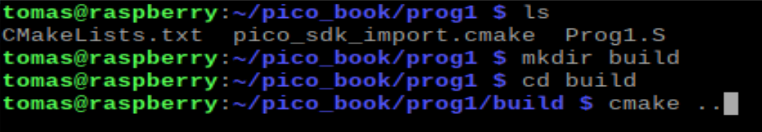
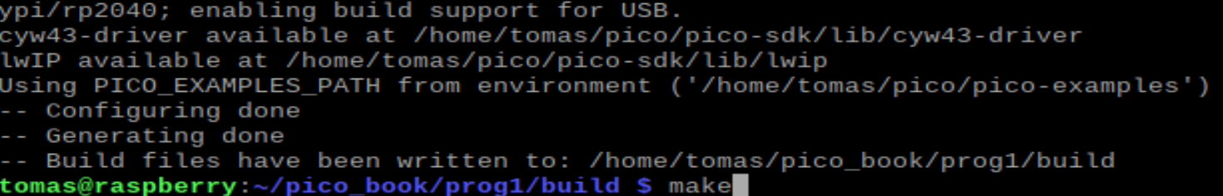
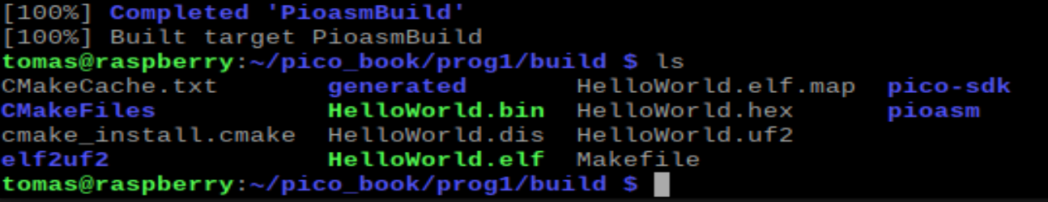
The compile process
The compiled files should be in folder Build, start by creating that folder.
From build folder, run cmake .. To set up everything to run make
From build folder, run make to compile and link to get binary pico file (.uf2)

Slide 9
Running the programs
After running cmake and make, the program is translated to binary format for Pico.
The binary file is an .uf2 file, for example Prog1.uf2
To transfer it to the Pico:
Hold the BOOTSEL button on the pico, while connecting it to the USB.
The Pico should be visible as a usb unit now.
Copy the .uf2 file to the USB drive by dragging it in file explorer or copy commands in the terminal.
Now, the program is executed on the Pico.

Slide 10
Uploading new versions
You only need to run cmake the first time the program is compiled!
To compile new versions, only make has to be run, from within the build folder.
To upload a new program to the Pico, you must disconnect it and reconnect it while holding the BOOTSEL button.
Unfortunately, the Pico does not have a Reset button!

Slide 11
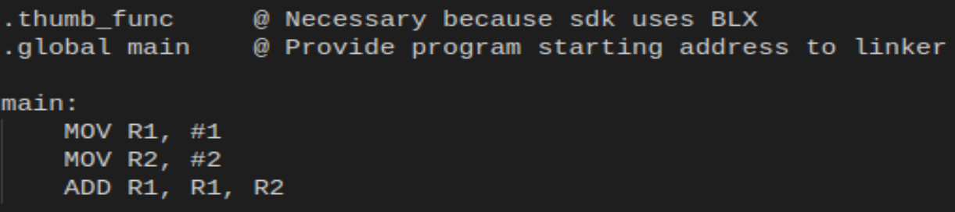
A simple armv6-m program
The program starts executing on line after main:
The first two lines must always be inluded in a program for the Rpi Pico!

Slide 12
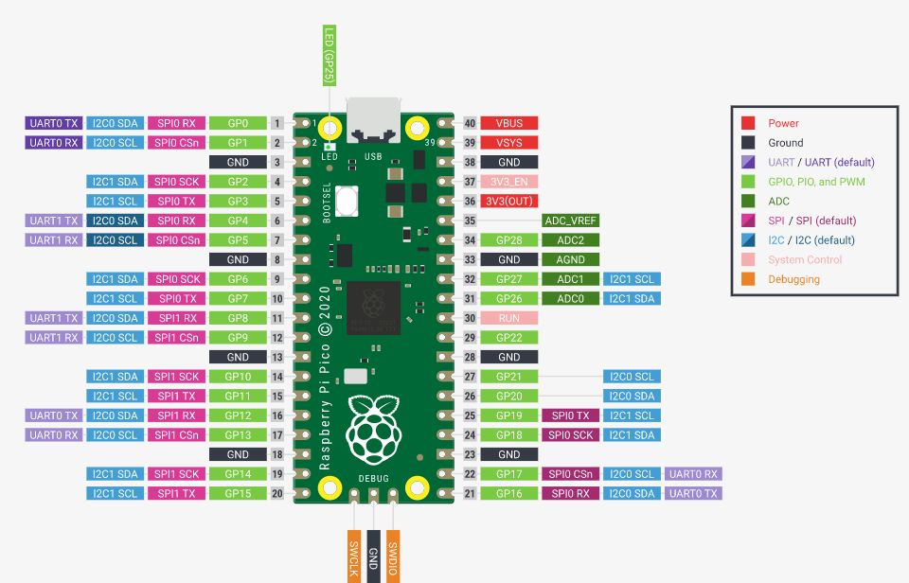
Rpi Pico PINOUT

Slide 13
Connecting LEDs
Important to remember that LEDs must be connected with the correct polarity!
The anode must be connected to positive voltage.
The cathode must be connected to ground (GND).
The Rpi Pico provides 3.3 volts output.
Important to always connect a resistor in series to the LED or the LED will burn out!
For 3.3 volts, a resistor with resistance around 200 Ohms can be used!

Slide 14
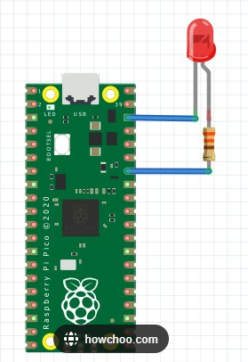
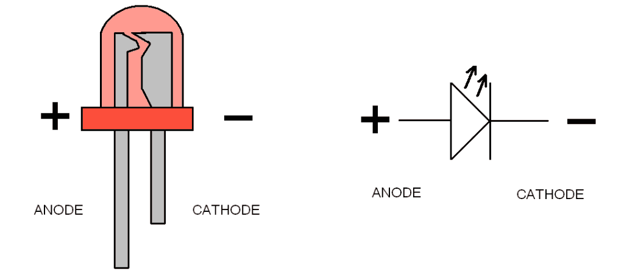
Connecting a LED

Slide 15
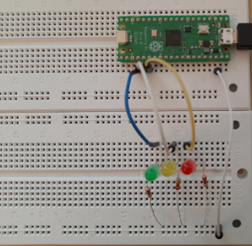
Using a breadboard
Breadboards are used to connect components without soldering.
Important to get comfortable with using them!
In Lab2, you will use a breadboard to connect LEDs and a 7-segment display to the Rpi Pico!

Slide 16
Preparing for lab 3
Install a development environment, there are several options:
Use the .OVA file provided by Paolo to setup a Virtual Box with Rpi OS. This is probably the easiest option!
Install the Raspberry Pi OS in a virtual machine (e.g. Virtual Box)
Install Raspberry Pi OS Desktop on your PC or Mac
Install an environment for Windows or MacOS (not very straightforward, but possible! There are several guides available)
Read first 3 chapters in Smith’s book.
Compile and run the Hello World program (page 24).
Learn how to connnect LEDs and use a breadboard. ALWAYS remember the resistor!

