Slide 1
2DT901: Computer Organization Lecture 7
Subroutines in Assembly language

Slide 2
What is a subroutine?
A subroutine is a small part of the program that is called from other program parts.
High-level languages such as Python and C have functions to divide programs into smaller parts.
If some lines code is repeated in the program, these lines should be moved into a subroutine!
The following examples have been executed and tested in the ARMv7 simulator CPULator, https://cpulator.01xz.net/

Slide 3
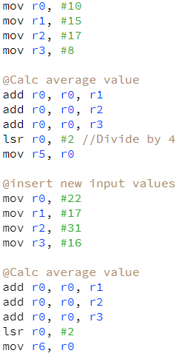
A simple example
The code calculates the average value of the data in registers r0, r1, r2, r3
The result is stored in register r0
Then, new values are inserted and a new average is calculated.
The code for average is repeated twice in the code, and should be moved to a subroutine!

Slide 4
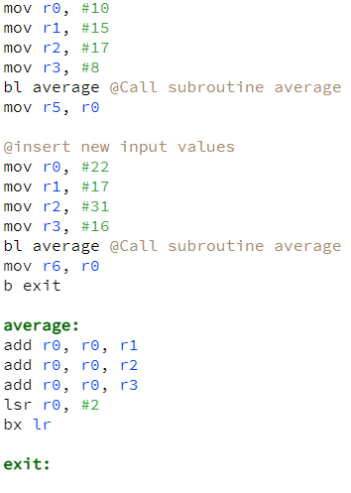
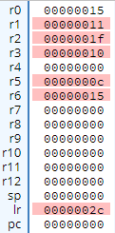
Same example with subroutine
Call subroutine, pc saved in bl
Jump to after function, so average is not executed again
Copy lr back into pc

Slide 5
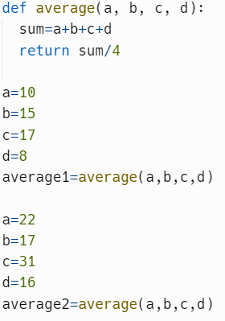
Similar program in python

Slide 6
Nested procedure calls
A very common case is that a procedure is called from another procedure.
This is called nested procedures.
Simple example: Average function of four numbers.
One function sum to add the four numbers.
The function average calls the sum function, then divides the result by 4.
The sum function is called from within the average function.
In machine code, we must save the return address before the second function is called!

Slide 7
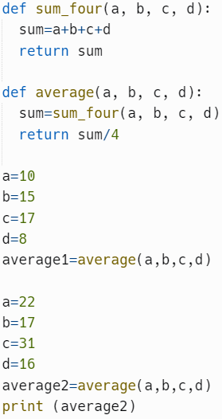
Python example

Slide 8
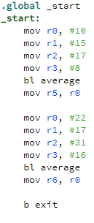
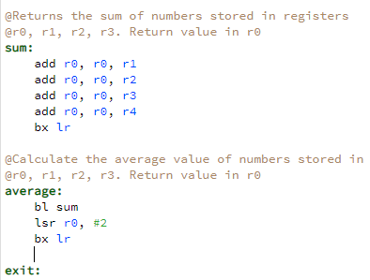
Non-working Assembly example

Slide 9
What went wrong?
The program got stuck in the average: procedure!
The reason is this:
When the average: function is called, the PC is copied to the LR
When the sum function is called, the PC is once again copied to LR
The second time, the original PC value is overwritten.
Because of this, the return location to the main program is lost.
The solution is to save the value of the LR before the nested procedure call.
A structure called a stack is used to save the LR value!

Slide 10
The stack
A stack is a data structure of type LIFO (Last In First Out)
Two operations are available:
Push: Insert data on top of the stack
Pop: Get access to and remove element from top of stack
On subroutine calls, the LR register must be pushed to the stack before a nested subroutine call is made.
After the call, we have to "pop" the LR.
The register SP (Stack Pointer) stores the top of the stack.
On the RP2040 (Pico) we can not pop the LR, so we push the LR and pop the PC. See pages 124-125 in Smith's book.

Slide 11
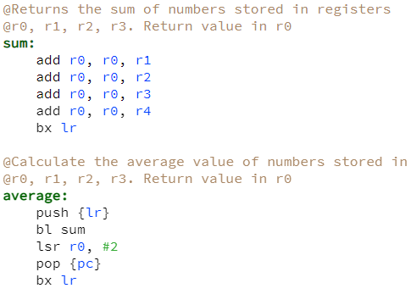
Subroutines with use of stack

Slide 12
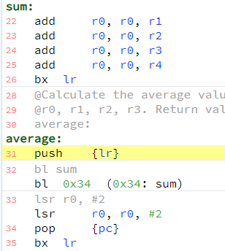
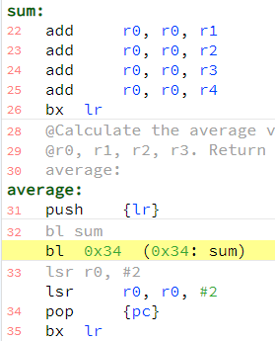


Before and after push

Slide 13
Memory before and after stack operations
Higher addresses
SP = fffffff4
fffffff4
0x14
SP = fffffff0
Lower addresses

Slide 14
Rules for funcion calls
The following rules apply for function calls in ARMV6m
Registers R0-R3 can be used freely as function parameters.
Registers R4-R11 can be used as parameters but the programmer is responsible for saving them by pushing to and popping from the stack!
R0 is used as return parameter
SP is the stack pointer used py the push and pop instructions
LR is the link register. The called procedure must preserve its value!
CPSR (flag registers): No assumptions can be made about flag values! Must be considered unknown for the programmer of a function!

Slide 15
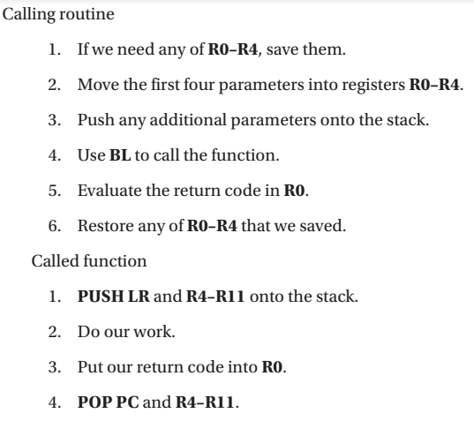
Algorithm for calling functions

Slide 16
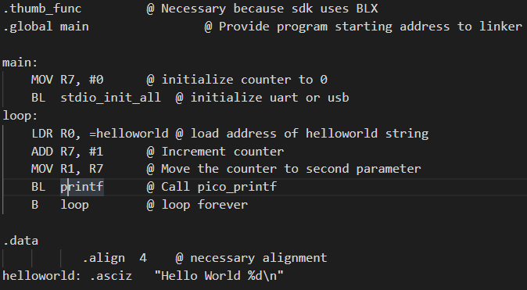
Hello world program revisited
BL printf calls the subroutine printf (built into the Pico SDK)
Registers R0 and R1 are used as parameters to printf.
R0 stores the start of the string, R1 stores the integer.

Slide 17
Programming GPIO pins
The Rpi Pico has 28 GPIO (General Purpose Input/Output) pins.
The pins can be programmed to output a voltage (output), or check the voltage on a pin (input).
To program the pins in pure Assembly, the programmer must read from or write to specific memory addresses.
We will look at this in the next lecture.
It is also possible to use C functions from the Rpi Pico SDK.
A C function can be called from an Assembly program (if the source file is namned .S, not .s)

Slide 18
Two important C functions
To program a pin, the pin must first be initialised at output or input.
The C function static void gpio_set_dir (uint gpio, bool out) can be used for that purpose.
Example in C: gpio_set_dir(25, 1); defines the pin 25 (built-in LED pin) as output.
In ASM, we can call such a function with BL, and the parameters #25 and #1 must be put in resisters R0 and R1, respectively.
Link to SDK documentation: https://www.raspberrypi.com/documentation/pico-sdk/hardware.html#hardware_gpio

Slide 19
Creating a link to the C functions
One complication is that the C functions are declared inline. Because of this, they can not be directly called from the ASM program.
The solution is to make wrapper functions in a C file, and include that file in our project, see Smith’s book, page 152-153. The wrapper functions can be called from the ASM program.
There is also a SDK function to output 3,3V (value 1) or 0V (value 0) to a pin, this function is called gpio_put(…), and is wrapped as link_gpio_put(…)

Slide 20
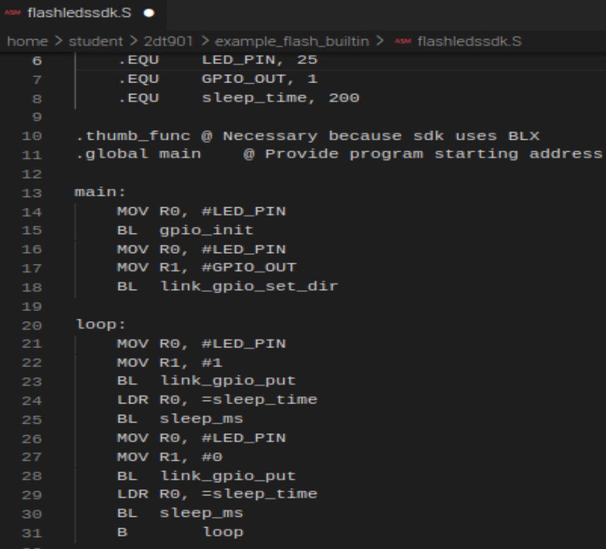
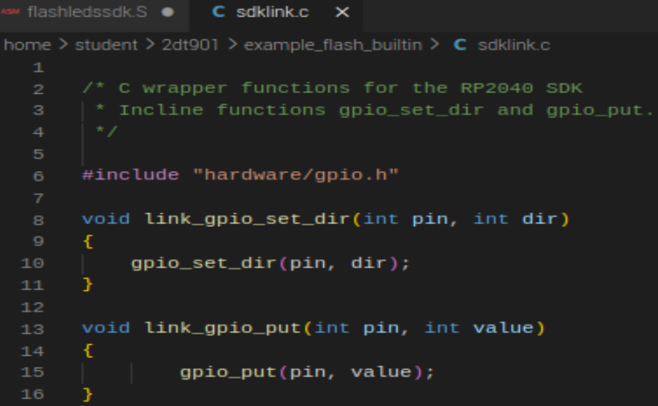
ASM program to flash the built-in LED

Slide 21
Recommended reading
Patterson & Hennessy: Section 2.8 (pages 100 – 109). More general theory with examples from LEGv8 and ARMv8
Smith: Chapter 7 (pages 121 – 138). More practical programming in ARMv6M for the Pico.
Smith: Chapter 8 (pages 147-153). Example to connect LEDs and programming them.
Compile and execute the example code on your Pico and make sure you understand how it works!

