Slide 1
2DT901: Computer Organization Lecture 8
Flag registers, conditional statements and loops

Slide 2
Conditional branches
All computer languages have structures to make decisions.
For example, there is the if... else statements in most high-level languages.
Loops are also an example of a similar structure.
Depending on a condition, some instructions should be repeated or not.
The simplest decision statements in LEGv8 Assembly are called CBZ and CBNZ
Condition Branch if Zero and Condition Branch if Not Zero.
There is also the unconditional branch B that means always branch!

Slide 3
Labels
When a branch instruction is executed, the program jumps to another address in instruction memory.
The assembly language provides labels to use instead of memory addresses!
A label is a name followed by :
Example:
CBZ X1, label1 jumps to the code directly after label1:
See the example on next page!

Slide 4
The program counter
The Program Counter (PC) is a register that holds the memory address for the next instruction to run.
On LEGv8, the address of the next instruction is 4 after the previos one.
Instructions are executed in sequence, if a jump does not occur.
A jump moves the PC to another location in the program (another memory address than the previous+4)
Often, we want a program to jump to different places depending on a condition.

Slide 5
Example: CBZ and CBNZ
MOVZ x1, #0
CBNZ x1, label1 //Jump to label1 of x1 not 0
CBZ x1, label2 //Jump to label2 if x1=0
label1:
MOVZ x2, #11
MOVZ x3, #11
B Exit
label2:
MOVZ x2, #22
MOVZ x3, #22
B Exit
Exit:
MOVZ x4, #555

Slide 6
Loops
The branch statements can also be used to create loops.
A loop repeats a number of statements until a condition is met.
For example: The loop initiates a counter, that starts on 10, then repeats some statements, decrements the counter and stops when the counter reaches 0.
A register is used to store the value of the counter.

Slide 7
Example: Simple loop
MOVZ x1, #10 //Initialize counter to value 10
loop:
SUBI x1, x1, #1 //Subtract 1 from x1
CBNZ x1, loop //jump to loop: if x1 not zero

Slide 8
flags
Sometimes, we want to check other conditions than zero or not zero.
For example, we may want to check if a number is greater than another number.
To help with this, the LEGv8 have four flag registers.
A flag is a register with only one bit, can be 1 or 0.
The flags in LEGv8 are: N: 1 if Negative, 0 if positive Z: 1 if Zero, 0 if not Zero V: 1 if oVerflow, 0 if not oVerflow C: 1 if Carry, 0 if not Carry

Slide 9
Instructions for setting flags
Some instructions does a calculation and also sets the flags according to the result.
The instructions ending with 's' set flags.
Instruction SUB does subtraction but does not set flags.
Instruction SUBS does subtraction and also sets flags.
Many instructions have one versions that sets flags and one that does not.

Slide 10
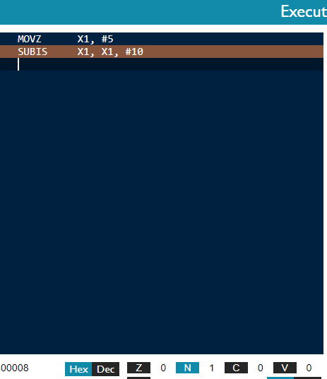
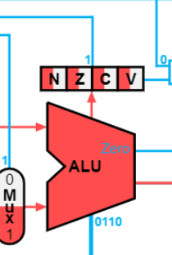
Example: Instructions with S set flags
The Negative flag (N) is set, because the result of the SUBIS instruction is negative

Slide 11
Branch instructions
When a flag is set, a branch instruction can do a jump if a flag is set.
Examples:
SUBS X3, X1, X2
B.LT label //Jump to label if X1<X2
B.LT label //Jump to label if X1>X2
B.EQ label //Jump to label if X1=X2

Slide 12
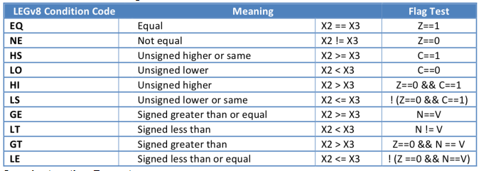
More conditional codes

Slide 13
Example in LEGv8 ASM
MOVZ x1, #99
MOVZ x2, #378
SUBS x3, x1, x2
B.LT label1 //Jump to label1 if x1<x2
B.GT label2 //Jump to label2 if x1>x2
label1:
MOVZ x10, #100
B exit
label2:
MOVZ x10, #200
exit:
MOVZ x11, #555

Slide 14
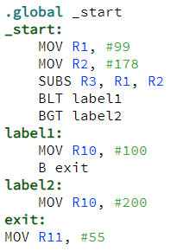
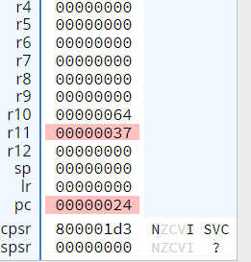
Similar example in ARMv7 Assembler
This program is run in the CPUlator ARMv7 emulator
We see that the negative (N) flag is set.

Slide 15
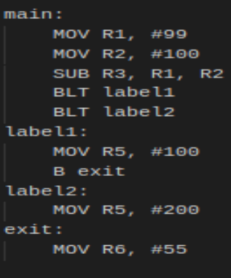
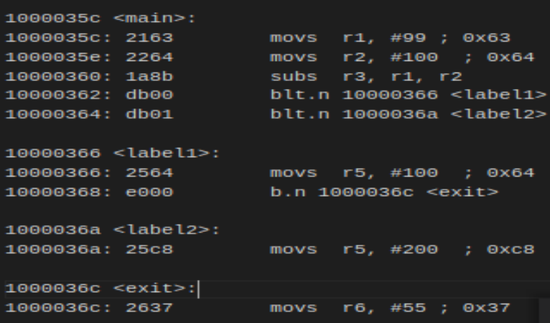
Similar program for Pico (ARMv6M)
The disassembly program
The SUBS instruction is not implemented because of limited instruction size, but in this case, ALL instructions like ADD, ADDI, SUBI, SUB, …. are instructions that set the flags, as we can see in the Disassembly file in the example!

Slide 16
Recommended reading
Read Section 2.7 (page 93 Patterson & Hennessy)
Work with Exercise 2.25 + 2.25.1--2.25.7 (page 180)
Read pages 79-96 in Smith
Work with exercises 5-1 to 5-3, page 97

