Slide 1
2DT901: Computer Organization Lecture 9
Memory operations
Direct hardware access

Slide 2
The memory of the pico
The pico uses a von Neumann architecture (shared memory for instructions and data).
Memory addresses and register sizes are 32 bits.
Instruction size is 16 bits.
The immediate operands of a mov instruction is only 8 bits.
How do we insert a 32-bit memory address into a register with this limitation?

Slide 3
Inserting a 32-bit address
To insert 32-bit memory address using 8-bit immediate operands, 2 hex numbers/operation must be inserted , then shifted to the left.
Example: Inserting the address 0xd0000014 into register R2: MOV R2, #0xd0 LSL R2, R2, #24 @ becomes 0xd0000000 ADD R2, #0x14
In this case, we have a lot of zeros in the middle of the number.
Exercise: How can we insert the address 0xfffff1d0 into a register?

Slide 4
Loading and storing data
The following instructions can be used to read and store data:
STR R1, [R2] @Stores the number in register R1 in memory on address R2
LDR R1, [R2] @Load the number on memory address R2 into register R1
These instructions are essentially the same as LEGv8's STUR and LDUR.
Example: MOV R2, #0xd0 LSL R2, R2, #24 @ becomes 0xd0000000 ADD R2, #0x14 MOV R1, #89 STR R1, [R2] MOV R2, #55 STR R2, [R2, #4]

Slide 5
Data section
A data section can be defined inside the Assembly source file.
The data section can contain, for example, ASCII strings, arrays or blocks of allocated memory, read more in Smith, pages 100-104 .
Example from the Hello World-example: .data .align 4 @ necessary alignment helloworld: .asciz "Hello World %d\n"
.asciz means an ASCII string with a zero termination character (new line)

Slide 6
PC relative addressing
If data is in the data section, it can be easily accessed by memory addresses relative to the PC.
The assembler will give very useful help with this!
Example: ldr r0, =helloworld
Loads the memory address of the first character in the string
The assembler then translated the instruction to something like: LDR R0, [PC, #32]

Slide 7
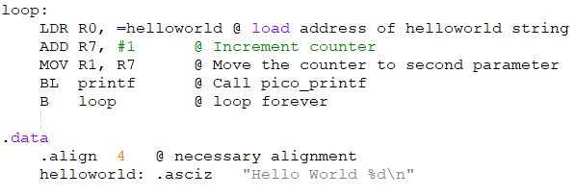
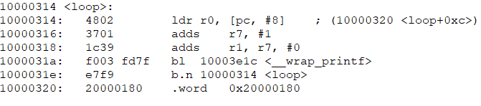
Assembly and disassembly

Slide 8
Arrays in the .data section
An array is easy to define in the .data section: .data .align 4 my_array: .word 243, 544, 89, 3498
Use the LDR instruction to get the address of the first element of the array: LDR R0, =my_array
We can then get the elements in the array by using the LDR instruction, for example: LDR R1, [R0, #(3*2)] %Get the third element (index 2)

Slide 9
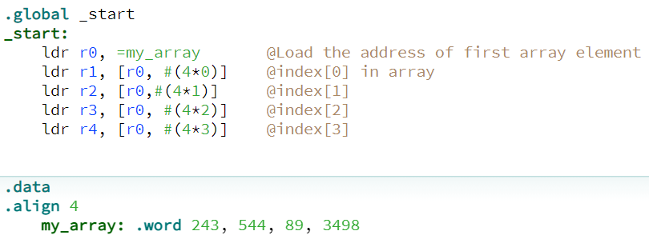
Example: Loading from array
This example is from the CPULator ARM v7 emulation, but also works on the Pico!

Slide 10
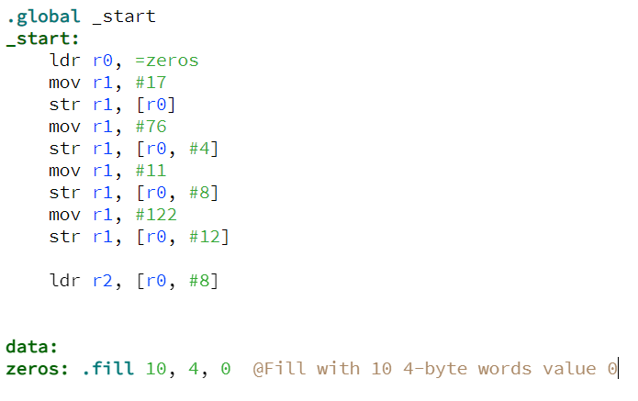
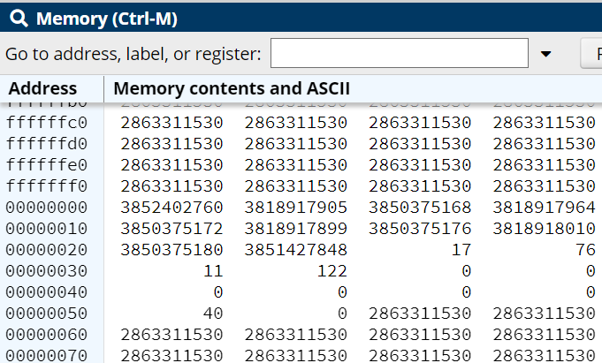
Define blocks of memory

Slide 11
Addresses of hardware components
In a microcomputer, every piece of hardware has its own memory address.
For example, the GPIO pins has one base address, the hardware registers one base address and so on.
To control a piece of hardware, binary numbers can be inserted directly into the memory address connected to the hardware.
First exemple: Control of LEDs on the DE1-SOC, which is an educational microcomputer.
We don’t have the hardware, to we will emulate it in CPULator.

Slide 12
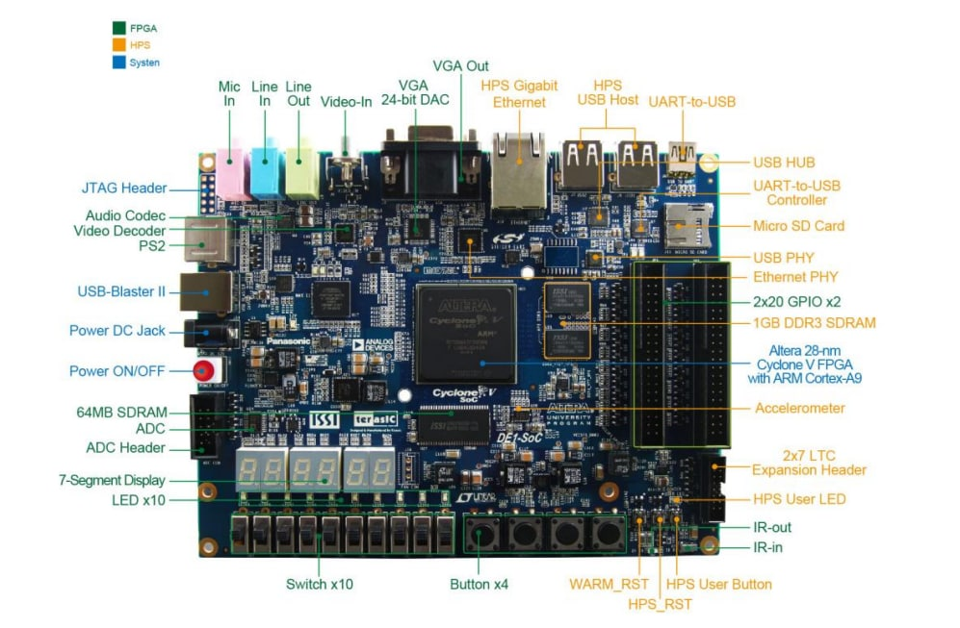
The DE1-SOC hardware

Slide 13
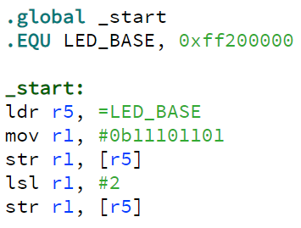
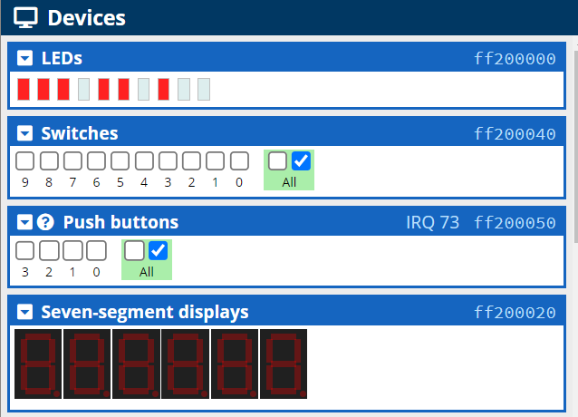
DE1-SOC program to control LEDs
Exercise: Write a simple program to show a number on a seven-segment display

Slide 14
Different ways of accessing hardware
In lab assigments 2 and 3 you controlled the LEDs and buttons by accessing C functions.
This saves some code, because we can use functions in the SDK.
However, the programmer does not have full control of the hardware, since the code is not 100% Assembler.
If we don't want to call C functions, it is also possible to access the hardware directly.
Such hardware access is made by loading to and storing from specific memory addresses.

Slide 15
Memory addresses on Pico
Every piece of hardware on a microcomputer must have a memory address.
For exemple, in the memory of the Pico there is one address to access the SIO registers used for the GPIO pins start at memory address 0xd0000000
See page 162 in Stephen Smith's book!
From an Assembly program, we can write to these addresses to affect the hardware or read from the addresses to get data from the hardware.
The reads and writes are made from the ordniary LDR and STR instructions.

Slide 16
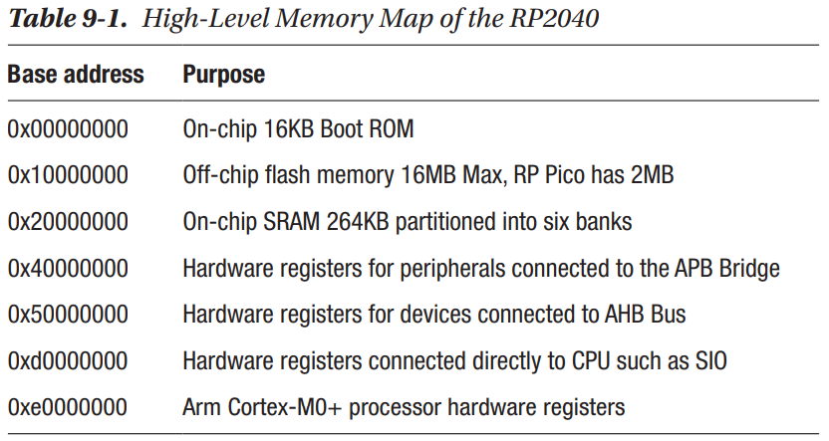
Memory map of RPI Pico

Slide 17
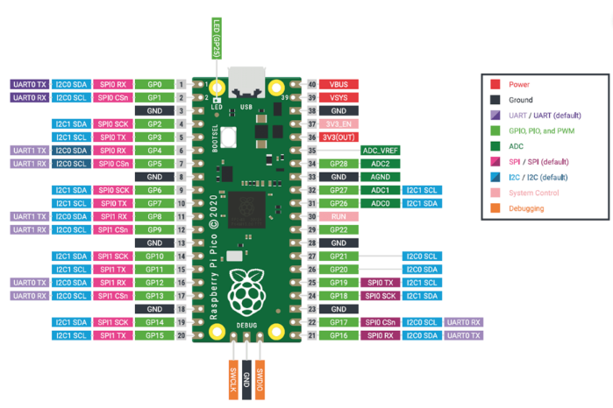
Pins have different functions
As we can see on the pinout diagram, many of the pins have different functions.
The pins can have up to 9 different functions!
For example, pin 1 can be used as GP, UART, I2C and SPI pin.
The programmer has to initialize the pin to one of the functions before it can be used.
See Smith's book, pages 164-165

Slide 18
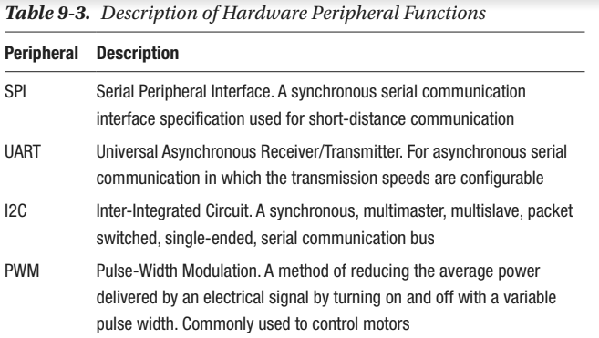
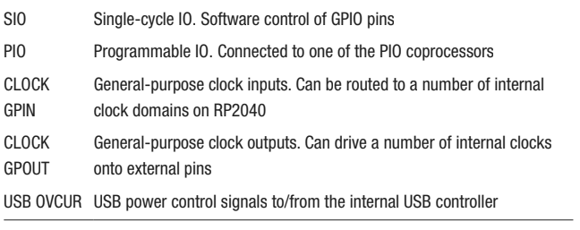
Functions of the pins

Slide 19
Memory address for SIO registers
To flash a LED, the SIO function can be used.
First, we need the base address for the SIO.
That address is 0xd0000000.
One way to enter this memory address is: MOV R1, #0xd LSL R1, #28
Explicit memory addresses in the code is not good practice, a better way is to define a constant.

Slide 20
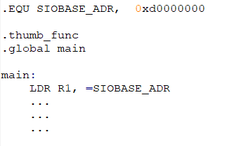
Using labels for addresses
The label is used to give the memory address a name.
This makes the code much easier to understand!

Slide 21
Using c header files
Most of the memory addresses and offsets needed to program hardware are already defined in C header files (.h files).
If the Assembler source files uses the extension .S (not .s) these files can be used.
The files do not contain any C code, only #defines (constants).
To use a constant, the file where it is defined must be included.
The preprocessor command #include"filename.h" is used to include the file.

Slide 22
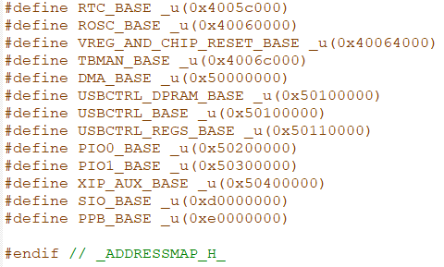
Some contents of a .h file
For example, we can find the SIO_BASE defined within this file!

Slide 23
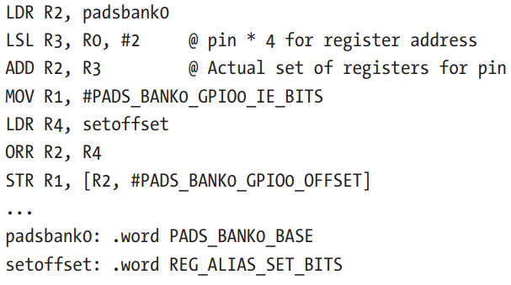
Programming the pads
The RPI Pico uses pads to provide electrical isolation when communicating with external devices through the pins.
See Smith's book, page 169
The pads must be turned on before the pins can be used.

Slide 24
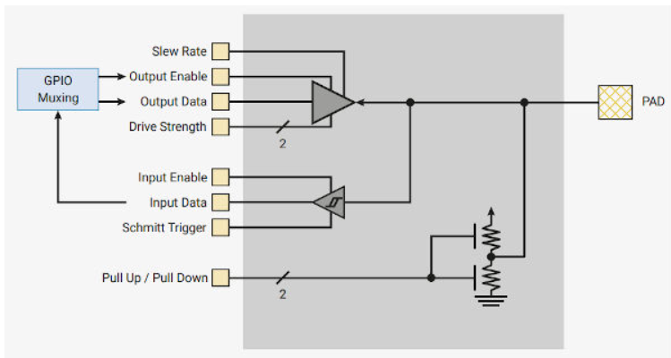
The ”pads” of the Pico

Slide 25
Initializing SIO
The SIO (Single-cycle Input/Output) must be initialized before the pins can be used.
The pins can be accessed through a 32-bit register.
Access a pin by placing a 1 in this register and shift it left by the pin number (Smith, page 169)
To initialize the SIO pin 1 (Smith, page 170):
Write one to the pin’s position in the output enable set register to configure it for output. 2.
Write the same value to the output clear register to turn the pin off.

Slide 26
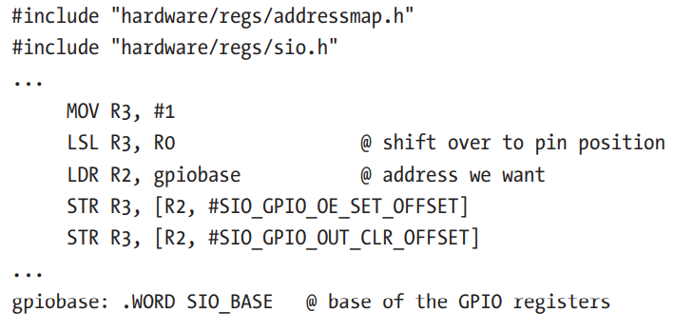
Configuring SIO

Slide 27
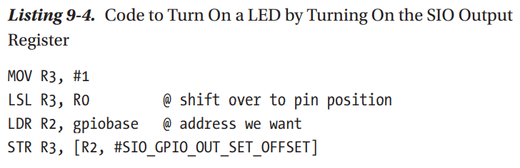
How to turn a pin on/off

Slide 28
Example program to flash LEDs
In Smith's book, a complete program to flash three LEDs is presented on pages 171-174.
Of course, the source code is available in the Github repo for the book!
Link: https://github.com/Apress/RP2040-Assembly-Language-Programming/tree/main/Chapter%209
The program controls the output pins without using C functions.
However, C function sleep_ms is still used to make a pause.
Download and test the program!

Slide 29
Recommended reading
Chapter 6 (Pages 99 – 120) in Stephen Smith's book
Chapter 9 (pages 161-175) in Stephen Smith's book.
Experiment with the code, and try to make the LEDs flash in different patterns!

