Slide 1
Accessibility Team 10
Annie, Cyrus, and Steven

Slide 2
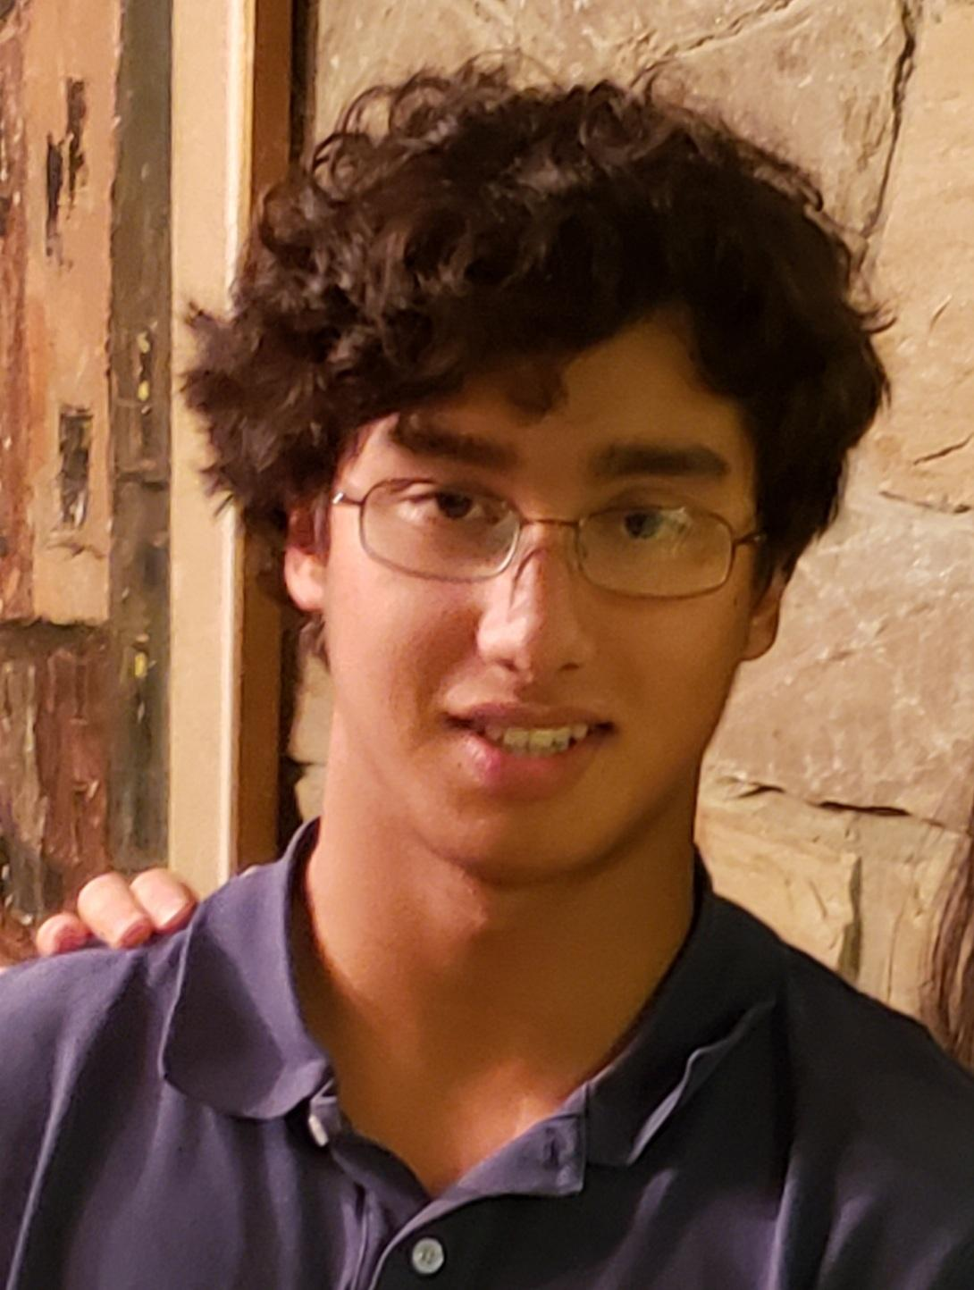
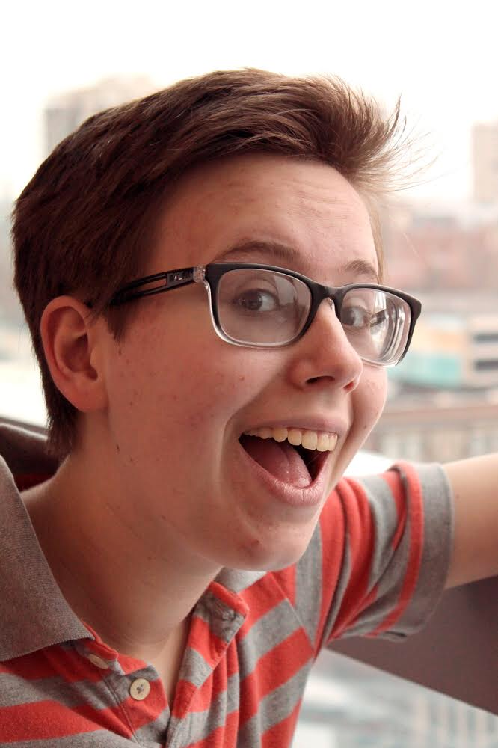
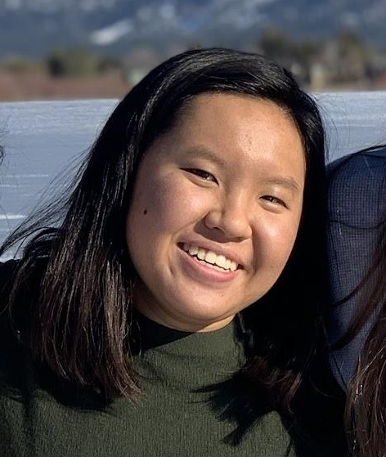
Our Team
Annie Nguyen
Steven Opferman
Cyrus D’Arcy
2024, Symbolic Systems
2023, Electrical Engineering
202?, Computer Science

Slide 3
Problem Domain: Old Folks
55 or older & self-identified
Notes:
Our problem domain concerns old folks, which we define as those 55 or older, and who self identify as older

Slide 4
Participant Selection
Eva | Lives at the home Steven worked at
Shari | Responded to our Reddit post
Susan | [redacted for anonymity]
Notes:
Shari: google forms interest form, posted on reddit
Susan: different method, excluded here for privacy

Slide 5
Eva
Who | 98, retired school secretary
Why | Old but very able; lives in a care home
How | “Would do anything for [Steven]”
Where | Indianapolis, IN (phone)
Extreme user!
Notes:
Indianapolis, Indiana

Slide 6
Shari
Who | 57, degree in psychology, product reviewer, writer/blogger, at home with husband
Why | Younger in the age group
How | Saw our post on Reddit
Where | Yreka, CA (Zoom)

Slide 7
Susan
Who | 78, retired medical insurance agent
Why | Volunteers extensively in care homes
How | [redacted for anonymity]
Where | Queens, NY (Zoom)
Notes:
Old person who works with old people, interesting perspective
None compensated, just volunteers (which we appreciate)

Slide 8
We asked about…
COMMUNITY
COMMUNICATION
EXPERIENCES
Are you currently part of any communities?
How do you communicate with friends and family?
What experiences have defined your life?

Slide 9
Shari:
“I met my now-husband through long distance. We were pen pals and mailed tapes to each other.”
“I play Diablo III while chatting with a close friend of mine. It’s fun, has made inside jokes, and helps us feel a little more like kids hanging out.”
Notes:
Surprising points that came up!
Very open to modern, technological communications (video games!)
Her previous experiences in long-distance communications have helped her continue connecting

Slide 10
Susan:
“After he died, I was sad. But I was happy that we were able to connect.”
“Can you imagine, I wanted to do something good but what if I gave her the virus? I would have felt guilty.”
Notes:
Experiences with particular people — a dying person connected to family
Went to visit a mother whose daughter had died, then found out she had been exposed, was very nervous — extremely emotionally engaged

Slide 11
Eva:
“It makes you think, ‘I could be in that situation one of these days.’”
“I had to push myself in just to make conversation. I still feel like I don’t know some of [the other residents].”
Notes:
Difficult to engage with fellow residents in the old folks home
She’s very able, but one of the most — thinks a lot about mortality, aging, loss of ability that is inevitable
Hard to connect with the other residents, has to push herself to make conversation

Slide 12
Empathy Map Analysis: Eva

Slide 13
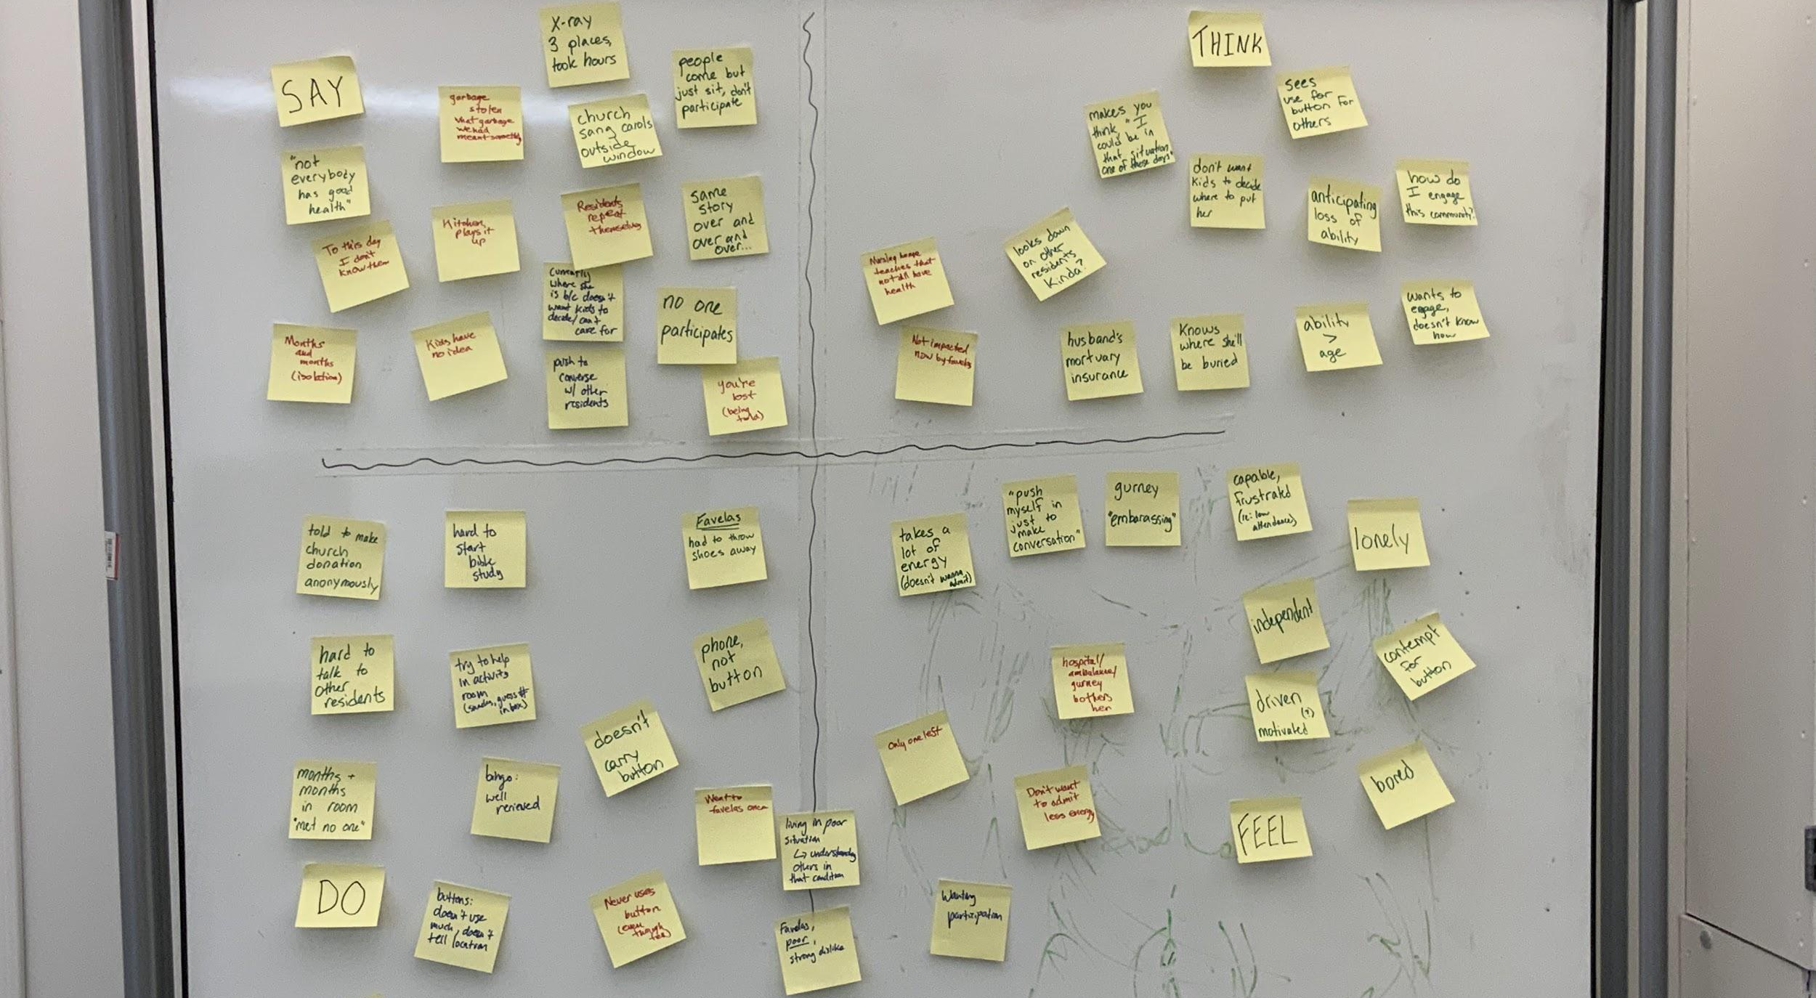
Notes:
Here’s our empathy map
But we boiled it down lol

Slide 14
Say + Do
“Not everybody has good health”
“I’m not lost”
“What little garbage we had meant something”
Spent many months in her room, met no one
Wants to/attempts to talk to residents
“People don’t participate”
“The same story over and over…”
“To this day, I don’t know them”
Doesn’t use the button, carries her phone
Tries to make activities for community
Notes:
Overall takeaways very negative
Continues to make attempts, which is surprising bc she’s failed over and over

Slide 15
Think + Feel
Ability > Age
“How do I engage this community?”
Knows where she will be buried
Embarrassed to ask for ambulance
Anticipating loss of ability
Bored
Lonely
Frustrated that others don’t participate
Notes:
Lots of tension points…
Continues to try to engage the community despite frustration
Feels very lonely but is so determined

Slide 16
Insights → Needs
Old folks value both surface level and deeper relationships.
Need multiple avenues to create and maintain relationships.
Old folks cover a wide range of ability levels.
Need opportunities for engagement that consider high-ability and low-ability (mobility, mental, tech)
Community engagement becomes more difficult as one ages
Need a way to keep aging members engaged, have them open up to each other

Slide 17
Questions + Future Considerations
AGE VS. ABILITY
FRIEND DURATION
DEPTH?
LOW-ABILITY??
WHY is bingo such a hit??
What is the relationship between the two? Is there a trend? Exceptions?
Folks age, lose long-held friends. Replaced with newer friendships?
What is the right balance surface-level and deep relationships? How does it change as you age?
What are the experiences of people with low-ability?
Will we be able to interview this group?

Slide 18
Summary
EMOTIONAL INVESTMENT
AGENCY

