Slide 1
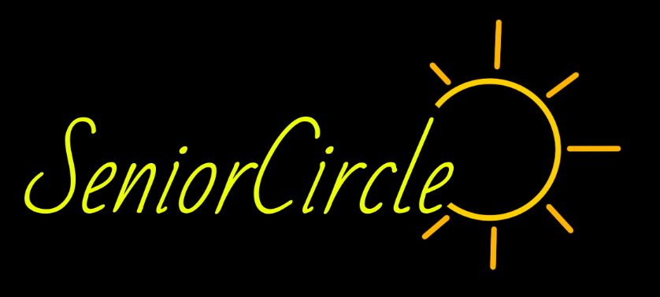
Annie N.
Cyrus D.
Steven O.

Slide 2
Value Proposition, Problem and Solution
Value Proposition
Problem:
Seniors who live in care homes often struggle to find community. Their diverse abilities and inconsistent energy levels make it difficult to connect equivalently, as they could in their younger years.
Solution:
SeniorCircle is an app that groups care home residents of complementary ability and energy levels and assigns them a task that serves an overall community goal.
Brighten your community — together!

Slide 3
Values Encoded
Values
Design
Conflicts
Community
Agency
Teamwork
Team profiles
Completion page shows overall goal
Community Garden
Social media is only fun if everyone uses it
Auto-generated posts
Notes:
Our overall goal is to strengthen community of residents in care homes. We have people working together on the same community goal. Our app will also give agency to residents because they will see how their work benefits others. The Community Garden feature will show each community goal and within the plot highlight each person’s tasks that they contributed. Seeing their work will make them feel like they made a difference.
The team profiles page will show the pictures of the other residents that the person is working with so they can recognize each other better. After the user finishes the task, the app reminds them why they did the task and how it will help the community. This reinforces that they did something together to help others.
A problem we considered was that only power users will use the social media posting feature which isolates them from the average users. This could conflict with the value of community and we would be back where we started. We solved this by making auto-generated posts so average users can be on the Community Garden.

Slide 4
Simple Task
Identify Your Task
Go to the page that has your task and team

Slide 5
Moderate Task
Ask for Help
Call a staff member for assistance

Slide 6
Complex Task: View and post on Community Garden
After:
View and post on Community Garden
Post what each user did
View and edit auto-generated posts
Before:
Choose to do another task
Notes:
We revised our complex task because it was redundant to our simple task and had similar UI of answering questions and being assigned a task. The Community Garden more clearly aligns with our goals of allowing the users to see the results of their work and a visible representation of the community.

Slide 7
Usability Goals & Key Measurements
Robustness
Did the user get lost?
Efficiency
How many button taps did it take for the user to complete the task?
Linear style
Minimal options
Call screen
Clarifying text
Notes:
We kept the linear style so users could have an accurate conceptual model of the app and the direction they were going in. We also presented few options for the users so that they could would not get confused or lost. A point of confusion in the Lo-fi prototype was that the call screen did not do anything. We elaborated that to show the app was calling a staff member and the user could go to the previous page. In general, we reinforced robustness by making sure text for page headers/directions was more clear and offered information directly.

Slide 8
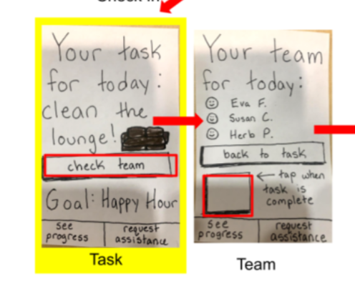
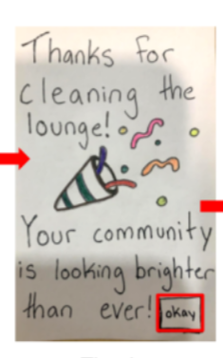
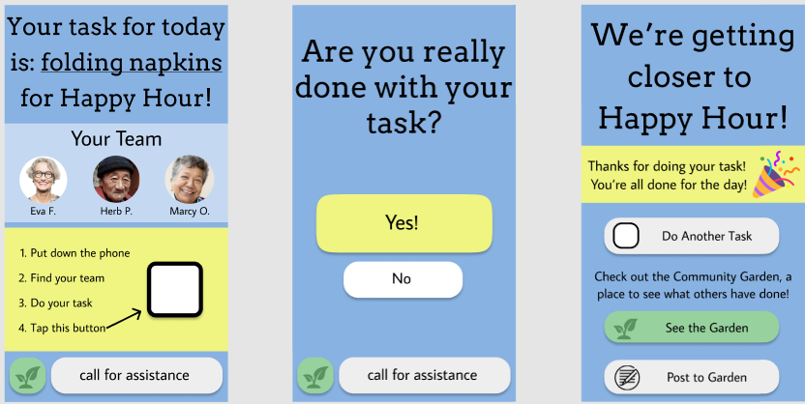
Major Design Change #1

Slide 9
Major Design Change #1
Before:
2 screens
Confusing navigation between task assignment, team, and task completion
Profiles look like buttons
After:
1 screen
Instructions for real world
Task completion procedure
Notes:
We simplified the way users find their team and do their task. Before we had three separate screens for getting the task, finding the team, and finishing the task. We decluttered that part by putting the task and team on one page. We also added a procedure when the user completes their task so that they can feel accomplishment and proceed in the app at the correct time (when they finished the task).
We also added instructions for what to do when given the task so the user can make the transition from virtual to real life.

Slide 10
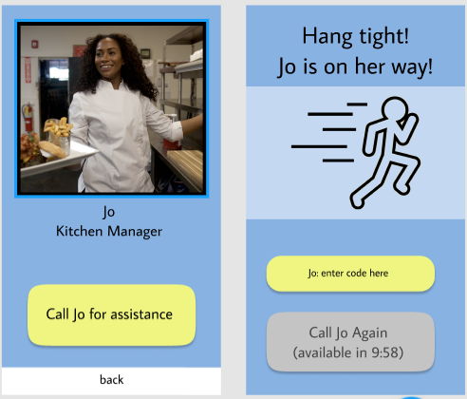
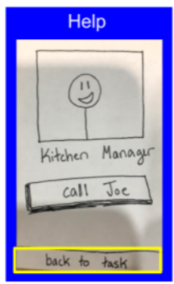
Major Design Change #2

Slide 11
Major Design Change #2
Before:
Unactionable button
Confusing navigation
After:
Actionable button
Confirmation of action
Staff Check In
Notes:
We vitalized the call for help screen by adding an additional screen to show that the user actually called for help and a staff member in coming to them. The previous back button also went to the task page where the user would have to redo the process of identifying a task to get to complete the task. Now the back button goes to the main task page and complete the task. The staff member can type a code on the screen to show that they arrived.

Slide 12
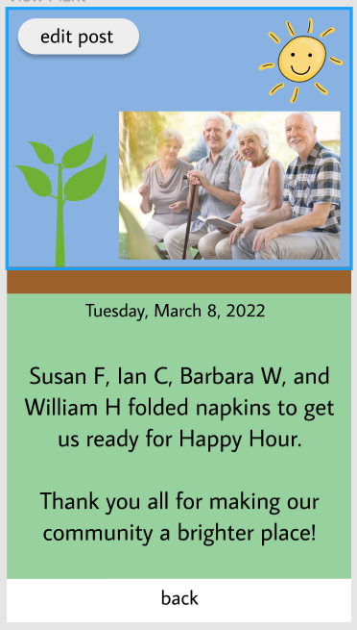
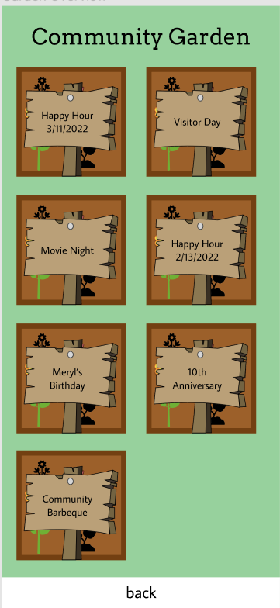
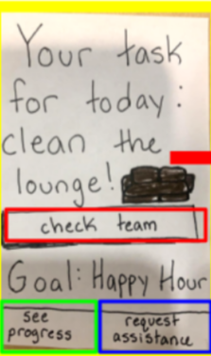
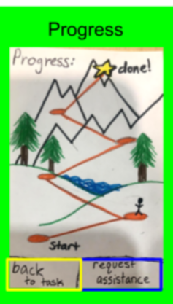
Major Design Change #3

Slide 13
Major Design Change #3
Before:
Progress screen did not progress
Confusing navigation
Individual over community emphasis
After:
Community progress and involvement
User action
Visible history
Notes:
We changed the progress page into our new complex task of posting to the Community Garden. Our testers wanted to progress screen to actually show their progress and that they accomplished something. It also was focused on the individual ascending the mountain instead strengthening the community. It also was not integrated into the UI flow well with the tasks. The CG congratulates each person and group for doing the task and organizes it to show how they all benefited the community event. The user can edit and post to the CG. They can also see past events to remind them of how they felt when the community united previously.

Slide 14
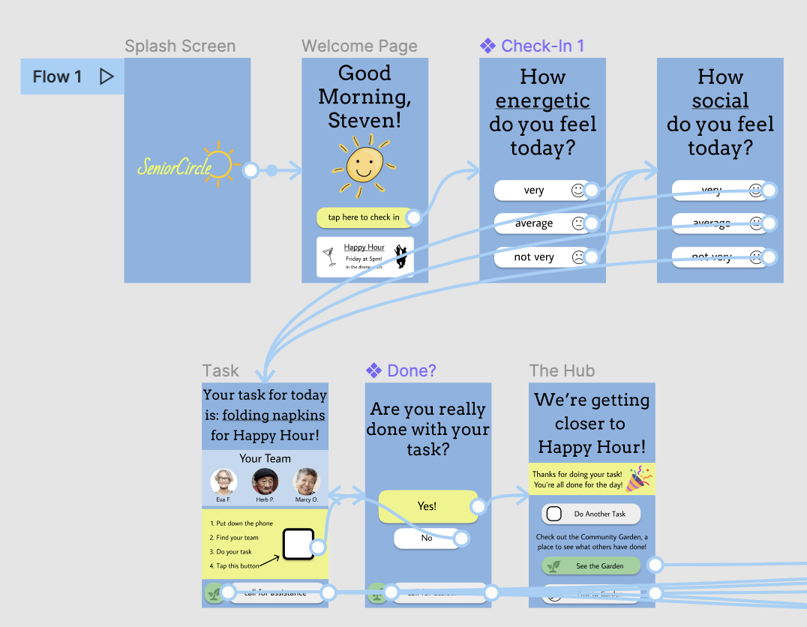
Simple Task Flow
User taps through check in questions to reach task of the day
User checks off task when completed, following instructions

Slide 15
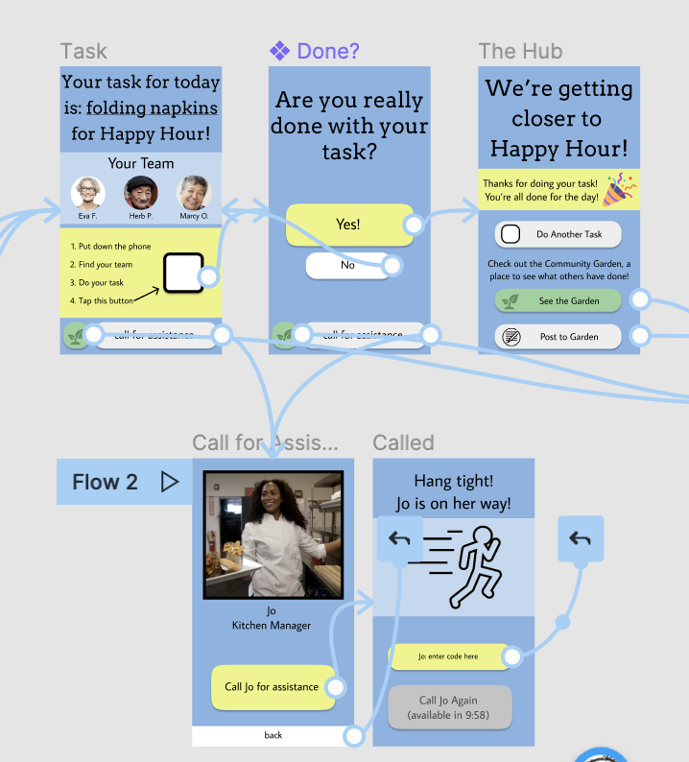
Moderate Task Flow
User taps “call for assistance” button as necessary for completing task
User confirms calling for specific assistance, staff member confirms help by entering code, or user can ask for help again if staff member has not arrived

Slide 16
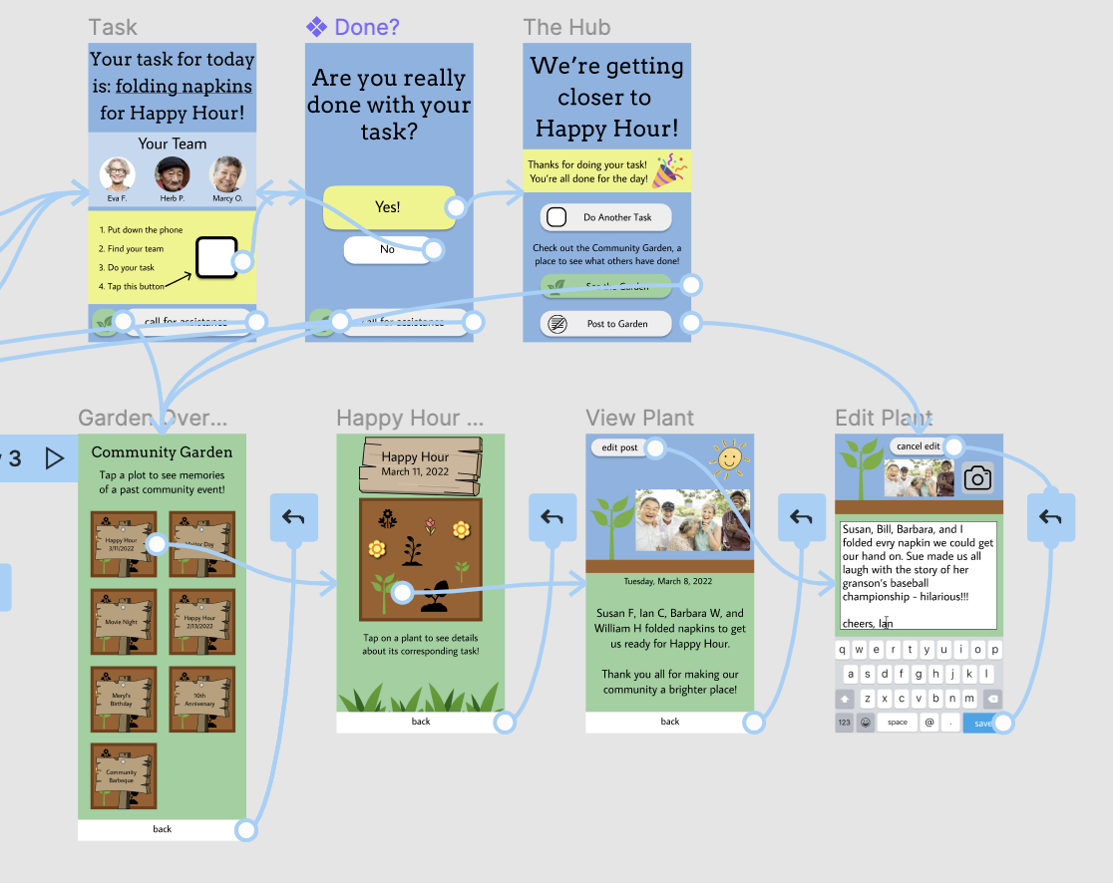
Complex Task Flow
User can access the community garden (once they’ve checked in and gotten their task) via the green button (emphasized after task completion)
User can edit/make a post to the community garden, depending on which flow they are on to encounter this screen
User can browse past event contributions

Slide 17
Design & Prototyping Tools:
Figma
Cons:
Steep learning curve
Adding images is clunky
Pros:
Design styles
“Back” navigation
Notes:
Steep learning curve, but styles help with consistency (better than copy/paste!)
The “back” navigation option fixed a big problem that we had with our lo-fi
Images paste in giant for no good reason

Slide 18
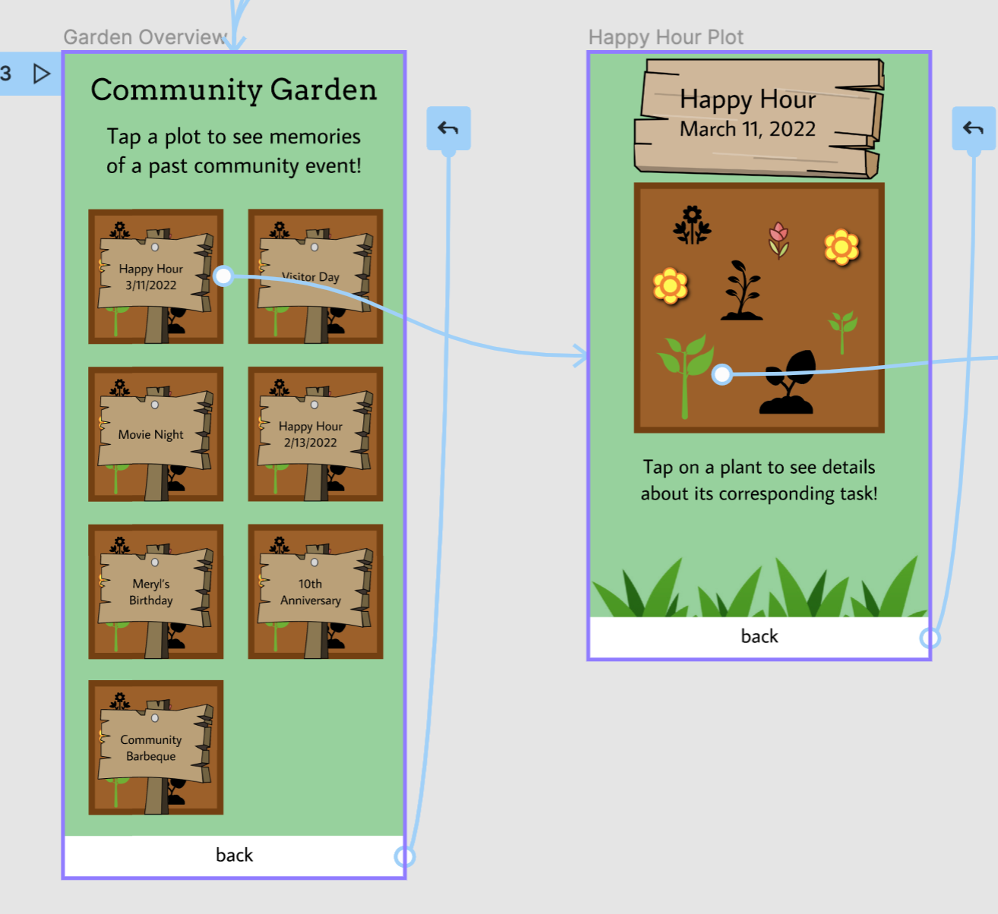
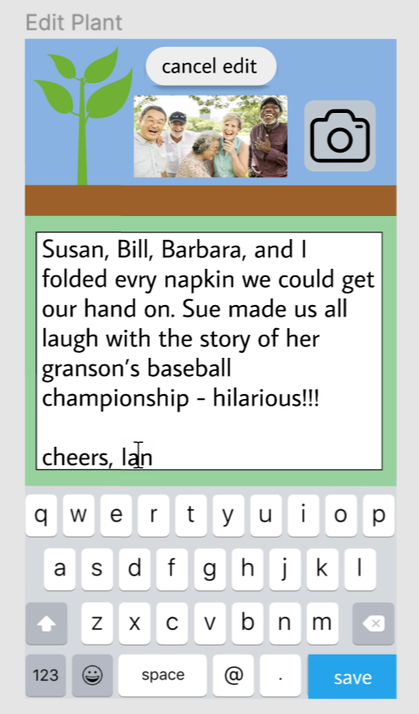

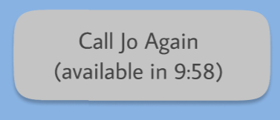
Limitations and Tradeoffs
1 plant, 1 plot selectable
Cooldown timer does not count down
Staff member’s code
Welcome page placard
Notes:
In the community garden, only one plot and one plant are selectable, for simplicity — there’s only one copy of the next screen to implement, and the key functionality is there
The cooldown timer does not actually count down
The auto-generated posts cannot be edited, nor can photos be uploaded (OS-specific)
The worst one: Jo’s code-entering isn’t relevant to our users, so we just hacked it to go back via dragging the button…
The advertisement on the welcome page for Happy Hour should be a gallery that scrolls through all the upcoming events, but can’t be done in Figma

Slide 19
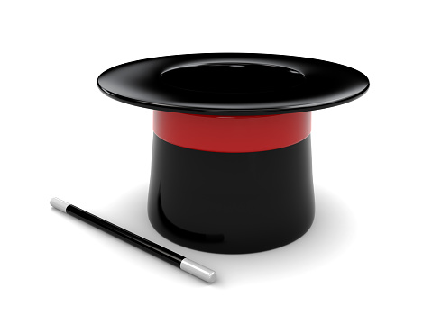
Wizard of Oz & Hard Coded Features
Task and Team Assignment
Staff Member
Example event: Happy Hour
The Magic
Algorithm
Notes:
Tasks and teams are assigned afresh each day, based on the user check-in questions and any information staff may choose to enter into the backend. We hardcoded the task and team that would be assigned by the magic algorithm.
The supervising staff member is determined by the task, so that is also hardcoded
Happy Hour is an example event; the banner advertisement on the welcome screen should match whatever event(s) the community is working towards, we just hardcoded to match our example event

Slide 20
Figma Prototype
https://www.figma.com/proto/umAGrZH039lXSOxaF67TPM/SeniorCircle-take-1?scaling=scale-down&page-id=0%3A1&hide-ui=1

