Slide 1
CY243-L Penetration Testing

Slide 2
whoami

Slide 3
whoami
Ali Taqi Wajid a.k.a TheFlash2k
Recently graduated from Air University (in Cyber Security [Batch of ‘23])
DevSecOps Engineer
A True Linux Enthusiast
A Hacker by day; Gamer by night.
Certifications
eCPPT (eLearn Security Certified Professional Penetration Tester)
eJPT (eLearn Security Junior Penetration Tester)
CEH|P (Certified Ethical Hacker | Practical)
Blogs/Writeups @ https://theflash2k.me

Slide 4
who are you?

Slide 5
Class Rules
01
Ask questions where you’re stuck
02
If you’re not in the mood to study, don’t disturb others
03
Be punctual about Assignment deadlines
04
Help your classmates but don’t ruin the process
05
Make GOOD notes. They’ll help.

Slide 6
Course Outline

Slide 7
Course Outline
Linux
Footprinting and Reconnaissance
Scanning Networks and Enumeration
Vulnerability Analysis
Malware Generation and Deployment
Social Engineering
WebApp Penetration Testing
App Server Exploitation
Wireless Penetration Testing
Mobile Application Penetration Testing
Cloud Platform and Applications Penetration Testing
Binary Exploitation
AND MORE.

Slide 8


At the end of this course, you will be able to pass

Slide 9
What is Linux

Slide 10
What is Linux
Open-source Operating System KERNEL
NOT an OS
Kernel:
Foundation for an OS
Manages hardware, processes, memory, I/O etc.
Flavors/Distro:
Ubuntu
Linux Mint
Debian
Fedora
CentOS

Slide 11
What is Linux
Distros for Hacking
Kali Linux
Parrot OS
BlackArch
BackBox
Pentoo

Slide 12
What is a Shell
A CLI program to help user interact with OS
Acts as intermediary between user and OS
Allows user to execute commands and fetch their output
Examples: ZSH, BASH
What is a Terminal
Software to allow interaction with a shell
Terminal communicates with the shell and shows output on its screen

Slide 13
Shell vs Terminal
In many cases, people use the terms "shell" and "terminal" interchangeably because they often work together to provide a command-line environment. Common shells include Bash, Zsh, and PowerShell, while terminals can be various software applications like GNOME Terminal, macOS Terminal, or Windows Terminal.

Slide 14
What is a Virtual Machine?
A Software Emulation of an Operating System on a Physical computer
Why VMs?
Allows independent hardware resources such as CPU, Memory, Storage
Provides Isolation which enables testing to be within a contained environment
Allows backups and restoration with ease using Snapshots
Reduces hardware costs and energy consumption

Slide 15
Setting up VirtualBox

Slide 16
Setting up Kali Linux

Slide 17
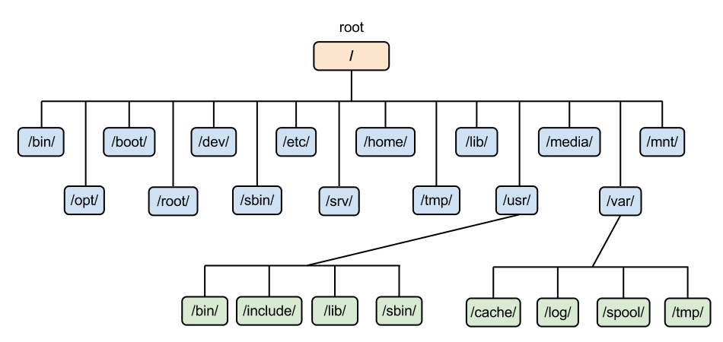
Linux Filesystem

Slide 18
Basic Linux Commands
Whoami
Pwd
Ls
Cd
Mkdir
Touch
Rm
Mv
Cp
Cat
Echo
Man
Clear
Exit
Sudo
Su
Passwd
Chmod
Chown
Useradd
Userdel
Groupadd
Groupdel
Ps
Apt
Wget
Curl
git

Slide 19
Note Taking
How to take good notes?
Note Taking softwares
Notion.so
Obsidian.md
Microsoft OneNote
CherryTree

Slide 20
Class Task
1. List all files inside the /usr/share directory
2. Create a new user called test
3. Create a new group called testgrp
4. Add the test user to the testgrp group
5. Create 2 new files called test1.txt and test2.txt inside the /home/kali directory and them delete them.

Slide 21
Resources
https://www.stackscale.com/blog/hypervisors/
https://www.virtualbox.org/wiki/Downloads
https://kali.org
https://www.vmware.com/products/workstation-player.html
https://www.notion.so/
https://obsidian.md/
https://www.giuspen.net/cherrytree/
https://www.microsoft.com/en-us/microsoft-365/onenote/digital-note-taking-app

