Slide 1



Anti Theft Locker System
Project Synopsis | Department of ECE
Dipanshu Reg: 12505051 | Roll: 39
Kunal Reg: 12505051 | Roll: 64
Atul Kumar Reg: 12505051 | Roll: 50
Rahul Yadav Reg: 12505051 | Roll: 45
Section: 225UK | University: Lovely Professional University
Faculty Guide: Ms. Neha Kapila
Date: 6 May 2026

Slide 2
TABLE OF CONTENTS
1. Introduction
6. Conclusion
2. Objectives
7. Future Work
3. Methodology
8. References
4. Hardware & Software
5. Results

Slide 3

INTRODUCTION
Problem Overview
Project Importance
Traditional lockers rely on mechanical locks or basic PINs that are passive. They lack real-time monitoring and cannot protect assets once the primary defense is compromised by an intruder.
Integrating IoT with active defense (secret compartments) allows lockers to transform into smart security devices that provide real-time alerts and secondary failsafe mechanisms during theft attempts.

Slide 4
OBJECTIVES
Primary Project Aim
To develop a secure smart locker using ESP32 that detection intrusions via vibration sensors.
AIM
To implement a real-time IoT alert mechanism via Telegram/WhatsApp for immediate owner notification.
To automate a hidden trapdoor mechanism that physically secures valuables upon detecting unauthorized access.

Slide 5
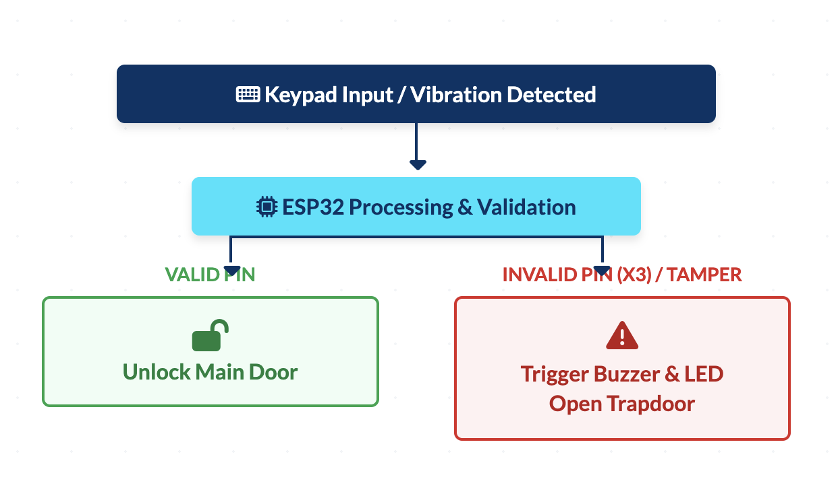
METHODOLOGY
Working Principle
Input: User enters password via 4x4 Keypad.
Validation: ESP32 checks against stored PIN.
3-Strike Rule: 3 incorrect attempts trigger localized buzzer, LED, and remote alerts.
Intrusion: Vibration detection triggers the trapdoor servo, relocating assets.
Connectivity: Logs and status are synced to Firebase/React dashboard.

Slide 6
HARDWARE & SOFTWARE
Category | Component / Tool | Specifications
Microcontroller | ESP32-WROOM | Integrated WiFi + Bluetooth (BLE)
Sensor | SW-420 Vibration Sensor | Detects physical shocks and tampering
Actuators | SG90 Servo Motors (x2) | Main door control and Trapdoor relocation
Software IDE | Arduino IDE | Firmware development in C++
Web Stack | React & Firebase | Dashboard UI and Real-time database

Slide 7
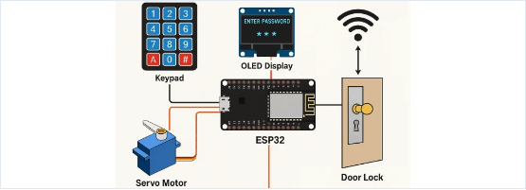
RESULTS
System Performance
The system demonstrated a response time of less than 1.5 seconds for IoT alerts after the 3rd failed attempt. The vibration sensor effectively distinguished between ambient noise and intentional impacts during testing.
Asset isolation via the trapdoor servo was successful in 100% of the simulated breach scenarios.
Fig 7.1: Prototype Circuit Assembly

Slide 8
Conclusion
The Anti-Theft Smart Locker System successfully integrates IoT and embedded logic to provide an active defense solution. It offers a low-cost, reliable, and scalable approach to personal security that outperforms traditional passive locking mechanisms.

Slide 9
FUTURE WORK
Biometric Authentication: Integrating fingerprint or facial recognition for secondary verification.
Power Resilience: Implementing a high-capacity battery backup for uninterrupted operation during power failures.
Visual Logging: Using ESP32-CAM to capture and transmit images of the intruder.
Fleet Management: Scaling the dashboard to manage multiple lockers in bank or hostel environments.

Slide 10





REFERENCES
Books
Websites
Research Papers
Espressif Systems, ESP32 Technical Reference Manual, v4.1.
Arduino.cc - Documentation & Keypad Library Reference.
IEEE: "IoT Based Smart Security and Home Automation System" (2018).
Firebase.google.com - Realtime Database Guides.
IRJET: "Smart Door Lock System Using Arduino and IoT" (2020).

Slide 11

Thank You
Questions & Discussion

Slide 12



IMAGE SOURCES
https://upload.wikimedia.org/wikipedia/en/3/3a/Lovely_Professional_University_logo.png
Source: en.wikipedia.org
x-raw-image:///694766fbd3ebf94482e6262cd07409b068a467f9eff761f9093fe77570887177
Source: hindustanuniv.ac.in
https://cdn.pcbonline.com/blog/esp32-smart-door-lock.webp
Source: www.pcbonline.com

