Slide 1
WET – Water Efficiency tooL
Bessis Hugo, Saouab Oumniya,
Utama Takara Izzah, van der Heide Niklas

Slide 2
Table of contents
Introduction
Solution
Demo
Questions

Slide 3
Introduction
Home Water Consumption Management App
Give overview over appliances
Manage home appliances
Help people live more sustainable

Slide 4





Solution
WET
Flutter App (cross platform)
Firebase Authentication
MongoDB database
Node.js API
AWS hosting

Slide 5
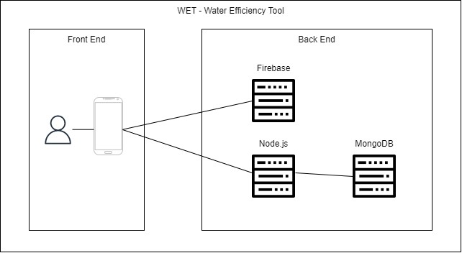
Architecture

Slide 6
Demo time

Slide 7
Question time

