Slide 1
Copyright © 2014 by Software Craftsmanship Guild.
All rights reserved. No part of these materials may be reproduced, distributed, or transmitted in any form or by any means, including photocopying, recording, or other electronic or mechanical methods, without the prior written permission of the Software Craftsmanship Guild. For permission requests, write to the Software Craftsmanship Guild, addressed “Attention: Permissions Coordinator,” at the address below.
Software Craftsmanship Guild
526 S. Main St, Suite 609
Akron, OH 44311

Slide 2
Intro To ADO.NET
Software Craftsmanship Guild

Slide 3
Lesson Goals
Learn about the ADO.NET Data providers and namespaces
Learn how to work with connections, commands, and data readers

Slide 4
What is ADO.NET
ADO stands for Active Data Objects and it pre-dates the .NET Framework. The original ADO was the common set of classes for interacting with databases. ADO.NET is the evolution of ADO.
ADO.NET was built to serve both persistent and disconnected data needs.
We will find the core ADO.NET classes in the System.Data namespace.

Slide 5
Three Layers of ADO.NET
Connected
These classes explicitly connect and disconnect from the database. It is the most flexible, but also the most work to set up.
Disconnected
These classes allow you to store data in Tables and Sets disconnected from the database and handle bulk updates
Entity Framework
The Entity Framework is an ORM (object relational mapper) tool which can automate the creation of classes that map to tables and allow manipulation through LINQ queries. For straight-forward apps this saves a lot of time.

Slide 6
There are MANY other choices
Dapper, NHibernate, LLBGen, etc etc etc
The ADO.NET core uses interfaces to define all the key components, so developers can easily roll out their own data access frameworks and provide libraries for connecting to other databases
These libraries are called drivers. So if you want to connect C# to say, MySQL, you just go search for the MySQL .NET Driver and reference the DLL

Slide 7
Core ADO.NET Classes
Type | Base Class | Interfaces | Usage
Connection | DbConnection | IDbConnection | Connect and disconnect from a data store, register transactions
Command | DbCommand | IDbCommand | Handle the execution of SQL Queries or Stored Procedures
DataReader | DbDataReader | IDataReader, IDataRecord | Provides forward-only, read-only access to data. Persistent connection.
DataAdapter | DbDataAdapter | IDataAdapter, IDbDataAdapter | Transfers sets of data between caller and data store
Parameter | DbParameter | IDataParameter, IDbDataParameter | Transfers parameters to and from the server in queries
Transaction | DbTransaction | IDbTransaction | Handles database Transactions

Slide 8
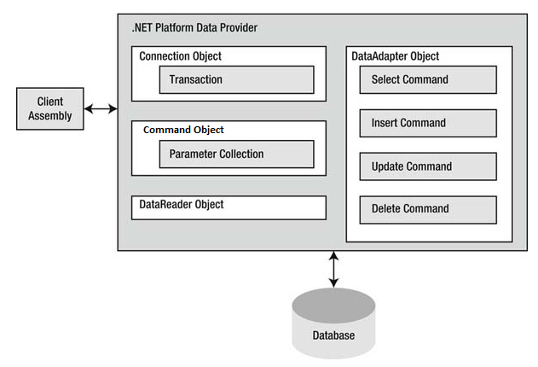
ADO.NET Providers Illustrated

Slide 9
Out of the Box Providers
OLEDB (System.Data.OleDb)
This is a classic COM based protocol. Used for old legacy access databases, pervasive, etc
SQL Server (System.Data.SqlClient)
Highly optimized for SQL Sever databases, only connects to SQL Server
Oracle (System.Data.OracleClient)
Do not use, Oracle provides its own implementation now, go download it
ODBC (System.Data.Odbc)
Most databases support ODBC, so you can use this if there is no .NET provider available.

Slide 10
Reading Data From a SQL Server Database
When using basic ADO.NET, there are a few steps to connecting to a SQL Server Database:
Create a connection
Create a command
Loop through the data reader
Close the reader
Close the connection

Slide 11
Creating a Connection
First, we need to add a using statement for System.Data.SqlClient
Second, we need to be able to provide our connection with a connection string
Connection strings tell the connection class which server to connect to, what database to use, and specifies credentials (login/pwd) if necessary

Slide 12
Aside: Configuration Files
In a real production environment, we will often have Dev, QA, and Production servers and we need to be able to change things, like which database we connect to, without having to recompile the application
Configuration files allow our programs to change settings slightly by modifying a text file that lives outside the program.
These files are XML format, and have two sections we can define: appSettings and connectionStrings
appSettings is for any setting, like file paths, etc
connectionStrings is for database connections

Slide 13
Note - Security
In a real application you may want to consider encrypting your config file’s appSettings and connectionStrings.
http://msdn.microsoft.com/en-us/library/zhhddkxy.aspx.

Slide 14
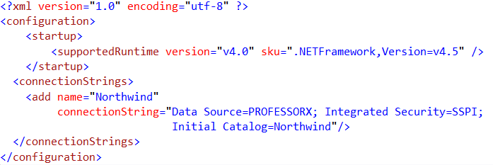
Adding a ConnectionStrings Section
Open your app.config file in the console app (or if one isn’t there you can go to Add->New Item and choose Application Configuration File)
Add the following text:

Slide 15
Connection String Elements
Server- The name or ip address of the server
Database- The name of the database on the server
User Id- user name to log in (if not using windows authentication)
Password- password for user id
Trusted_Connection- true if using windows authentication
For more, see www.connectionstrings.com

Slide 16


Configuration Manager
1.
We can read data from the configuration file by key or name by using the configuration manager in the system.configuration namespace.
1. First add a reference to system.configuration
2. Add a using statement
3. The configuration manager is a static class, so we don’t have to new it up. We can access the connection strings by name.
Note, in a website, the file wouldn’t be app.config, it would be web.config
2.
3.

Slide 17
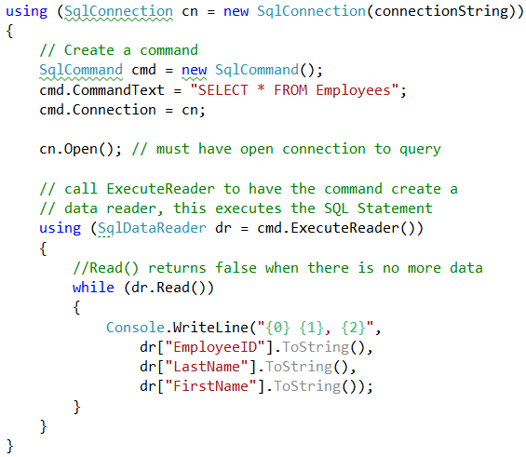
Running a SELECT Statement
Here we are creating a connection for our connection string, configuring a command with some SQL we want to execute, and looping through a data reader to print each result row out to the console
The using statements automatically close the connection and reader for us.
DataReader columns are accessed by name, and they are objects by default, so if we load a class we always have to cast the column to the right type, for example:
int id = (int)dr[“EmployeeID”]

Slide 18
Command Execute Methods
ExecuteReader- runs the SQL statement and returns a DataReader with all the result rows in it.
ExecuteNonQuery- runs a SQL statement where there is no result set (ex: Update/Insert/Delete)
ExecuteScalar- runs a SQL statement where only one value is returned (ex: Count)

Slide 19
Parameterized Queries
We should NEVER append text to create sql statements. This opens the door to SQL Injection Attacks which are one of the most common hacking techniques
SQL Server will automatically wrap parameters so that injection attacks are blocked.
Parameters are variables added to the command object, and in SQL they start with the @symbol

Slide 20
Demo Goal
Be able to get a list of employees and their manager (if they have one)
Be able to load a single employee by their ID
Handle null data using nullable properties.
Pass parameters to commands

Slide 21
Demo
Reading data into classes & parameterized queries

Slide 22
Nullable Types
Any type that doesn’t support null inherently (the numeric types, booleans, etc) will default to 0 (or false).
In databases where we can have null columns, we want to be able to have a null number for optional fields, 0 is not valid
Solution: append a question mark to the type declaration
We have to take extra care when working with these fields or we will get a null reference exception!

Slide 23
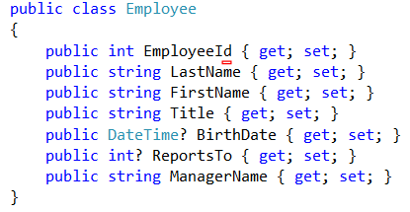
Employee Class With Nullables

Slide 24
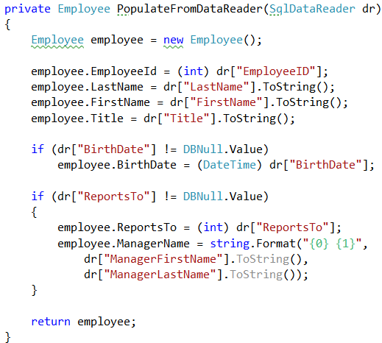
Method to Create Employee from DataReader
Since we are going to have to read each row from the data reader, it’s a common practice to create a method that takes the data reader in and returns an employee.
DataReader columns are of type object, so we have to cast them.
If we want to see if a column is null, we have to compare it to DBNull.Value

Slide 25
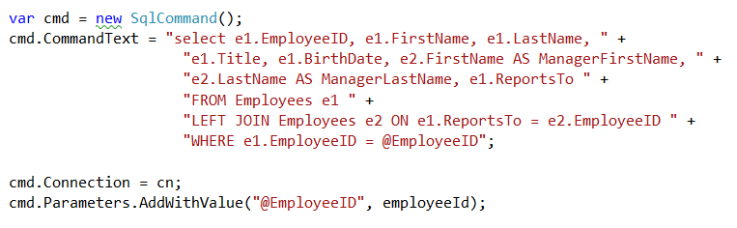
Parameterized SQL
As we covered in stored procedures, we need to parameterize our sql so we don’t get SQL Injection attacks.
The command object has an AddWithParameter to pass parameters to SQL Statements and Stored Procedures

Slide 26
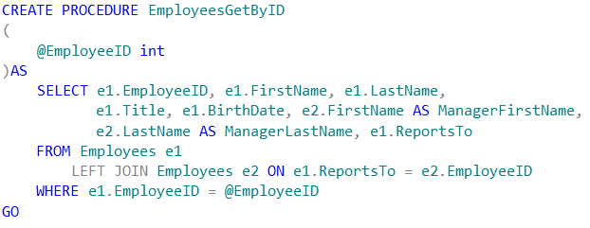
Let’s make a SPROC

Slide 27
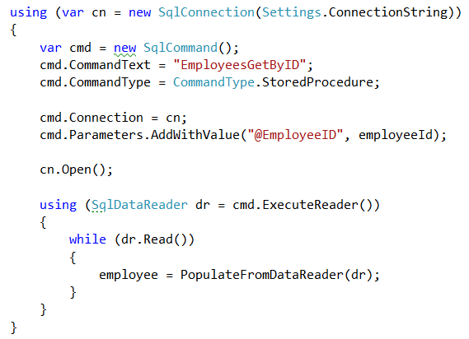
Calling Stored Procedures
Pretty much the same as writing SQL directly, we just put in the procedure name and set the command type to StoredProcedure

Slide 28
Demo
Enhancing our RSVP sample to store data in the database and display a guest list

Slide 29
Conclusion
Any SQL Statement we can run in SQL Studio we can run from C# to select data
Commands allow us the flexibility to call statements, call procedures, and add data to our calls to pass to the database

