Slide 1
BILL management
SIDDHARTH ROY
2K20/B7/09
Fundamentals of programming

Slide 2
INTRODUCTION
A bill calculating management is a necessity for the current generations
No former knowledge is required for the user to use this.
It will help the user to keep track of his/her invoices in order.
Current date and time is also mentioned, to keep a track for bill payment date.
By using C language I have made a program which will not only calculate the bill for electricity and phone but also prompts the user to enter his queries and give possible solutions.

Slide 3
OBJECTIVES AND GOALS
The purpose of bill management system is to automate the existing manual system by the help of computerized equipments and fully fledged computer software, so that valuable information can be stored for a long period for easy accessing an manipulation.
In my project I will be calculating phone and electricity bill.
A penalty charge will also be applied for late payment.
I will also be taking care of queries from customer side to make it more user friendly.

Slide 4
KEYWORDS
Functions : A function is a block of code that performs a specific task. It can be used multiple times.
Array : An array is collection of data of same type using a single variable .
Switch: a switch is used as a decision maker where various decision making is required.
Structures: Structure is a user-defined datatype in C language which allows us to combine data of different types together.
If else: in C is used to perform the operations based on some specific condition.

Slide 5
Libraries used
Function used
#include<stdio.h>
#include<stdlib.h>
#include <time.h>
#include<conio.h>
Void phone
Void help1
Int penalty
Void elec
Void help
#include<math.h>
Void tme
Int func1

Slide 6
Functions used and their use
Void elec : to take care of all electricity bill related calculation and printing the persons information.
Void phone : to take care of all phone bill related calculation and printing. the persons information.
Void help1: for taking queries from phone bill customers.
Void help : for taking queries from electricity bill customers.
Int penalty : for adding extra charge upon late payment.
Void tme : for showing present time and date.

Slide 7
Overview of code
Declaring 2 structures , one will store the necessary variables needed for those users who have chose electricity bill and the other for those who have chose phone bill
There are two structure each for phone bill and electricity bill having two arguments and containing the necessary condition for calculation of bill
The help1() and help() function will take care of the queries of the user from the phone as well as the electricity department.
Penalty() and func1() are used for calculating the extra amount and number of days the user is late for bill payment repectively.
I have also include tme() function for displaying the current date and time for the user convenience.

Slide 8
result

Slide 9
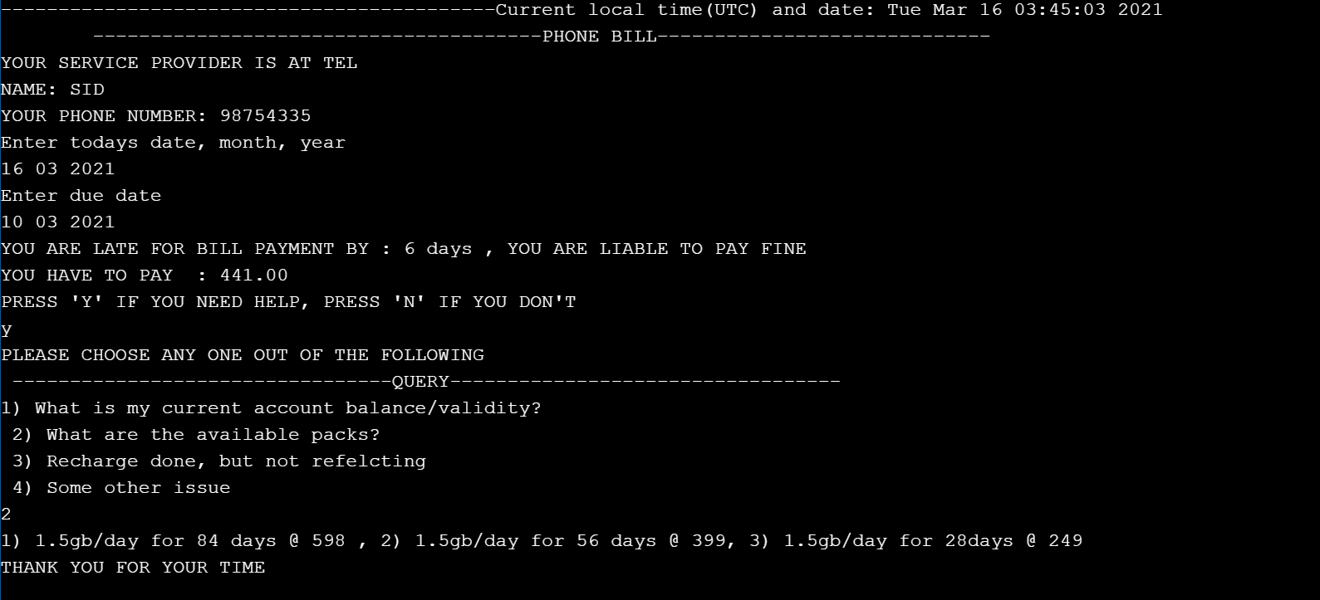
Phone bill

Slide 10
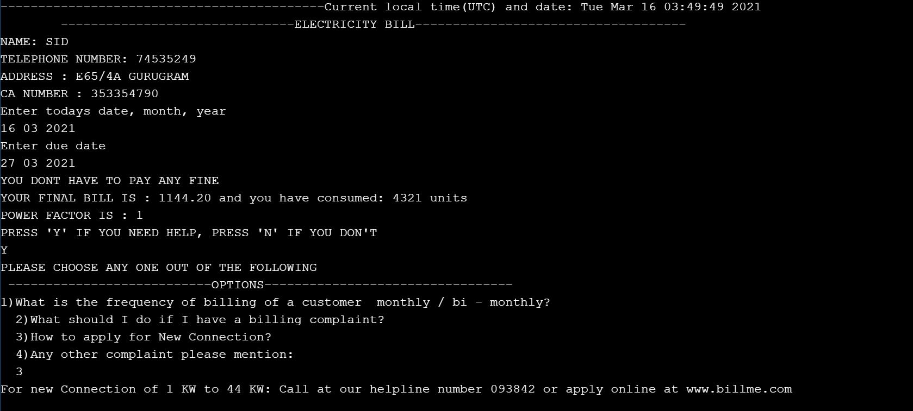
Electricity bill

Slide 11
LIMITATION
The user has to manually enter his details , that is his information will not be stored at some accessible directory.
This program is offline and cannot be used online.
The user has only two options for bill calculation .
Once the user has pressed enter after giving his input it cant be edited.

Slide 12
CONCLUSION
It helps the user to keep a track of his billing cycles, paying bills and managing them
It will help the user to pay his bills on time.

Slide 13
LEARNING from project
The project has helped me in enhancing my coding skills and has increased my knowledge in C language
Through this project I have revised the fundamentals of programming

Slide 14
references
https://www.tutorialspoint.com/
https://en.wikibooks.org
https://www.geeksforgeeks.org
https://www.onlinegdb.com

