Slide 1


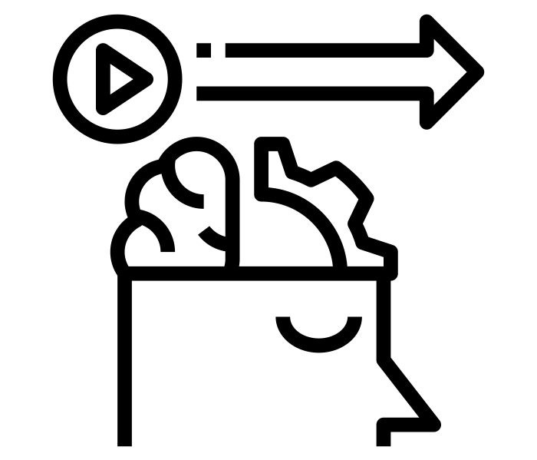


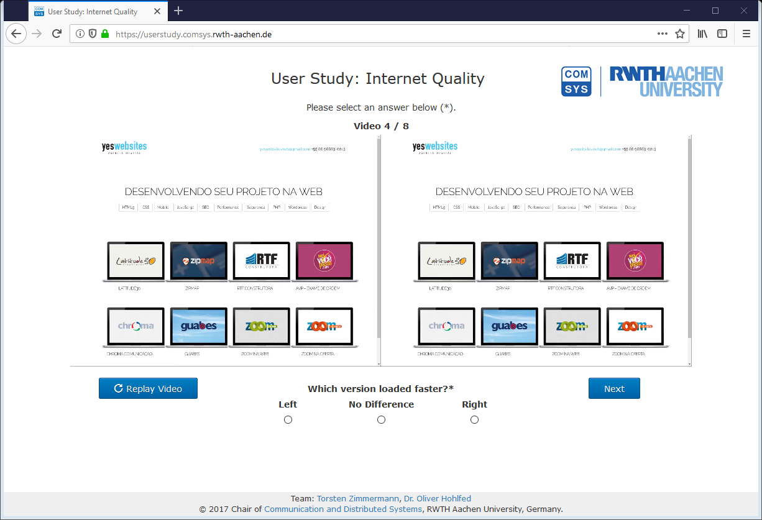
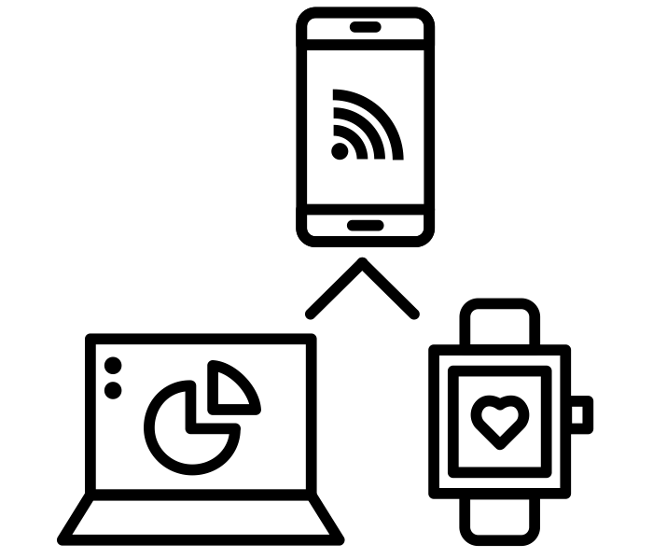
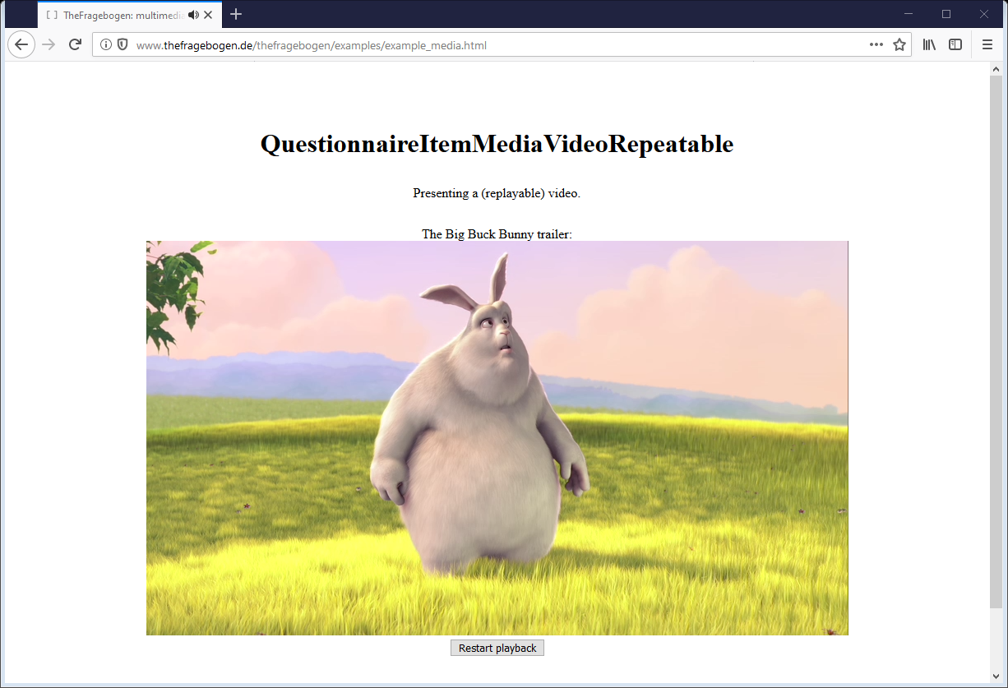
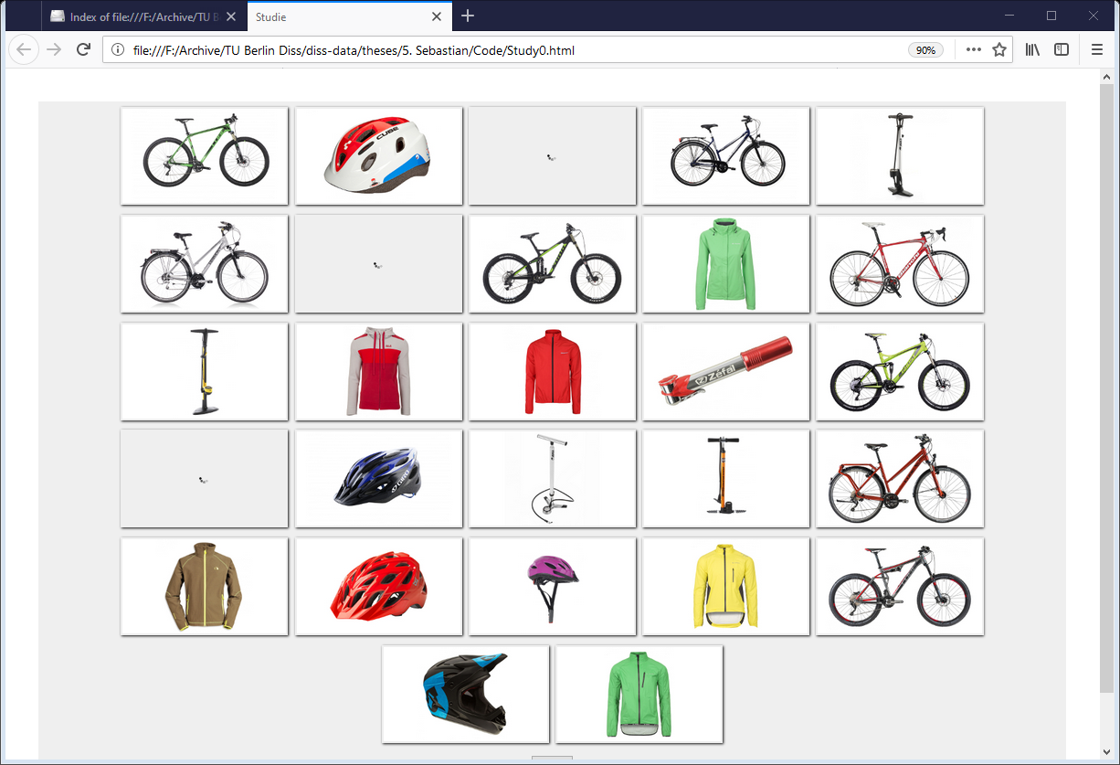
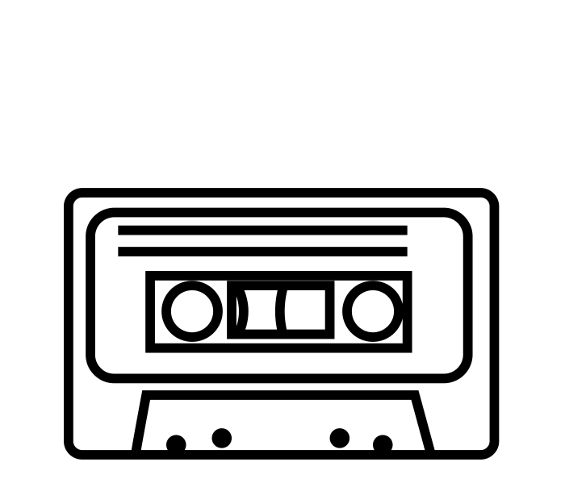
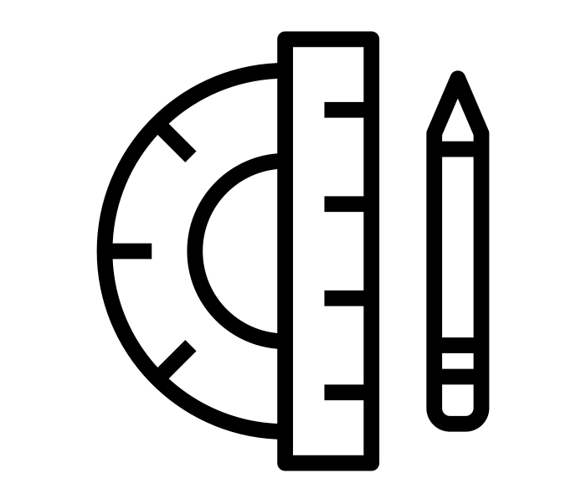
TheFragebogen.de
A software framework for user studies made simple.
open source
behavioral data
privacy friendly
cross platform
multi device
multimedia
graphical scales
Deployed in several QoE studies: audio/video, web.
Also as 2nd screen and crowdsourcing.
Notes:
Icons from the Noun Project:
“open source” by I Putu Kharismayadi
“Responsive Design” by Kiran Joseph
“Communication” by Shocho
“cassette tape” by Universal Icons
“enhance tool” by icon54
“dynamic” by Nithinan Tatah
“html” by Creative Stall
“Crowdsourcing” by Atif Arshad
“behavior” by Nithinan Tatah
“Privacy” by johartcamp
“archive” by Dilla Chee
“signature” by Vadim Solomakhin

