Slide 1

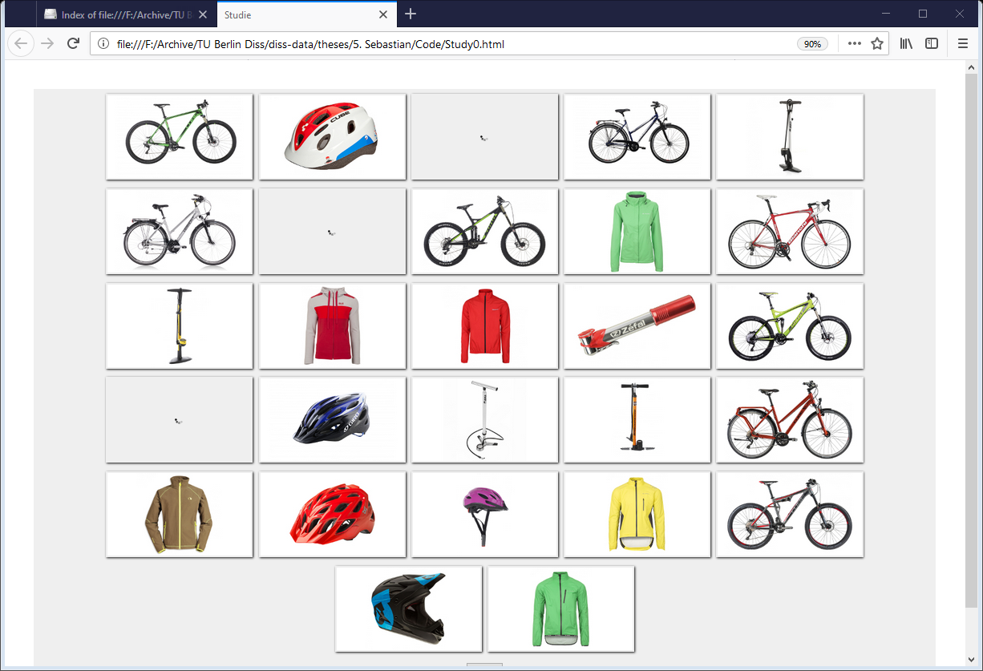
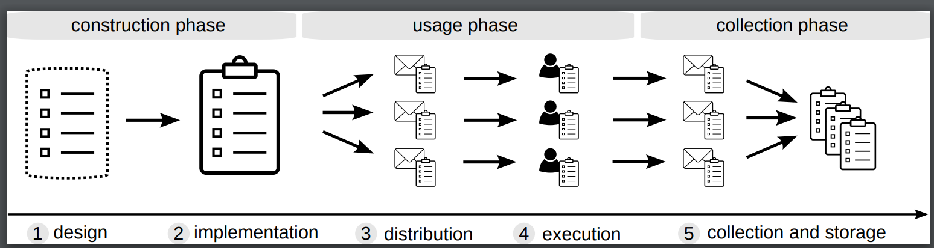
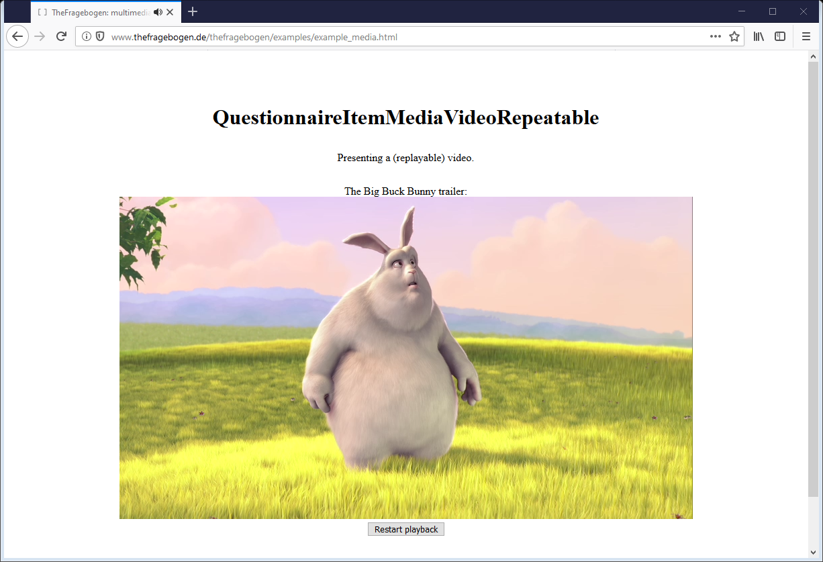
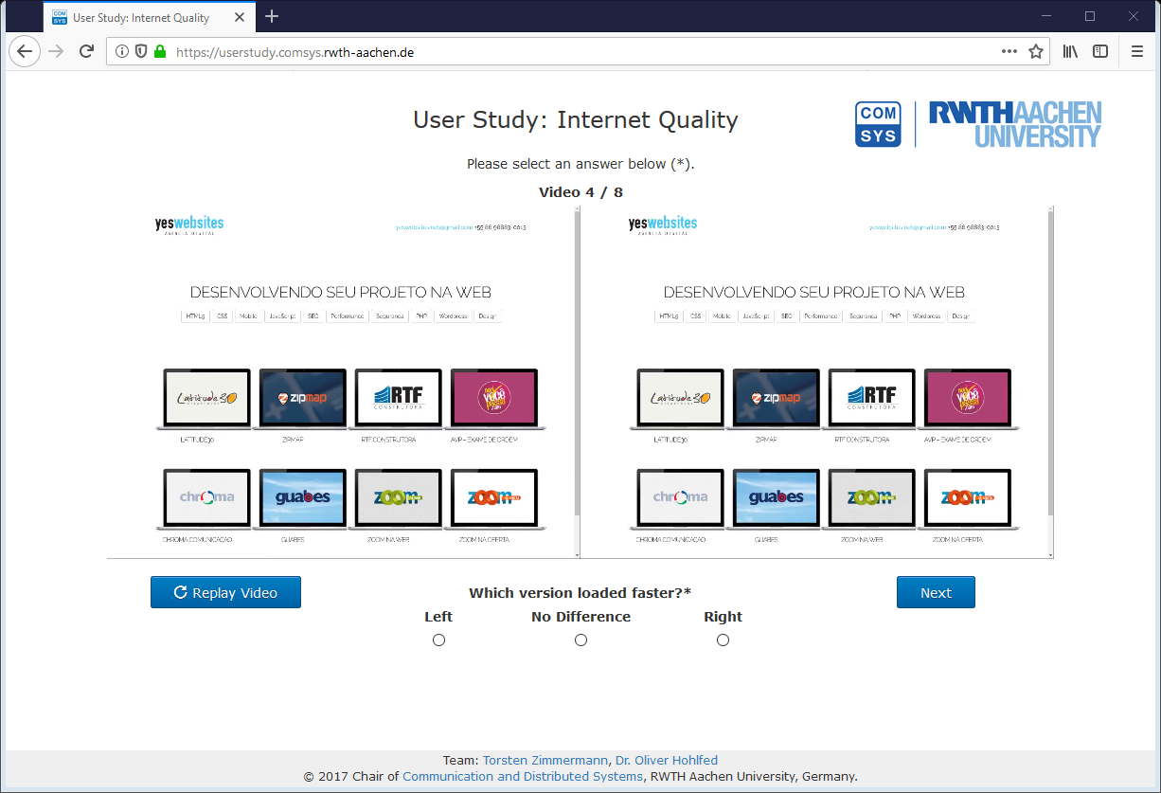
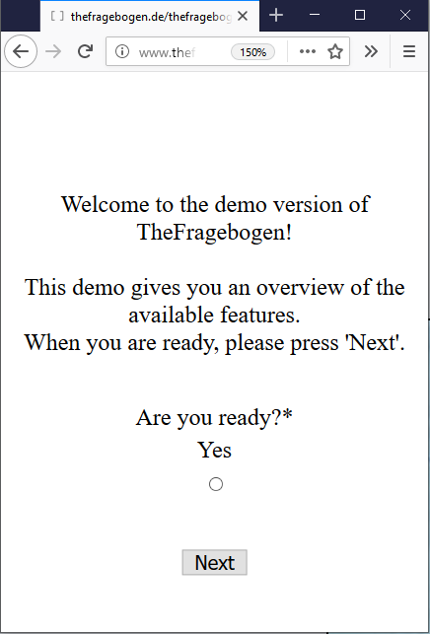

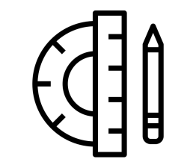
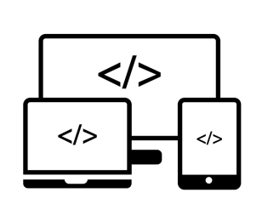
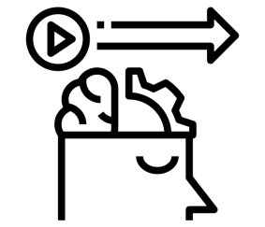
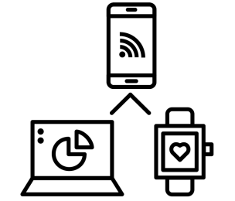

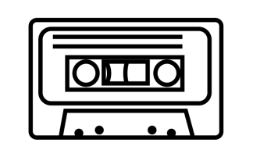
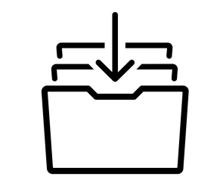
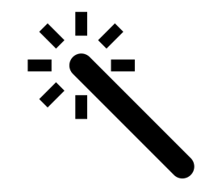
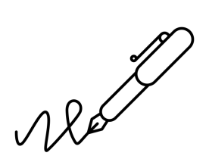
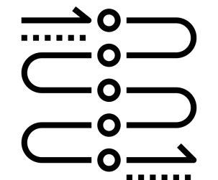
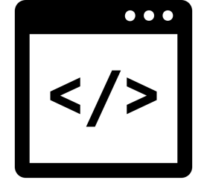
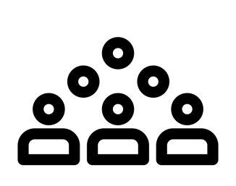

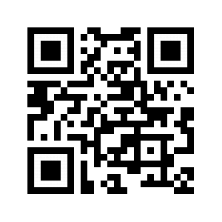


TheFragebogen
A Web Browser-based Questionnaire Framework for Scientific Research
Figure 2: General lifecycle of a digital questionnaire.
Lifecycle of an implementation
design: select questionnaire content
implementation: create questionnaire (if needed with individualization such as randomization)
distribute: distribute questionnaires to user (e.g., e-Mail, web, laboratory)
execution: participants conduct the experiment
results: collect data and store for evaluation.
Figure 1: Screenshots of use cases of TheFragebogen.
>> TheFragebogen <<
… a software framework to implement questionnaires.
Why TheFragebogen?
TheFragebogen supports in conducting experiments. It reduces the effort on implementing necessary software and thus allows researchers focusing on their actual research questions.
Demo code
var screens = [];
var screen1 = new ScreenUIElements(
new UIElementHTML("CSS", "This is some text."),
new QuestionnaireItemDefinedOne( "CSS", "Are you ready?", true, ["Yes"])
);
screens.push(screen1);
var sc = new ScreenController(screens);
...
sc.start(document.body);
Advantages of TheFragebogen
open source
graphical scales
cross platform
behavioral data
multi device
privacy friendly
Lessons learned
limit necessary (network) infrastructure
plan for technical failures
use version control software
reuse and enhance available implementations
follow the “boy scout rule”: always leave a campground cleaner than you found it.
multimedia
achievable
extendable
handwriting
dynamic questionnaires
Future work
foster reproducibility by sharing implementations (Build public repository of implementations)
community building: share knowledge, technology, and expertise
invest resources to enhance/maintain TheFragebogen
usable standalone
ready for crowdsourcing
Web page
Live demos
Project information
Web page | www.thefragebogen.de
Software license | MIT License
Programming language | JS5+, CSS, HTML
Version control | GIT
thefragebogen.de
…/demo
Authors:
Dennis Guse
Henrique R. Orefice
Gabriel Reimers
Oliver Hohlfeld
Icons from the Noun Project:
“open source” by I Putu Kharismayadi
“Responsive Design” by Kiran Joseph
“Communication” by Shocho
“cassette tape” by Universal Icons
“enhance tool” by icon54
“dynamic” by Nithinan Tatah
“html” by Creative Stall
“Crowdsourcing” by Atif Arshad
“behavior” by Nithinan Tatah
“Privacy” by johartcamp
“archive” by Dilla Chee
“signature” by Vadim Solomakhin

