Slide 1
Scrum
Agile Project Management

Slide 2
Agenda
Scrum Framework
Key Roles
Artifacts
Ceremonies
Sprint
Work cycle
Exercise

Slide 3
Scrum Framework
Waterfall
Plan
Everything is planned before.
Build
Test
Review
Deploy
Risk of developing the wrong product

Slide 4
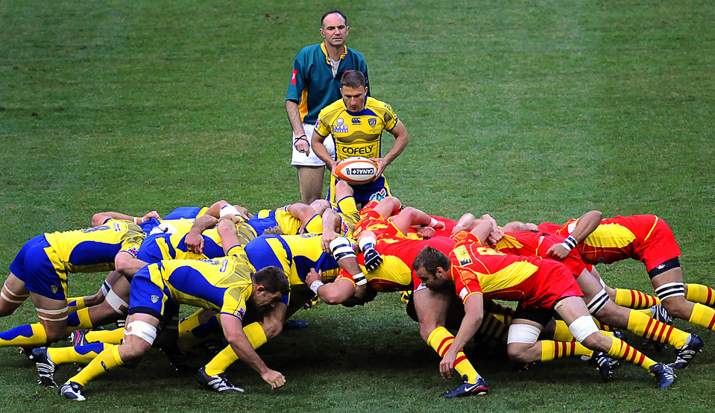
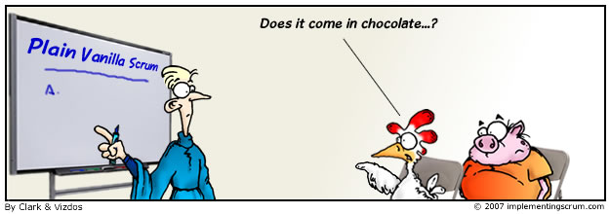
Scrum Framework
Scrum
Rugby (crowd, jam), “Gedränge”
Agile software development framework

Slide 5
Scrum Framework
Scrum
individual
clever
quick
agile
active
quick witted
lively
acute
Planning is based on Knowledge

Slide 6
Scrum Framework
Scrum
Deliver quick solutions
Flexible and holistic
Self organizing
Based on what is known (Empiricism)
Teamsize: 3 to 9
Transparency
Inspection
Adaption

Slide 7
Scrum Framework
Problems to manage
Unpredictable changes
Customer changes its mind
Team member drops out
Problem not well enough defined
Team is not efficient
New technology
Market conditions

Slide 8
Scrum Framework
Scrum
Key Roles
Artifacts
Ceremonies

Slide 9
Scrum Framework
Key Roles
Product Owner
Vision, ideas
Defines Backlog
Team Member
Multiple roles (Developer, Tester, etc.)
Scrum Master
Work conditions

Slide 10
Scrum Framework
As a … I need … so that …
Product Backlog
Artifacts
Product Backlog
Epics
User Stories
Prioritized by Owner
Features
Requirements
As a student I need to have access to my professors slides so that I can understand what she told us
As a professor I need to have access to my rooms so that I can upload my slides

Slide 11
Scrum Framework
Artifacts
Product Backlog
Product Backlog
Epic
Refinement (User Story) Any developer should know what is required!

Slide 12
Scrum Framework
Sprint Backlog
Artifacts
Sprint Backlog
List of User Stories
Enough User Stories for next work cycle
Defined by developers

Slide 13
Scrum Framework
Artifacts
Burndown Chart
Visualizes workload and progress
Available for one sprint and whole project
Workload
Time

Slide 14
Scrum Framework
Ceremonies
Sprint Planning
Planning Poker
Estimation: what can be done
Team chooses User Stories
Product Backlog
?
Sprint Backlog

Slide 15
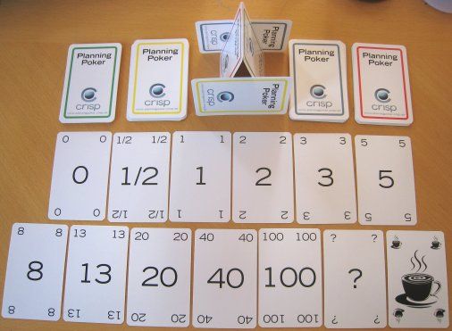
Scrum Framework
Ceremonies
Planning Poker
Team members receive a set of cards
Estimation for every User Story
Lowest and highest Estimation will be discussed
Played until nearly equal
User Story
3
5
8
Estimation
Implementation

Slide 16
Scrum Framework
Ceremonies
Daily Scrum
15 min standup meeting
No discussions!
What has been done?
Any blocked items?
?
What am I working on?
What can be done till tomorrow?

Slide 17
Scrum Framework
Ceremonies
Sprint Review
At end of Sprint
Ensure that
Everything is done (implemented)
AND tested
DoD
Showcase work to Product Owner

Slide 18
Scrum Framework
Ceremonies
Sprint Retrospective
Team efficiency
What can be improved?

Slide 19
Scrum Framework
Sprint
Work cycle
Always same length
1 to 4 weeks
No changes on Sprint Backlog!
Team is not disturbed
Sprint
Product Owner is able to cancel a Sprint (can be planed and restarted)

Slide 20
Scrum Framework
Sprint
Work cycle
Starts with Sprint Planning
Planning Poker
Sprint Backlog
Time limit: 45min per Sprint week
Sprint
Sprint Planning

Slide 21
Scrum Framework
Sprint
Work cycle
Daily Scrum routine
15min each day
Overview
Sprint
Daily Scrum
Sprint Planning

Slide 22
Scrum Framework
Sprint
Work cycle
Ends with Sprint Review
(additional) Retrospective
Sprint
Daily Scrum
Sprint Planning
Sprint Review

Slide 23
Scrum Framework
Scrum
Sprint
Product Owner
Daily Scrum
Sprint Planning
Backlog
Sprint Backlog
?
Refinement
Sprint Review
+ Retrospective

Slide 24
Scrum Framework
Scrum
Agile Board
To Do
In Progress
Testing
Release
Sprint
Backlog

Slide 25
Scrum Framework
Scrum
Agile Board
To Do
In Progress
Testing
Release
Sprint
Backlog

Slide 26
Scrum Framework
Scrum
Agile Board
To Do
In Progress
Testing
Release
Sprint
Backlog

Slide 27
Scrum Framework
Scrum
Agile Board
To Do
In Progress
Testing
Release
Review
Sprint
Backlog
Back to Sprint Backlog (next Sprint)

Slide 28
Scrum Framework
Scrum
Agile Board
To Do
In Progress
Testing
Release
Review
Any Questions?
Sprint
Backlog
Back to Sprint Backlog (next Sprint)

Slide 29
Exercise
Scrum on Jira

Slide 30
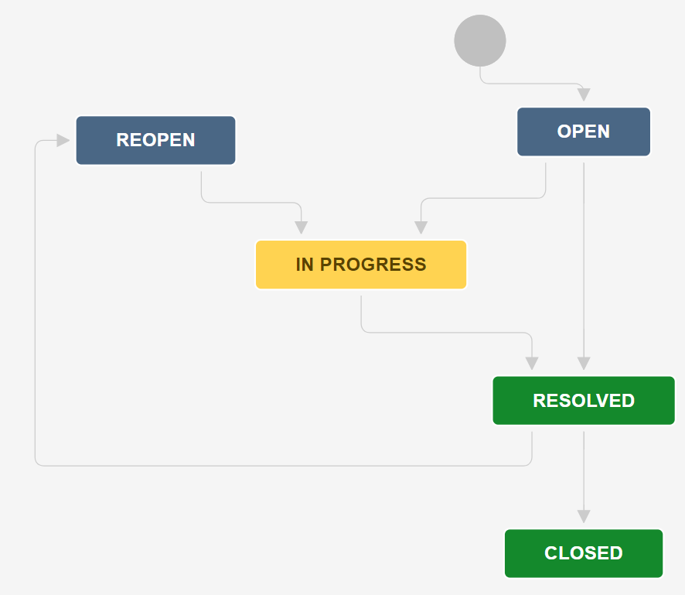
Scrum with Jira
Workflow
Project Settings
Issue Types

Slide 31
Sources
Content
http://www.scrumguides.org/docs/scrumguide/v1/Scrum-Guide-US.pdf
https://www.youtube.com/watch?v=0Nuj-GgEW6o
https://en.wikipedia.org/wiki/Scrum_(software_development)
Images
http://www.implementingscrum.com/images/070806-scrumtoon.jpg
http://sportycious.com/wp-content/uploads/2015/01/A-Beginnerss-Guide-to-the-Basics-of-Rugby-Union-Positions.jpg
http://2.bp.blogspot.com/-SfS0bN-_1RM/UP03wLmx_pI/AAAAAAAAAX8/_FsLLTANiYM/s1600/PlanningPoker.jpg

