Slide 1
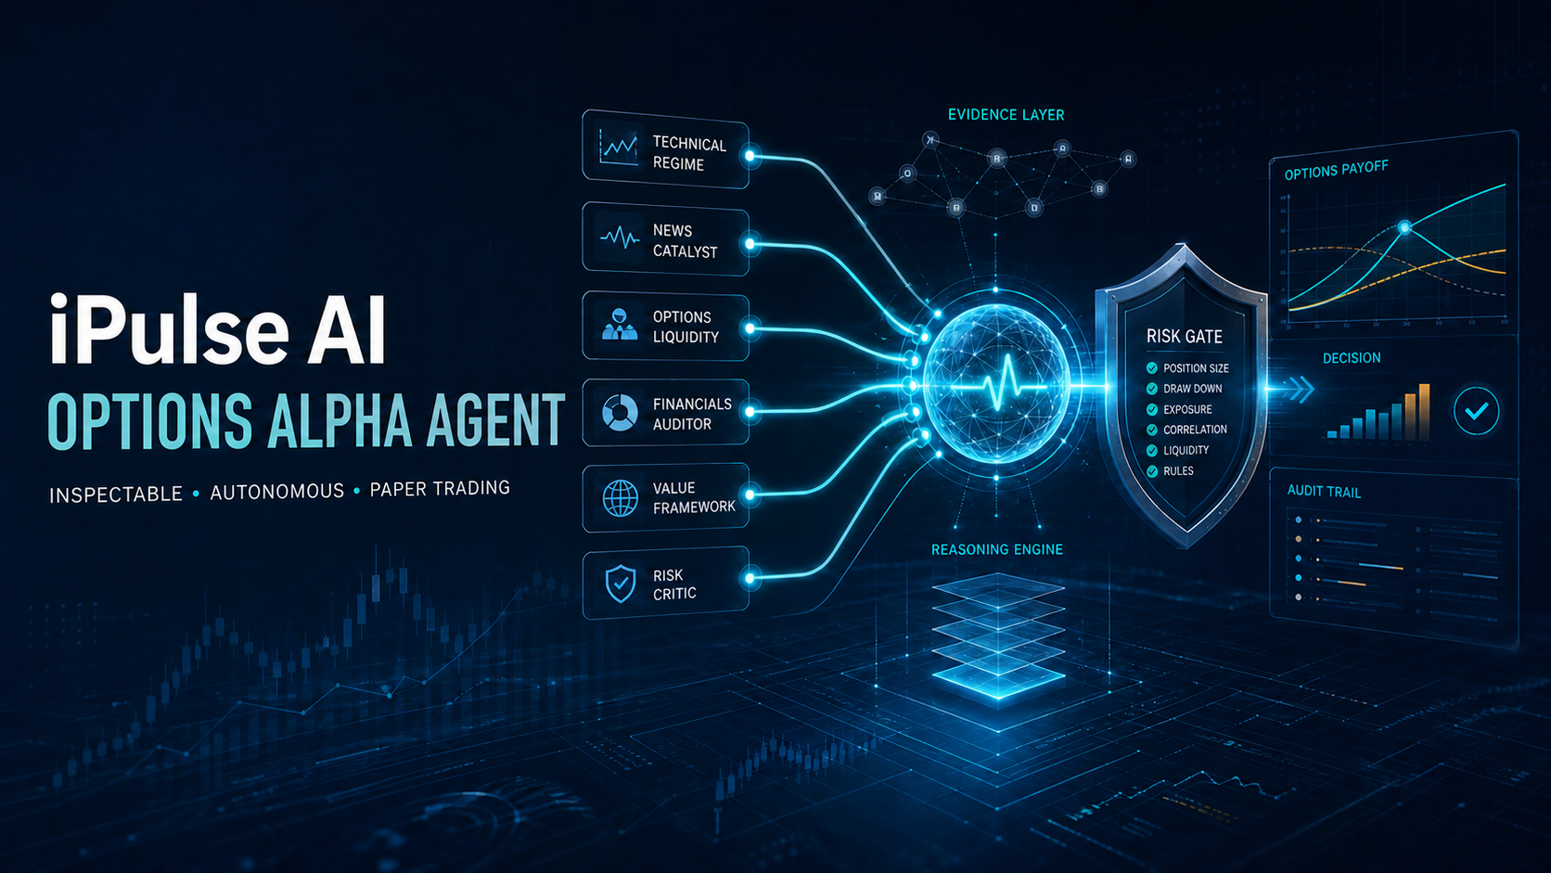
Notes:
Most trading-agent demos optimize for activity. We designed for accountability, including the ability to WAIT.
[Sources]
- https://lablab.ai/ai-hackathons/alpaca-ai-trading-agents-hackathon
- Local generated cover: public/assets/ipulse-options-alpha-agent-cover.png

Slide 2
IPULSE AI OPTIONS ALPHA AGENT
A trade is not proof of intelligence
BLACK BOX
INSPECTABLE AGENT
Signal
Order
Outcome
Evidence
Disagreement
Risk decision
Broker receipt
No visible evidence.
No preserved dissent.
No reason for refusal.
WAIT and REJECT are evidence, too.
02
Notes:
If judges cannot reconstruct the evidence, dissent, vetoes, and broker result, autonomy is indistinguishable from unattended execution.
[Sources]
- Local source: docs/judge_one_pager.md

Slide 3
IPULSE AI OPTIONS ALPHA AGENT
Never let one AI own the conclusion
PROBABILISTIC RESEARCH
01
Technical regime
04
Financials auditor
Consensus
proposes
02
News catalyst
05
Value framework
Deterministic
safety
decides
03
Options liquidity
06
Risk critic
Every advisor cites evidence, contrary evidence, confidence, and an invalidation condition.
03
Notes:
Advisors may CALL, PUT, WAIT, or ABSTAIN. Missing evidence never becomes a guess, and no advisor owns execution authority.
[Sources]
- Local source: src/ipulse_options_alpha_agent/advisors.py
- Local source: src/ipulse_options_alpha_agent/consensus.py

Slide 4
IPULSE AI OPTIONS ALPHA AGENT
Reasoning may evolve. Capital boundaries stay explicit.
01
Environment
Paper account only · two explicit execution switches
02
Market state
Open session · fresh quote · complete broker state · no duplicate
03
Order and portfolio
One contract · limit only · long premium · max loss $500 · circuit breakers
04
Notes:
No advisor or language model can bypass these rules. A failed check returns WAIT or REJECT; it never changes order type, size, or environment.
[Sources]
- Local source: src/ipulse_options_alpha_agent/safety.py
- Local source: src/ipulse_options_alpha_agent/risk.py
- Local source: src/ipulse_options_alpha_agent/execution.py

Slide 5
IPULSE AI OPTIONS ALPHA AGENT
A clean account and an honest starting line
Dedicated Alpaca paper account created for the competition. Raw identifiers never enter public artifacts.
$100K
LEVEL 3
0
starting equity
options approval
initial fills
Connectivity proof: one deliberately non-marketable $1 equity limit order, canceled without a fill.
05
Notes:
The dedicated account began with $100,000, active status, options level 3, and no positions or fills. The raw account ID belongs only in the private judging field.
[Sources]
- Local sanitized source: artifacts/competition/performance.jsonl
- https://docs.alpaca.markets/docs/paper-trading

Slide 6
IPULSE AI OPTIONS ALPHA AGENT
The agent passed its refusal test
WAIT
MARKET CLOSED
Regular US session was not open.
A real retained run reached aligned technical and options views—then stopped.
QUOTE STALE
The option quote exceeded the 120-second limit.
No fallback. No forced demo trade.
06
Notes:
This was the desired result. The system preserved all advisor views and vetoes instead of forcing activity for a demo.
[Sources]
- Local source: artifacts/decisions/advisor_market_evidence.jsonl
- Local source: public/index.html

Slide 7
THE PROOF PATH
From evidence to paper P&L, every step stays reviewable
01
02
03
Public code
Decision dashboard
Competition evidence
Tests, strategy, MCP adapter, and risk gates
Advisor dissent, vetoes, orders, and scorecard
Dedicated account baseline and paper performance
AI proposes. Deterministic risk decides. Alpaca executes.
Research and simulated paper trading only. Not investment advice.
Notes:
Close on the inspection path: code, dashboard, evidence, and final paper scorecard. Short paper performance does not predict live returns.
[Sources]
- https://github.com/alpacahq/alpaca-mcp-server
- Local source: docs/judge_one_pager.md

